Slide 1
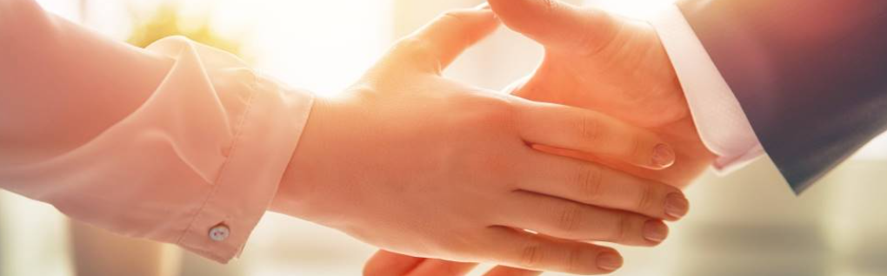
Welcome to our services
New Lebanon Church of Christ
We are Simply Christians.
Our Emphasis is Spiritual, Not Material or Social.
We are striving to be The Same Church as Described in The New Testament.
Please Come Back Again

Slide 2
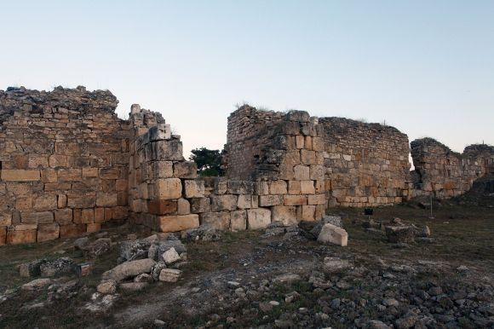
And I told them of the hand of my God which had been good upon me, and also of the king's words that he had spoken to me. So they said,
"Let us rise up and build."
Then they set their hands to this good work.
Nehemiah 2:18

Slide 3
Nehemiah accepted the destruction of Jerusalem as a personal responsibility for he "sat down and wept, and mourned certain days; and fasted and prayed before the God of heaven" (Neh.1:4).

Slide 4
Nehemiah concludes by saying, "so built we the walls, for the people had a mind to work, neither I nor My brethren, nor my servants, nor the men of the guard which followed me, none of us put off our clothes, saving that everyone put them off for washing" (Neh.4:6, 23).

Slide 5
What could we accomplish right here
if we have the same mind?

Slide 6
What is the lesson in this
for the people of God today?
We can do all that God desires of us today if we will recognize the importance of the work and the need to be personally involved in doing it.

Slide 7
What is the lesson in this
for the people of God today?
Just as Nehemiah and a few of the people could not have completed the wall in the required time, neither can just a few of God's people do all the work to be done in the time that we have.

Slide 8
What is the lesson in this
for the people of God today?
We each need to have "a mind to work."
You hear people today talking about how hard they have to work at their job, and sometimes making fun of others who do not like to work, but you do not very often find that person doing much work for the Lord.

Slide 9
What is the lesson in this
for the people of God today?
The secret was in the hearts of the people.
To every Christian is given many opportunities to be cupbearers for the Lord. Responsibilities to these opportunities vary according to our peculiar abilities. Whatever place we occupy in the Lord's work, we would benefit greatly by following the pattern of Nehemiah's life.

Slide 10
Some Things to notice about Nehemiah.
He Was Responsible and Committed
He Prayed Earnestly
He, like Isaiah, said “Here am I. Send me”
He Set Goals for himself and Made Plans
He Became Thoroughly Engrossed in the work

Slide 11
Am I responsible and committed like Nehemiah?
Do I pray earnestly like Nehemiah?
Do I set goals and plans like Nehemiah?
Do I become engrossed in the Lord’s work like Nehemiah?
Do I have the proper balance in my life like Nehemiah by putting God first?
If God isn’t first, your life is out of balance (tire/life – not going to have a smooth ride – end up in the ditch).

Slide 12
Questions?
Want to learn more about the Bible?
We will be glad to study the Bible with you.
New Lebanon
New Lebanon
Church of Christ
Church of Christ
New Lebanon, OH
newlebanoncoc.com
newlebanoncoc@gmail.com

