Slide 1
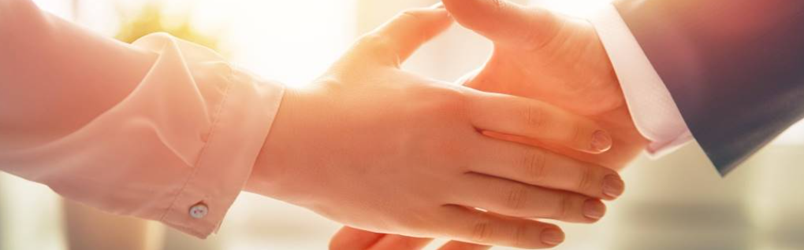
Welcome to our services
New Lebanon Church of Christ
We are Simply Christians.
Our Emphasis is Spiritual, Not Material or Social.
We are striving to be The Same Church as Described in The New Testament.
Please Come Back Again

Slide 2
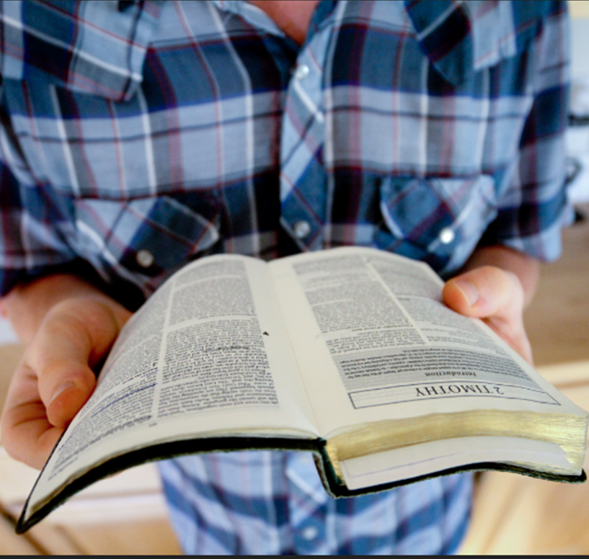
Is The Bible Reliable?
Galatians 1:6-9 I marvel that you are turning away so soon from Him who called you in the grace of Christ, to a different gospel, 7 which is not another; but there are some who trouble you and want to pervert the gospel of Christ. 8 But even if we, or an angel from heaven, preach any other gospel to you than what we have preached to you, let him be accursed. 9 As we have said before, so now I say again, if anyone preaches any other gospel to you than what you have received, let him be accursed.

Slide 3
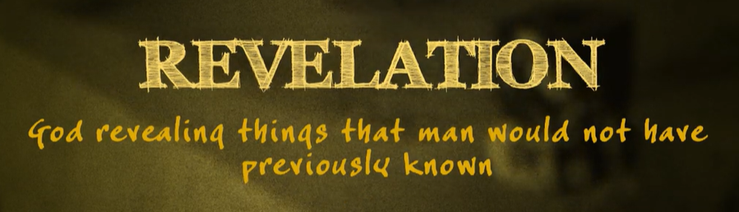
2Peter 1:19-21.
19 And so we have the prophetic word confirmed, which you do well to heed as a light that shines in a dark place, until the day dawns and the morning star rises in your hearts; 20 knowing this first, that no prophecy of Scripture is of any private interpretation, 21 for prophecy never came by the will of man, but holy men of God spoke as they were moved by the Holy Spirit.

Slide 4
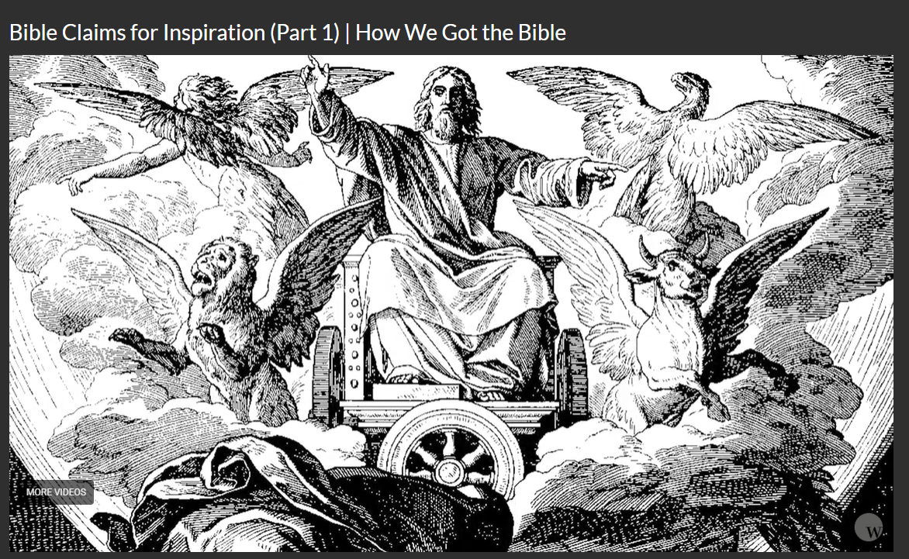
Ezekiel’s vision (revelation)

Slide 5
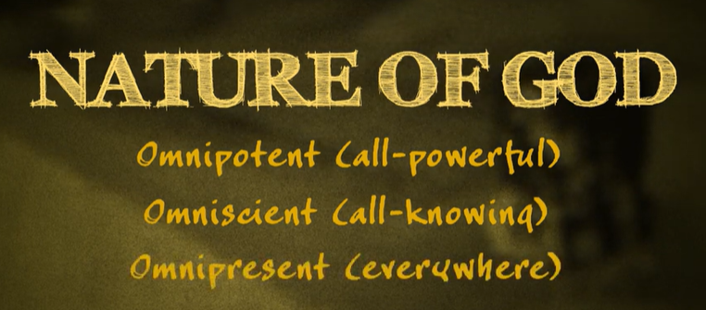

Slide 6
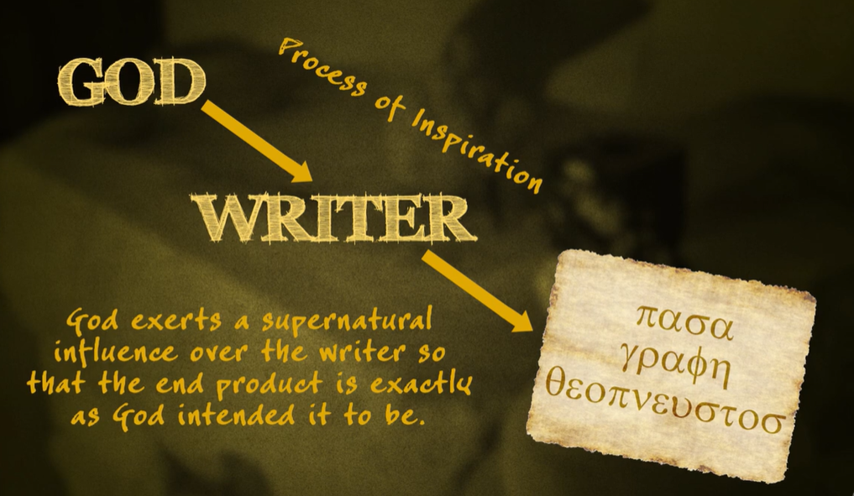
2Timothy 3:16-17. 16 All Scripture is given by inspiration of God, and is profitable for doctrine, for reproof, for correction, for instruction in righteousness, 17 that the man of God may be complete, thoroughly equipped for every good work.

Slide 7
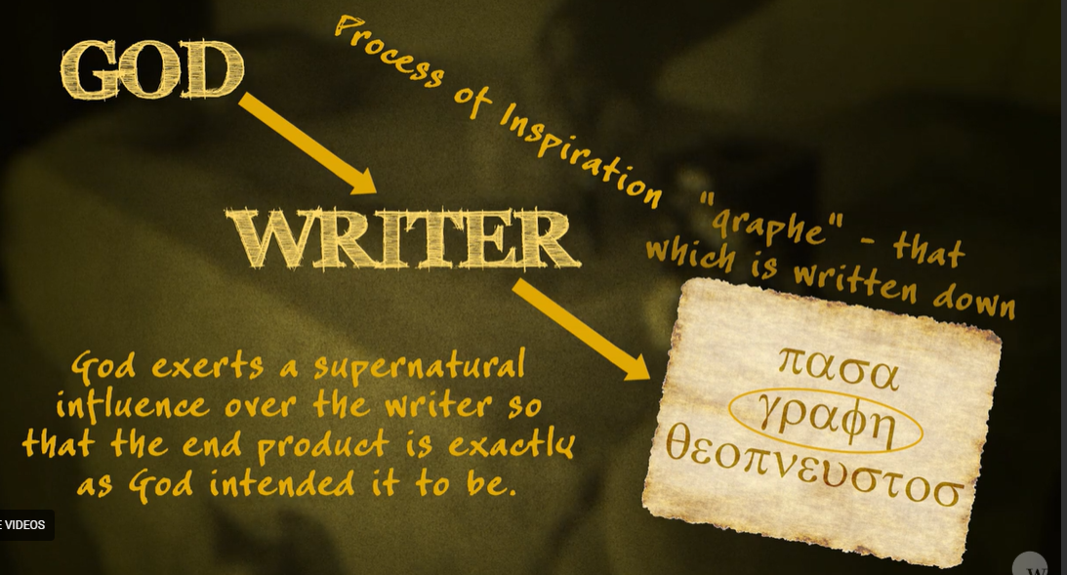
Holy words -
The word of God

Slide 8
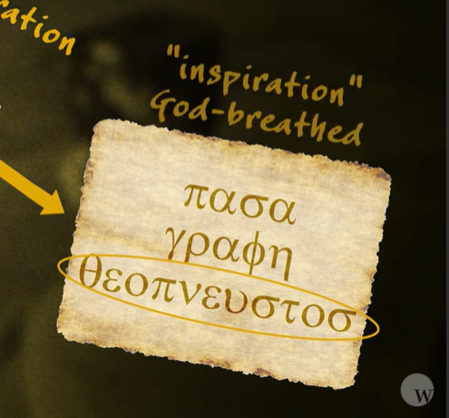
God breathed

Slide 9
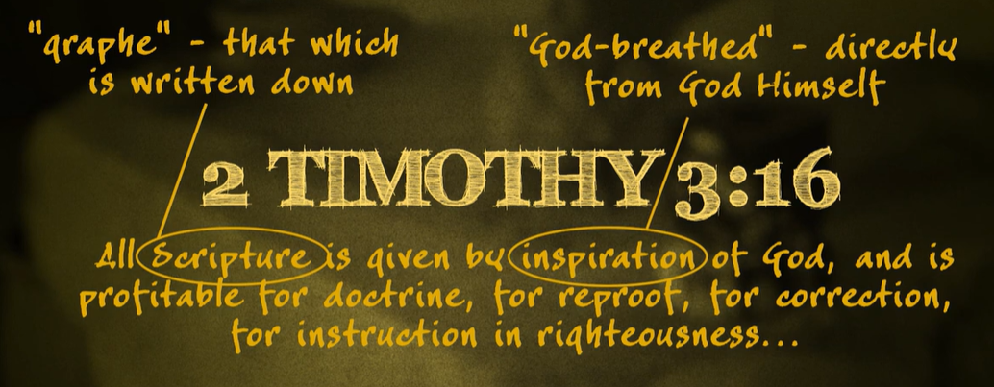

Slide 10
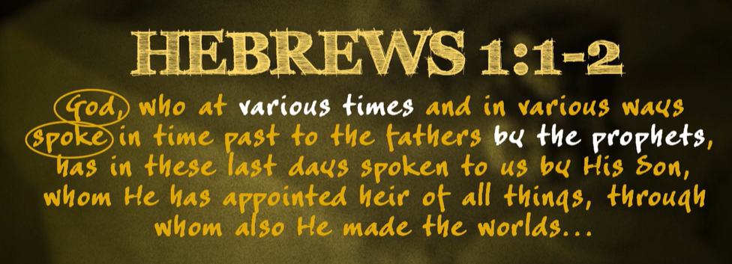

Slide 11
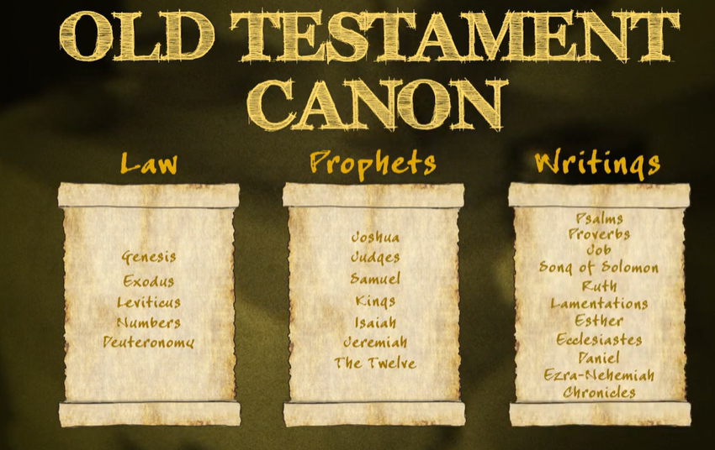
Law
Prophets
Major
Minor
History
poetry

Slide 12
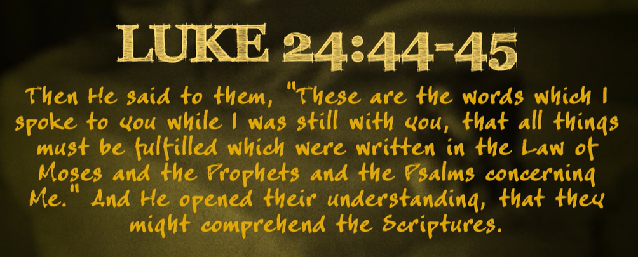

Slide 13
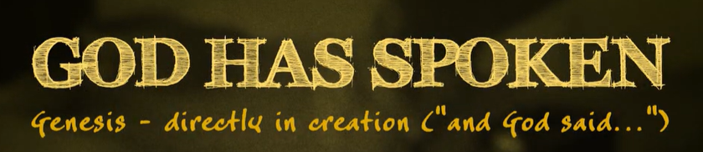
Hebrews 1:1-2
Gen 1:3 Then God said,
"Let there be light"; and there was light.
(10xs in the beginning – GOD SAID)
Gen 2:16. 16 And the LORD God commanded the man, (God speaking to His Creation);

Slide 14
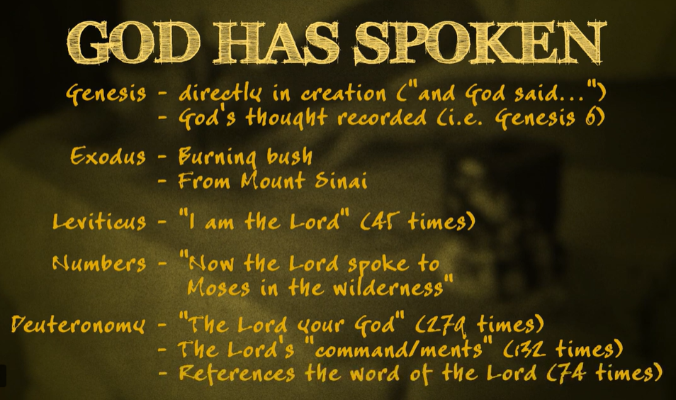

Slide 15
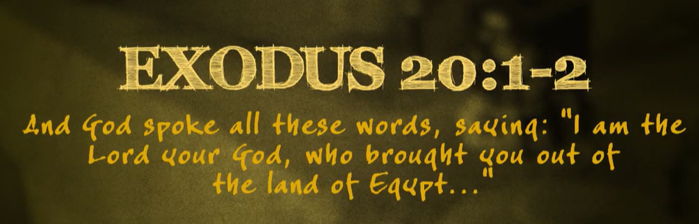
10 commandments preceded by -
Exodus 24:3-4. 3 So Moses came and told the people all the words of the LORD and all the judgments. And all the people answered with one voice and said, "All the words which the LORD has said we will do." 4 And Moses wrote all the words of the LORD. And he rose early in the morning, and built an altar at the foot of the mountain, and twelve pillars according to the twelve. tribes of Israel.

Slide 16
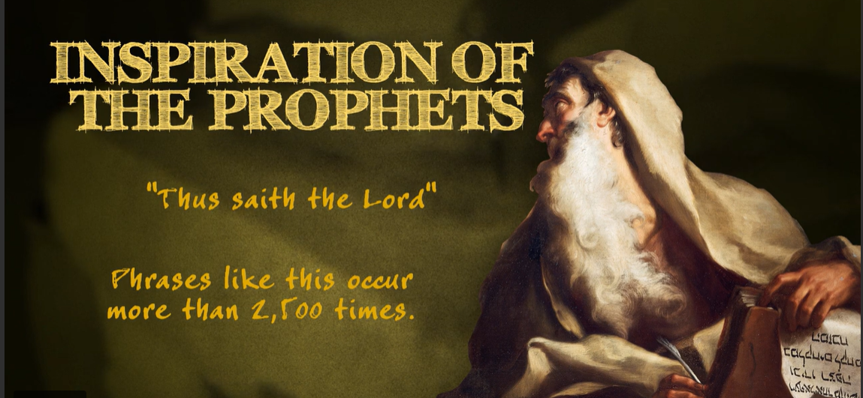
More than 2,500 xs
Over and over and over, the Bible claims to be The Word of God. We either believe those claims and submit to them or we do not believe those claims. There is No Middle ground. Not believing facts does not change facts,

Slide 17
On average, the phrase “thus says the Lord,” or its equivalent occurs 1-3 times per page
2Sam. 23:1-2. 1 Now these are the last words of David. Thus says David the son of Jesse; Thus says the man raised up on high, The anointed of the God of Jacob, And the sweet psalmist of Israel: 2 "The Spirit of the LORD spoke by me, And His word was on my tongue.
Act 4:25. 25 "who by the mouth of Your servant David have said: 'Why did the nations rage, And the people plot vain things?

Slide 18
Matt. 5:18. 18 "For assuredly, I say to you, till heaven and earth pass away, one jot or one tittle will by no means pass from the law till all is fulfilled.
John 3:34. 34 "For He whom God has sent speaks the words of God, for God does not give the Spirit by measure. (Jesus)

Slide 19
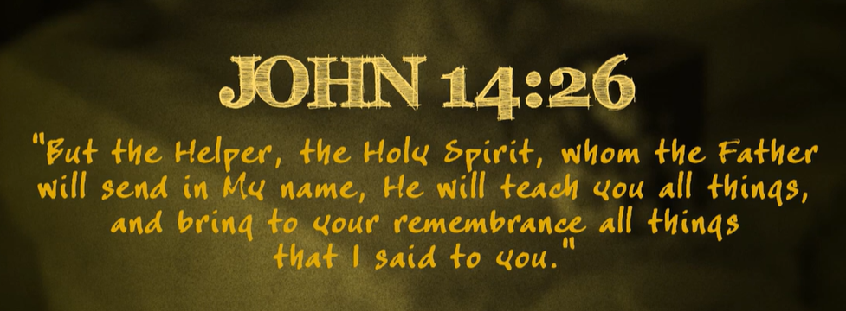
God, prophets, men, Jesus, Holy Spirit

Slide 20
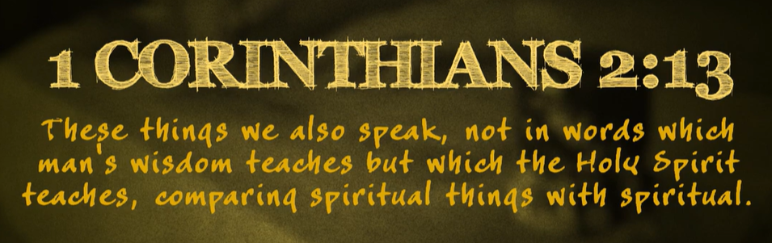
Gal.1:12. 12 For I neither received it from man, nor was I taught it, but it came through the revelation of Jesus Christ.
Eph. 3:3-5. 3 how that by revelation He made known to me the mystery (as I have briefly written already, 4 by which, when you read, you may understand my knowledge in the mystery of Christ), 5 which in other ages was not made known to the sons of men, as it has now been revealed by the Spirit to His holy apostles and prophets:

Slide 21
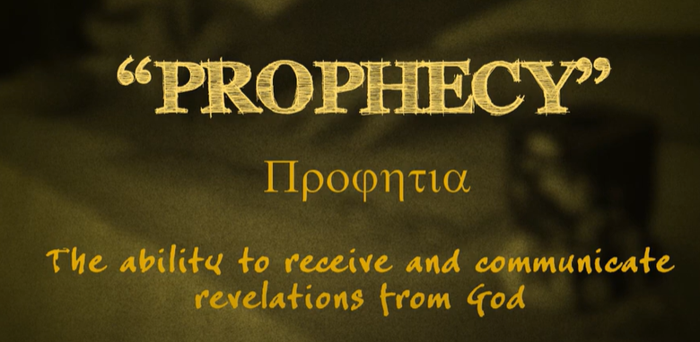
What about Mark? Luke? James? Jude??
They were not apostles
1Cor.12:7-10. 7 But the manifestation of the Spirit is given to each one for the profit of all: 8 for to one is given the word of wisdom through the Spirit, to another the word of knowledge through the same Spirit, 9 to another faith by the same Spirit, to another gifts of healings by the same Spirit, 10 to another the working of miracles, to another prophecy, to another discerning of spirits, to another different kinds of tongues, to another the interpretation of tongues.

Slide 22
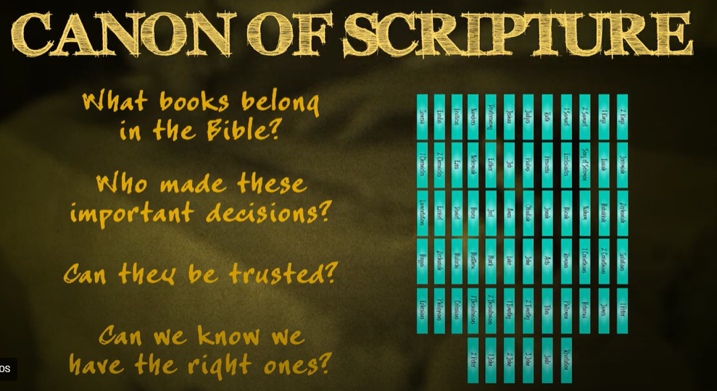

Slide 23
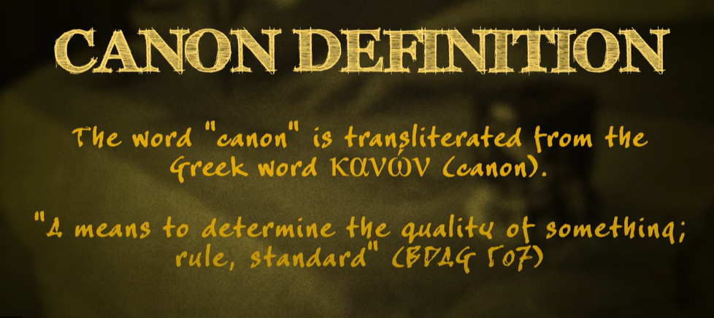
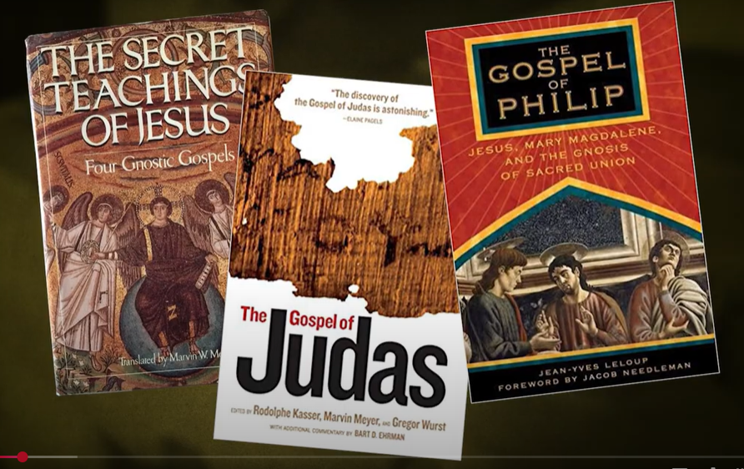
Lost Books?

Slide 24
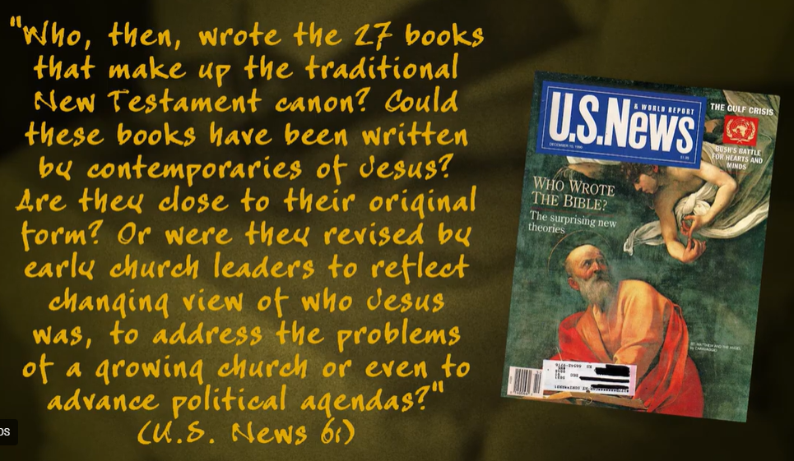
Rewritten? Redacted? Personalized?

Slide 25
Joshua 24:26. 26 Then Joshua wrote these words in the Book of the Law of God. And he took a large stone, and set it up there under the oak that was by the sanctuary of the LORD.
Joshua’s words were canonized (accepted according to the standard) and added to the five books that Moses wrote.
The standard – signs, wonders, and miracles of God. (crossing Jordan, capture of Jericho, etc.)
Books were added without a single council or vote!!!

Slide 26
1Samuel 10:25. Then Samuel explained to the people the behavior of royalty, and wrote it in a book and laid it up before the LORD. And Samuel sent all the people away, every man to his house.
Books were added without a single council or vote!!! The signs wonders and miracles confirmed they were from God.
Moses + Joshua + Samuel +++++++++++++++

Slide 27
Dan 9:2. 2 in the first year of his reign I, Daniel, understood by the books the number of the years specified by the word of the LORD through Jeremiah the prophet, (Jeremiah’s book was added to the other books of DIVINE AUTHORITY) that He would accomplish seventy years in the desolations of Jerusalem.
* Jeremiah was a prophet contemporary with Daniel. The books were immediately accepted. Books were added without a single council or vote!!!
Jeremiah, Daniel, Ezekiel all contemporary. Jeremiah was left in Jerusalem, Daniel was taken into Babylonian captivity. The book of Jeremiah had made it to Babylon where Daniel was able to read it and have hope!!!.

Slide 28
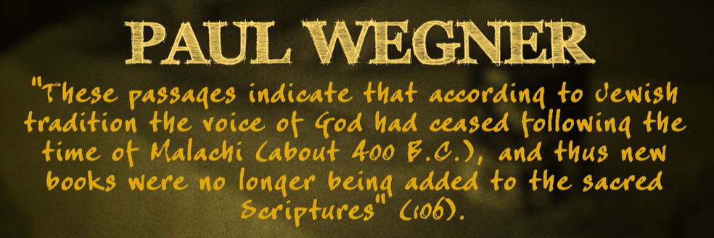
Haggai, Zechariah, and Malachi
These books were accepted (canonized) before any human council ever convened to vote on them because of the signs wonders and miracles which showed these men spoke for God.

Slide 29
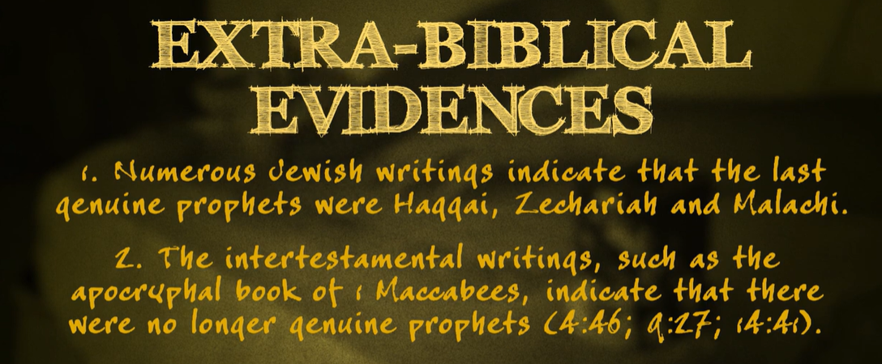
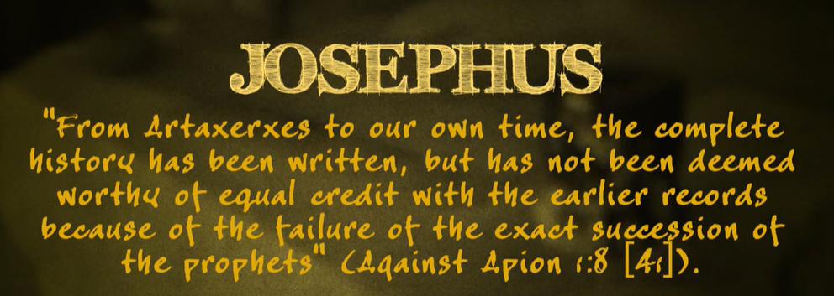
400 years
Flavius Josephus was a Roman-Jewish historian who fully defected to the Roman side and was granted Roman citizenship. He became an advisor and close associate of Vespasian's son Titus, serving as his translator during Titus's protracted siege of Jerusalem in AD 70, which resulted in the near-total razing of the city and the destruction of the Second Temple.

Slide 30
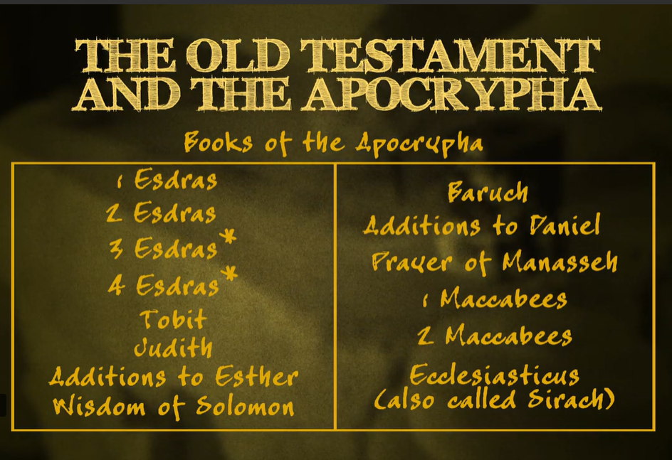

Slide 31
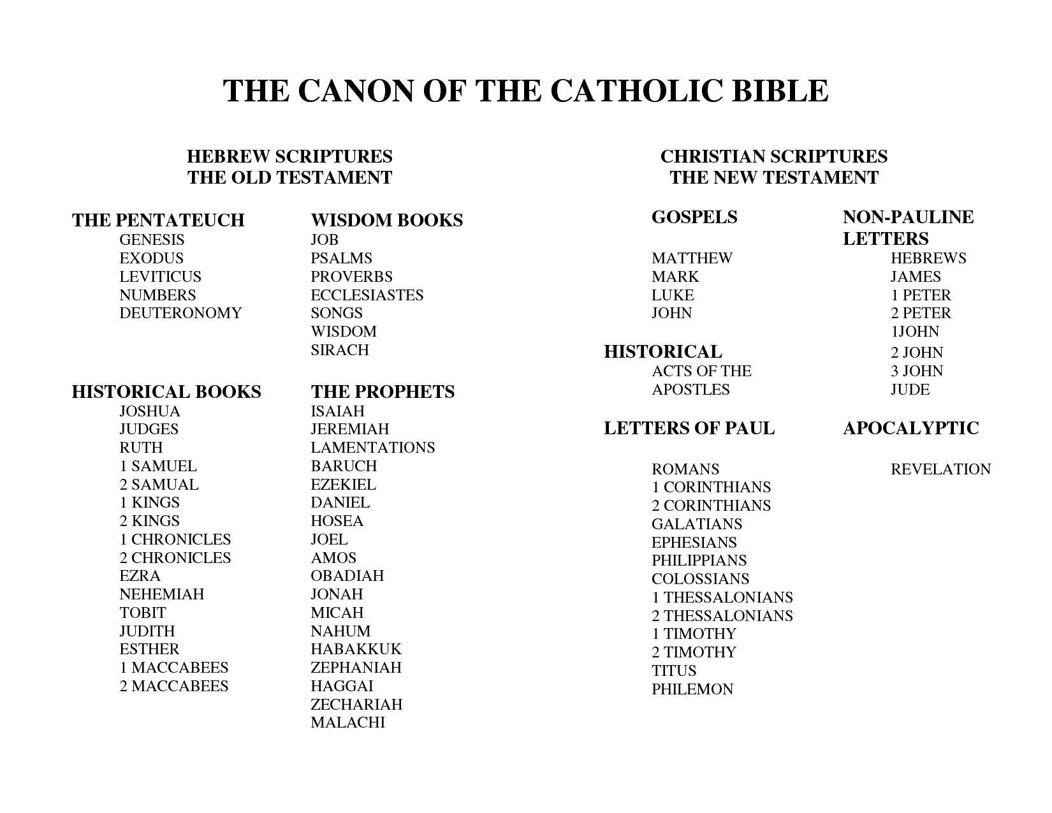
When did the Catholic church begin???????

Slide 32
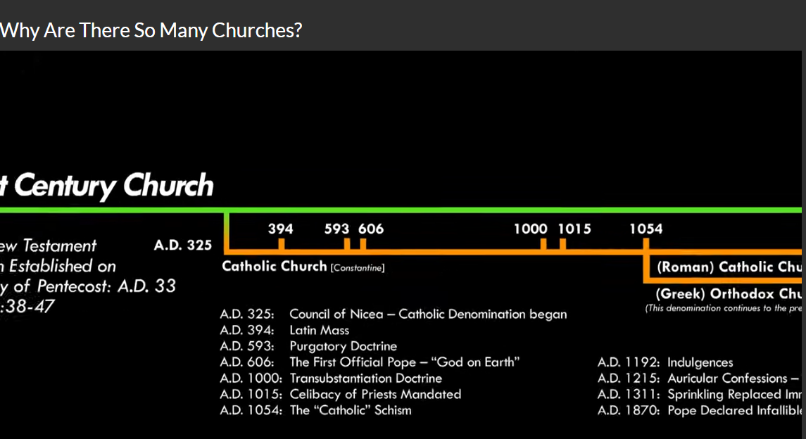

Slide 33
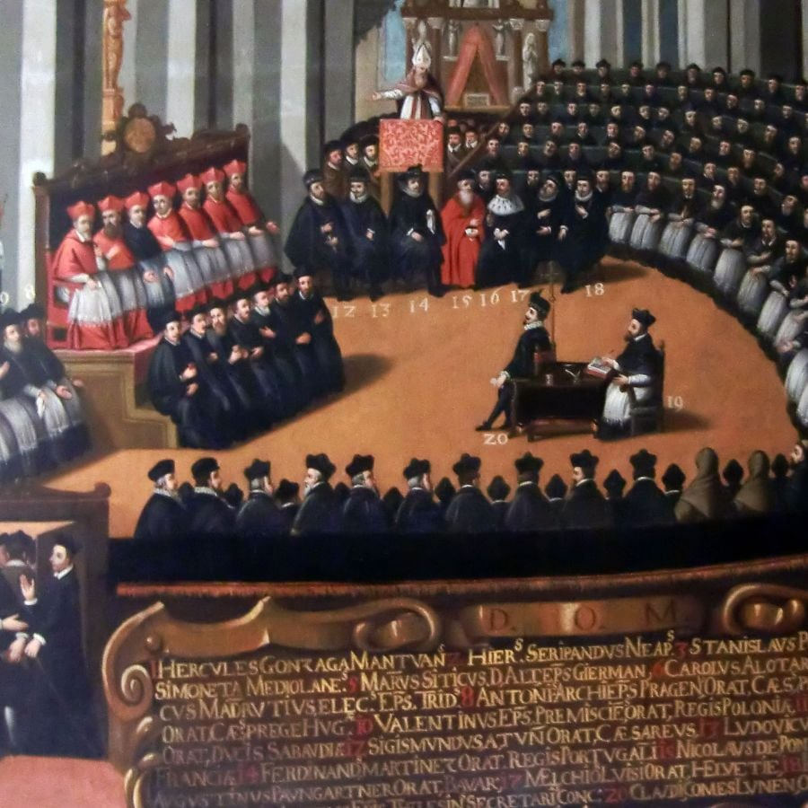
1546 AD Council of Trent

Slide 34
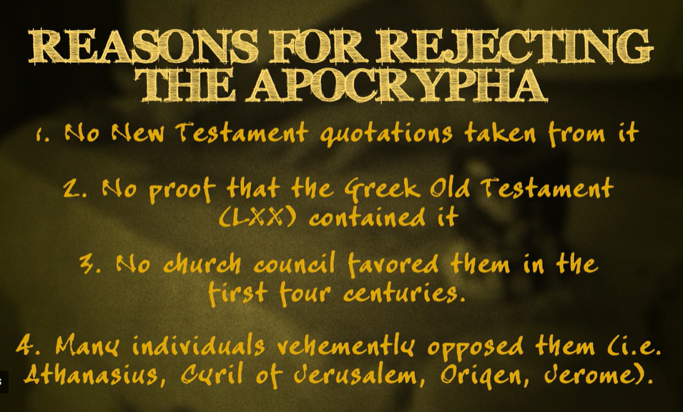

Slide 35
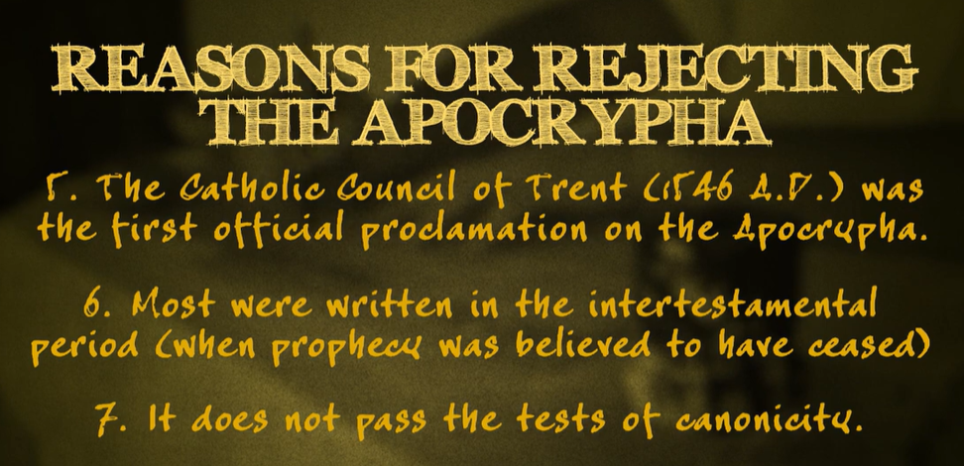

Slide 36
The precise order and date of the books is highly disputed, but we will make an attempt at a chronological presentation
of these lessons onTHE EPISTLES,
and in doing so make the point that they are individual letters with a history all their own.
A.D. 52 1 Thessalonians
A.D. 53 2 Thessalonians
A.D. 56 1 Corinthians
A.D. 57 2 Corinthians
A.D. 57 Galatians
A.D. 58 Romans
A.D. 62 Ephesians
A.D. 62 Colossians
A.D. 62 Philemon
A.D. 62 Luke
A.D. 63 Acts
A.D. 63 Philippians
A.D. 62 James
A.D. 63 1 Peter
A.D. 63 Hebrews
A.D. 66 1 Timothy
A.D. 66 Titus
A.D. 67 Mark
A.D. 67 Matthew
A.D. 67 2 Peter
A.D. 67 2 Timothy
A.D. 75 Jude
A.D. 85 John
A.D. 90 1 John; 2 John; 3 John
A.D. 96 Revelation
The OT was written over a period of approximately 1,000 years.
The NT was written over a period of approximately 50 years.
The NT could be accepted immediately because of the signs, wonders and miracles attesting these were the words of God.
No need for a council or vote.

Slide 37
Eph 2:19-20. 19 Now, therefore, you are no longer strangers and foreigners, but fellow citizens with the saints and members of the household of God, 20 having been built on the foundation of the apostles and prophets, Jesus Christ Himself being the chief corner[stone],
Eph 3:3-5. 3 how that by revelation He made known to me the mystery (as I have briefly written already, 4 by which, when you read, you may understand my knowledge in the mystery of Christ), 5 which in other ages was not made known to the sons of men, as it has now been revealed by the Spirit to His holy apostles and prophets:

Slide 38
Acts 2:22. "Men of Israel, hear these words: Jesus of Nazareth, a Man attested by God to you by miracles, wonders, and signs which God did through Him in your midst, as you yourselves also know--
Heb 2:1-4. 1 Therefore we must give the more earnest heed to the things we have heard, lest we drift away. 2 For if the word spoken through angels proved steadfast, and every transgression and disobedience received a just reward,
3 how shall we escape if we neglect so great a salvation, which at the first began to be spoken by the Lord, and was confirmed to us by those who heard Him, 4 God also bearing witness both with signs and wonders, with various miracles, and gifts of the Holy Spirit, according to His own will?

Slide 39
1Cor. 13:10. But when that which is perfect (That is neuter not masculine /he) has come, then that which is in part will be done away.
1Cor. 13:9 For we know in part
and we prophesy in part.
Jude 1:3 Beloved, while I was very diligent to write to you concerning our common salvation, I found it necessary to write to you exhorting you to contend earnestly for the faith which was once for all delivered to the saints.

Slide 40
Why do people not want to accept the Bible as the complete inspired word of God?
Satan has convinced people if the Bible is questionable, (discredited) then they do not have to accept what God says on a matter – it is subject to personal interpterion…They can accept man’s changes or substitutions.
How did that work for people in the days of Noah?

Slide 41
Questions?
Want to learn more about the Bible?
We will be glad to study the Bible with you.
New Lebanon
New Lebanon
Church of Christ
Church of Christ
New Lebanon, OH
newlebanoncoc.com
newlebanoncoc@gmail.com

