Slide 1
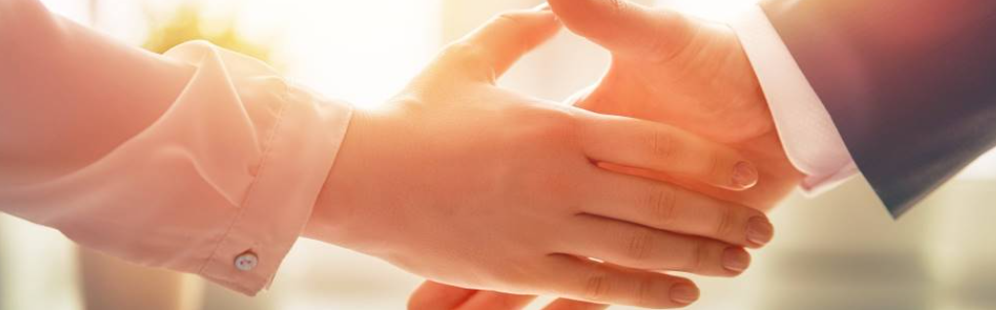
Welcome to our services
New Lebanon Church of Christ
We are Simply Christians.
Our Emphasis is Spiritual, Not Material or Social.
We are striving to be The Same Church as Described in The New Testament.
Please Come Back Again

Slide 2


God - lesson 5. God’s Purpose

Slide 3
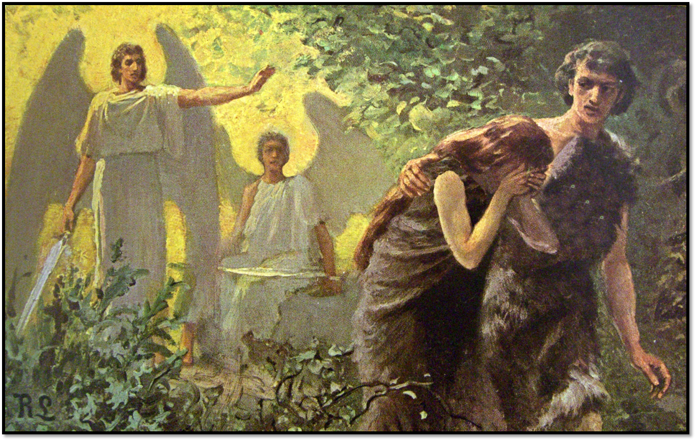
God - lesson 5. God’s Purpose
Creation of Adam and Eve. Fall Of Mankind
Is this the
end of the story?

Slide 4
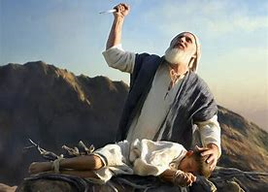
God - lesson 5. God’s Purpose
2. Promise made to Abraham he would be father of many nations. God commands him to sacrifice his son
Is this the
end of the story?

Slide 5
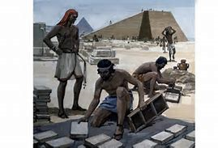
God - lesson 5. God’s Purpose
3. Isaac is spared. God tells Abraham his descendants will be slaves for 400 years.
Is this the
end of the story?

Slide 6

God - lesson 5. God’s Purpose
4. Moses delivers the heirs of promise. But they become trapped by the Red Sea when Pharoah is following with his army to destroy them.
Is this the
end of the story?

Slide 7
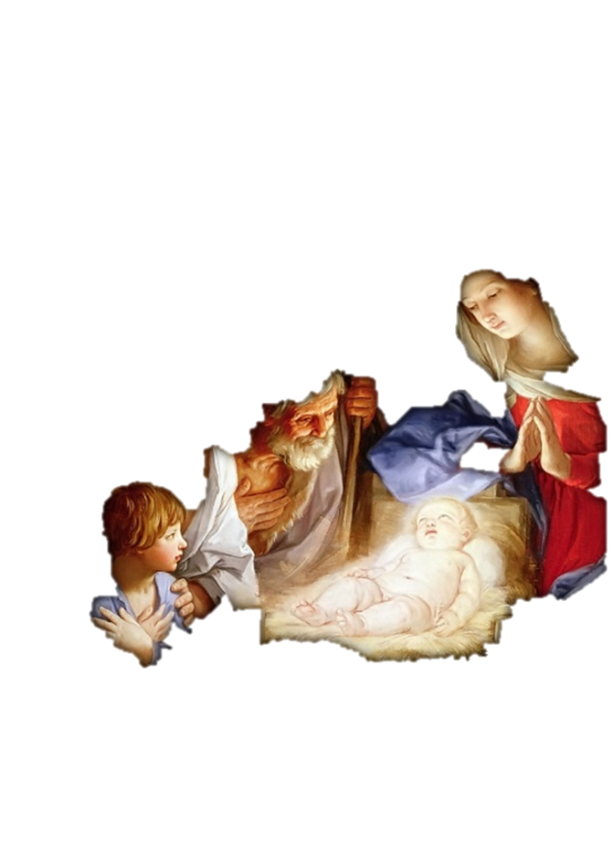
God - lesson 5. God’s Purpose
6. The Messiah is born. King Herod tries to kill him.
Is this the
end of the story?

Slide 8
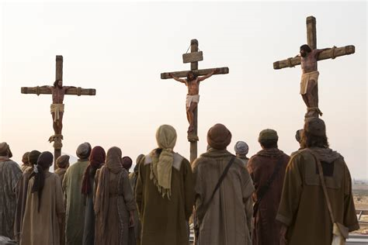
God - lesson 5. God’s Purpose
7. Later, Jesus the promised Messiah is crucified and buried.
Is this the
end of the story?

Slide 9
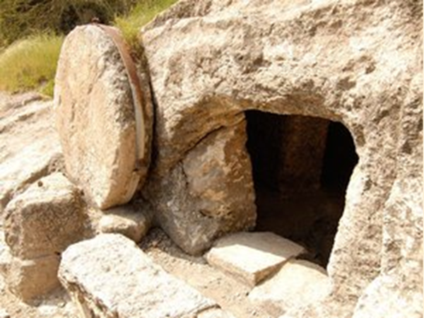
God - lesson 5. God’s Purpose
8. Jesus is victorious over death. Nothing can stop the promise of God

Slide 10
God - lesson 5. God’s Purpose
Galatians 4:4 But when the fullness of the time had come, God sent forth His Son, born of a woman, born under the law, 5 to redeem those who were under the law, that we might receive the adoption as sons.
6 And because you are sons, God has sent forth the Spirit of His Son into your hearts, crying out, "Abba, Father!“ 7 Therefore you are no longer a slave but a son, and if a son, then an heir of God through Christ.

Slide 11
Questions?
Want to learn more about the Bible?
We will be glad to study the Bible with you.
New Lebanon
New Lebanon
Church of Christ
Church of Christ
New Lebanon, OH
newlebanoncoc.com
newlebanoncoc@gmail.com

