Slide 1
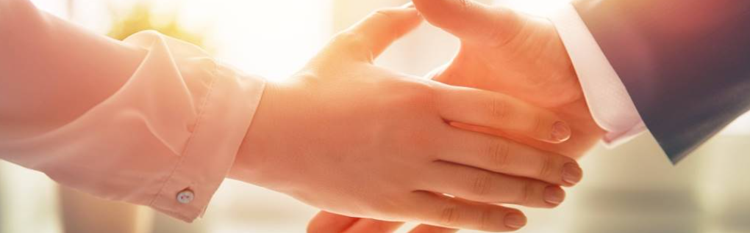
Welcome to our services
New Lebanon Church of Christ
We are Simply Christians.
Our Emphasis is Spiritual, Not Material or Social.
We are striving to be The Same Church as Described in The New Testament.
Please Come Back Again

Slide 2

Act 17:23 "for as I was passing through and considering the objects of your worship, I even found an altar with this inscription: TO THE UNKNOWN GOD. Therefore, the One whom you worship without knowing, Him I proclaim to you:

Slide 3
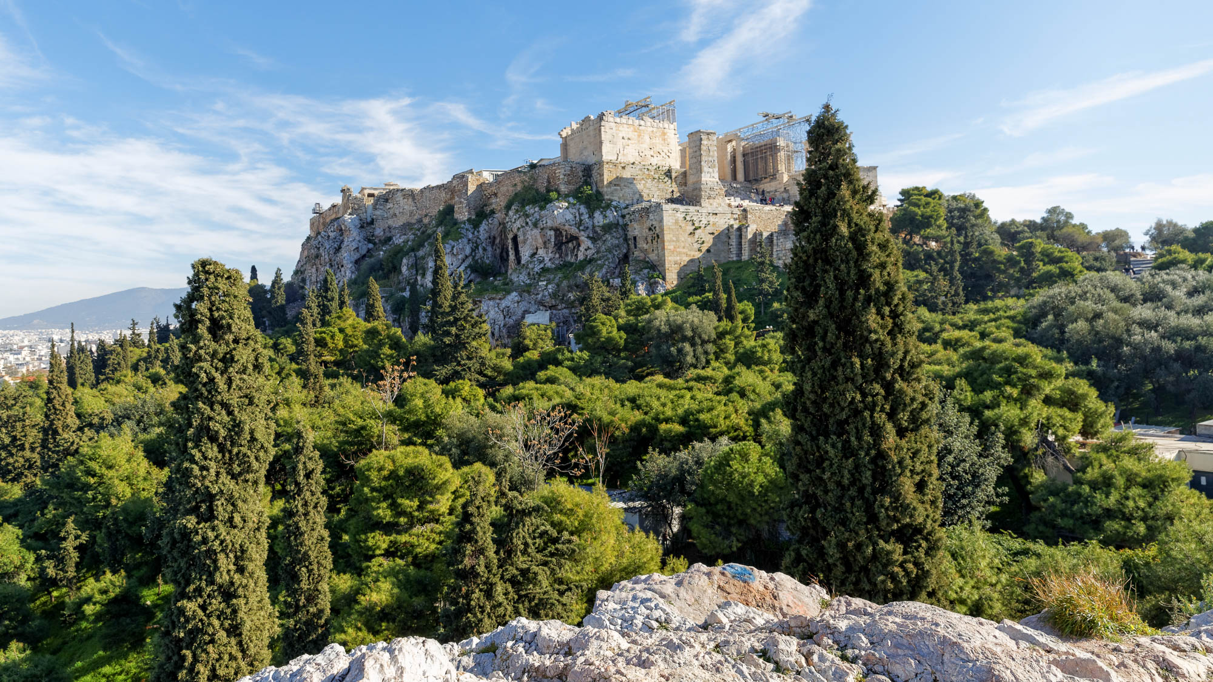
God – Lesson One. Who Is God?
Acts 17:22-23. Then Paul stood in the midst of the Areopagus and said, "Men of Athens, I perceive that in all things you are very religious; "for as I was passing through and considering the objects of your worship, I even found an altar with this inscription: TO THE UNKNOWN GOD. Therefore, the One whom you worship without knowing, Him I proclaim to you:

Slide 4

God – Lesson Two. Who God Is Not.
"God is not a man, that He should lie, Nor a son of man, that He should repent. Has He said, and will He not do? Or has He spoken, and will He not make it good? Numbers 23:19

Slide 5

God – Lesson Three.
The Goodness and Severity Of God.
Romans 11:11-25

Slide 6

God – Lesson Four.
WARNINGS
From God

Slide 7

warning /wôr′nĭng/
noun
A statement telling of or an indication providing evidence of impending danger, difficulty, or misfortune.
Advice to be cautious.
A cautionary or deterrent example.

Slide 8
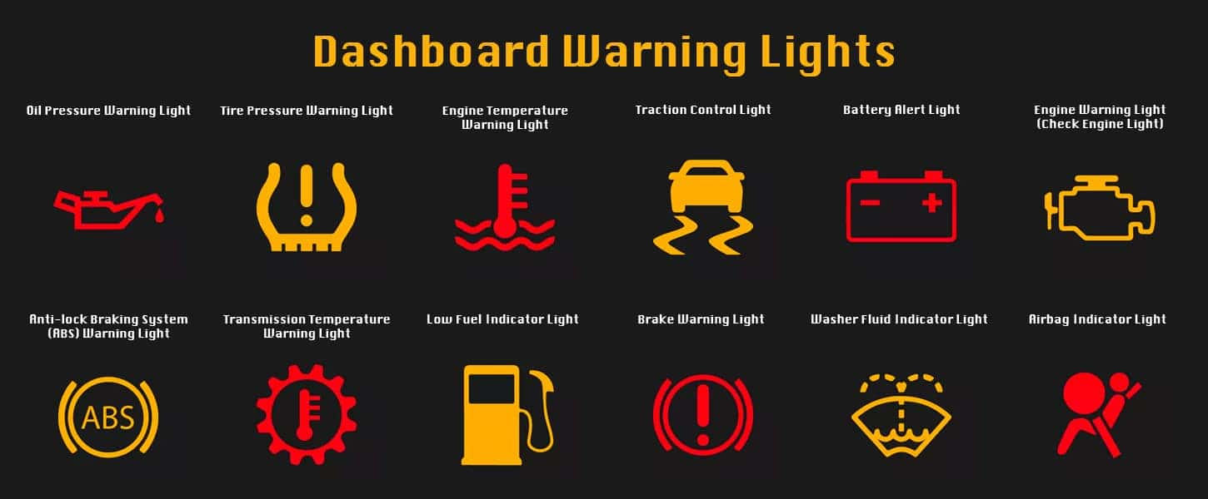

Slide 9
Warnings From God
1.God warns us that one cannot enter the kingdom without the new birth.

Slide 10


Slide 11
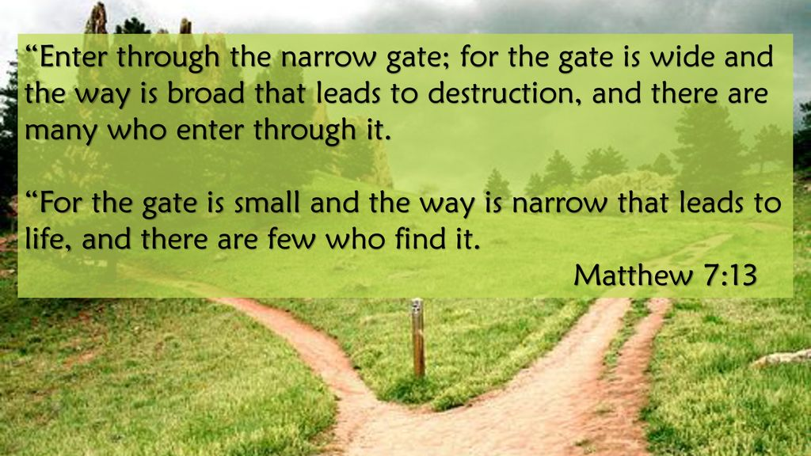
Warnings From God

Slide 12
Warnings From God
2. God warns us that we have an enemy.

Slide 13


Slide 14
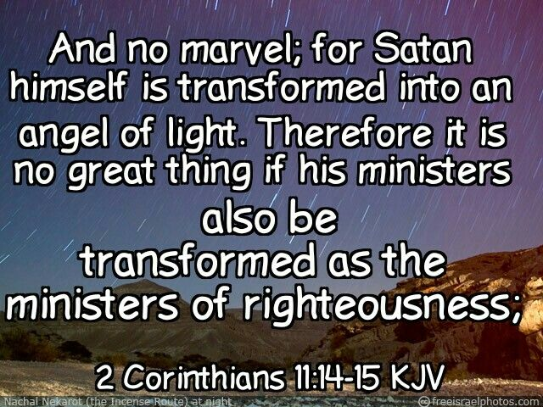

Slide 15

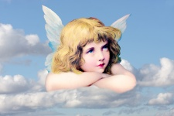

Slide 16
Warnings From God
3.God warns us we cannot be saved if we walk in the flesh.

Slide 17
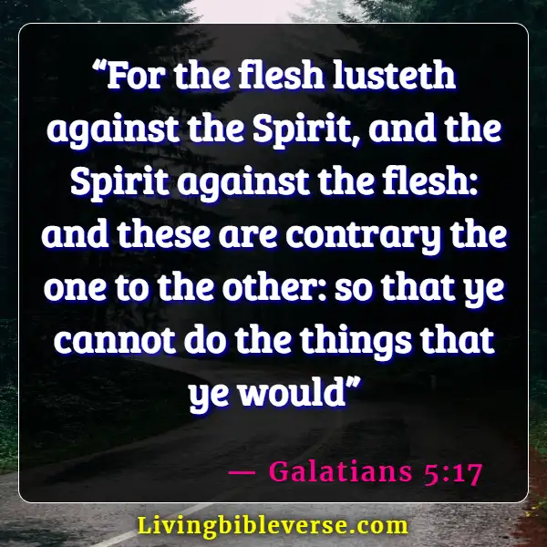
Warnings From God

Slide 18
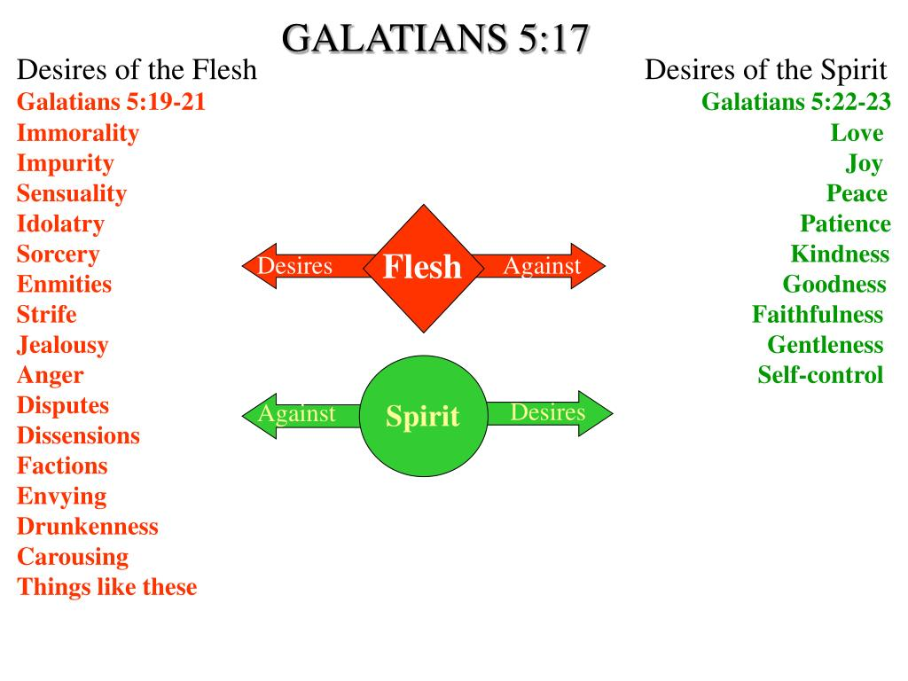

Slide 19
Warnings From God
4. God warns us that Jesus will return as a thief in the night.

Slide 20
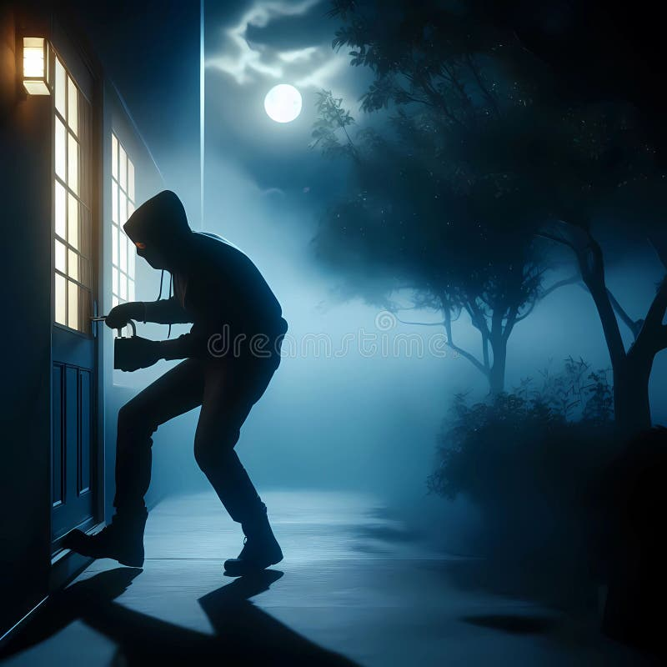

Slide 21
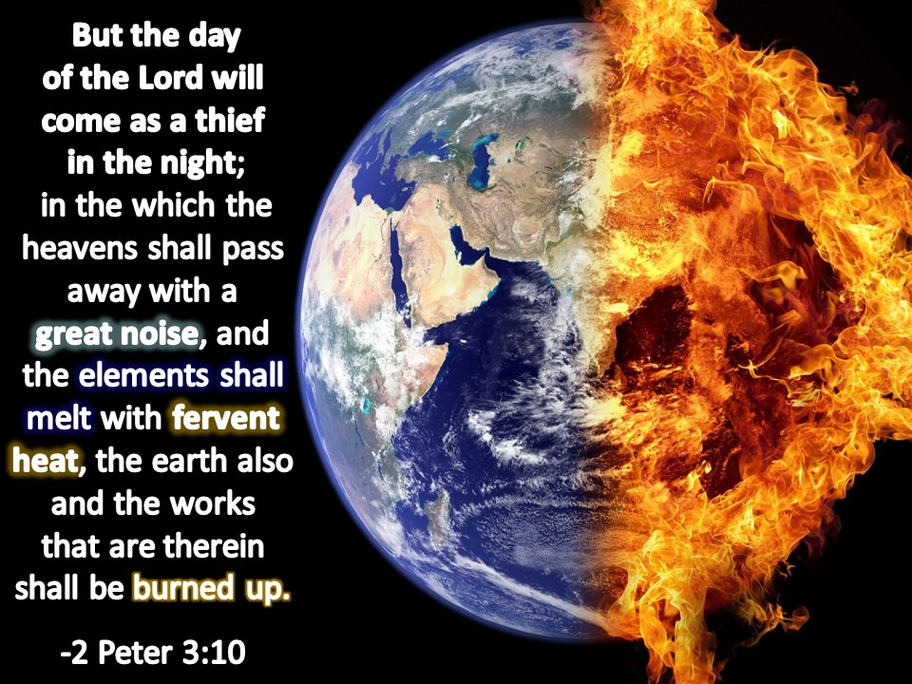

Slide 22
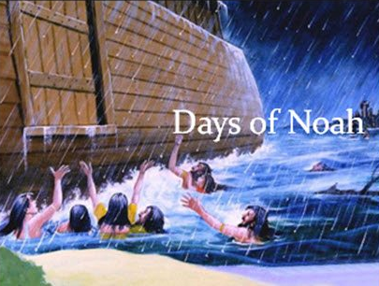
Psalm 32:6 NKJV. 6 For this cause everyone who is godly shall pray to You In a time when You may be found; Surely in a flood of great waters They shall not come near him.

Slide 23
Questions?
Want to learn more about the Bible?
We will be glad to study the Bible with you.
New Lebanon
New Lebanon
Church of Christ
Church of Christ
New Lebanon, OH
newlebanoncoc.com
newlebanoncoc@gmail.com

