Slide 1
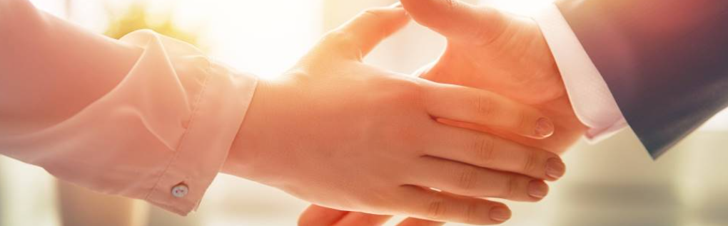
Welcome to our services
New Lebanon Church of Christ
We are Simply Christians.
Our Emphasis is Spiritual, Not Material or Social.
We are striving to be The Same Church as Described in The New Testament.
Please Come Back Again

Slide 2

Act 17:23 "for as I was passing through and considering the objects of your worship, I even found an altar with this inscription: TO THE UNKNOWN GOD. Therefore, the One whom you worship without knowing, Him I proclaim to you:

Slide 3
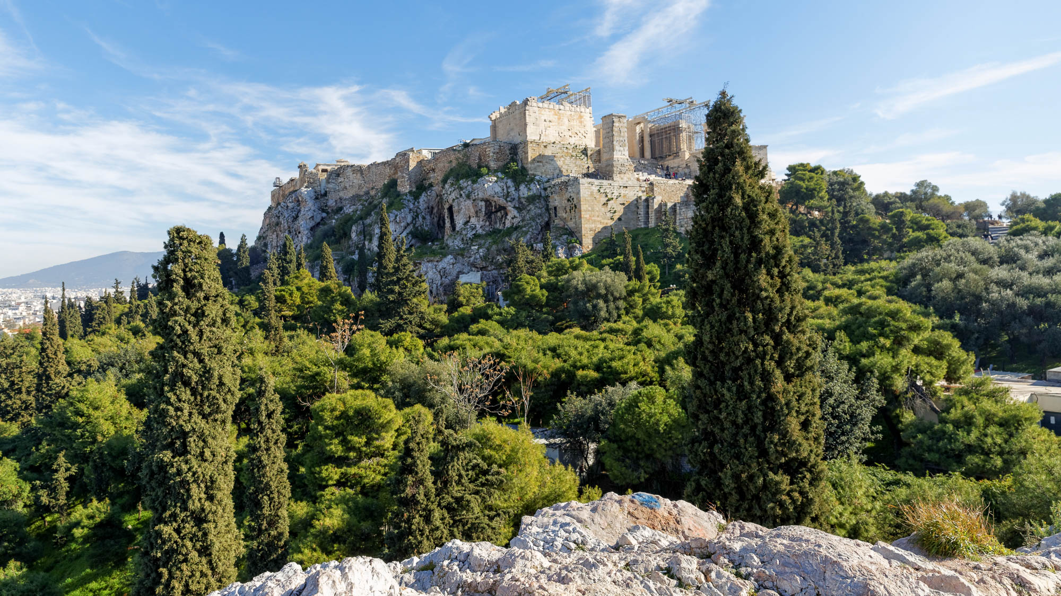
God – Lesson One. Who Is God?
Acts 17:22-23. Then Paul stood in the midst of the Areopagus and said, "Men of Athens, I perceive that in all things you are very religious; "for as I was passing through and considering the objects of your worship, I even found an altar with this inscription: TO THE UNKNOWN GOD. Therefore, the One whom you worship without knowing, Him I proclaim to you:

Slide 4
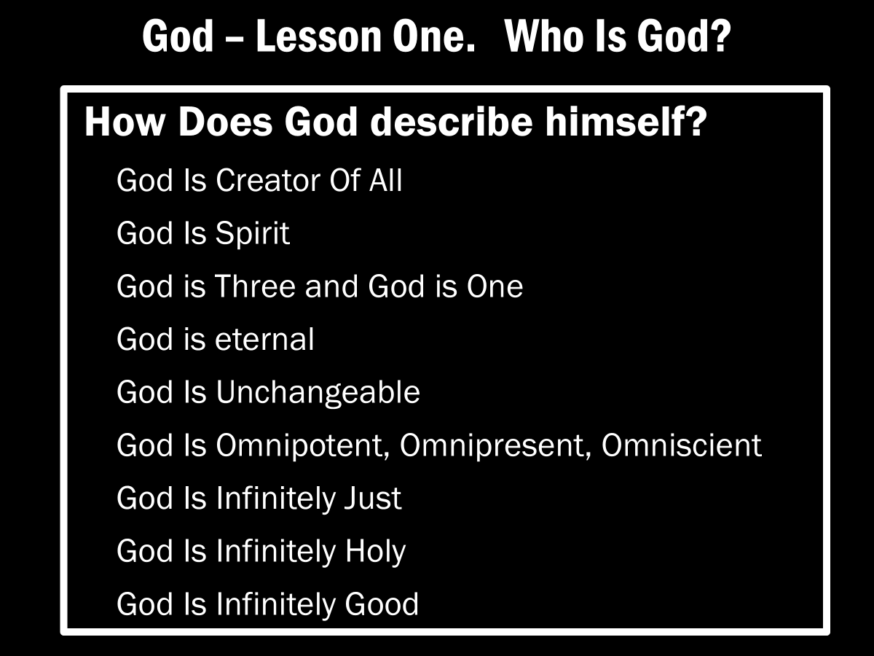

Slide 5

God – Lesson Two. Who God Is Not.
"God is not a man, that He should lie, Nor a son of man, that He should repent. Has He said, and will He not do? Or has He spoken, and will He not make it good? Numbers 23:19

Slide 6
God – Lesson Two. God Is Not…
God is Not…
God Is not a magnet
God Is not an American God
God is not physical
God is not local
God Is not absent
God Is not confusing
God Is not reluctant to save
God Is not reluctant to punish
God Is not like man

Slide 7

God – Lesson Three
Romans. 11:22 Therefore consider the goodness and severity of God: on those who fell, severity; but toward you, goodness, if you continue in His goodness. Otherwise you also will be cut off.

Slide 8
Questions?
Want to learn more about the Bible?
We will be glad to study the Bible with you.
New Lebanon
New Lebanon
Church of Christ
Church of Christ
New Lebanon, OH
newlebanoncoc.com
newlebanoncoc@gmail.com

