Slide 1
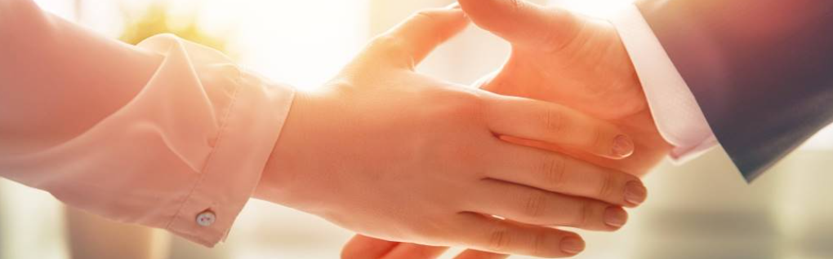
Welcome to our services
New Lebanon Church of Christ
We are Simply Christians.
Our Emphasis is Spiritual, Not Material or Social.
We are striving to be The Same Church as Described in The New Testament.
Please Come Back Again

Slide 2

God – Lesson One. Who Is God?
Acts 17:22-23. Then Paul stood in the midst of the Areopagus and said, "Men of Athens, I perceive that in all things you are very religious; "for as I was passing through and considering the objects of your worship, I even found an altar with this inscription: TO THE UNKNOWN GOD. Therefore, the One whom you worship without knowing, Him I proclaim to you:

Slide 3
God – Lesson One. Who Is God?
How Does God describe himself?
God Is Creator Of All
God Is Spirit
God is Three and God is One
God is eternal
God Is Unchangeable
God Is Omnipotent, Omnipresent, Omniscient
God Is Infinitely Just
God Is Infinitely Holy
God Is Infinitely Good

Slide 4
Questions?
Want to learn more about the Bible?
We will be glad to study the Bible with you.
New Lebanon
New Lebanon
Church of Christ
Church of Christ
New Lebanon, OH
newlebanoncoc.com
newlebanoncoc@gmail.com

