Slide 1
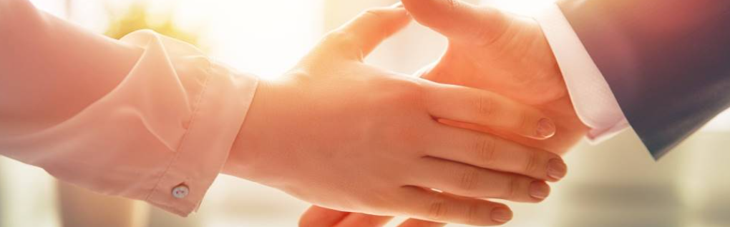
Welcome to our services
New Lebanon Church of Christ
We are Simply Christians.
Our Emphasis is Spiritual, Not Material or Social.
We are striving to be The Same Church as Described in The New Testament.
Please Come Back Again

Slide 2

1Peter 3:15 But sanctify the Lord God in your hearts, and always be ready to give a defense to everyone who asks you a reason for the hope that is in you, with meekness and fear;
pngtree.com

Slide 3
The Hope That Is In You
pngtree.com
1 Peter 3:15

Slide 4
Vine's Expository Dictionary of New Testament Words
A-1 Noun Strong's Number: g1680 Greek: elpis
Hope (Noun and Verb), Hope (For):
In the NT, "favorable and confident expectation" It has to do with the unseen and the future, Rom 8:24, 25.
"Hope" describes
(a) the happy anticipation of good Titus 1:2; 1Pe 1:21;
(b) the ground upon which "hope" is based, Act 16:19; Col 1:27, "Christ in you the hope of glory;"
(c) the object upon which the "hope" is fixed, 1Titus 1:1.

Slide 5

The Hope That Is In You
There is nothing worse
than having no hope!

Slide 6
The Hope That Is In You
What is hope?

Slide 7
The Hope That Is In You
Hope does not arise from your
desires or wishes but from God,
who is Himself the believer's hope: "My hope is in You" (Psalm 39:7).

Slide 8
The Hope That Is In You
Hope distinguishes the Christian from the unbeliever, who has no hope

Slide 9
The Hope That Is In You
In contrast to Old Testament hope, your hope is superior
His grace
His Word
His gospel

Slide 10
The Hope That Is In You
And your Hope should be directed back toward God and Christ

Slide 11
The Hope That Is In You
The objects of hope are:
eternal life
Salvation
the glory of God
the appearing of Christ
and the resurrection from the dead

Slide 12
The Hope That Is In You
Hope is the anchor
of the soul.

Slide 13
The Hope That Is In You
God wants you to be able to tell people about your wonderful hope.

Slide 14
The Hope That Is In You
1Peter 1:3 Blessed be the God and Father of our Lord Jesus Christ, who according to His abundant mercy has begotten us again to a living hope through the resurrection of Jesus Christ from the dead,
1Peter 3:15 But sanctify the Lord God in your hearts, and always be ready to give a defense to everyone who asks you a reason for the hope that is in you, with meekness and fear;

Slide 16
Questions?
Want to learn more about the Bible?
We will be glad to study the Bible with you.
New Lebanon
New Lebanon
Church of Christ
Church of Christ
New Lebanon, OH
newlebanoncoc.com
newlebanoncoc@gmail.com

