Slide 1
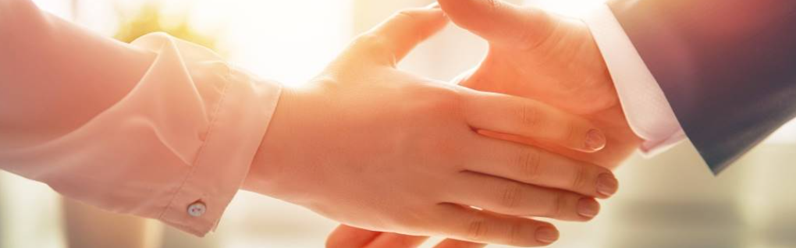
Welcome to our services
New Lebanon Church of Christ
We are Simply Christians.
Our Emphasis is Spiritual, Not Material or Social.
We are striving to be The Same Church as Described in The New Testament.
Please Come Back Again

Slide 2

Brethren, I do not count myself to have apprehended; but one thing I do, forgetting those things which are behind and reaching forward to those things which are ahead,
I press toward the goal for the prize of the upward call of God in Christ Jesus. Philippians 3:13-14

Slide 3
I Press Toward The Goal
Philippians 3:13-14

Slide 4

1. A Sense Of personal Unworthiness.
newlebanoncoc.com

Slide 5
2. Singleness Of Purpose (FOCUS)
newlebanoncoc.com

Slide 6
3. Forget The Past
newlebanoncoc.com

Slide 7
4. A Commitment To Progress
newlebanoncoc.com

Slide 8
Questions?
Want to learn more about the Bible?
We will be glad to study the Bible with you.
New Lebanon
New Lebanon
Church of Christ
Church of Christ
New Lebanon, OH
newlebanoncoc.com
newlebanoncoc@gmail.com

