Slide 1
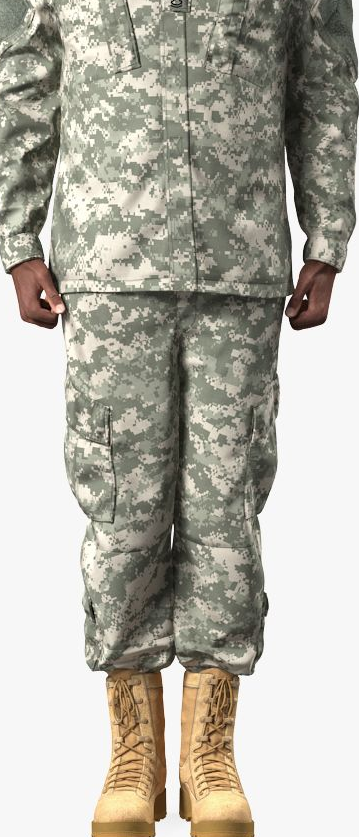
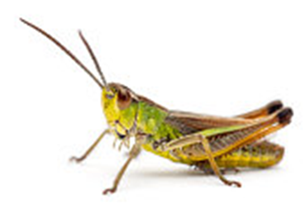
"There we saw the giants (the descendants of Anak came from the giants); and we were like grasshoppers in our own sight, and so we were in their sight.“ Numbers 13:33

Slide 2
Grasshoppers In Our Own
Sight.
Numbers 13

Slide 3
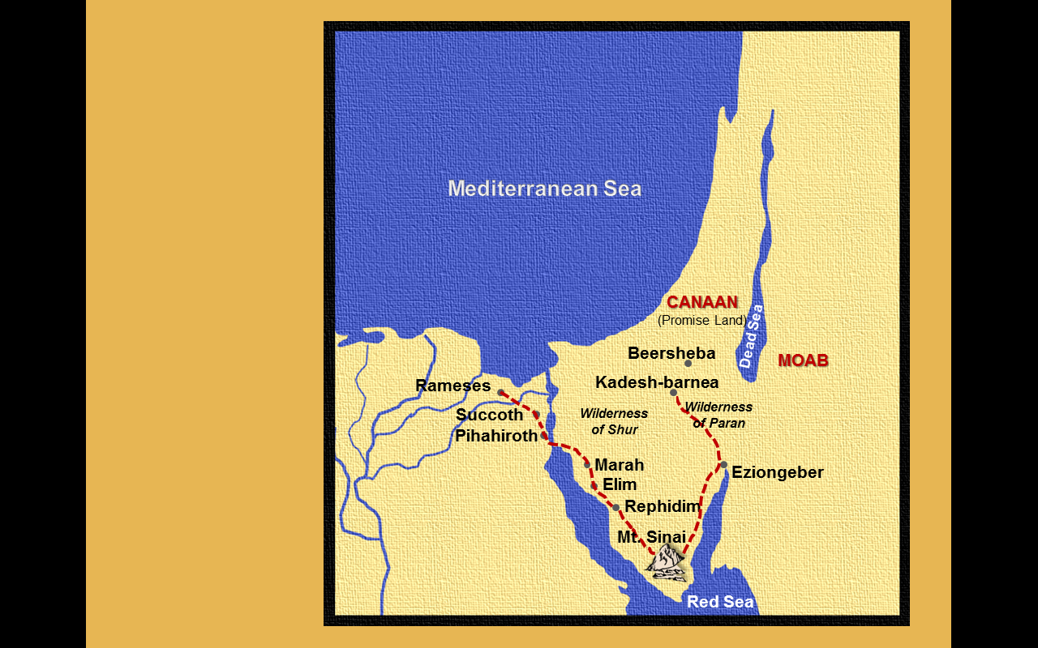
Moses sent 12 men into Canaan to spy out the land.
Numbers 13
“¹And the LORD spake unto Moses, saying,
²Send thou men, that they may search the land of Canaan, which I give unto the children of Israel: of every tribe of their fathers shall ye send a man, every one a ruler among them.
³And Moses by the commandment of the LORD sent them from the wilderness of Paran: all those men were heads of the children of Israel.”
The spies entered Canaan from the South up through Beersheba not Moab.

Slide 4
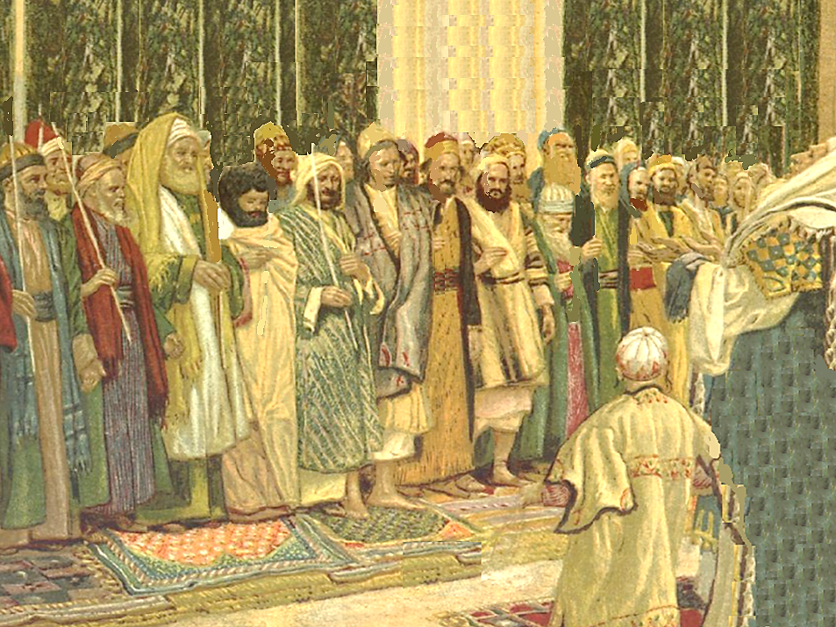
Numbers 13
“¹⁷And Moses sent them to spy out the land of Canaan, and said unto them, Get you up this way southward, and go up into the mountain.”

Slide 5
They were to spy out the land and report about :
. . . the people that dwelt there
. . . whether they were strong or weak, few or many
. . . what kind of land it was, whether it was good or bad
. . . what size the cities were
. . . whether they lived in tents, or in strong holds
. . . if the land was fat or lean, whether it had wood or not

Slide 6
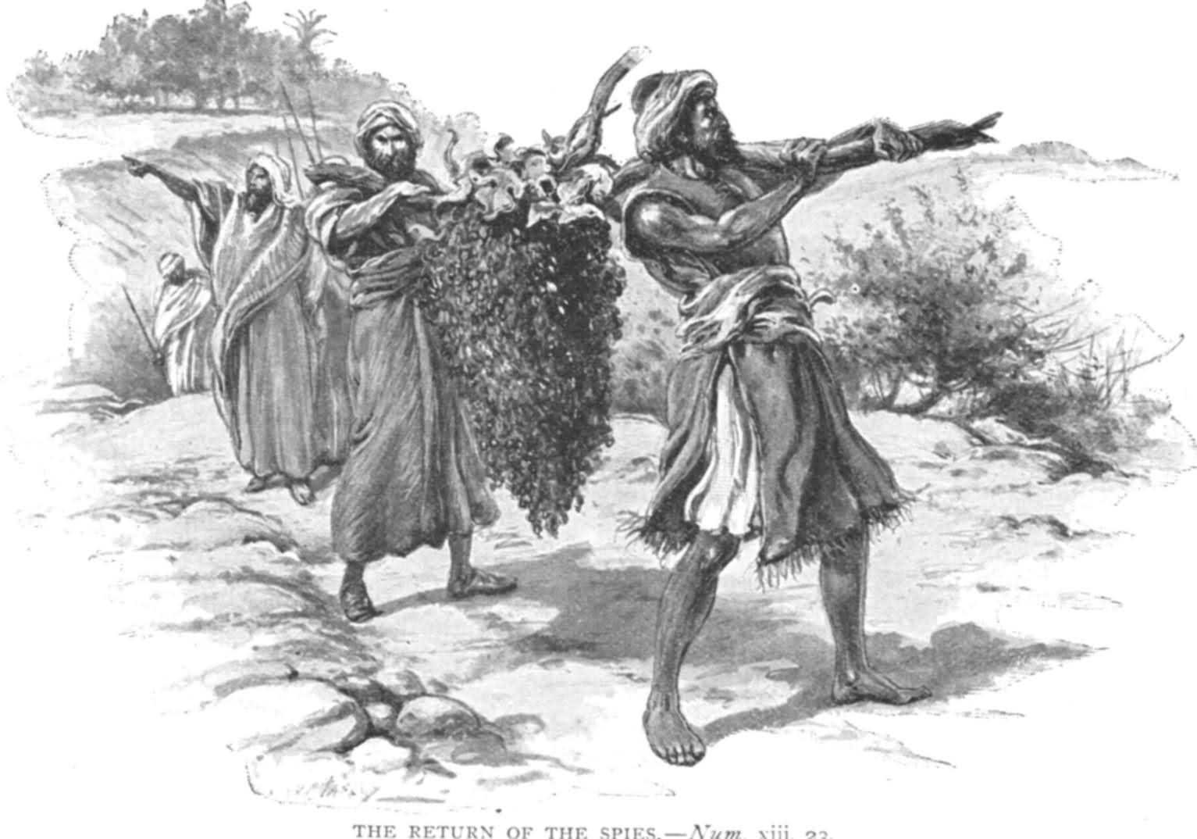
And they were to—
. . . Bring of the fruit of the land
. . . Be of good courage

Slide 7
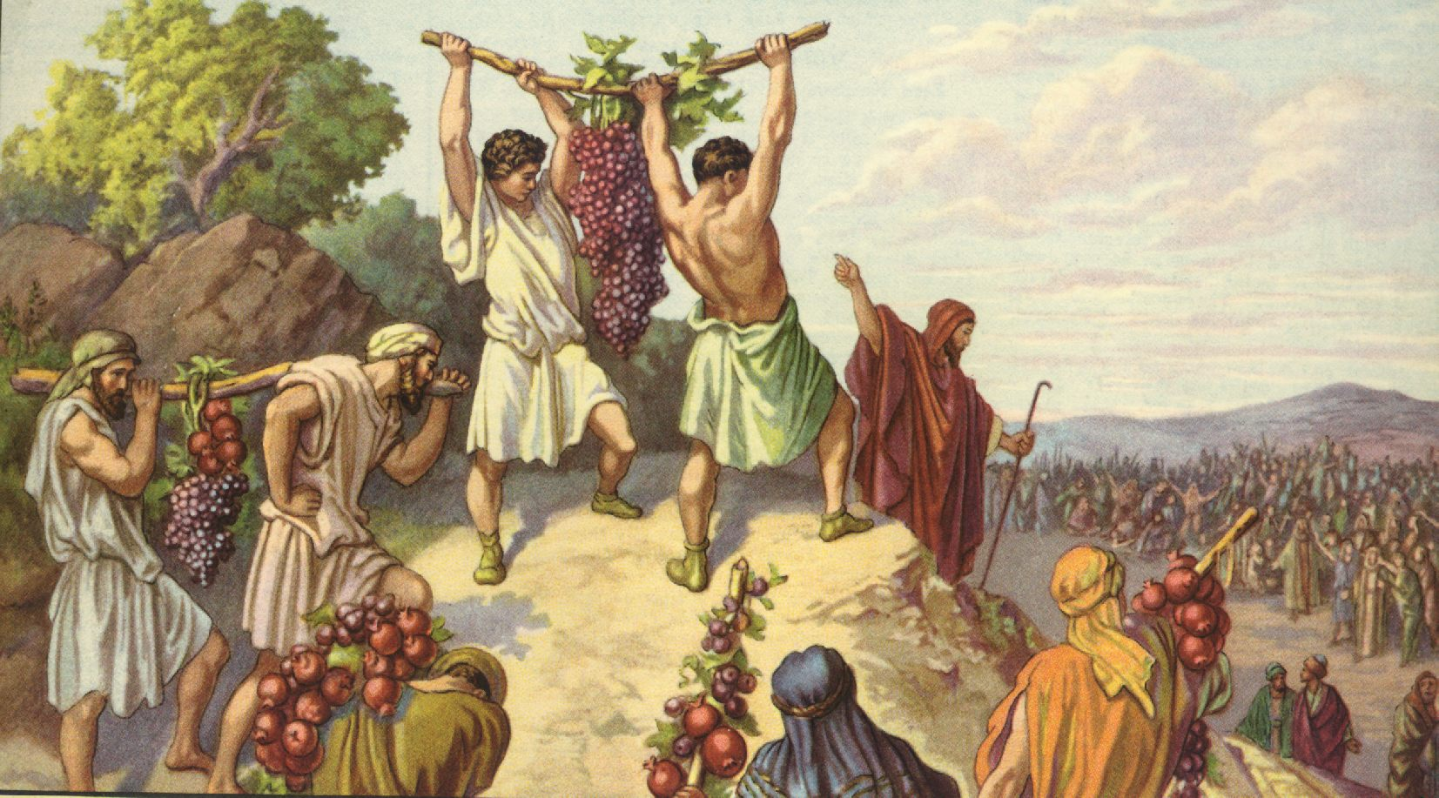
Numbers 13
“And they came unto the brook of Eshcol, and cut down from thence a branch with one cluster of grapes, and they bare it between two upon a staff; and they brought of the pomegranates, and of the figs.”

Slide 8
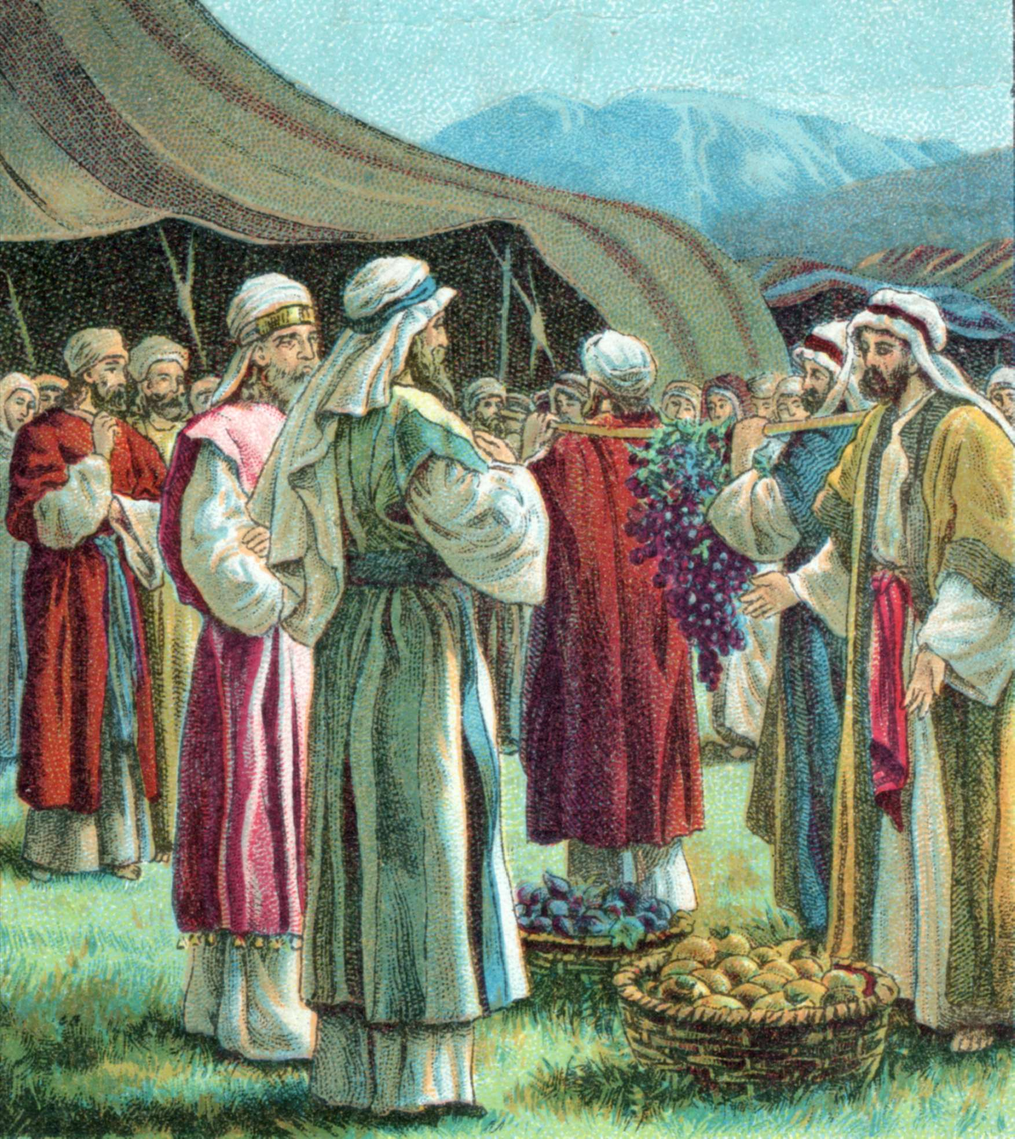
Numbers 13
“²⁴The place was called the brook Eshcol, because of the cluster of grapes which the children of Israel cut down from thence. ²⁵And they returned from searching of the land after forty days.”

Slide 9
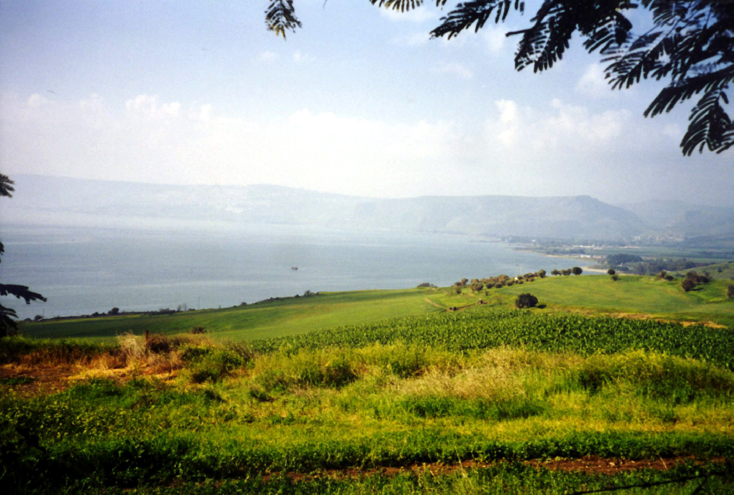
They searched the land. They spied out the mountains, the wilderness, the walled cities, and the sea coast. From their report they had never seen such a beautiful, abundant land.

Slide 10
The spies’ report told of a land that flowed with milk and honey . . .

Slide 11
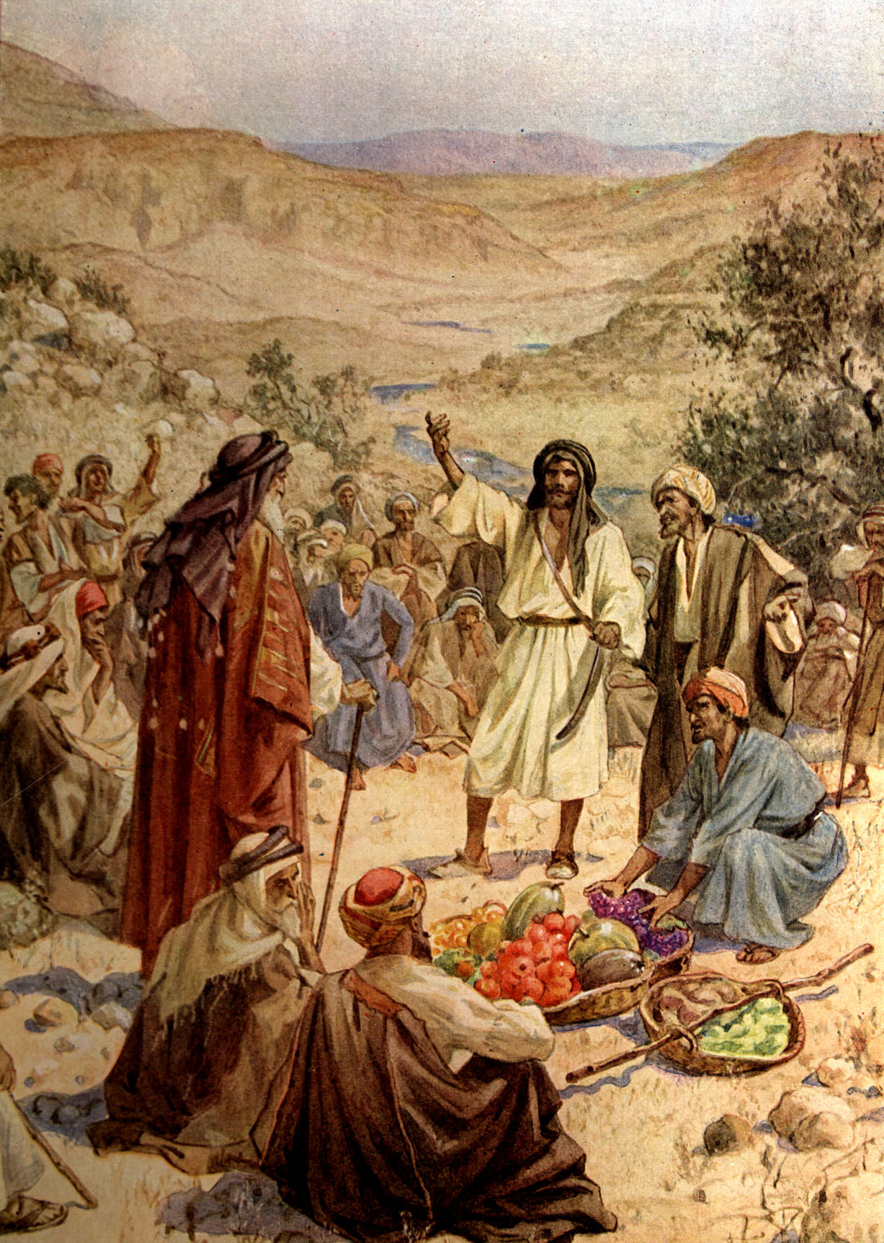
You would think after seeing beautiful Canaan and knowing God was on their side they would be ready to claim it for their own.

Slide 12
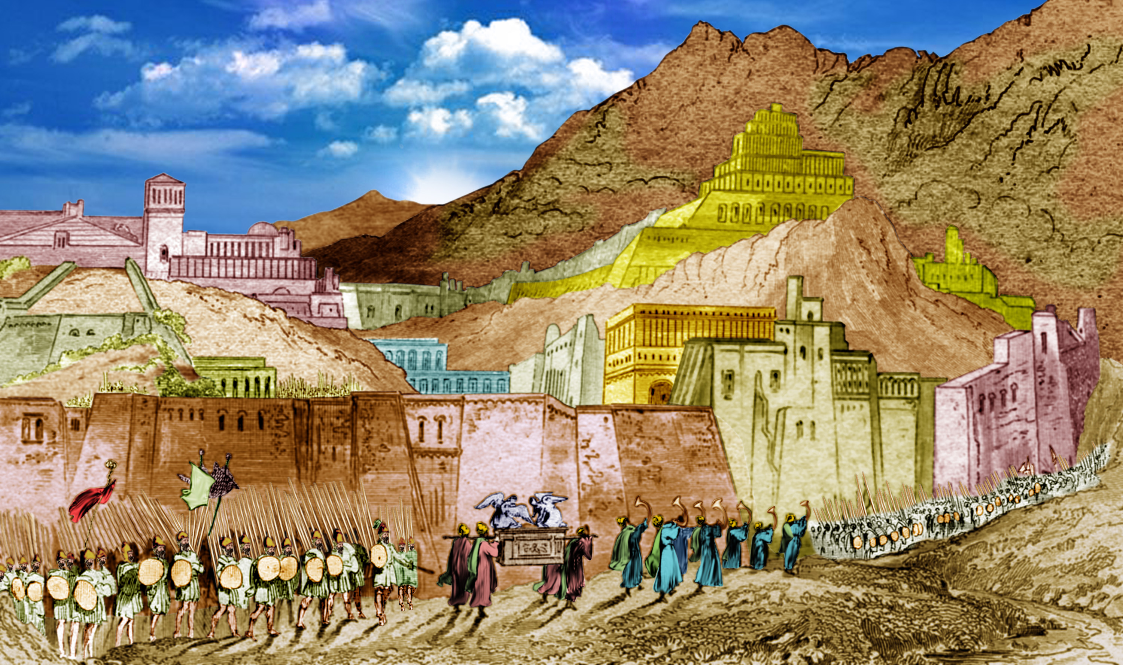
But 10 of the spies were less impressed with the beauty and bounty and more impressed with the people who, they saw as too much of a threat. They said the people are too strong and the cities were walled and very great.

Slide 13
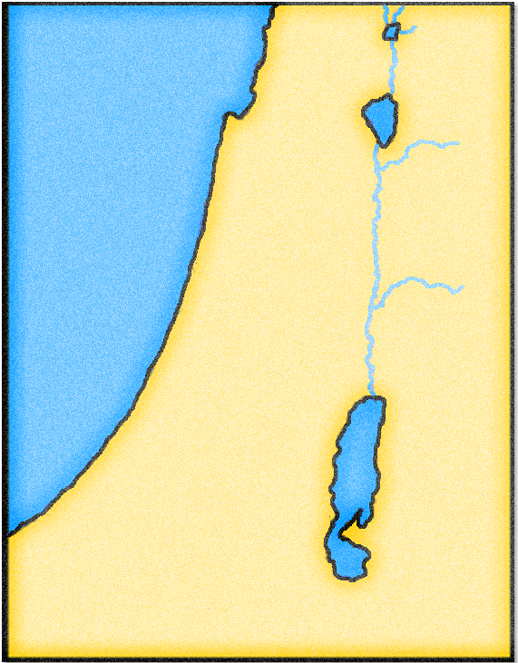
The 10 spies were afraid because of the evil nations that inhabited the Promise Land.
Hivites
Girgasites
Jordan River
CANAAN LAND
There were
seven nations
of Canaan—
Hittites
Perizzites
Jebusites
Amorites
Canaanites
Girgasites
Hivites
Amorites
Canaanites
Jebusites
Dead Sea
Perizzites
Hittites

Slide 14
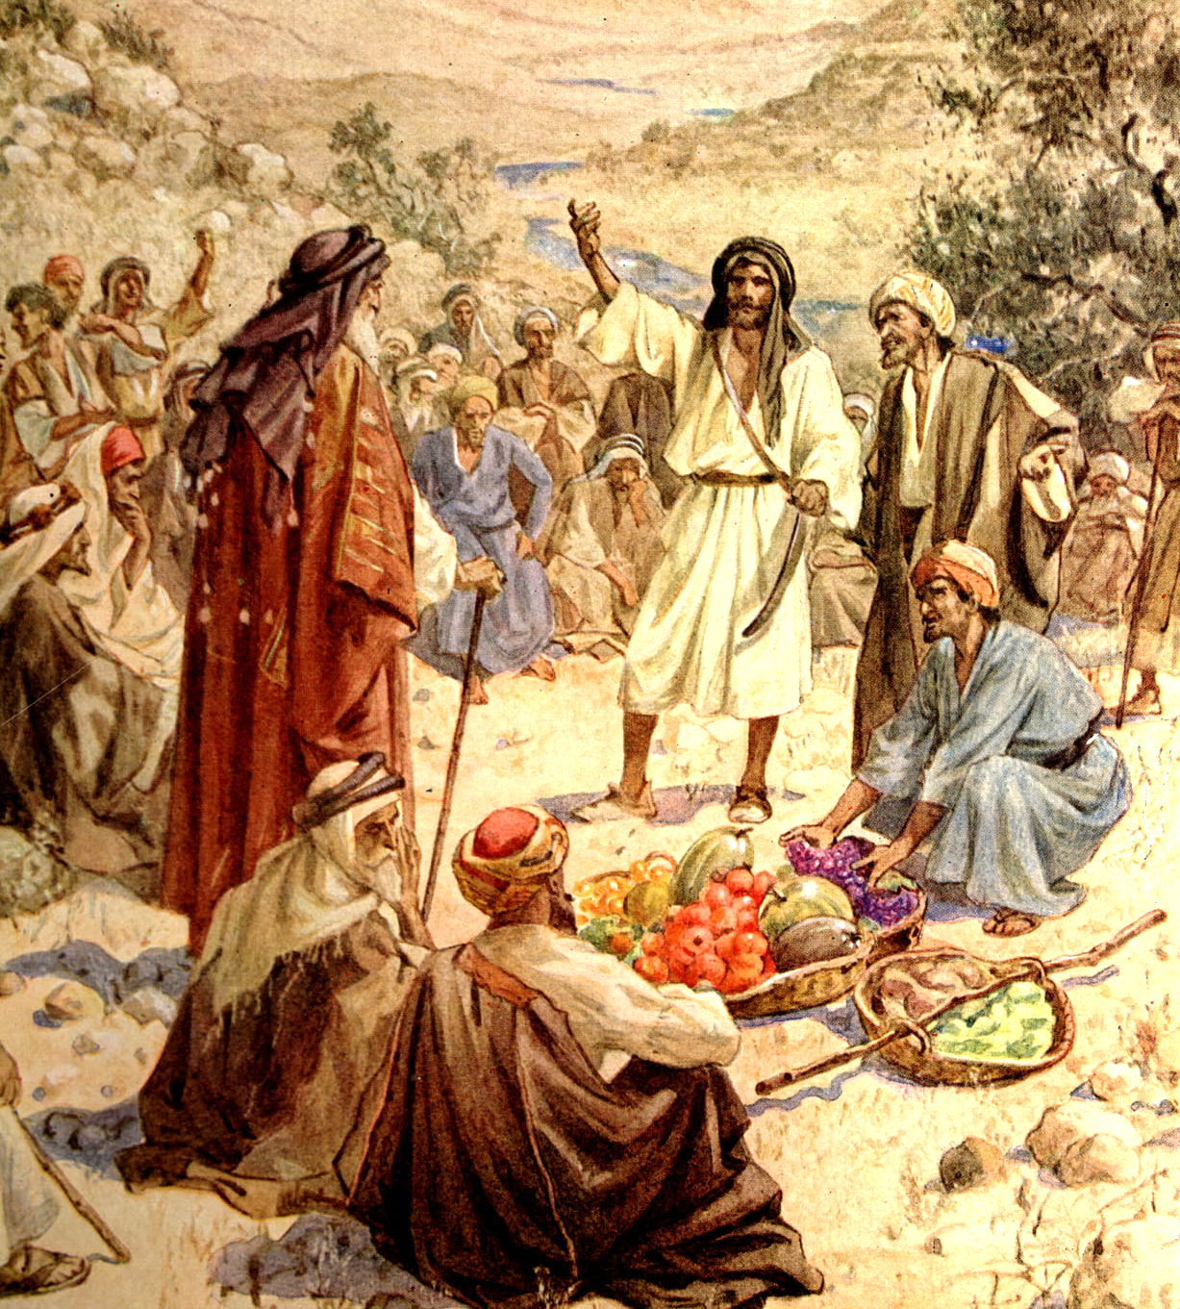
But two of the spies, Joshua and Caleb, had faith in God, and courage to obey him.
Caleb said:
“Let us go up at once and possess it; for we are well able to overcome it.”

Slide 15
The other spies were adamant that it was impossible to take the land
because the Canaanites were stronger .

Slide 16
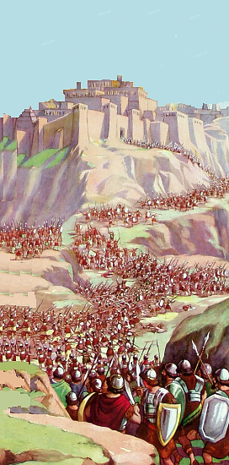
Numbers 13
“³²And they brought up an evil report of the land which they had searched unto the children of Israel, saying, The land, through which we have gone to search it, is a land that eateth up the inhabitants thereof.”

Slide 17
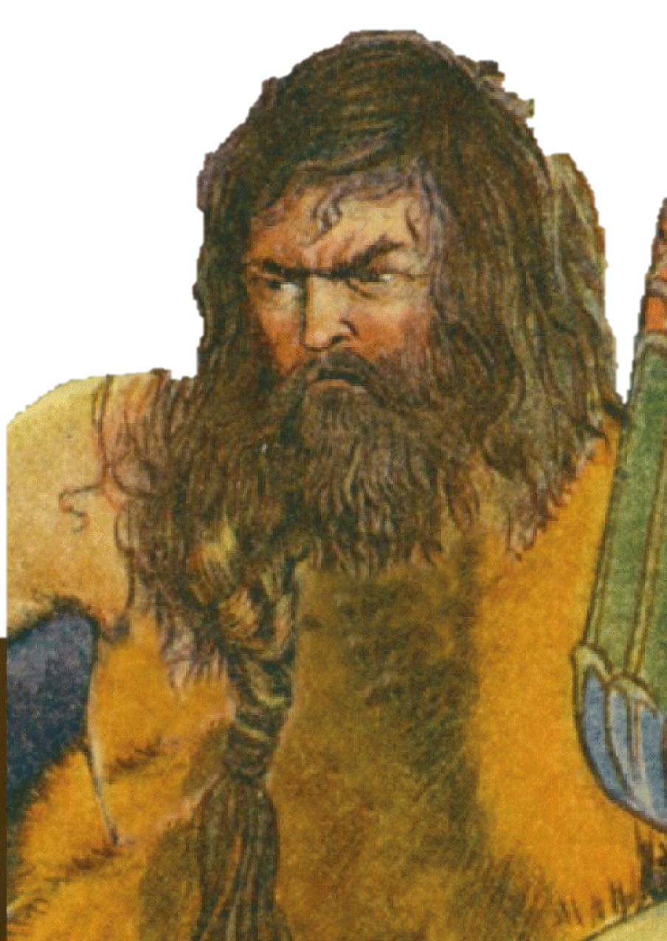
Numbers 13
“³² . . . and all the people that we saw in it are men of a great stature.
³³And there we saw the giants, the sons of Anak, which come of the giants: and we were in our own sight as grasshoppers, and so we were in their sight.”

Slide 18
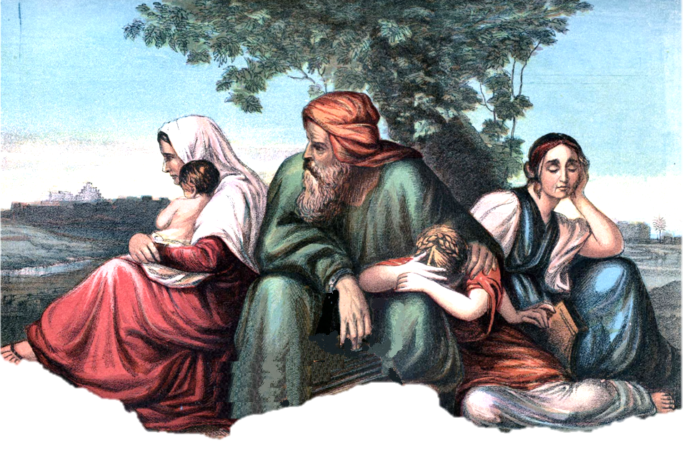
Numbers 14
“ ¹And all the congregation lifted up their voice, and cried; and the people wept that night.”

Slide 19
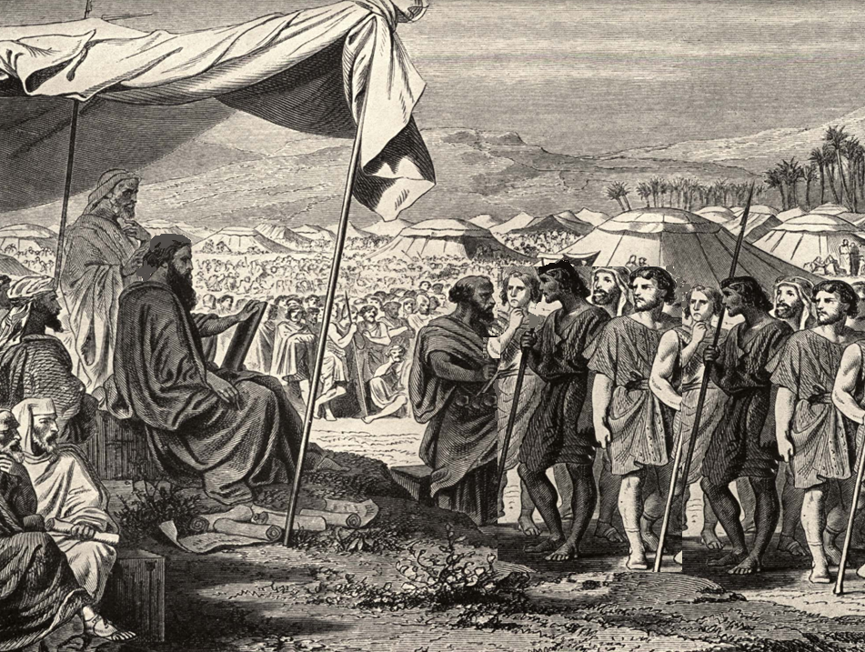
Numbers 14
“²All the children of Israel murmured against Moses and against Aaron: and the whole congregation said unto them, Would God that we had died in the land of Egypt! or would God we had died in this wilderness! ³And wherefore hath the LORD brought us unto this land, to fall by the sword, that our wives and our children should be a prey? were it not better for us to return into Egypt?”

Slide 20
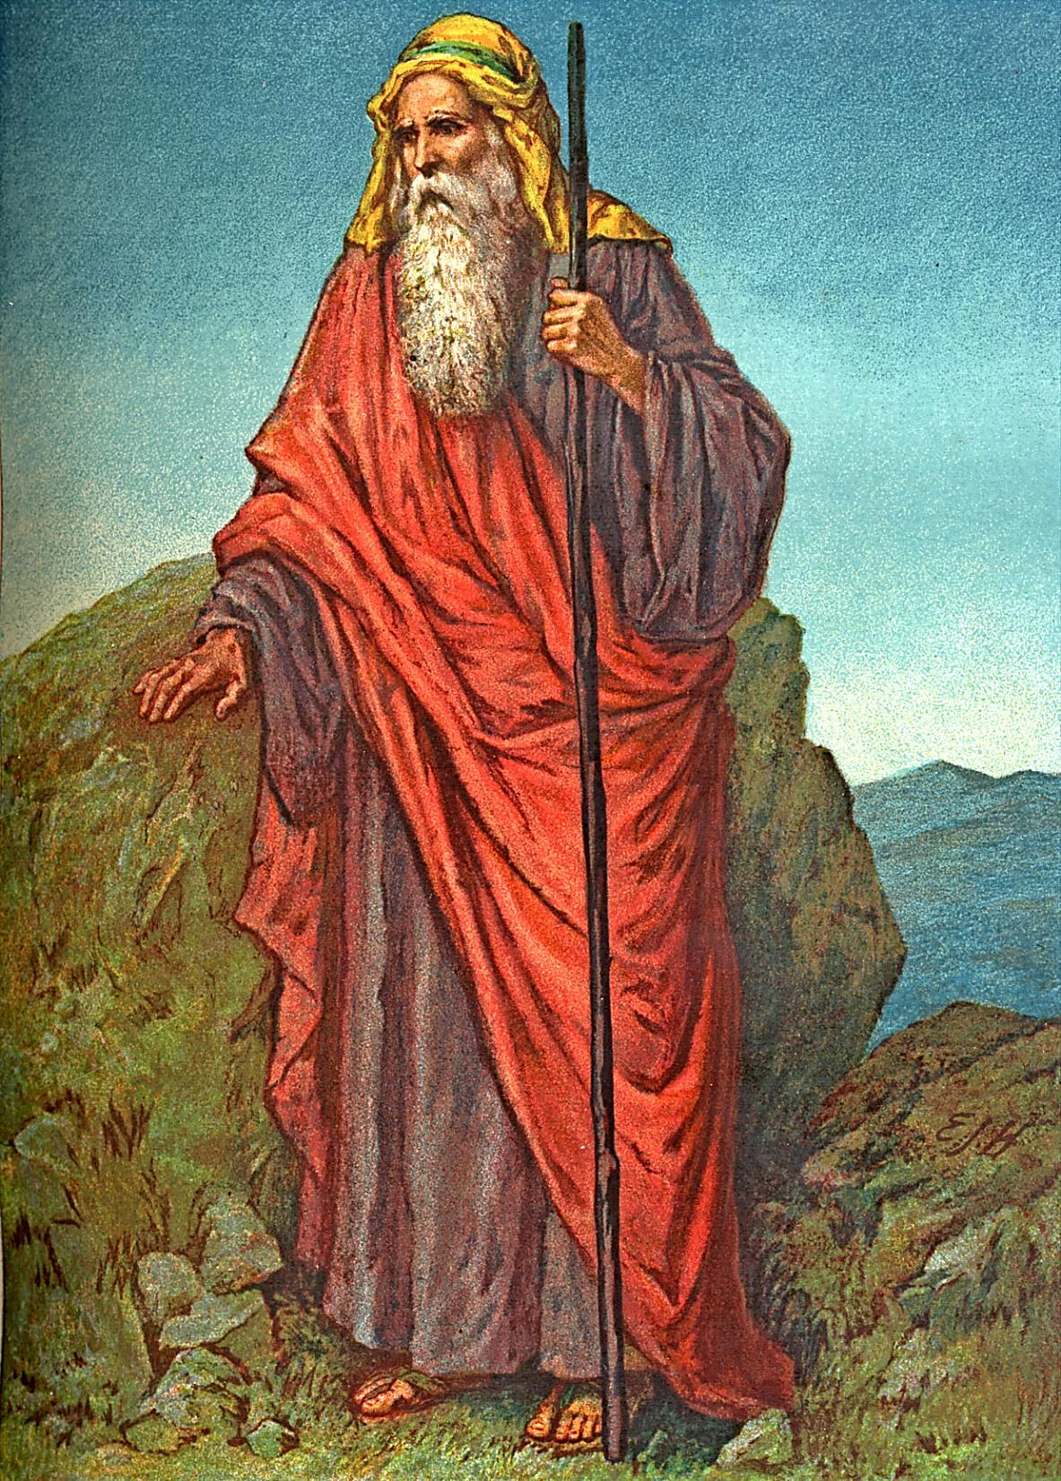
Numbers 14
“¹³And Moses said unto the LORD,
Then the Egyptians shall hear it, (for thou broughtest up this people in thy might from among them;) ¹⁴And they will tell it to the inhabitants of this land: for they have heard that thou LORD art among this people, that thou LORD art seen face to face, and that thy cloud standeth over them, and that thou goest before them, by day time in a pillar of a cloud, and in a pillar of fire by night.”
Numbers 14
“¹¹And the LORD said unto Moses,
How long will this people provoke me? and how long will it be ere they believe me, for all the signs which I have shewed among them? ¹²I will smite them with the pestilence, and disinherit them, and will make of thee a greater nation and mightier than they.”

Slide 21
Within the sight of Canaan they turned back. The people were so afraid they would have killed Moses if God had not intervened. For them this opportunity never returned. Only Caleb and Joshua of the 600,000 men over 20 years old lived to enter the Promise Land.
After one year at Mount Sinai, the Israelites journeyed to the Promised Land by way of Kadesh-barnea. Afraid to enter Canaan, they turned back and wandered in the wilderness until that generation died.
Moses had planned to go directly from Sinai to Canaan. Kadesh-barnea was only 150 miles north of Sinai and 50 miles south of Beersheba, the southern gateway to Canaan. But, the spies brought a discouraging report, and the people refused to go forward.

Slide 22
Are we like the Israelites and focus on the Negative in the world?
Or do we focus on THE ONE THAT CREATED THE WORLD?

Slide 23
JOSHUA Chapter 1
1 Now after the death of Moses the servant of the LORD it came to pass, that the LORD spake unto Joshua the son of Nun, Moses’ minister, saying,
2 Moses my servant is dead; now therefore arise, go over this Jordan, thou, and all this people, unto the land which I do give to them, even to the children of Israel.
Every place that the sole of your foot shall tread upon, that
have I given unto you, as I said unto Moses.
4 From the wilderness and this Lebanon even unto the great river, the river Euphrates, all the land of the Hittites, and unto the great sea toward the going down of the sun, shall be your coast.
5 There shall not any man be able to stand before thee all the days of thy life: as I was with Moses, so I will be with thee: I will not fail thee, nor forsake thee.
6 Be strong and of a good courage: for unto this people shalt thou divide for an inheritance the land, which I sware unto their fathers to give them.
7 Only be thou strong and very courageous, that thou mayest observe to do according to all the law, which Moses my servant commanded thee: turn not from it to the right hand or to the left, that thou mayest prosper whithersoever thou goest.
8 This book of the law shall not depart out of thy mouth; but thou shalt meditate therein day and night, that thou mayest observe to do according to all that is written therein: for then thou shalt make thy way prosperous, and then thou shalt have good success.
9 Have not I commanded thee? Be strong and of a good courage; be not afraid, neither be thou dismayed: for the LORD thy God is with thee whithersoever thou goest.
10 Then Joshua commanded the officers of the people, saying,
11 Pass through the host, and command the people, saying, Prepare you victuals; for within three days ye shall pass over this Jordan, to go in to possess the land, which the LORD your God giveth you to possess it.
12 And to the Reubenites, and to the Gadites, and to half the tribe of Manasseh, spake Joshua, saying,
13 Remember the word which Moses the servant of the LORD commanded you, saying, The LORD your God hath given you rest, and hath given you this land.
14 Your wives, your little ones, and your cattle, shall remain in the land which Moses gave you on this side Jordan; but ye shall pass before your brethren armed, all the mighty men of valour, and help them;
15 Until the LORD have given your brethren rest, as he hath given you, and they also have possessed the land which the LORD your God giveth them: then ye shall return unto the land of your possession, and enjoy it, which Moses the LORD’S servant gave you on this side Jordan toward the sunrising.
16 And they answered Joshua, saying, All that thou commandest us we will do, and whithersoever thou sendest us, we will go.
17 According as we hearkened unto Moses in all things, so will we hearken unto thee: only the LORD thy God be with thee, as he was with Moses.
18 Whosoever he be that doth rebel against thy commandment, and will not hearken unto thy words in all that thou commandest him, he shall be put to death: only be strong and of a good courage.

Slide 24
Do we focus on sharing the gospel?
Or do we focus on the negative responses we might get?

Slide 25
"For what profit is it to a man if he gains the whole world, and loses his own soul?
Or what will a man give
in exchange for his soul?” Matthew 16:26

Slide 26
If we share the gospel, we never fail.
If we fail to share the gospel,
we fail.

Slide 27
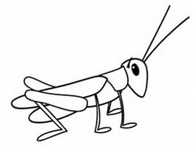
Numbers 13:33 "There we saw the giants (the descendants of Anak came from the giants); and we were like grasshoppers in our own sight, and so we were in their sight."
(NKJV)
“That will never work”

Slide 28
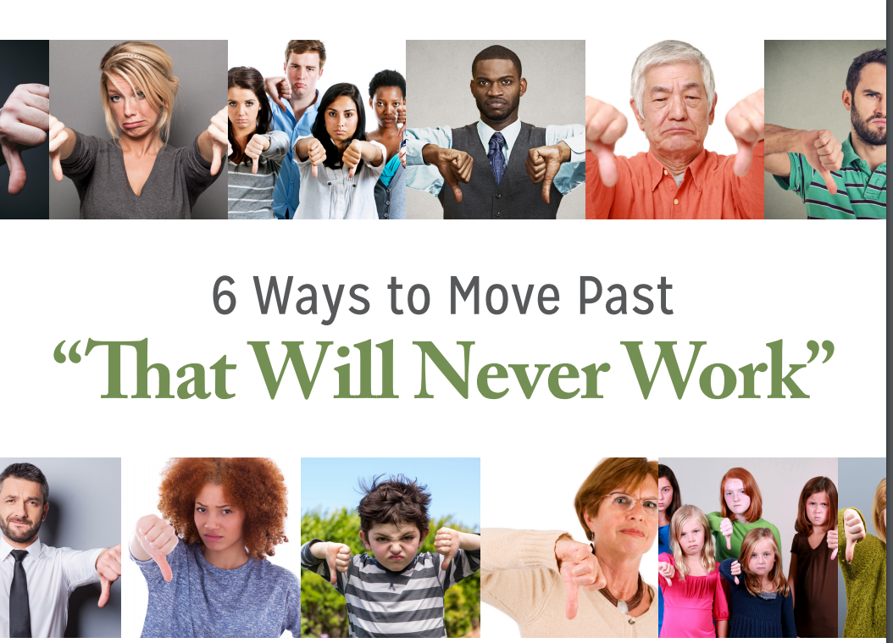
Numbers 13:30 Then Caleb quieted the people before Moses, and said, "Let us go up at once and take possession, for we are well able to overcome it."
Numbers 13:31 But the men who had gone up with him said, "We are not able to go up against the people, for they are stronger than we."

Slide 29

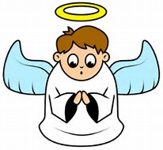
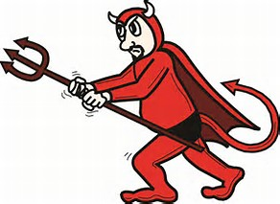
You will NEVER be able to do it.
You CAN do it.
Which voice
do we listen to?

Slide 30
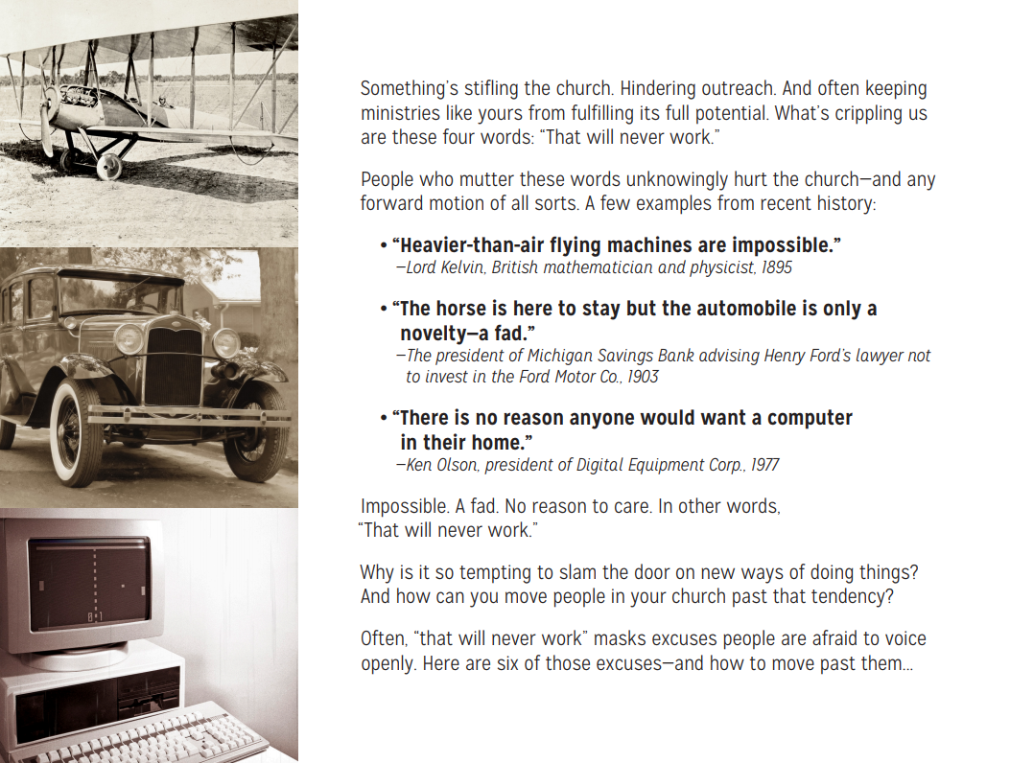

Slide 31
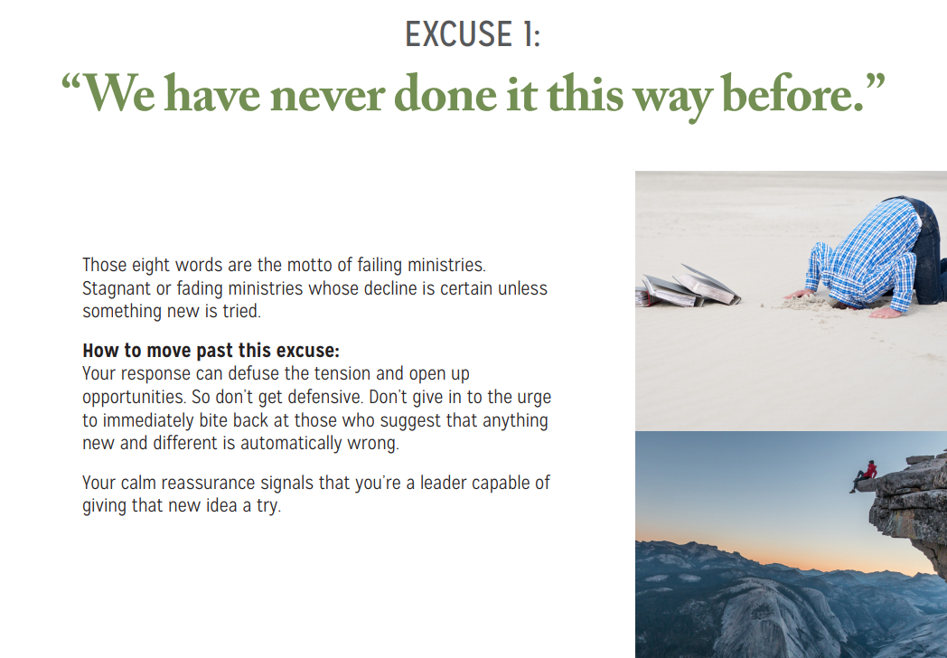
Do we evangelize exactly as they did in 1st century???
What then shall we say to these things? If God is for us, who can be against us? Romans 8:31
I can do all things through Christ who strengthens me. Philippians 4:13

Slide 32
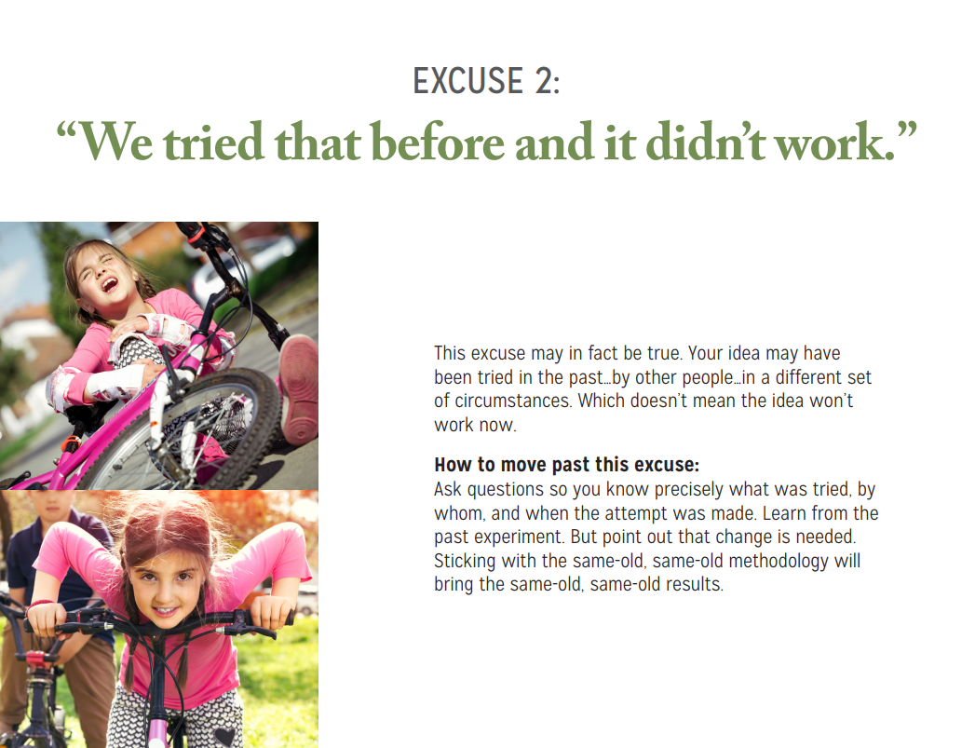
Luke 5:4 When He had stopped speaking, He said to Simon, "Launch out into the deep and let down your nets for a catch."
5 But Simon answered and said to Him, "Master, we have toiled all night and caught nothing; nevertheless at Your word I will let down the net."
6 And when they had done this, they caught a great number of fish, and their net was breaking.
And let us not grow weary while doing good, for in due season we shall reap if we do not lose heart. Galatians 6:9
And let us not grow weary while doing good, for in due season we shall reap if we do not lose heart.
Gal. 6:9
And let us not grow weary while doing good, for in due season we shall reap if we do not lose heart. Gal. 6:9

Slide 33
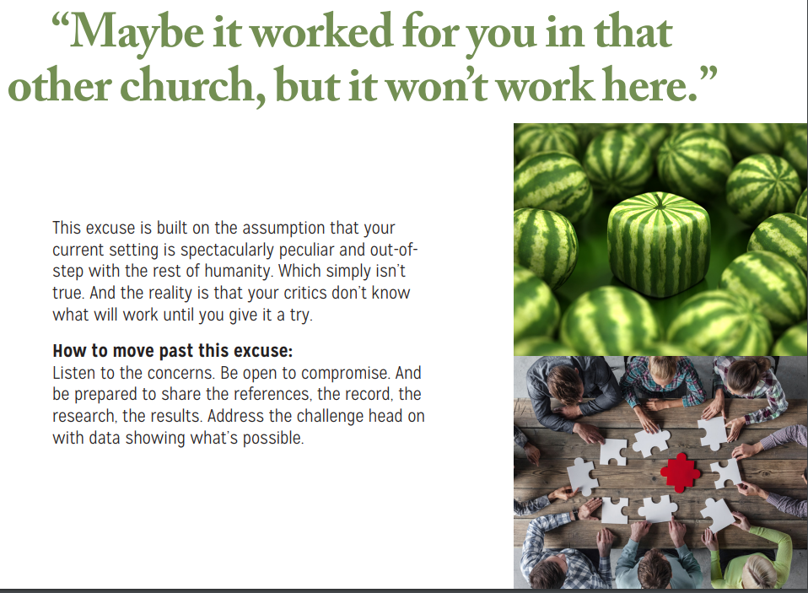
Hebrews 8:5 who serve the copy and shadow of the heavenly things, as Moses was divinely instructed when he was about to make the tabernacle. For He said, "See that you make all things according to the pattern shown you on the mountain."
Pattern – ark, tabernacle, temple, church

Slide 34
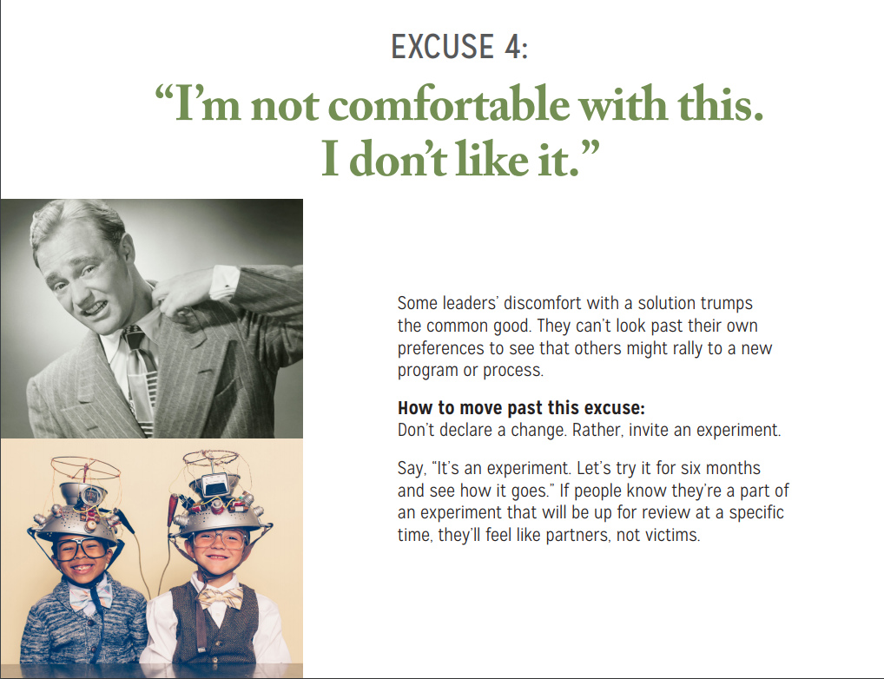
Numbers 14:3 "Why has the LORD brought us to this land to fall by the sword, that our wives and children should become victims? Would it not be better for us to return to Egypt?"
4 So they said to one another, "Let us select a leader and return to Egypt."

Slide 35
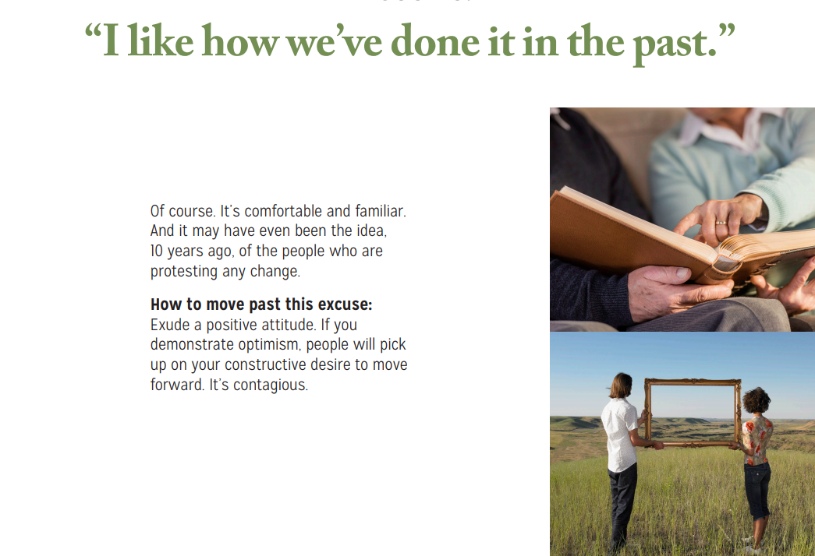
Numbers 14:1 So all the congregation lifted up their voices and cried, and the people wept that night.
2 And all the children of Israel complained against Moses and Aaron, and the whole congregation said to them, "If only we had died in the land of Egypt! Or if only we had died in this wilderness!
3 "Why has the LORD brought us to this land to fall by the sword, that our wives and children should become victims? Would it not be better for us to return to Egypt?"

Slide 36
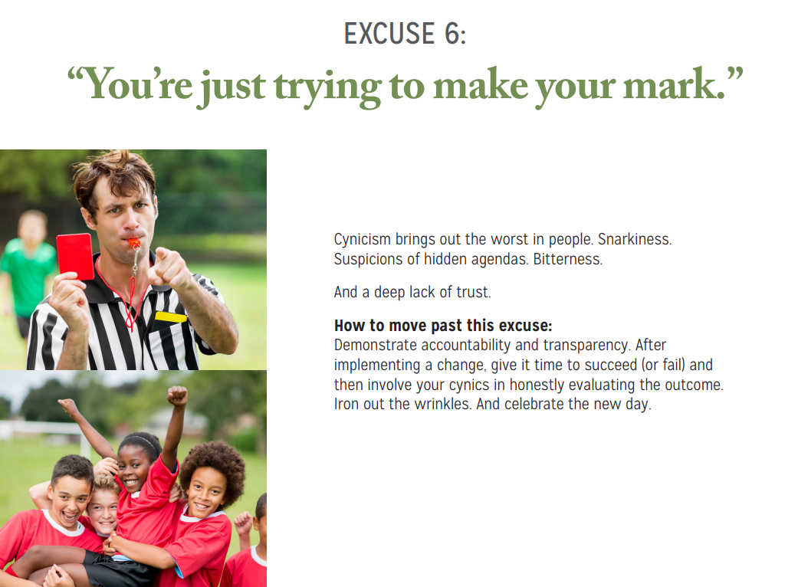
Numbers 14:4 So they said to one another, "Let us select a leader and return to Egypt.“
Nu 14:11 Then the LORD said to Moses: "How long will these people reject Me? And how long will they not believe Me, with all the signs which I have performed among them?
12 "I will strike them with the pestilence and disinherit them, and I will make of you a nation greater and mightier than they."

Slide 37

“Nobody is going to buy
cheap hamburgers.”

Slide 38
“Nobody is going to be interested in the gospel.”
So important:
Christ died for all men.
Christ told us to preach the gospel to every
creature.
Paul said (1Cor. 9:16) For if I preach the gospel, I have nothing to boast of, for necessity is laid upon me; yes, woe is me if I do not preach the gospel!

Slide 39
Negative people outnumber positive people.
The negative people did not enter the promise land- only the 2 positive people.
Today,
Negative people out number positive people.
Negative people will not enter heaven.
Are you positive or negative?

Slide 40
Are we like the Israelites and focus on the Negative in the world?
Or do we focus on THE ONE THAT CREATED THE WORLD?

Slide 41
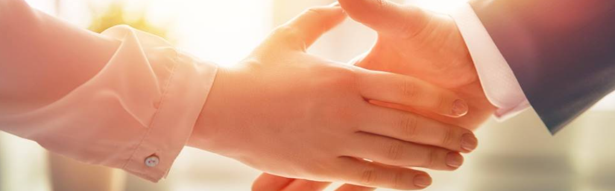
Questions?
Want to learn more about the Bible?
We will be glad to study the Bible with you.
New Lebanon
New Lebanon
Church of Christ
Church of Christ
New Lebanon, OH
newlebanoncoc.com
newlebanoncoc@gmail.com

