Slide 1
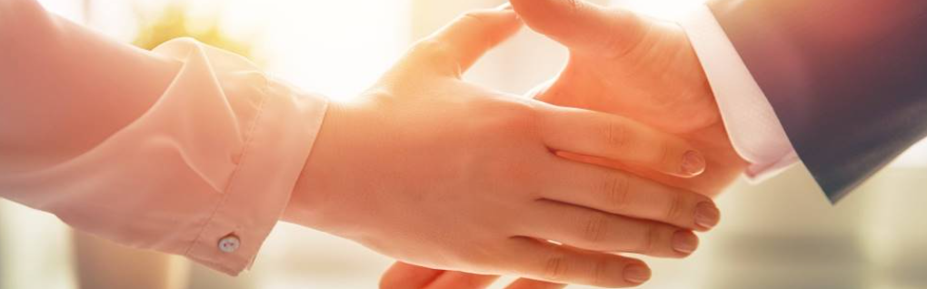
Welcome to our services
New Lebanon Church of Christ
We are Simply Christians.
Our Emphasis is Spiritual, Not Material or Social.
We are striving to be The Same Church as Described in The New Testament.
Please Come Back Again

Slide 2
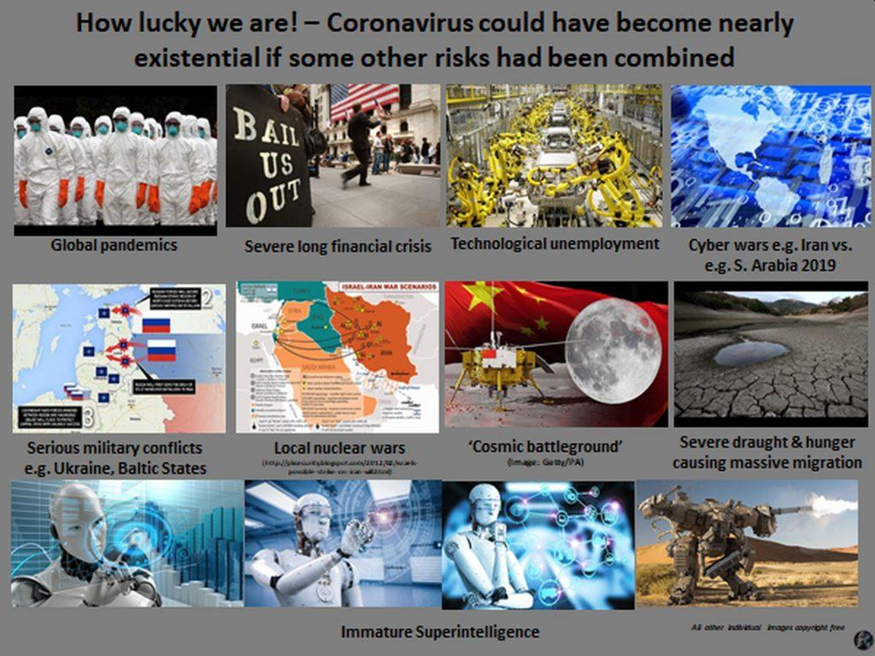

Slide 3

Existential Threats Tier List!
msn.com

Slide 4
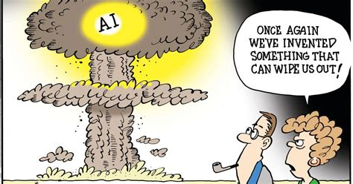
Editorial Cartoon: Existential threat | Opinion | dailyastorian.com
dailyastorian.com

Slide 5

What Are the Psychological Effects of Chronic Exposure to Existential ...
lifestyle.sustainability-directory.com

Slide 6

nbcsandiego.com

Slide 7

Food Crisis: Soaring Food Prices, Food Insecurity And Climate Change ...
dailytrust.com

Slide 8

Living In a World Of Constant
Emergencies.
Part Two
Stand on God’s Promises

Slide 9
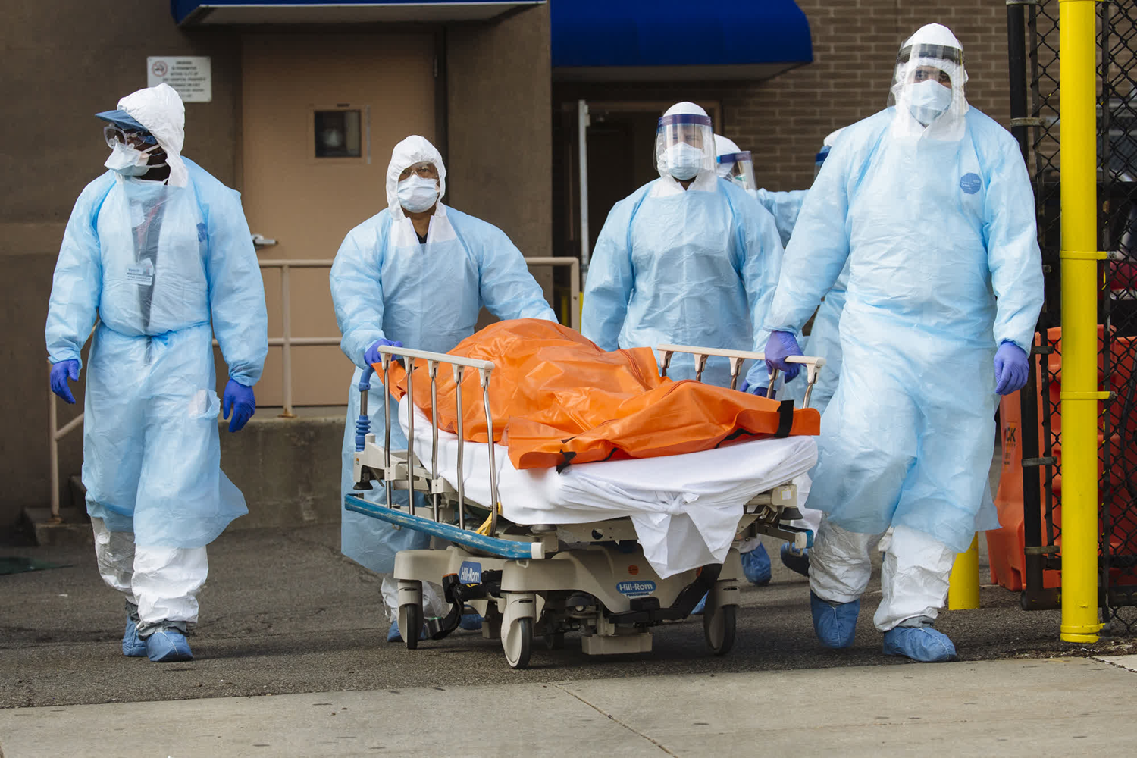
Stand On God’s Promises
Matt. 6:33 "But seek first the kingdom of God and His righteousness, and all these things shall be added to you.

Slide 10

Stand On God’s Promises
Romans 8:28 And we know that all things work together for good to those who love God, to those who are the called according to His purpose.

Slide 11
Stand On God’s Promises
Jeremiah 29:11 For I know the thoughts that I think toward you, says the LORD, thoughts of peace and not of evil, to give you a future and a hope.

Slide 12

Stand On God’s Promises
1 John 1:7 But if we walk in the light as He is in the light, we have fellowship with one another, and the blood of Jesus Christ His Son cleanses us from all sin.

Slide 13

Stand On God’s Promises
1 John 1:9 If we confess our sins, He is faithful and just to forgive us our sins and to cleanse us from all unrighteousness.

Slide 14
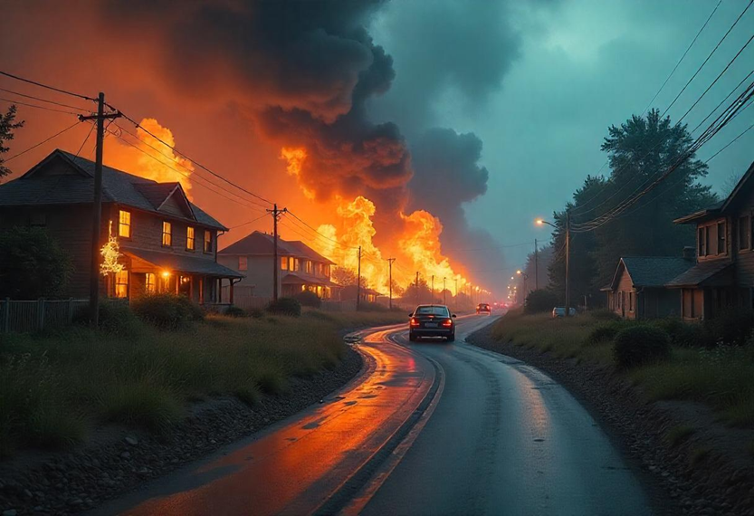
Stand On God’s Promises
Proverbs 3:5 Trust in the LORD with all your heart, And lean not on your own understanding;

Slide 15
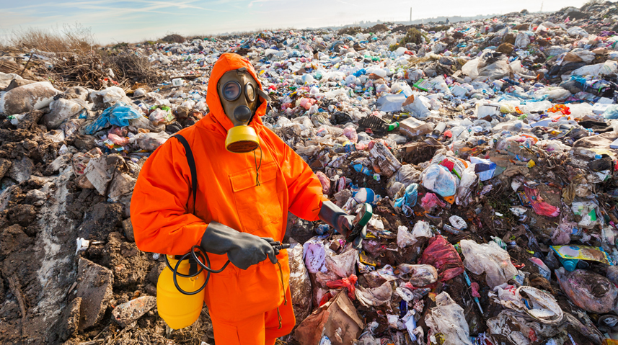
Stand On God’s Promises
Proverbs 3:6 In all your ways acknowledge Him, And He shall direct your paths.

Slide 16

Stand On God’s Promises
1 Cor. 10:13 No temptation has overtaken you except such as is common to man; but God is faithful, who will not allow you to be tempted beyond what you are able, but with the temptation will also make the way of escape, that you may be able to bear it.

Slide 17

Stand On God’s Promises
Psalm 55:22 Cast your burden on the LORD, And He shall sustain you; He shall never permit the righteous to be moved.

Slide 18

Stand On God’s Promises
1 Peter 5:7 casting all your care upon Him, for He cares for you.

Slide 19
Put Your Trust In God
Psalm 31:19 Oh, how great is Your goodness, Which You have laid up for those who fear You,
Which You have prepared for those who trust in You
In the presence of the sons of men!
newlebanoncoc.com

Slide 20
Questions?
Want to learn more about the Bible?
We will be glad to study the Bible with you.
New Lebanon
New Lebanon
Church of Christ
Church of Christ
New Lebanon, OH
newlebanoncoc.com
newlebanoncoc@gmail.com

