Slide 1
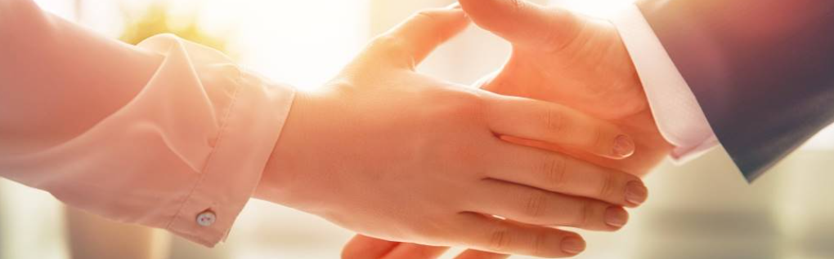
Welcome to our services
New Lebanon Church of Christ
We are Simply Christians.
Our Emphasis is Spiritual, Not Material or Social.
We are striving to be The Same Church as Described in The New Testament.
Please Come Back Again

Slide 2
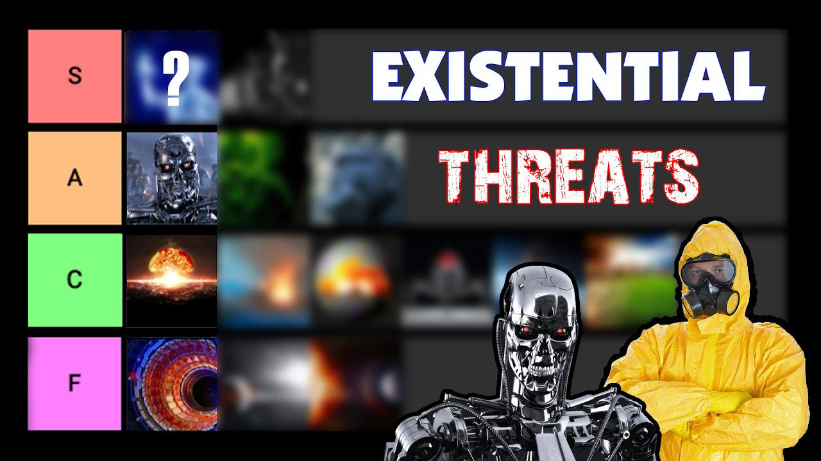
Existential Threats Tier List! msn.com

Slide 3
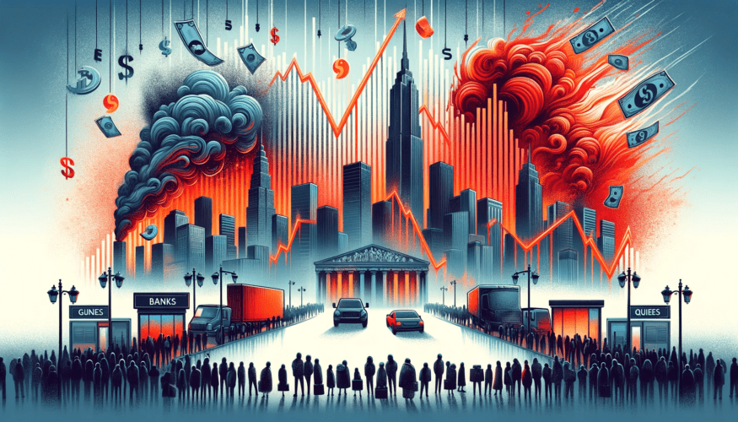
Understanding Economic Collapse: Causes and Indicators - MarketCollapse.com
marketcollapse.com

Slide 4

Day Of Economic Collapse: 10 Things To Do IMMEDIATELY | Recession - YouTube
youtube.com

Slide 5

Peter Schiff Warns of Looming US Dollar Crisis and Economic Collapse ... coinsurges.com

Slide 6

Food Crisis: Soaring Food Prices, Food Insecurity And Climate Change ...
dailytrust.com

Slide 7

Living In a World Of Constant
Emergencies.
Part One
Put Your Trust In God

Slide 8
Trust = confidence in God
Psalm 18:3
I will call upon the LORD, who is worthy to be praised; So shall I be saved from my enemies

Slide 9

Put Your Trust In God
1. Trust involves listening to God.

Slide 10

Put Your Trust In God
2. Trust involves leaning on God.

Slide 11

Put Your Trust In God
3. Trust involves lifting up God.

Slide 12
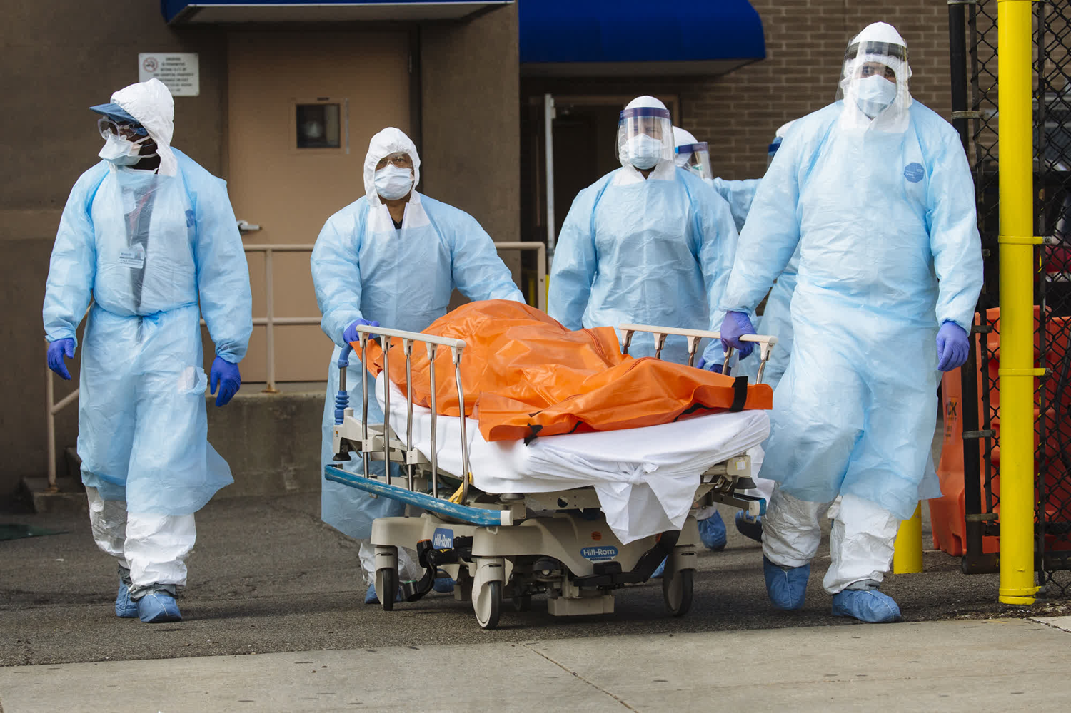
Put Your Trust In God
4. Trust involves looking forward to living with God.

Slide 13
Put Your Trust In God
Psalm 31:19 Oh, how great is Your goodness, Which You have laid up for those who fear You,
Which You have prepared for those who trust in You
In the presence of the sons of men!
newlebanoncoc.com

Slide 14
Put Your Trust In God
John 14:1-3 “Let not your heart be troubled; you believe in God, believe also in Me.
In My Father’s house are many mansions; if it were not so, I would have told you. I go to prepare a place for you.
And if I go and prepare a place for you, I will come again and receive you to Myself; that where I am, there you may be also”
newlebanoncoc.com

Slide 15
Questions?
Want to learn more about the Bible?
We will be glad to study the Bible with you.
New Lebanon
New Lebanon
Church of Christ
Church of Christ
New Lebanon, OH
newlebanoncoc.com
newlebanoncoc@gmail.com

