Slide 1
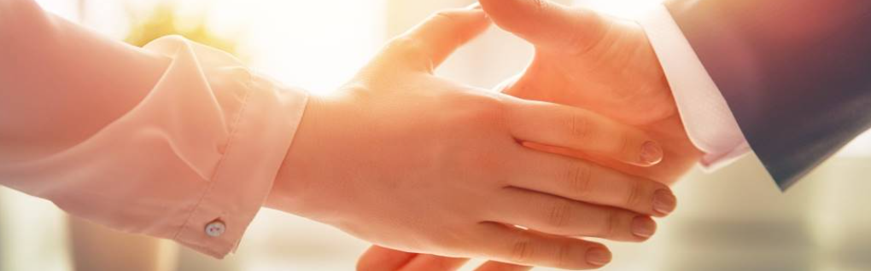
Welcome to our services
New Lebanon Church of Christ
We are Simply Christians.
Our Emphasis is Spiritual, Not Material or Social.
We are striving to be The Same Church as Described in The New Testament.
Please Come Back Again

Slide 2

Being Filled With The Fruits Of Righteousness
And this I pray, that your love may abound still more and more in knowledge and all discernment, that you may approve the things that are excellent, that you may be sincere and without offense till the day of Christ, 11 being filled with the fruits of righteousness which are by Jesus Christ, to the glory and praise of God.
Philippians 1:9-11
newlebanoncoc.com

Slide 3
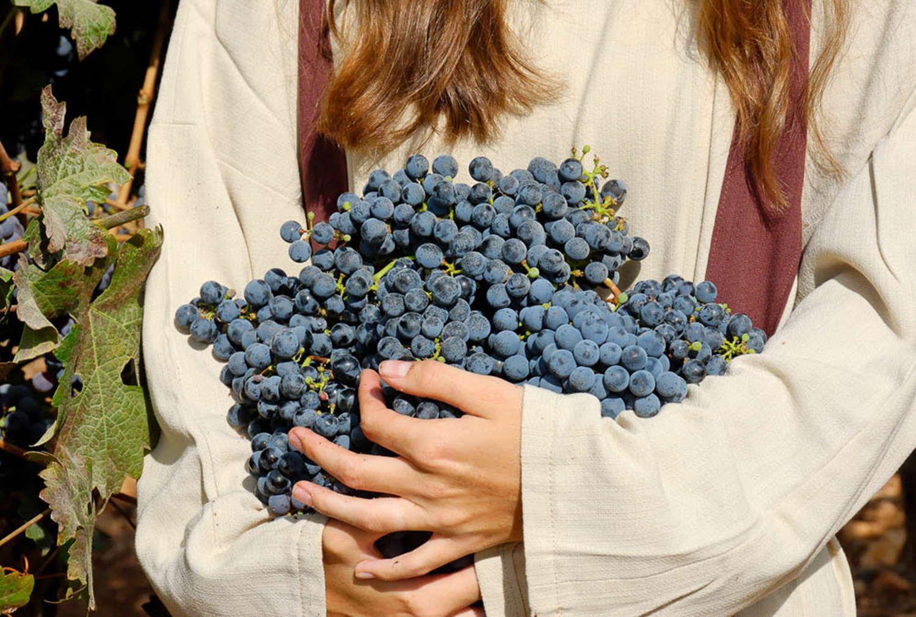
Being Filled With The Fruits Of Righteousness
Philippians 1:9-11
newlebanoncoc.com

Slide 4
Questions?
Want to learn more about the Bible?
We will be glad to study the Bible with you.
New Lebanon
New Lebanon
Church of Christ
Church of Christ
New Lebanon, OH
newlebanoncoc.com
newlebanoncoc@gmail.com

