Slide 1

Welcome to our services
New Lebanon Church of Christ
We are Simply Christians.
Our Emphasis is Spiritual, Not Material or Social.
We are striving to be The Same Church as Described in The New Testament.
Please Come Back Again

Slide 2

James 1:25-27 But he who looks into the perfect law of liberty and continues in it, and is not a forgetful hearer but a doer of the work, this one will be blessed in what he does.
If anyone among you thinks he is religious, and does not bridle his tongue but deceives his own heart, this one’s religion is useless.
Pure and undefiled religion before God and the Father is this: to visit orphans and widows in their trouble, and to keep oneself unspotted from the world.

Slide 3

A Religion Of The Heart
freepik.com
James 1:25-27

Slide 4
Acts 25:19 “but had some questions against him about their own religion and about a certain Jesus, who had died, whom Paul affirmed to be alive.
Acts 26:5 “They knew me from the first, if they were willing to testify, that according to the strictest sect of our religion I lived a Pharisee
Col 2:23 These things indeed have an appearance of wisdom in self-imposed religion, false humility, and neglect of the body, but are of no value against the indulgence of the flesh.

Slide 5
James 1:26 If anyone among you thinks he is religious, and does not bridle his tongue but deceives his own heart, this one's religion is useless.
James 1:27 Pure and undefiled religion before God and the Father is this: to visit orphans and widows in their trouble, and to keep oneself unspotted from the world.

Slide 6

In Acts 26:5 we find Paul speaking of the Pharisees religion
In Gal. 1:12- 14 twice he speaks of the Jews' religion
In James 1:26 he speaks of a vain religion
In James 1:27 he tells us plainly what pure and undefiled religion before God is

Slide 7
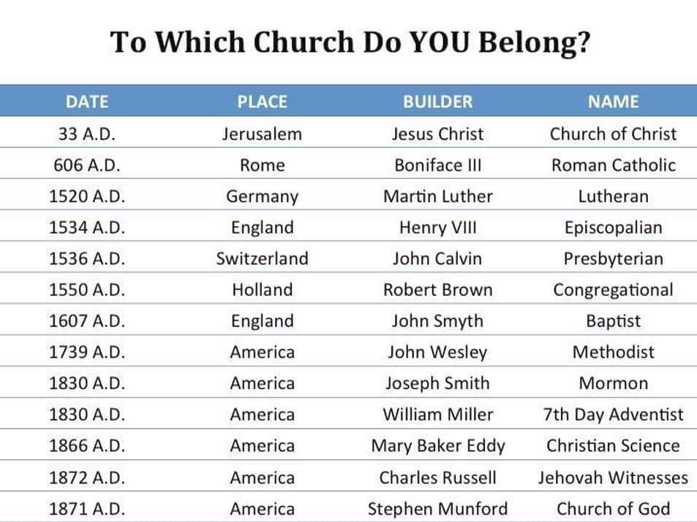
Acts 2:47 praising God and having favor with all the people. And the Lord added to the church daily those who were being saved.
These churches are too late to be the Lord’s church.
Which church were those in Acts 2:47 added to?

Slide 8
In Matt. 9:4 we are taught that man thinks with his heart.
2. In Matt. 13:15 we read that man understands with his heart.
3. In Rom. 10:10 man is said to believe with his heart.
4. Matt. 22:37 says man loves with all his heart.
5. In Rom. 6:17 man is said to obey from his heart a form of doctrine that makes him free from sin.

Slide 9
A Religion Of The Heart
Which heartfelt religion is right?

Slide 10
The Roman Road Of Salvation
(5) Rom. 3:23 for all have sinned and fall short of the glory of God,
(6) Rom. 6:23 For the wages of sin is death, but the gift of God is eternal life in Christ Jesus our Lord.
(7) Rom. 5:8 But God demonstrates His own love toward us, in that while we were still sinners, Christ died for us.
(8) Rom. 10:9 that if you confess with your mouth the Lord Jesus and believe in your heart that God has raised Him from the dead, you will be saved.
(9) Rom.10:10 For with the heart one believes unto righteousness, and with the mouth confession is made unto salvation.

Slide 11
A Religion Of The Heart
Which heartfelt religion is right?

Slide 12
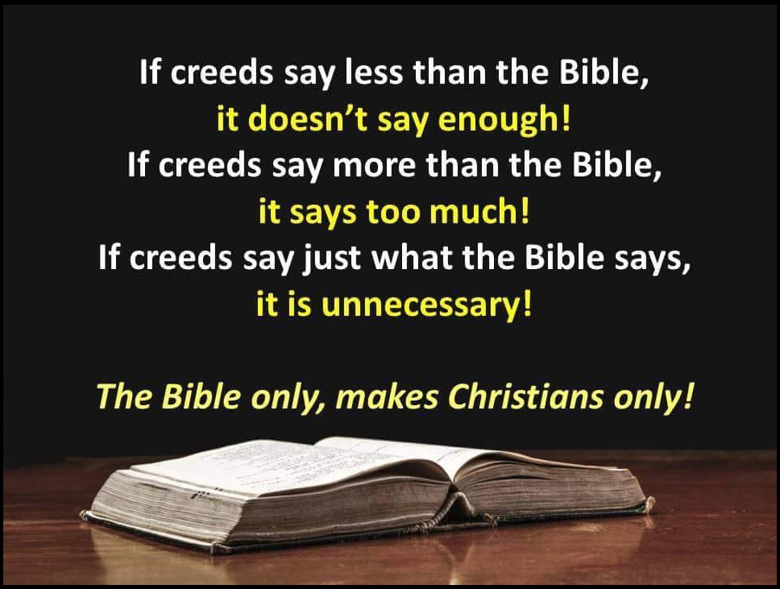

Slide 13
Questions?
Want to learn more about the Bible?
We will be glad to study the Bible with you.
New Lebanon
New Lebanon
Church of Christ
Church of Christ
New Lebanon, OH
newlebanoncoc.com
newlebanoncoc@gmail.com

