Slide 1

Welcome to our services
New Lebanon Church of Christ
We are Simply Christians.
Our Emphasis is Spiritual, Not Material or Social.
We are striving to be The Same Church as Described in The New Testament.
Please Come Back Again

Slide 2
Rejoice In The Lord. Psalm 33:1-15
Psalm 33:1 Rejoice in the LORD, O you righteous! For praise from the upright is beautiful. 2 Praise the LORD with the harp; Make melody to Him with an instrument of ten strings.
3 Sing to Him a new song; Play skillfully with a shout of joy. 4 For the word of the LORD is right, And all His work is done in truth.
5 He loves righteousness and justice; The earth is full of the goodness of the LORD. 6 By the word of the LORD the heavens were made, And all the host of them by the breath of His mouth.
7 He gathers the waters of the sea together as a heap; He lays up the deep in storehouses.8 Let all the earth fear the LORD; Let all the inhabitants of the world stand in awe of Him.
newlebanoncoc.com

Slide 3
Rejoice In The Lord. Psalm 33:1-15
Psalm 33:9 For He spoke, and it was done; He commanded, and it stood fast. 10 The LORD brings the counsel of the nations to nothing; He makes the plans of the peoples of no effect.
11 The counsel of the LORD stands forever, The plans of His heart to all generations. 12 Blessed is the nation whose God is the LORD, The people He has chosen as His own inheritance.
13 The LORD looks from heaven; He sees all the sons of men.
14 From the place of His dwelling He looks On all the inhabitants of the earth; 15 He fashions their hearts individually; He considers all their works.
newlebanoncoc.com

Slide 4
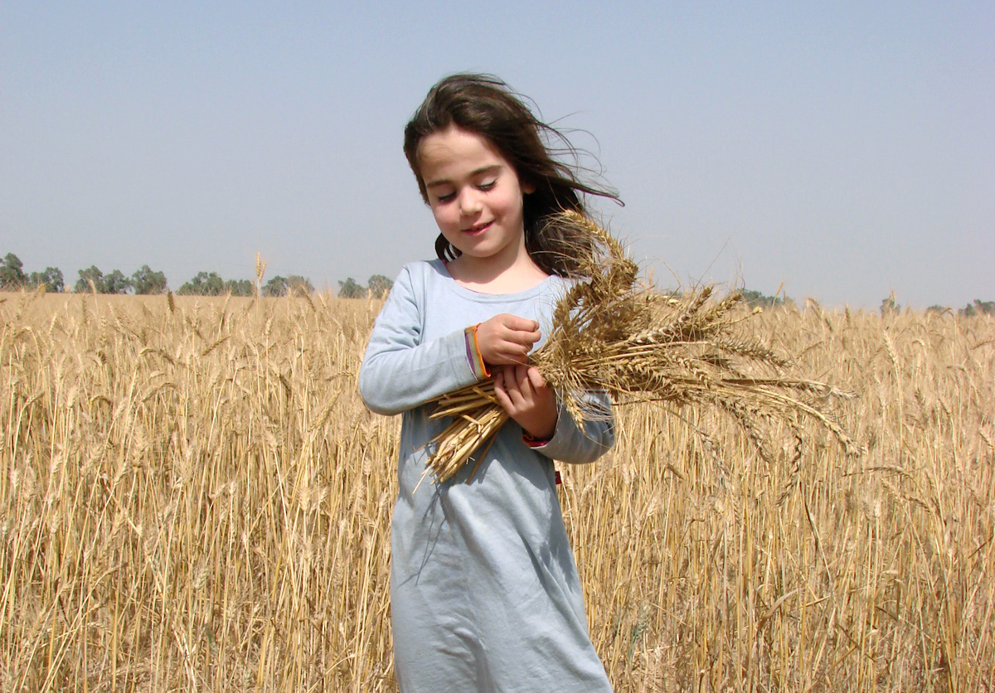
Rejoice In The Lord
BiblePlaces.com
Psalm 33:1-15

Slide 5

Rejoice In The Lord. Psalm 33:1-15
Why should we shout for joy and rejoice in the Lord?
1. Because of His WORD.
Psalm 33:4 For the word of the LORD is right
newlebanoncoc.com

Slide 6
Rejoice In The Lord. Psalm 33:1-15
Why should we shout for joy and rejoice in the Lord?
2. Because of His WORKS.
Psalm 33:4 For the word of the LORD is right, And all His work is done in truth.
newlebanoncoc.com

Slide 7
Rejoice In The Lord. Psalm 33:1-15
Why should we shout for joy and rejoice in the Lord?
3. Because of His LOVINGKINDNESS.
Psalm 33:5 He loves righteousness and justice; The earth is full of the goodness of the LORD.
newlebanoncoc.com

Slide 8
Rejoice In The Lord. Psalm 33:1-15
Why should we shout for joy and rejoice in the Lord?
4. Because of His POWER.
Psalm 33:8 Let all the earth fear the LORD; Let all the inhabitants of the world stand in awe of Him. 9 For He spoke, and it was done; He commanded, and it stood fast.
newlebanoncoc.com

Slide 9
Rejoice In The Lord. Psalm 33:1-15
Why should we shout for joy and rejoice in the Lord?
5. Because of His KNOWLEDGE.
Psalm 33:10 The LORD brings the counsel of the nations to nothing; He makes the plans of the peoples of no effect.
newlebanoncoc.com

Slide 10
Rejoice In The Lord. Psalm 33:1-15
Why should we shout for joy and rejoice in the Lord?
6. Because of His FAITHFULNESS.
Psalm 33:11 The counsel of the LORD stands forever, The plans of His heart to all generations.
newlebanoncoc.com

Slide 11
Rejoice In The Lord. Psalm 33:1-15
Why should we shout for joy and rejoice in the Lord?
7. Because of His GRACE.
Psalm 33:12 Blessed is the nation whose God is the LORD, The people He has chosen as His own inheritance.
newlebanoncoc.com

Slide 12
Rejoice In The Lord. Psalm 33:1-15
Why should we shout for joy and rejoice in the Lord?
Psalms 33:15 He fashions their hearts individually; He considers all their works.

Slide 13
Questions?
Want to learn more about the Bible?
We will be glad to study the Bible with you.
New Lebanon
New Lebanon
Church of Christ
Church of Christ
New Lebanon, OH
newlebanoncoc.com
newlebanoncoc@gmail.com

