Slide 1
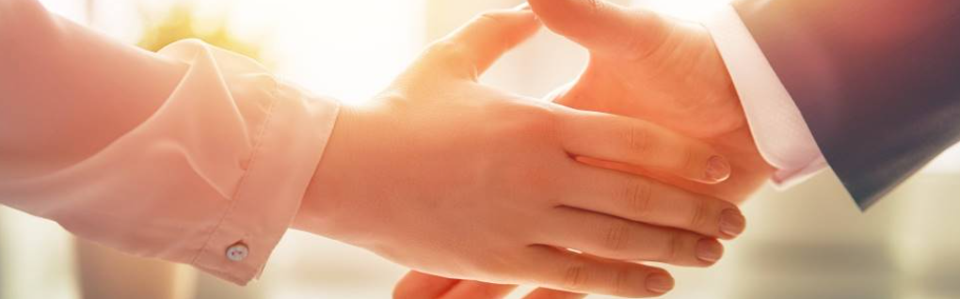
Welcome to our services
New Lebanon Church of Christ
We are Simply Christians.
Our Emphasis is Spiritual, Not Material or Social.
We are striving to be The Same Church as Described in The New Testament.
Please Come Back Again

Slide 2
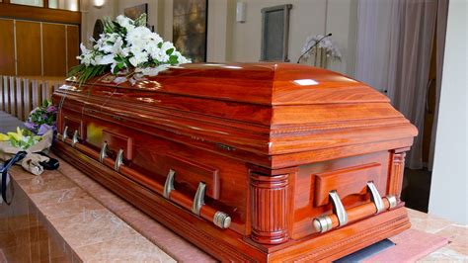
Mortify The Flesh - Colossians 3:5
Col.3:5 Therefore put to death your members which are on the earth: fornication, uncleanness, passion, evil desire, and covetousness, which is idolatry.

Slide 3
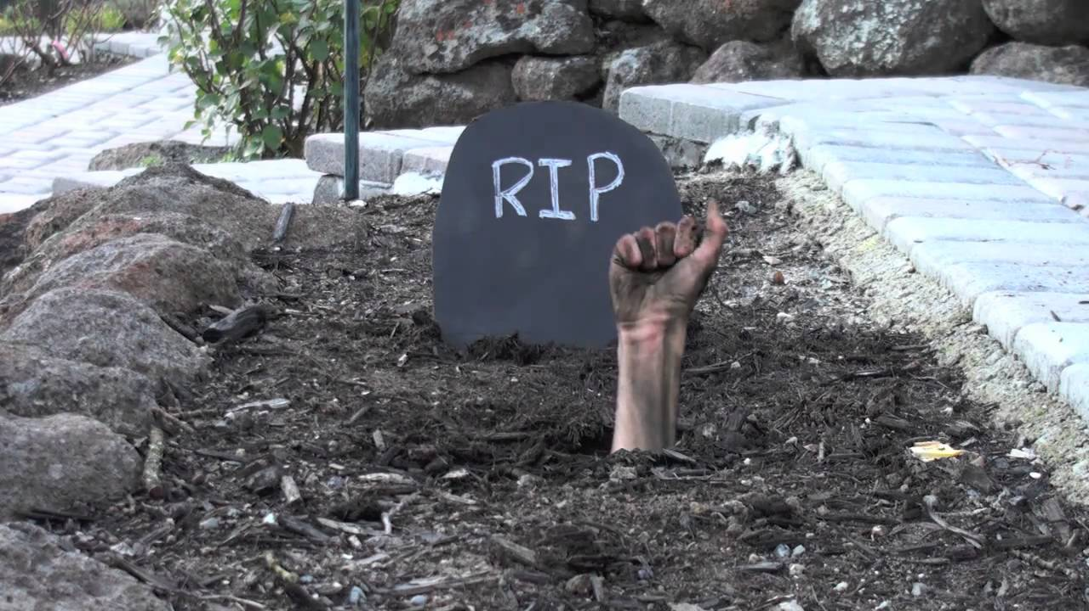
ar.inspiredpencil.com

Slide 4
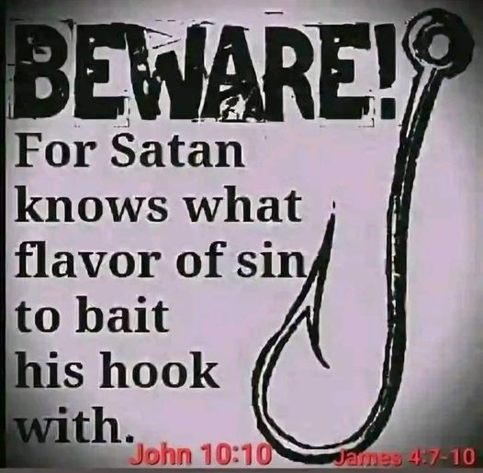

Slide 5
Mortify The Flesh - Colossians 3:5
Col.2:20 Therefore, if you died with Christ from the basic principles of the world, why, as though living in the world, do you subject yourselves to regulations--
21 "Do not touch, do not taste, do not handle,“ 22 which all concern things which perish with the using—
according to the commandments and doctrines of men? 23 These things indeed have an appearance of wisdom in self-imposed religion, false humility, and neglect of the body, but are of no value against the indulgence of the flesh.

Slide 6
Mortify The Flesh - Colossians 3:5
We are united to the risen Christ by faith. We no longer belong to this world and the rules it plays by—we belong to Christ and the age to come.
In order to have the power to fight lust,
Lust of eyes, lust of flesh, pride of life
we first have to understand this: we no longer belong to sin.

Slide 7
Mortify The Flesh - Colossians 3:5
1. Fighting Sin Is About Fighting For Our New Desires

Slide 8
Mortify The Flesh - Colossians 3:5
Col.3:1 If then you were raised with Christ, seek those things which are above, where Christ is, sitting at the right hand of God.
2 Set your mind on things above, not on things on the earth.

Slide 9
Mortify The Flesh - Colossians 3:5
1. Fighting Sin Is About Fighting For Our New Desires
2. Fighting Sin Is Sustained by Relationships that Remind Us of Our New Identity

Slide 10
Mortify The Flesh - Colossians 3:5
1. Fighting Sin Is About Fighting For Our New Desires
2. Fighting Sin Is Sustained by Relationships that Remind Us of Our New Identity
3. We cannot be a servant to sin and be a servant to Christ.

Slide 11
Mortify The Flesh - Colossians 3:5
Paul’s shows everyone’s sinful condition is a kind of slavery. Not just the so-called sickos and the junkies who experience enslaving compulsions. It is everyone.
As Paul explains in Romans 6, when our master is sin, we “obey its passions” (Rom.6:12). Therefore do not let sin reign in your mortal body, that you should obey it in its lusts.
The word “passions” here means more than a desire or a drive; it means over-desire or overdrive. The word is not so much about desires for evil things as it is an inordinate desire for good things.

Slide 12
Mortify The Flesh - Colossians 3:5
The reason our idols rule us is because of the power we’ve given them to define us.
Our idols make us feel good about ourselves,
make us feel secure, and we get hooked on the affirmation, the power, and the comfort.

Slide 13
Mortify The Flesh - Colossians 3:5
Rom. 8:18 For I consider that the sufferings of this present time are not worthy to be compared with the glory which shall be revealed in us.19 For the earnest expectation of the creation eagerly waits for the revealing of the sons of God.
20 For the creation was subjected to futility, not willingly, but because of Him who subjected it in hope;21 because the creation itself also will be delivered from the bondage of corruption into the glorious liberty of the children of God.
22 For we know that the whole creation groans and labors with birth pangs together until now.23 Not only that, but we also who have the firstfruits of the Spirit, even we ourselves groan within ourselves, eagerly waiting for the adoption, the redemption of our body.

Slide 14
Mortify The Flesh - Colossians 3:5
Jesus was born into a world of sin and experienced all the temptations we face, all the limitations of living in a body subject to weakness and death.
He then experienced the ultimate price of sin by dying for our sins on the cross. He experienced all of this without giving into sin Himself.

Slide 15
Mortify The Flesh - Colossians 3:5
1. Fighting Sin Is About Fighting For Our New Desires
2. Fighting Sin Is Sustained by Relationships that Remind Us of Our New Identity
3. We cannot be a servant to sin and be a servant to Christ.
4. Remember Your marriage with Christ

Slide 16
Mortify The Flesh - Colossians 3:5
We have been “united with Him” (Rom. 6:5), Paul says. “the Spirit of Christ dwells in us” (8:9).
The Spirit who raised Jesus from the dead is in us, giving life to our mortal bodies (8:11). Not miraculously but through the POWER of the WORD.
Rom. 8:11 But if the Spirit of Him who raised Jesus from the dead dwells in you, He who raised Christ from the dead will also give life to your mortal bodies through His Spirit who dwells in you.

Slide 17
Mortify The Flesh - Colossians 3:5
1. Fighting Sin Is About Fighting For Our New Desires
2. Fighting Sin Is Sustained by Relationships that Remind Us of Our New Identity
3. We cannot be a servant to sin and be a servant to Christ.
4. Remember Your marriage with Christ
5. Our relationship to our old master, Sin, is profoundly severed because the Spirit of the living Christ is in us.

Slide 18
Mortify The Flesh - Colossians 3:5
We must consider and reconsider and reconsider again— every single day— that we are new creatures (2 Cor. 5:17).

Slide 19
Mortify The Flesh - Colossians 3:5
1. Fighting Sin Is About Fighting For Our New Desires
2. Fighting Sin Is Sustained by Relationships that Remind Us of Our New Identity
3. We cannot be a servant to sin and be a servant to Christ.
4. Remember Your marriage with Christ
5. Our relationship to our old master, Sin, is profoundly severed because the Spirit of the living Christ is in us.
6. Make Each Part of Your Body a Weapon for Holiness

Slide 20
Mortify The Flesh - Colossians 3:5
“Let not sin therefore reign in your mortal body, to make you obey its passions. Do not present your members to sin as instruments for unrighteousness,
but present yourselves to God as those who have been brought from death to life, and your members to God as instruments for righteousness” (Rom. 6:12-13)

Slide 21
Mortify The Flesh - Colossians 3:5
1. Fighting Sin Is About Fighting For Our New Desires
2. Fighting Sin Is Sustained by Relationships that Remind Us of Our New Identity
3. We cannot be a servant to sin and be a servant to Christ.
4. Remember Your marriage with Christ
5. Our relationship to our old master, Sin, is profoundly severed because the Spirit of the living Christ is in us.
6. Make Each Part of Your Body a Weapon for Holiness
7. We Can Fight Sin Because We Are Changed By Love

Slide 22
Mortify The Flesh - Colossians 3:5
Eph.3:18 may be able to comprehend with all the saints what is the width and length and depth and height—
19 to know the love of Christ which passes knowledge; that you may be filled with all the fullness of God.
Eph.5:25 Husbands, love your wives, just as Christ also loved the church and gave Himself for her,

Slide 23
Mortify The Flesh - Colossians 3:5
abstinence
trigger
repentance
guilt
tempting
thoughts
defeated
thoughts
indulgence

Slide 24
Mortify The Flesh - Colossians 3:5
abstinence
trigger
repentance
guilt
tempting
thoughts
defeated
thoughts
indulgence

Slide 25
Mortify The Flesh - Colossians 3:5
Sin no longer needs to enslave us
because our old ruling desires no longer define us.
We have been given a new identity in Christ.

Slide 26
Questions?
Want to learn more about the Bible?
We will be glad to study the Bible with you.
New Lebanon
New Lebanon
Church of Christ
Church of Christ
New Lebanon, OH
newlebanoncoc.com
newlebanoncoc@gmail.com

