Slide 1
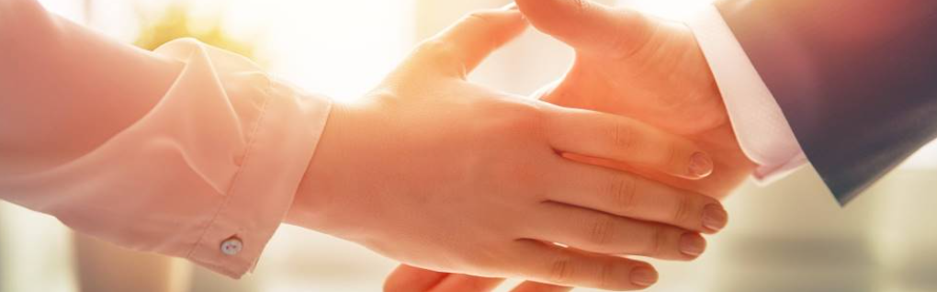
Welcome to our services
New Lebanon Church of Christ
We are Simply Christians.
Our Emphasis is Spiritual, Not Material or Social.
We are striving to be The Same Church as Described in The New Testament.
Please Come Back Again

Slide 2
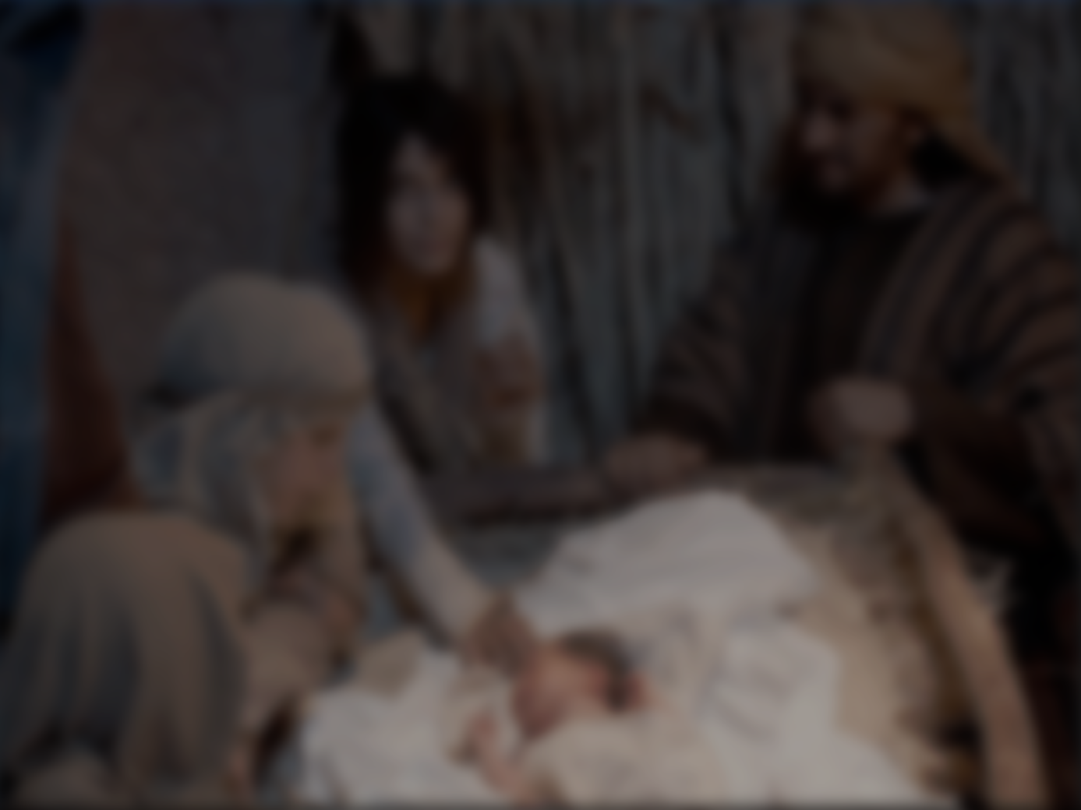
Luke 6:46 “But why do you call Me ‘Lord, Lord,’ and not do the things which I say? 47 Whoever comes to Me, and hears My sayings and does them, I will show you whom he is like: 48 He is like a man building a house, who dug deep and laid the foundation on the rock. And when the flood arose, the stream beat vehemently against that house, and could not shake it, for it was founded on the rock.
49 But he who heard and did nothing is like a man who built a house on the earth without a foundation, against which the stream beat vehemently; and immediately it fell. And the ruin of that house was great.”

Slide 3
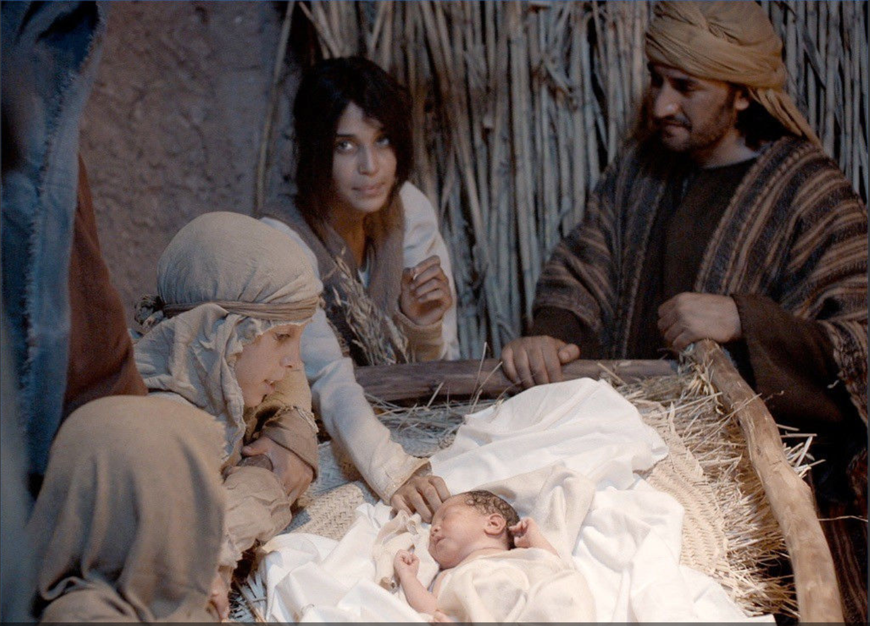
What Did Jesus Teach
About Worshipping Him
On His Birthday?
1

Slide 4
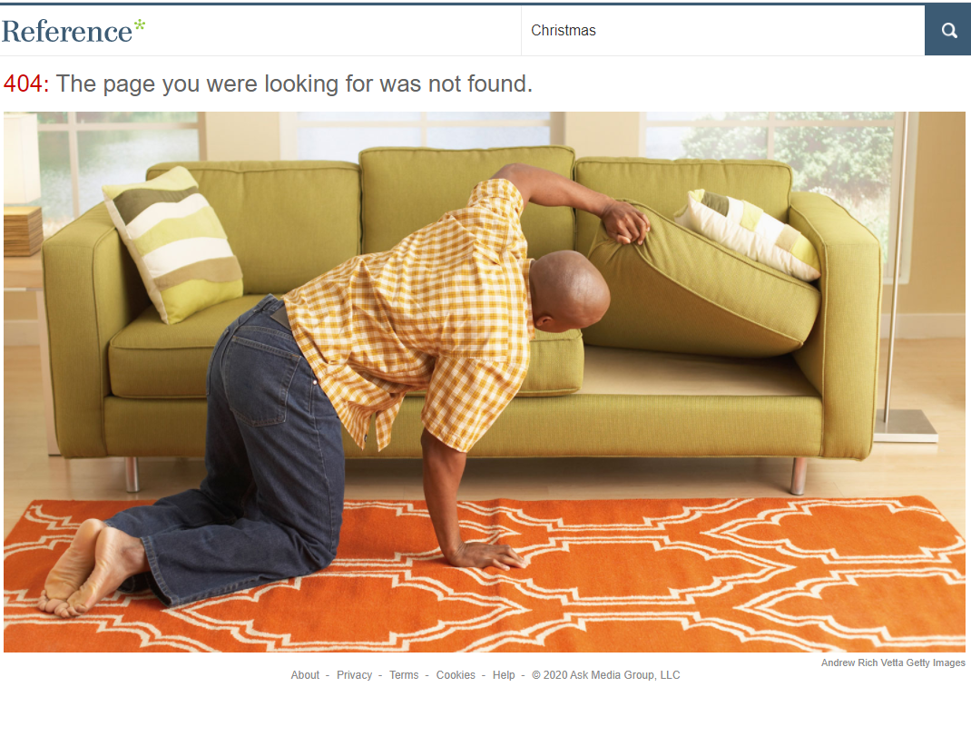
2

Slide 5
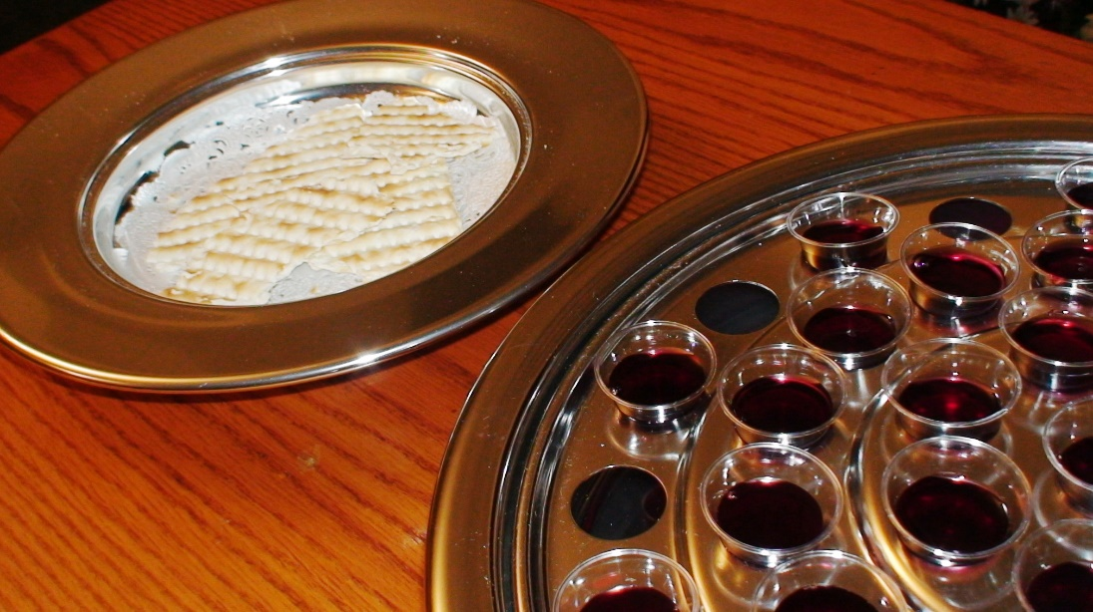
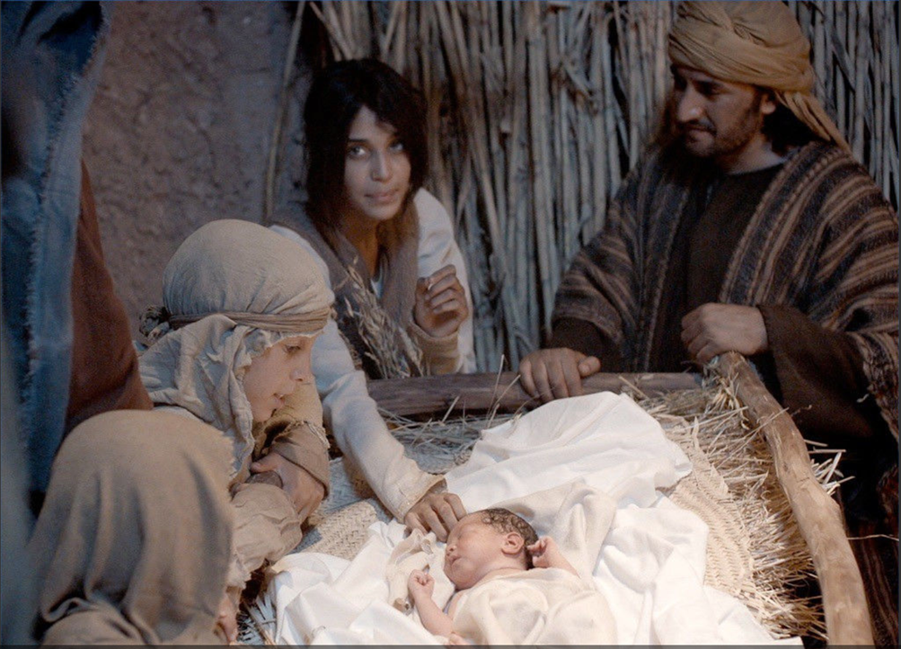
The Bible Tells Us To Celebrate
His death.
1st Corinthians 11:18-34
Not His Birth.
3

Slide 6
Malachi 1:6
"A son honors his father, And a servant his master.
If then I am the Father, Where is My honor?
And if I am a Master, Where is My reverence?
Says the LORD of hosts
4

Slide 7
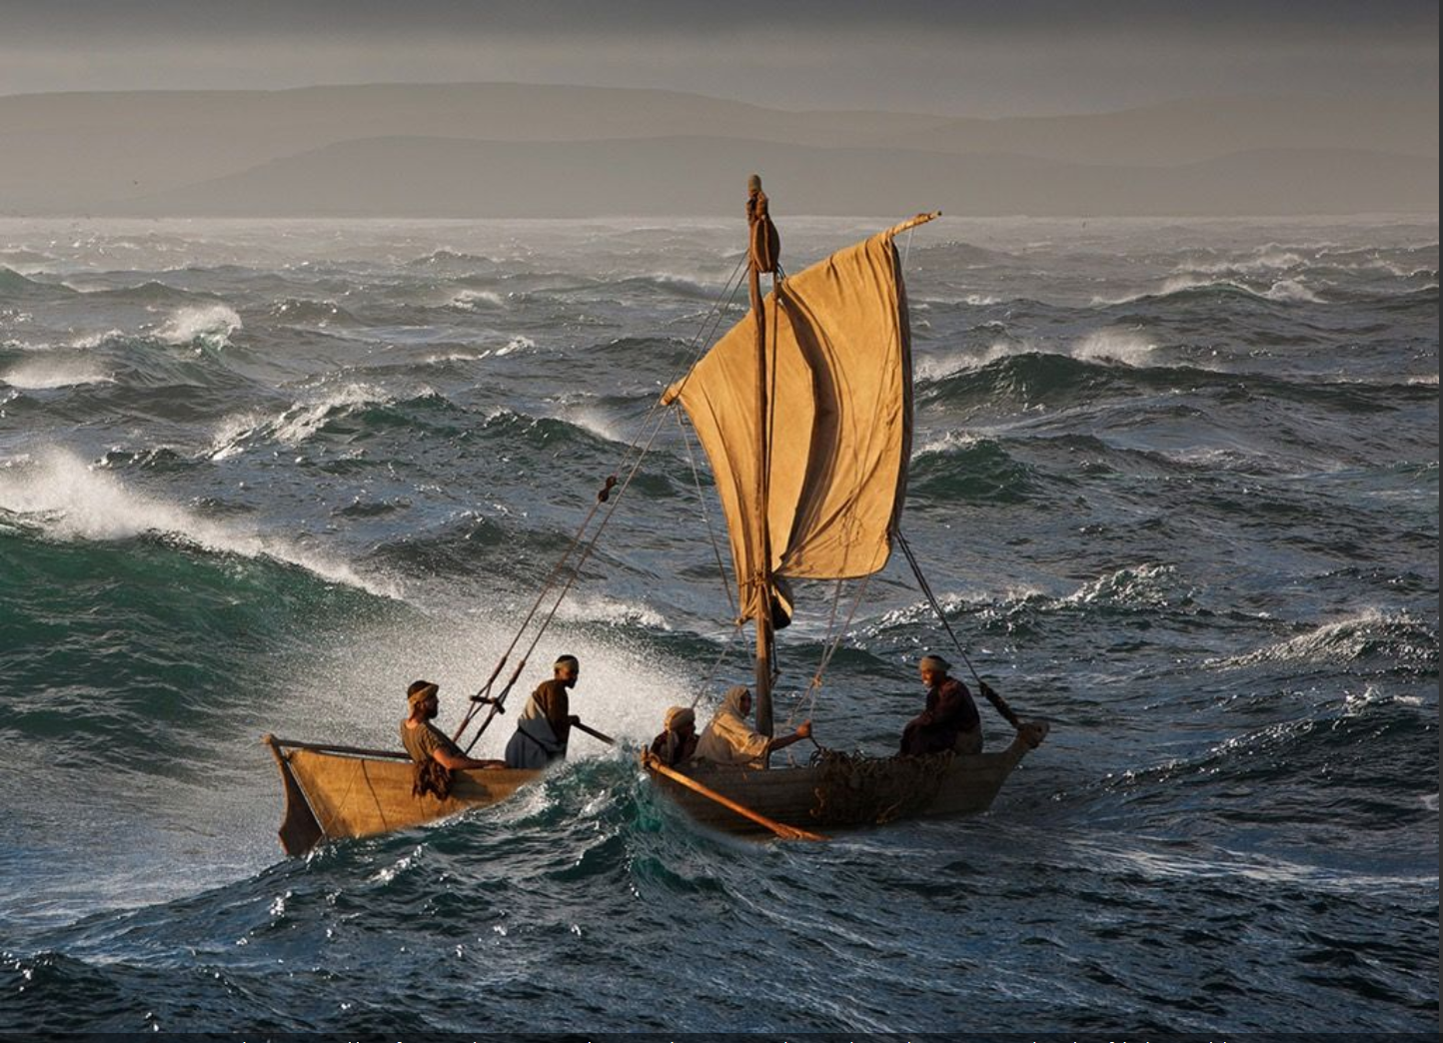
Most people like baby Jesus as their
Savior
But not as their
Lord
5

Slide 8
2 Peter 1:11 for so an entrance will be supplied to you abundantly into the everlasting kingdom of our Lord and Savior Jesus Christ.
2 Peter 2:20 For if, after they have escaped the pollutions of the world through the knowledge of the Lord and Savior Jesus Christ, they are again entangled in them and overcome, the latter end is worse for them than the beginning.
2 Peter 3:2 that you may be mindful of the words which were spoken before by the holy prophets, and of the commandment of us, the apostles of the Lord and Savior,
2Peter 3:18 but grow in the grace and knowledge of our Lord and Savior Jesus Christ. To Him be the glory both now and forever. Amen.
6

Slide 9
Mark 10:9
"Therefore what God has joined together,
let not man separate."
2 Peter 1:11 Lord and Savior Jesus Christ.
2 Peter 2:20 Lord and Savior Jesus Christ,
2 Peter 3:2 Lord and Savior,
2Peter 3:18 Lord and Savior Jesus Christ
7

Slide 10
John 4:24 "God is Spirit, and those who worship Him must worship in spirit and truth."
John 17:17 "Sanctify them by Your truth. Your word is truth.
8

Slide 11
If Jesus is not Lord of all
He is not
Lord at all.
9

Slide 12
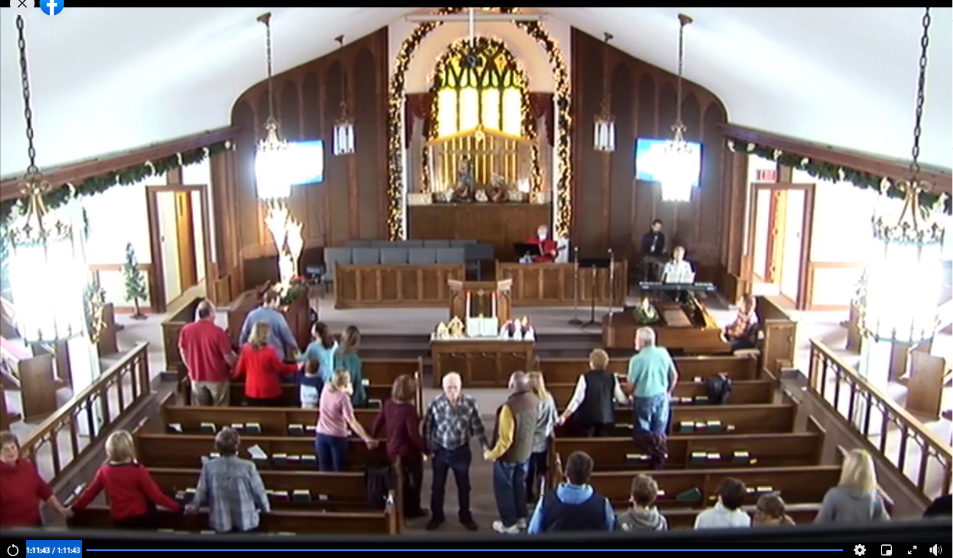

Slide 13
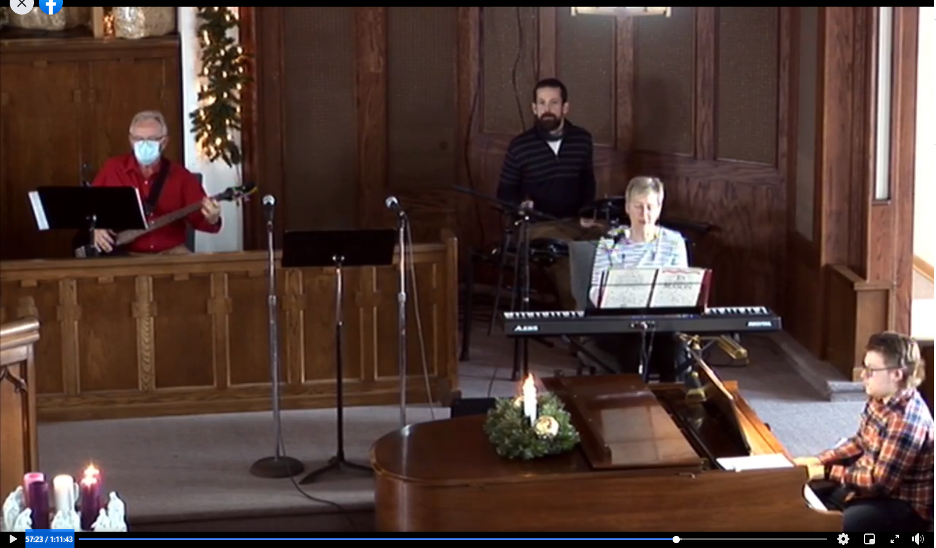

Slide 14
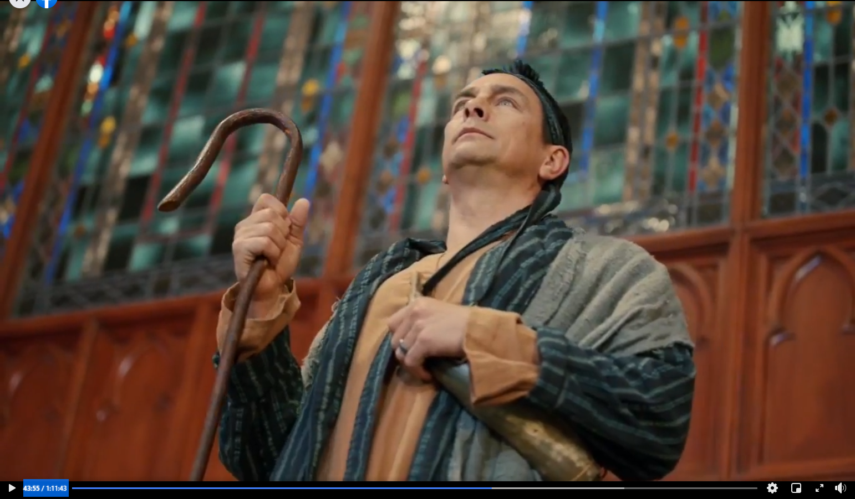

Slide 15
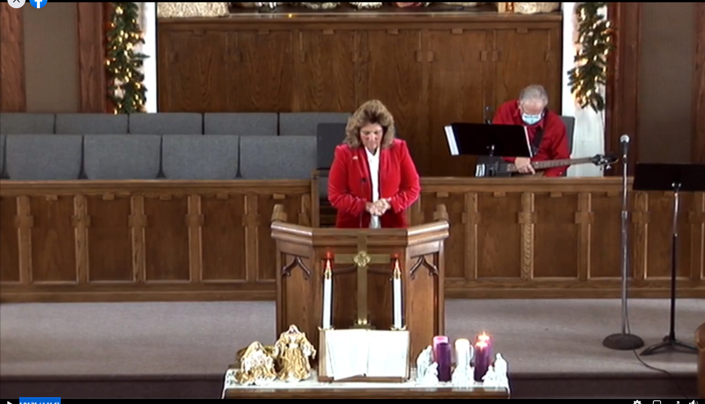

Slide 16
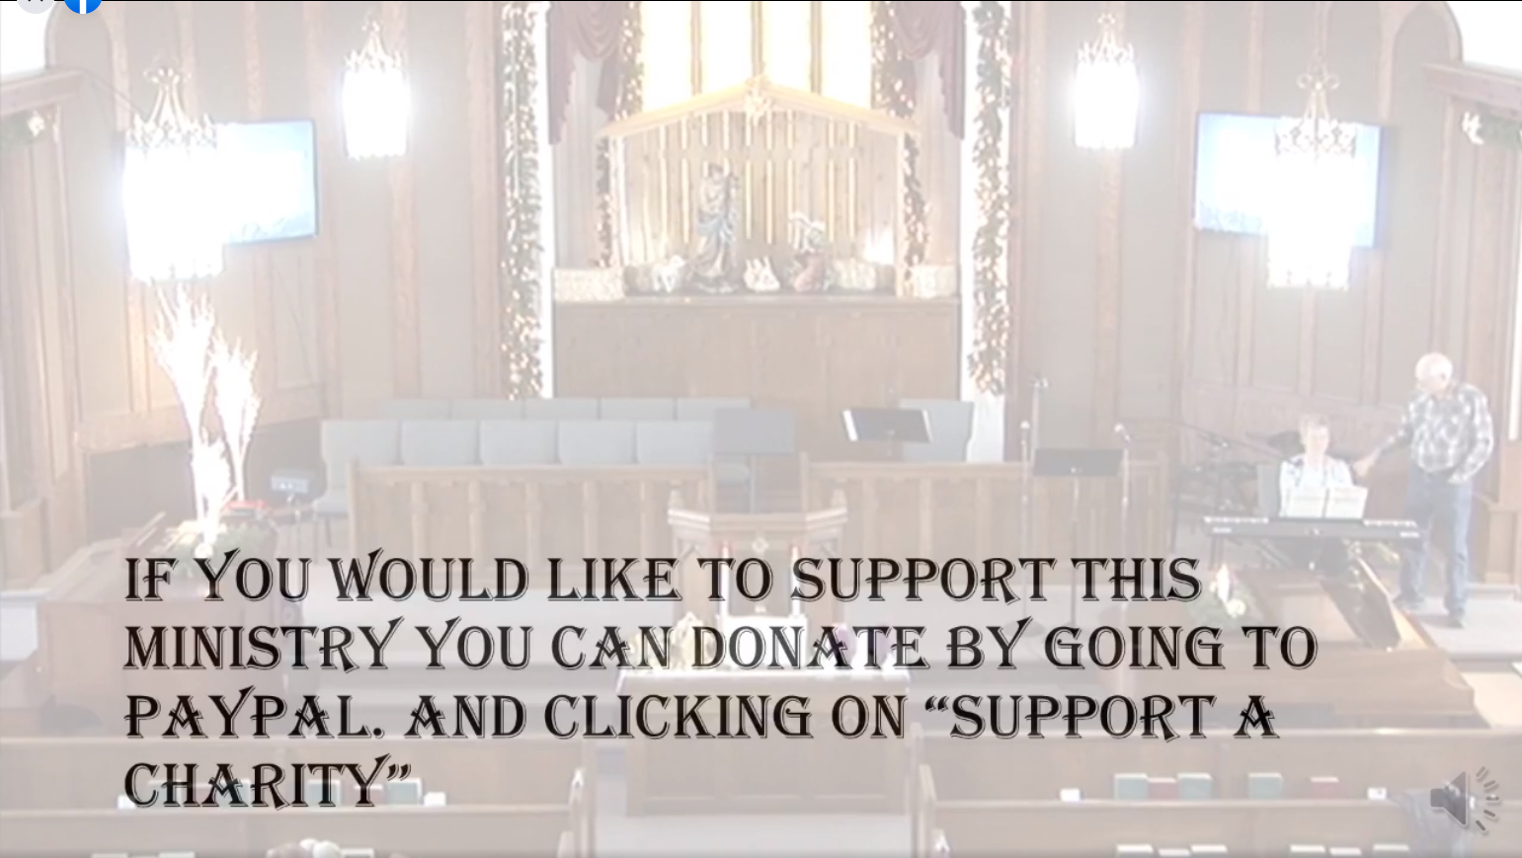

Slide 17
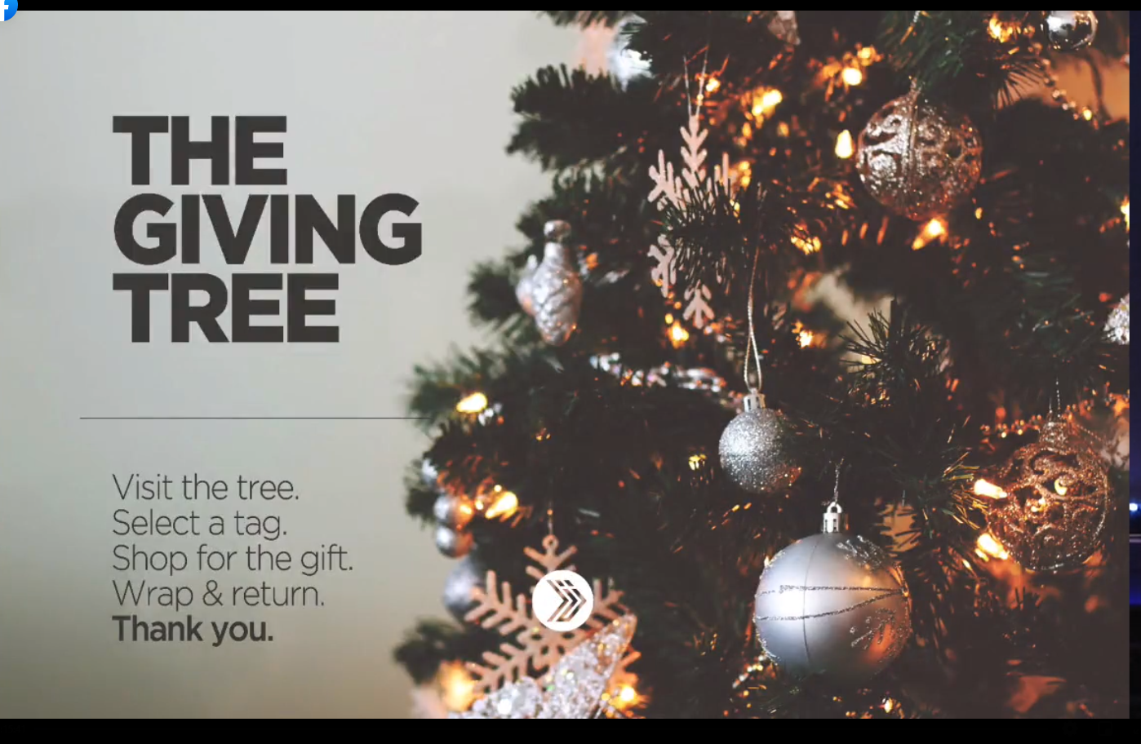

Slide 18
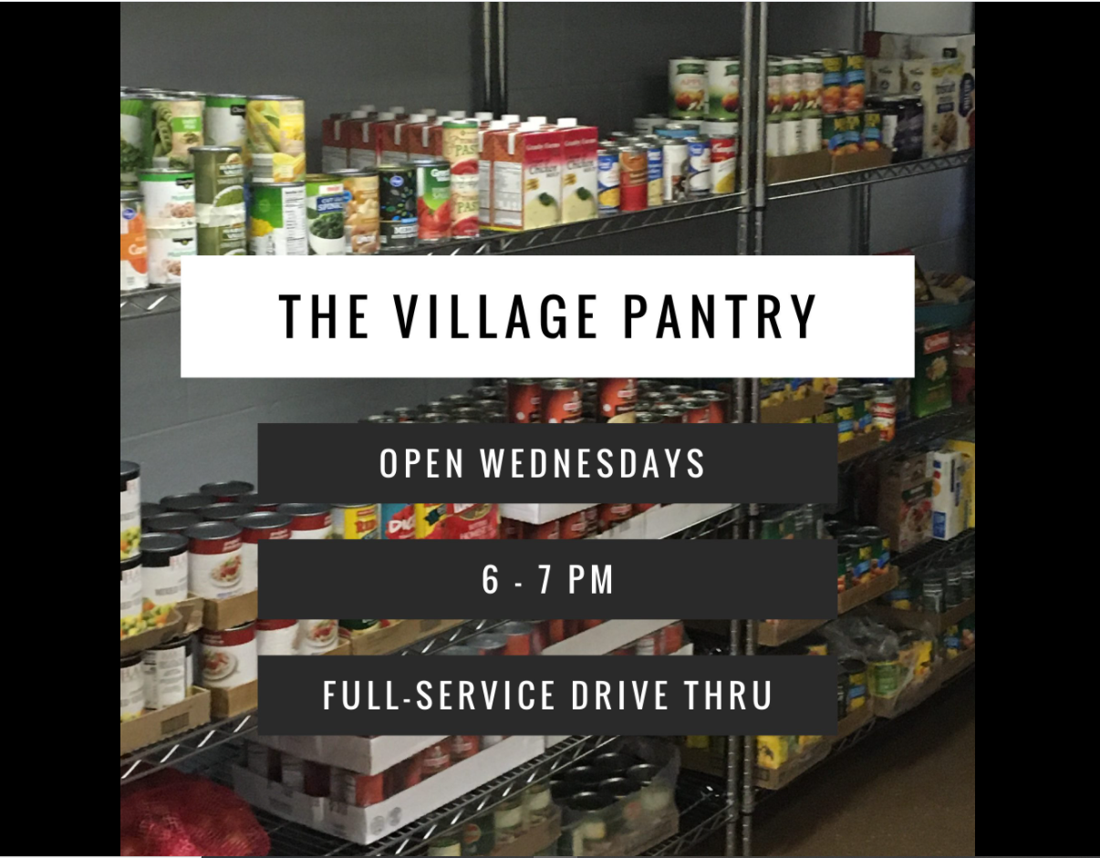

Slide 19
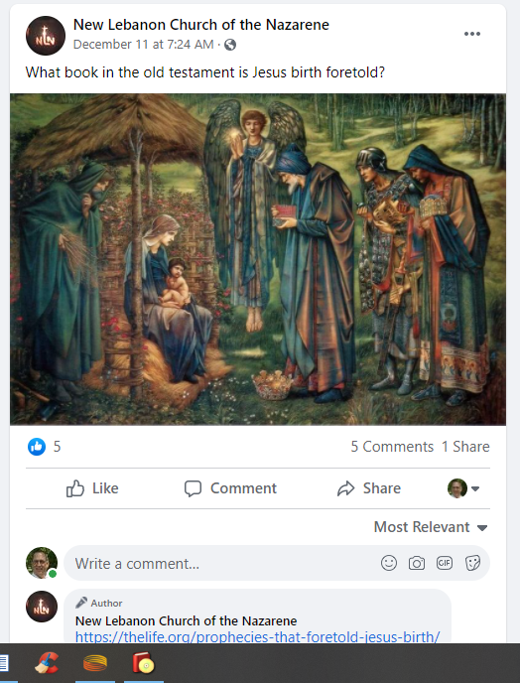

Slide 20
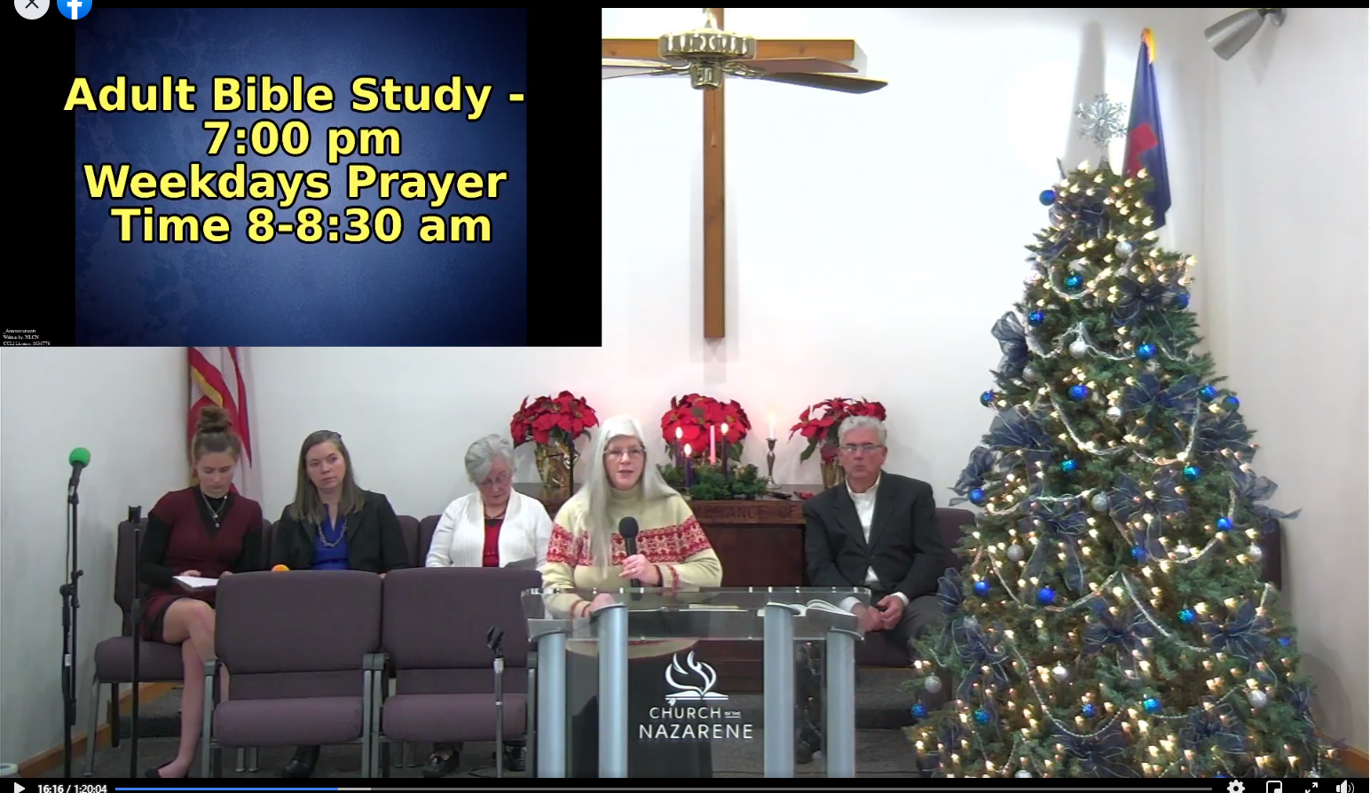

Slide 21
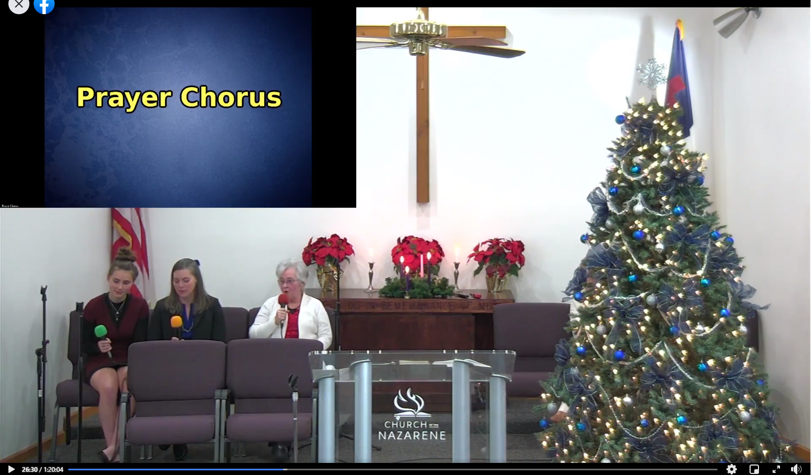

Slide 22
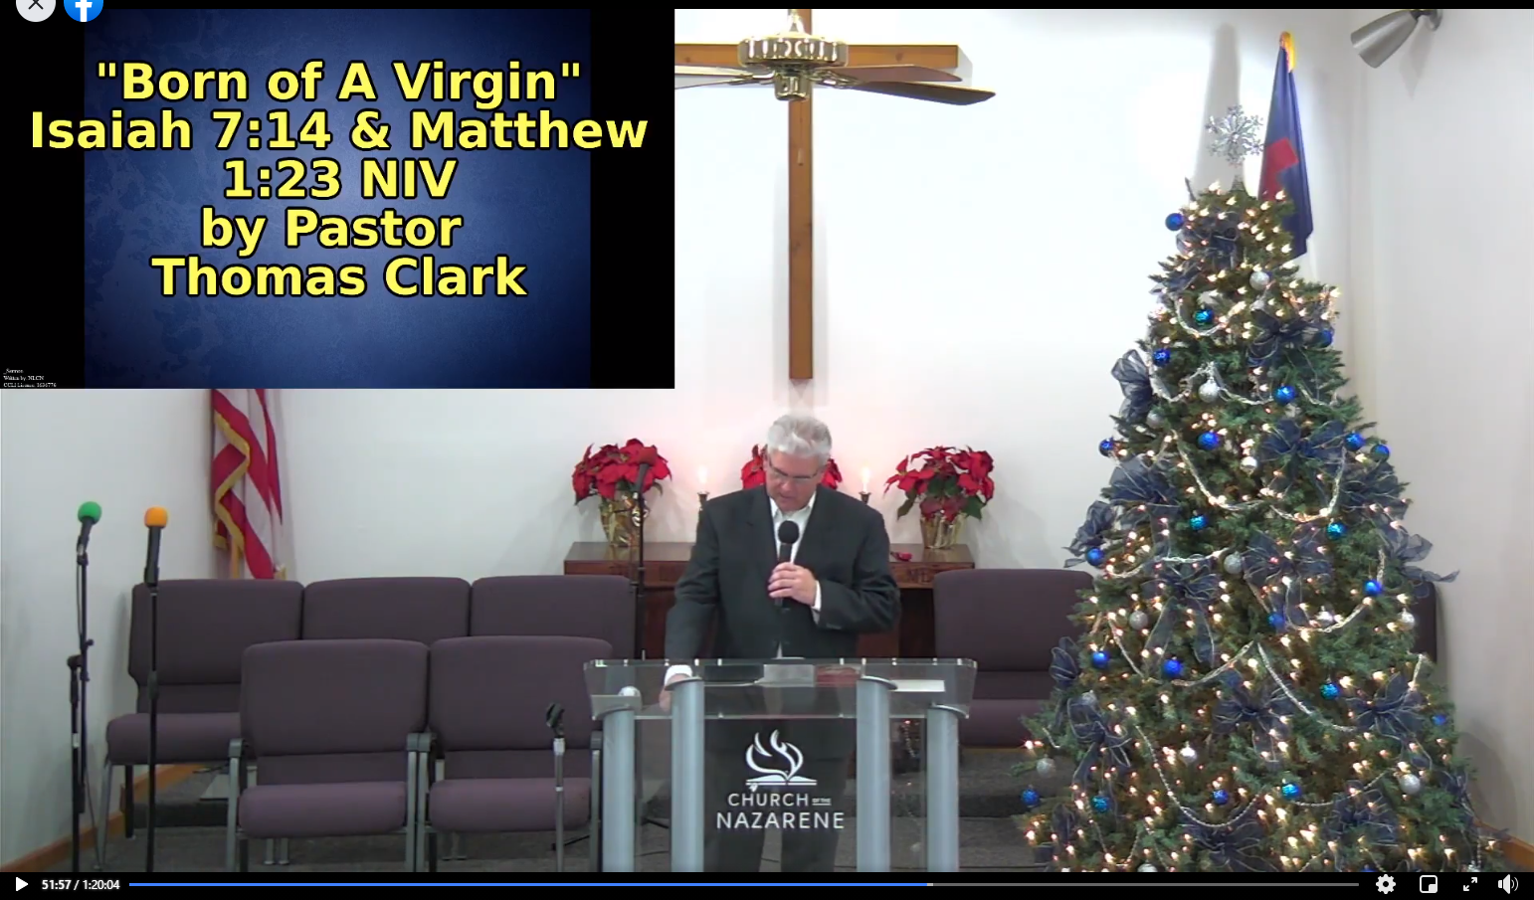

Slide 23
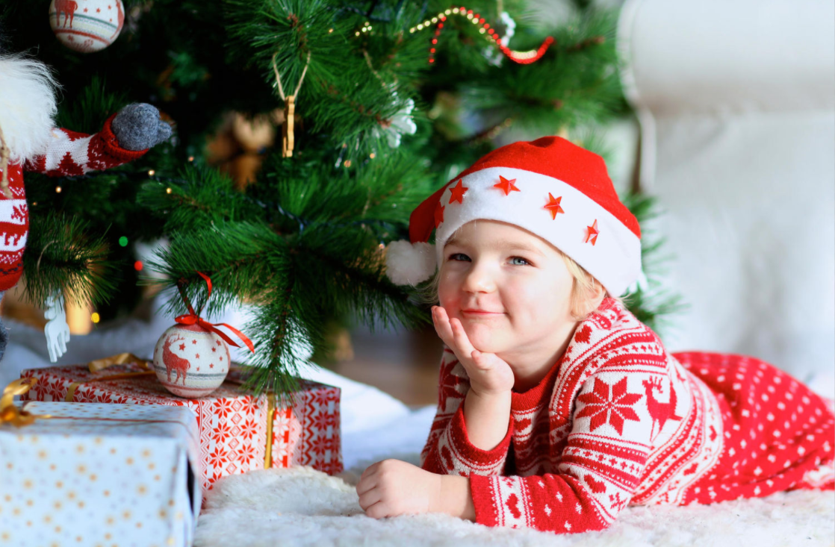
Are you excited and looking forward to worshipping God today and for time without end?
Or do you just want Jesus as your Savior
and not your Lord?

Slide 24
What Does The Bible Say
About Worshipping Jesus
at Christmas time?

Slide 26
The Bible Tells Us To Celebrate
His death.
1st Corinthians 11:18-34
Not His Birth.

Slide 27
Malachi 1:6
"A son honors his father, And a servant his master.
If then I am the Father, Where is My honor?
And if I am a Master, Where is My reverence?
Says the LORD of hosts

Slide 28
Questions?
Want to learn more about the Bible?
We will be glad to study the Bible with you.
New Lebanon
New Lebanon
Church of Christ
Church of Christ
New Lebanon, OH
newlebanoncoc.com
newlebanoncoc@gmail.com

