Slide 1
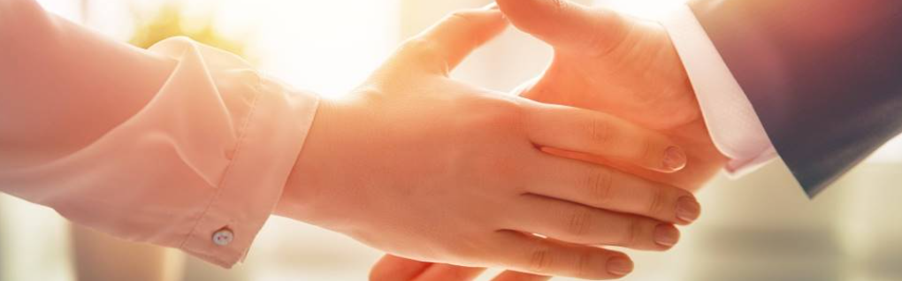
Welcome to our services
New Lebanon Church of Christ
We are Simply Christians.
Our Emphasis is Spiritual, Not Material or Social.
We are striving to be The Same Church as Described in The New Testament.
Please Come Back Again

Slide 2

But None Of These Things Move Me. Acts 20:22-27

Slide 3
1. Paul Was Not Moved By Former Teachers And Friends

Slide 4
2. Paul Was Not Moved By Monetary Consideration

Slide 5
3. Paul Was Not Moved By A Loss Of Fame

Slide 6
4. Paul Was Not Moved By Family Ties

Slide 7
Questions?
Want to learn more about the Bible?
We will be glad to study the Bible with you.
New Lebanon
New Lebanon
Church of Christ
Church of Christ
New Lebanon, OH
newlebanoncoc.com
newlebanoncoc@gmail.com

