Slide 1
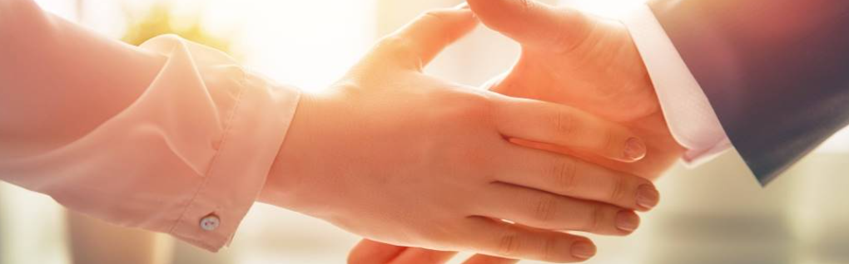
Welcome to our services
New Lebanon Church of Christ
We are Simply Christians.
Our Emphasis is Spiritual, Not Material or Social.
We are striving to be The Same Church as Described in The New Testament.
Please Come Back Again

Slide 2

Are You Ready? Luke 12

Slide 3
Are You Ready? Luke 12
1. We should be Ready to Meet Him.

Slide 4
Are You Ready? Luke 12
2. We should be Looking for Him.

Slide 5
Are You Ready? Luke 12
3. He will Come like a Thief

Slide 6
Are You Ready? Luke 12
4. The Faithful shall be Rewarded when He Comes

Slide 7
Are You Ready? Luke 12
5. The Unfaithful shall Suffer Loss at His Coming.

Slide 8
Are You Ready? Luke 12
6. The Lord IS Coming.

Slide 9
Are You Ready? Luke 12
We should be Ready
We should be Looking
He will come like a thief
Faithful / LIFE
Unfaithful / Death
He IS Coming

Slide 10
Questions?
Want to learn more about the Bible?
We will be glad to study the Bible with you.
New Lebanon
New Lebanon
Church of Christ
Church of Christ
New Lebanon, OH
newlebanoncoc.com
newlebanoncoc@gmail.com

