Slide 1
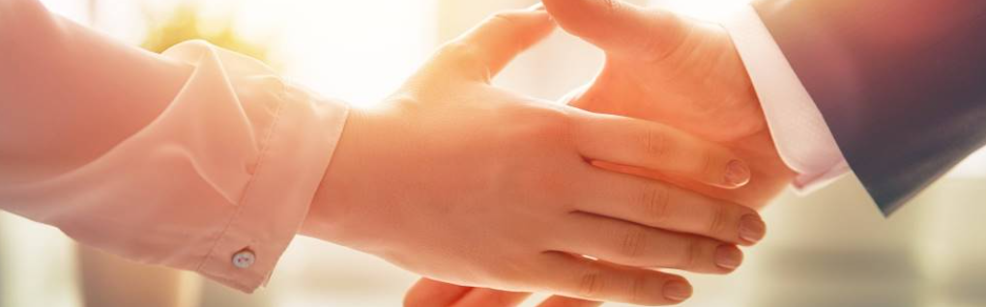
Welcome to our services
New Lebanon Church of Christ
We are Simply Christians.
Our Emphasis is Spiritual, Not Material or Social.
We are striving to be The Same Church as Described in The New Testament.
Please Come Back Again

Slide 2
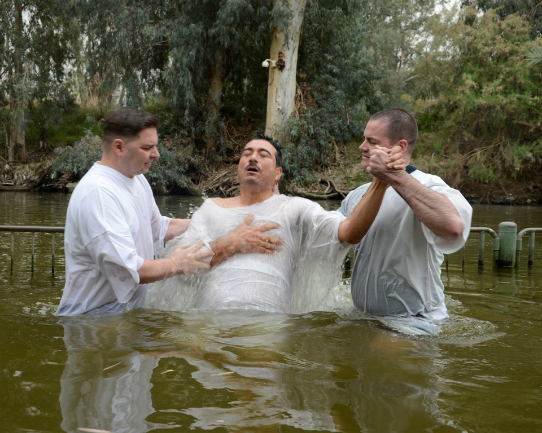
Therefore, He is able to save forever those that draw near to God through him
Baptism in the Jordan River
Hebrews 7:25
Notes:
The public expression of drawing near to God, from as early as the time of Jesus, was baptism. This photo shows sailors and Marines assigned to the amphibious transport dock ship USS Mesa Verde (LPD 19) being baptized during a tour to the Jordan River during a port visit. This image comes from Seaman Phylicia Hanson and is in the public domain, via Wikimedia Commons: https://commons.wikimedia.org/wiki/File:Baptism_in_the_Jordan_River_140308-N-HB951-058.jpg.
wiki052120150215768

Slide 3
God Is Able
What God is able to do:
newlebanoncoc.com

Slide 4
God Is Able
I. What God is able to do for us:
newlebanoncoc.com

Slide 5
God Is Able
I. What God is able to do for us. He is—
1. Able to Save us
(Heb. 7:25). Therefore He is also able to save to the uttermost those who come to God through Him, since He always lives to make intercession for them.
newlebanoncoc.com

Slide 6
God Is Able
I. What God is able to do for us. He is—
2. Able to Deliver us
(Dan. 3:17). "If that is the case, our God whom we serve is able to deliver us from the burning fiery furnace, and He will deliver us from your hand, O king.
newlebanoncoc.com

Slide 7
God Is Able
I. What God is able to do for us. He is—
3. Able to Make us Stand
(Phil. 3:21). who will transform our lowly body that it may be conformed to His glorious body, according to the working by which He is able even to subdue all things to Himself.
newlebanoncoc.com

Slide 8
God Is Able
I. What God is able to do for us. He is—
4. Able to Keep us
(Jude 24). Now to Him who is able to keep you from stumbling, And to present you faultless Before the presence of His glory with exceeding joy,
newlebanoncoc.com

Slide 9
God Is Able
I. What God is able to do for us. He is—
5. Able to Satisfy us
(2 Cor. 9:8). And God is able to make all grace abound toward you, that you, always having all sufficiency in all things, may have an abundance for every good work.
newlebanoncoc.com

Slide 10
God Is Able
I. What God is able to do for us. He is—
6. Able to Raise us
(Heb. 11:19). concluding that God was able to raise him up, even from the dead, from which he also received him in a figurative sense.
newlebanoncoc.com

Slide 11
God Is Able
I. What God is able to do for us. He is—
7. Able to present us Faultless
(Jude 24). Now to Him who is able to keep you from stumbling, And to present you faultless Before the presence of His glory with exceeding joy,
newlebanoncoc.com

Slide 12
God Is Able
II. What God is able to do in us:
newlebanoncoc.com

Slide 13
God Is Able
II What God is able to do in us. He is—
1. Able to Dwell in us
(Eph. 3:17–20). that Christ may dwell in your hearts through faith; that you, being rooted and grounded in love, 18 may be able to comprehend with all the saints what is the width and length and depth and height-- 19 to know the love of Christ which passes knowledge; that you may be filled with all the fullness of God. 20 Now to Him who is able to do exceedingly abundantly above all that we ask or think, according to the power that works in us,
newlebanoncoc.com

Slide 14
God Is Able
II What God is able to do in us. He is—
2. Able to Subdue
(Phil. 3:21). who will transform our lowly body that it may be conformed to His glorious body, according to the working by which He is able even to subdue all things to Himself.
newlebanoncoc.com

Slide 15
God Is Able
II. What God is able to do in us. He is—
3. Able to aid us
(Heb. 2:18). For in that He Himself has suffered, being tempted, He is able to aid those who are tempted.
newlebanoncoc.com

Slide 16
God Is Able
II. What God is able to do in us. He is—
4. Able to Strengthen
(2 Tim. 4:17). But the Lord stood with me and strengthened me, so that the message might be preached fully through me, and that all the Gentiles might hear. And I was delivered out of the mouth of the lion.
newlebanoncoc.com

Slide 17
God Is Able
II. What God is able to do in us. He is—
5. Able to Build up
(Acts 20:32) So now, brethren, I commend you to God and to the word of His grace, which is able to build you up and give you an inheritance among all those who are sanctified..
newlebanoncoc.com

Slide 18
God Is Able
II. What God is able to do in us. He is—
6. Able to Fill
(Col. 1:9). For this reason we also, since the day we heard it, do not cease to pray for you, and to ask that you may be filled with the knowledge of His will in all wisdom and spiritual understanding;
newlebanoncoc.com

Slide 19
God Is Able
II. What God is able to do in us. He is—
7. Able to Work
(Heb. 13:21). make you complete in every good work to do His will, working in you what is well pleasing in His sight, through Jesus Christ, to whom be glory forever and ever. Amen.
newlebanoncoc.com

Slide 20
God Is Able
III. What God
is able to do through us:
newlebanoncoc.com

Slide 21
God Is Able
III. What God is Able to Do Through Us.
He is—
1. Able to Reveal
(Gal. 1:16). to reveal His Son in me, that I might preach Him among the Gentiles, I did not immediately confer with flesh and blood
newlebanoncoc.com

Slide 22
God Is Able
III. What God is Able to Do Through Us.
He is—
2. Able to Reconcile
(2 Cor. 5:18–20). Now all things are of God, who has reconciled us to Himself through Jesus Christ, and has given us the ministry of reconciliation,
19 that is, that God was in Christ reconciling the world to Himself, not imputing their trespasses to them, and has committed to us the word of reconciliation.
20 Now then, we are ambassadors for Christ, as though God were pleading through us: we implore you on Christ's behalf, be reconciled to God.
newlebanoncoc.com

Slide 23
God Is Able
III. What God is Able to Do Through Us.
He is—
3. Able to Overcome
(Eph. 6:11). Put on the whole armor of God, that you may be able to stand against the wiles of the devil.
newlebanoncoc.com

Slide 24
God Is Able
III. What God is Able to Do Through Us.
He is—
4. Able to Bear Fruit
(Col. 1:10). that you may walk worthy of the Lord, fully pleasing Him, being fruitful in every good work and increasing in the knowledge of God;
newlebanoncoc.com

Slide 25
God Is Able
III. What God is Able to Do Through Us.
He is—
5. Able to do His Own Pleasure
(Phil. 2:13). or it is God who works in
you both to will and to do for His good pleasure.
newlebanoncoc.com

Slide 26
Questions?
Want to learn more about the Bible?
We will be glad to study the Bible with you.
New Lebanon
New Lebanon
Church of Christ
Church of Christ
New Lebanon, OH
newlebanoncoc.com
newlebanoncoc@gmail.com

