Slide 1
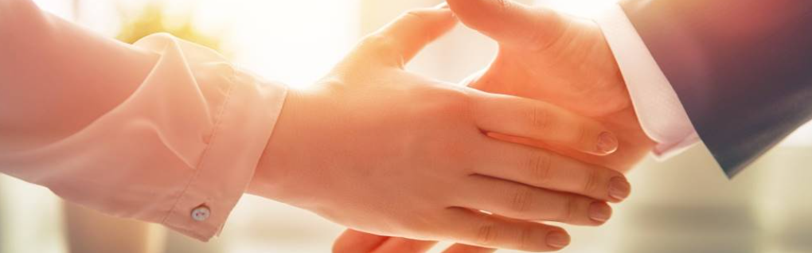
Welcome to our services
New Lebanon Church of Christ
We are Simply Christians.
Our Emphasis is Spiritual, Not Material or Social.
We are striving to be The Same Church as Described in The New Testament.
Please Come Back Again

Slide 2

Photo by icrosspoint.com

Slide 3

Oh Give Thanks To The Lord Psalm 107:1
Psalm 107:1-2. Oh, give thanks to the LORD, for He is good! For His mercy endures forever. Let the redeemed of the LORD say so, Whom He has redeemed from the hand of the enemy,
newlebanoncoc.com

Slide 4
Oh Give Thanks To The Lord Psalm 107:1
Are you thankful:
1. That someone taught you the truth?
2. That you were added to the church?
3.That you were baptized for the remission of your sins?
4. That you are forgiven of your past sins?
5. Are you thankful that God had his word recorded for you?
newlebanoncoc.com

Slide 5
Oh Give Thanks To The Lord Psalm 107:1
Are you thankful:
6. Are you thankful for the family you have in Christ?
7. Are you thankful for the sacrifice that Christ made for you?
8. Are you thankful for your inheritance?
9. Are you thankful for the trials that God gives to you?
10. What are you doing to show your thankfulness?
newlebanoncoc.com

Slide 6
Questions?
Want to learn more about the Bible?
We will be glad to study the Bible with you.
New Lebanon
New Lebanon
Church of Christ
Church of Christ
New Lebanon, OH
newlebanoncoc.com
newlebanoncoc@gmail.com

