Slide 1
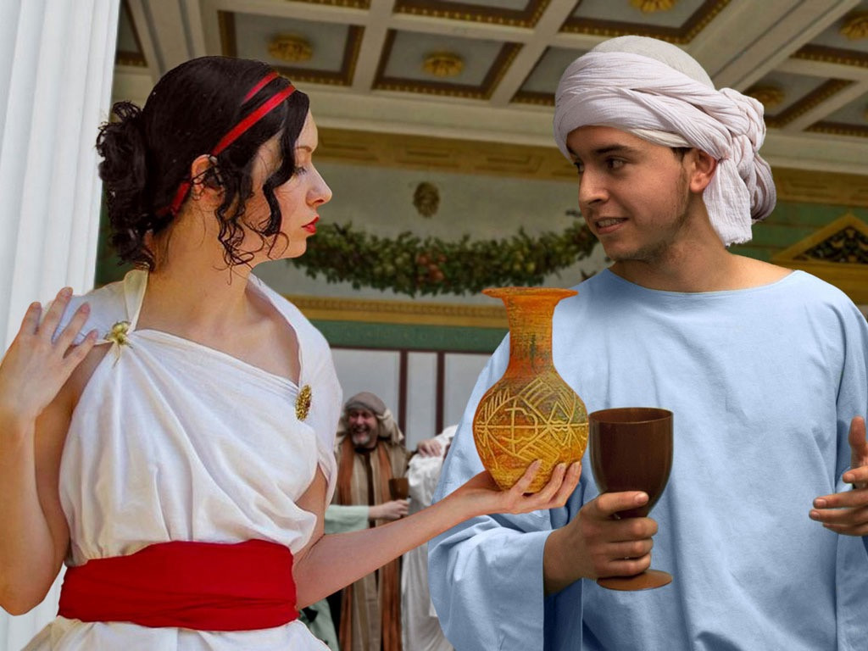
Lu 15:20 "And he arose and came to his father. But when he was still a great way off, his father saw him and had compassion, and ran and fell on his neck and kissed him.
21 "And the son said to him, 'Father, I have sinned against heaven and in your sight, and am no longer worthy to be called your son.'
22 "But the father said to his servants, 'Bring out the best robe and put it on him, and put a ring on his hand and sandals on his feet.
Luke 15:20 "And he arose and came to his father. But when he was still a great way off, his father saw him and had compassion, and ran and fell on his neck and kissed him.
21 "And the son said to him, 'Father, I have sinned against heaven and in your sight, and am no longer worthy to be called your son.’
22 "But the father said to his servants, 'Bring out the best robe and put it on him, and put a ring on his hand and sandals on his feet.
Notes:
... and living the party lifestyle.

Slide 2
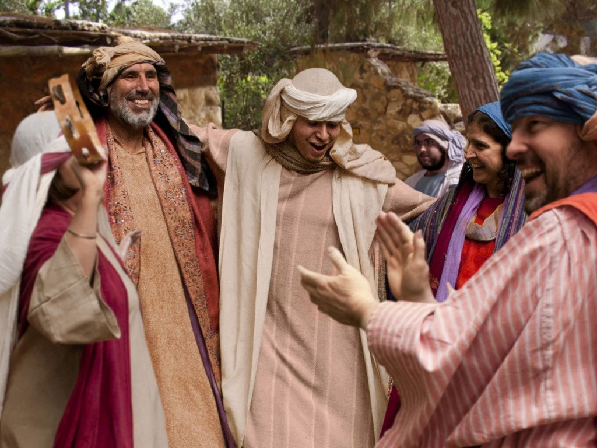

Notes:
The forgiving father celebrates his lost son being found, leaving the older son deciding how he is going to react.

Slide 3
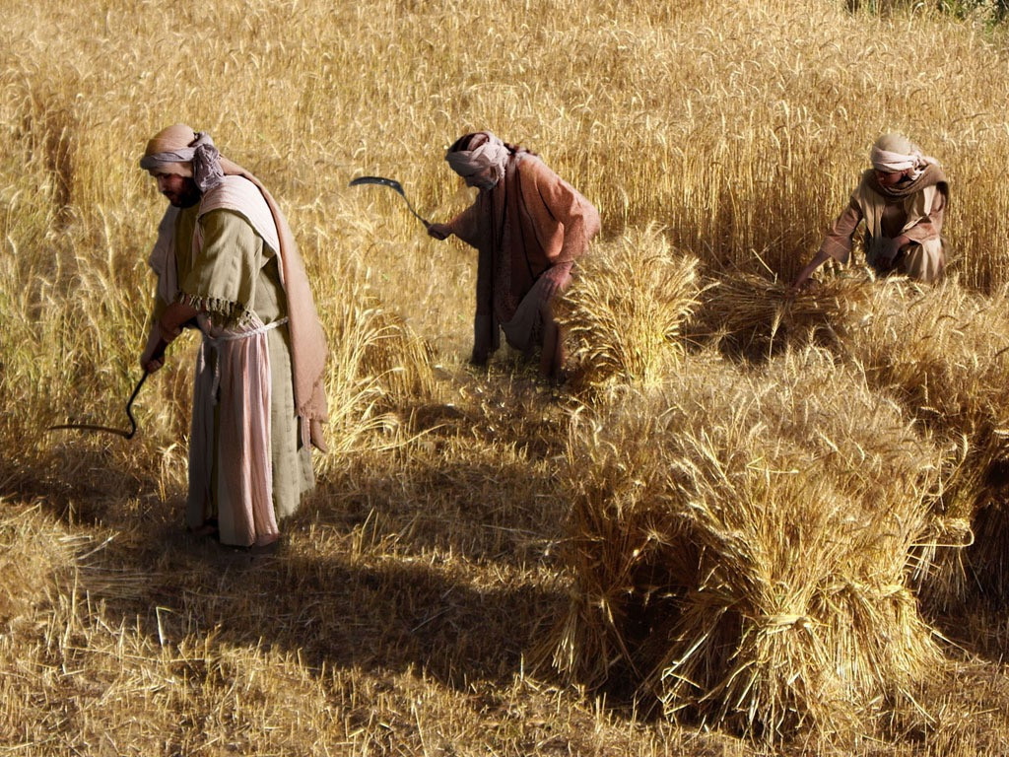
Notes:
Luke 15 v 11 The father and his two sons working in their fields.

Slide 4
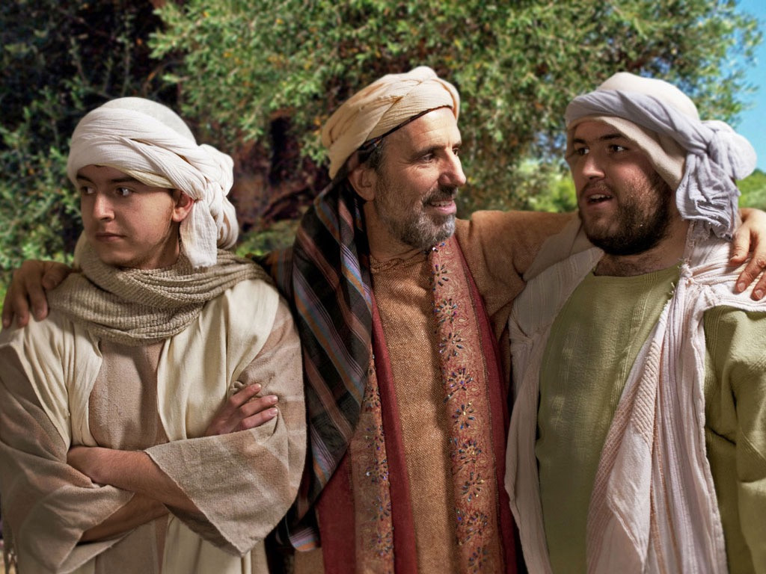
Notes:
The younger son is unhappy and planning to leave home.

Slide 5
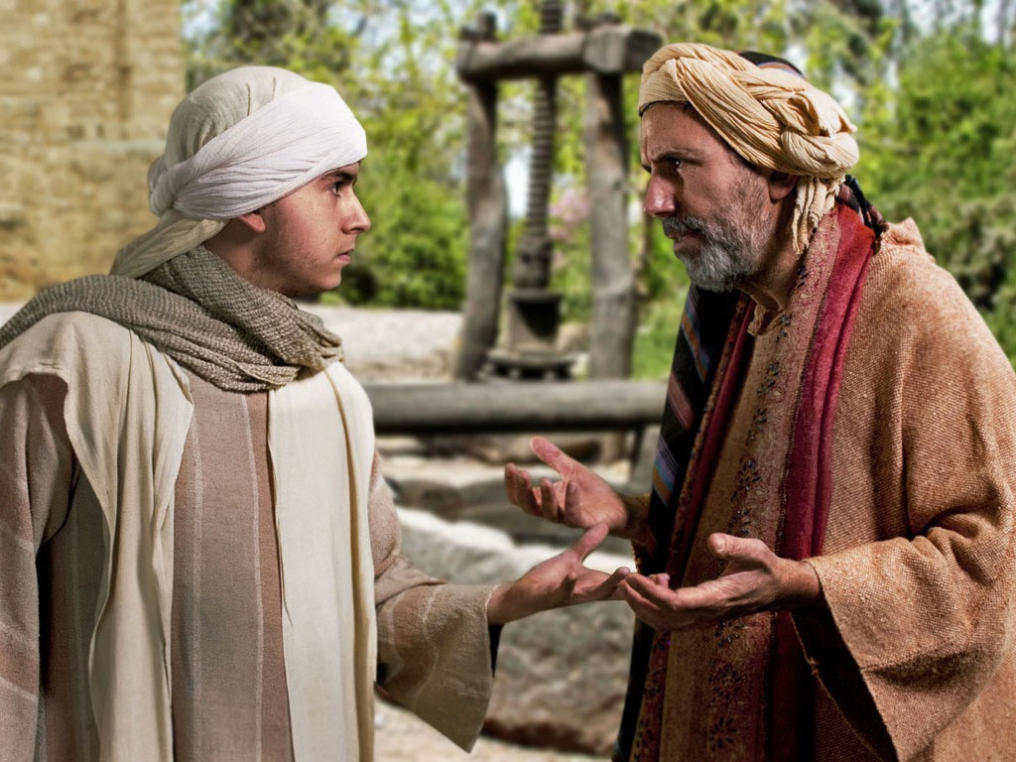
Notes:
Luke 15 v 12 He demands his share of the family inheritance.

Slide 6
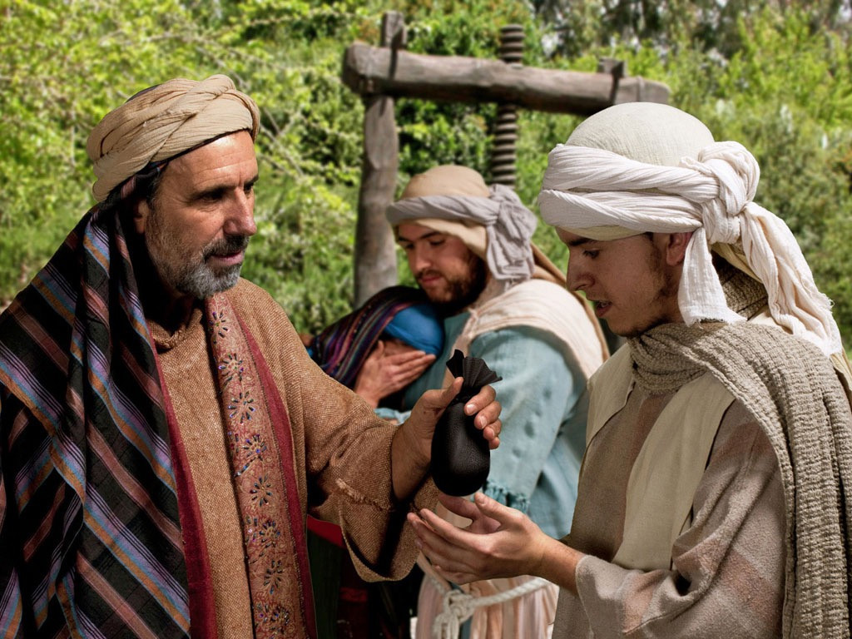
Notes:
The sad father hands over the younger son’s share of the inheritance.

Slide 7
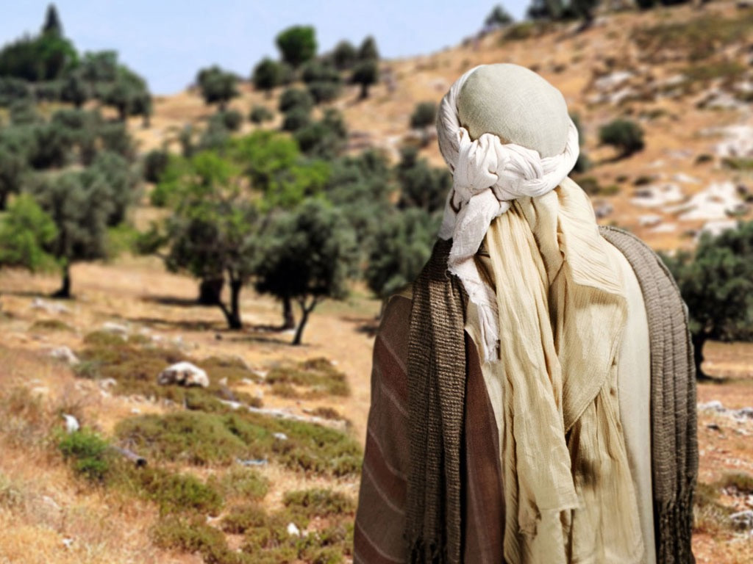
Notes:
Luke 15 v 13 The son leaves home.

Slide 8
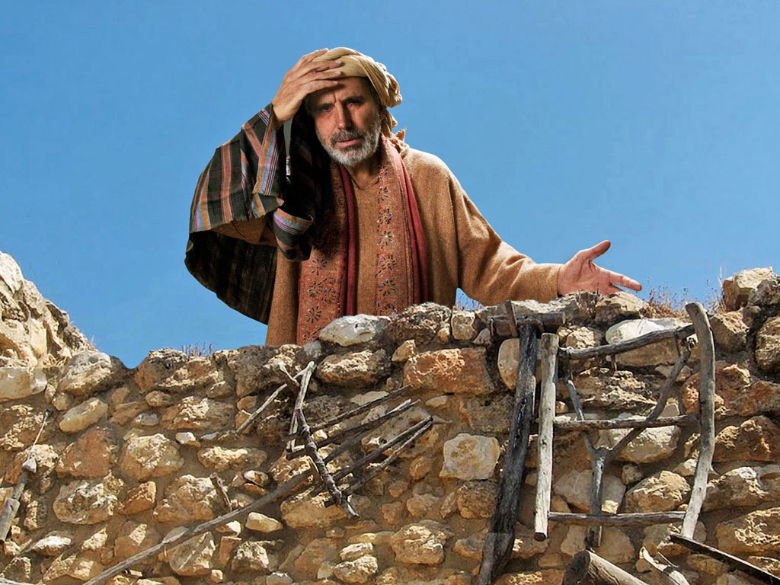
Notes:
His father watches from the rooftop, upset to see his son leaving

Slide 9
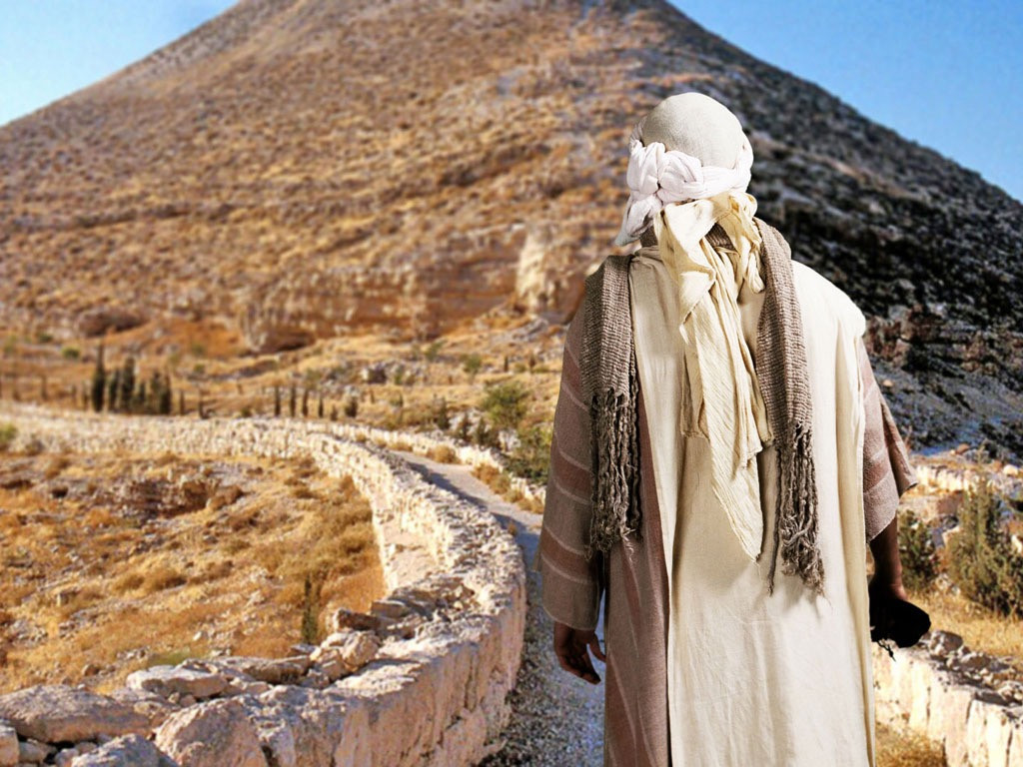
Notes:
The son heads to a far country.

Slide 10
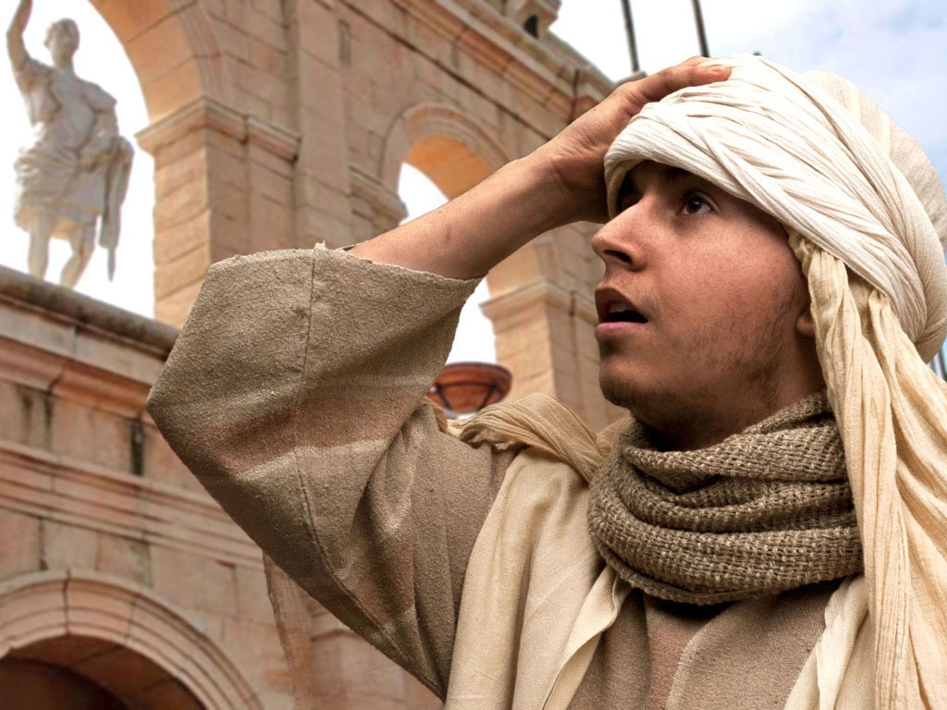
Notes:
He enters a city.

Slide 11
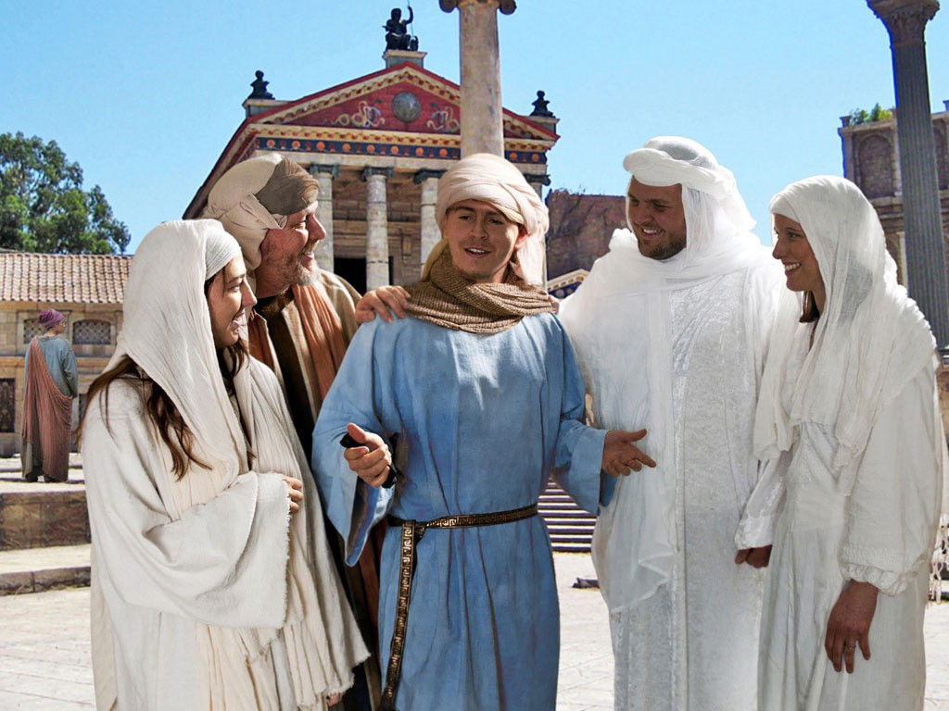
Notes:
He soon attracts friends eager to help him spend his money.

Slide 12
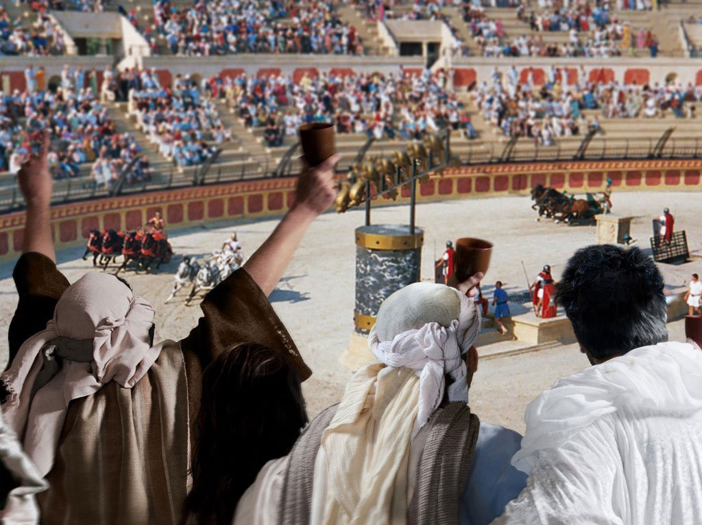
Notes:
He spends his money on wild living ...

Slide 13
Notes:
... and living the party lifestyle.

Slide 14
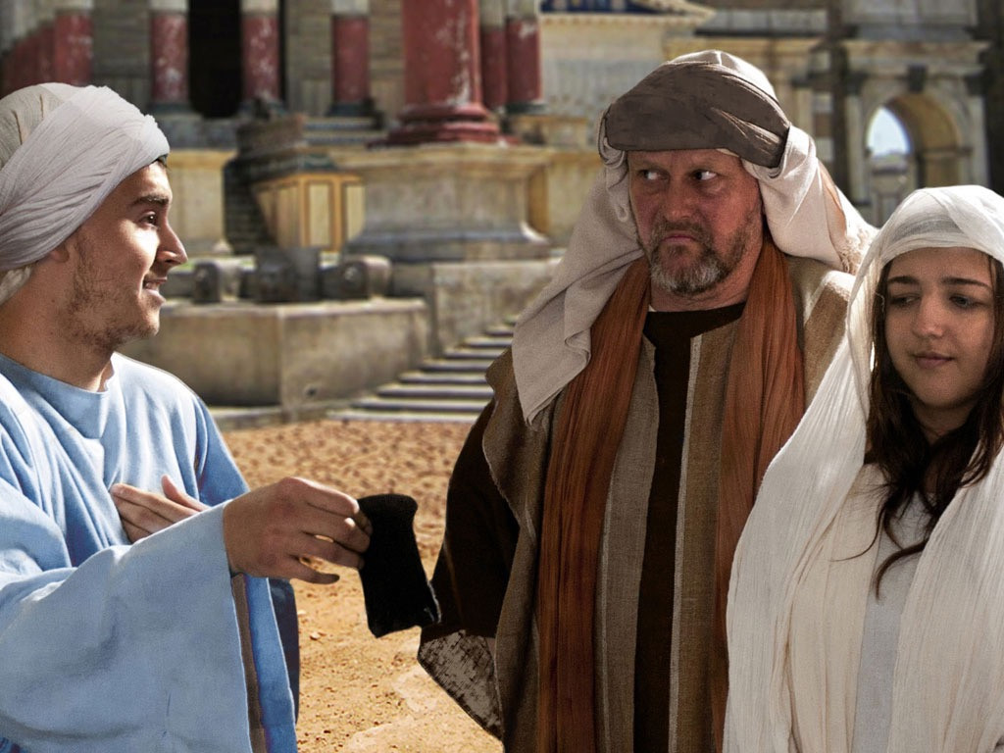
Notes:
Luke 15 v 14 A famine hits the area and his money runs out.

Slide 15
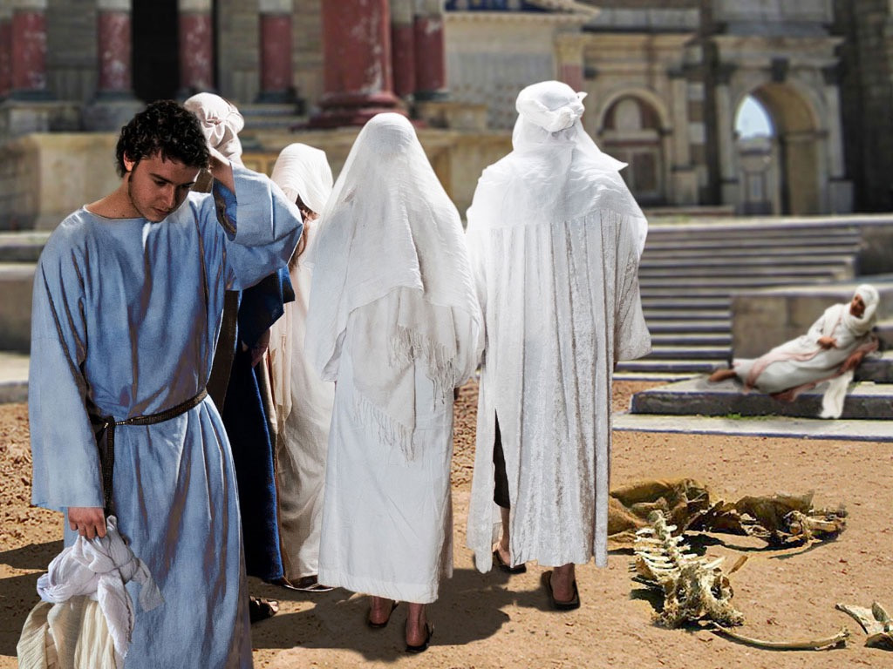
Notes:
His new friends desert him.

Slide 16
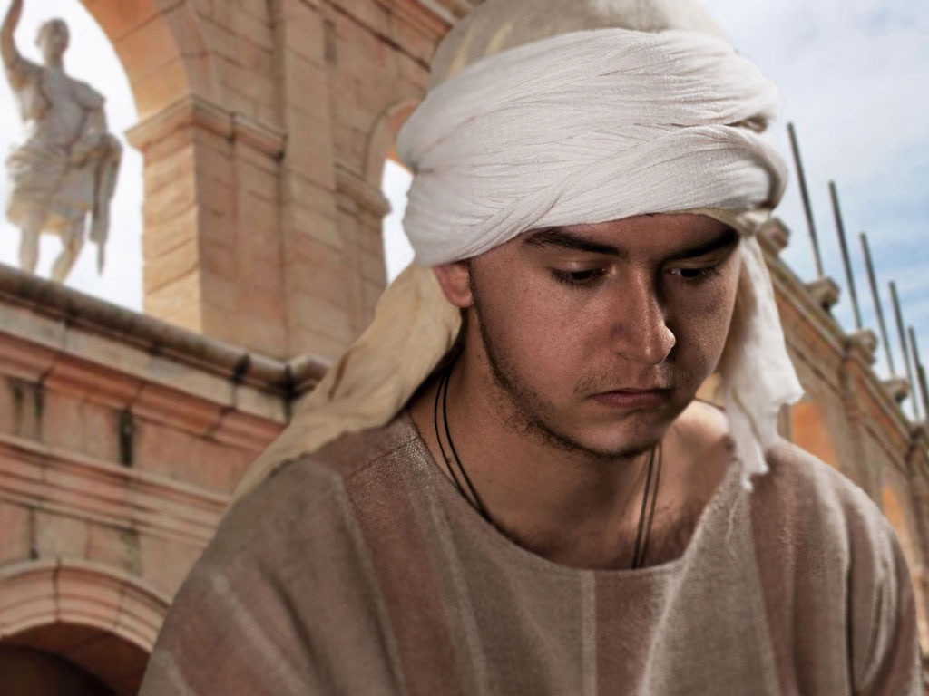
Notes:
He leaves the city to look for work.

Slide 17
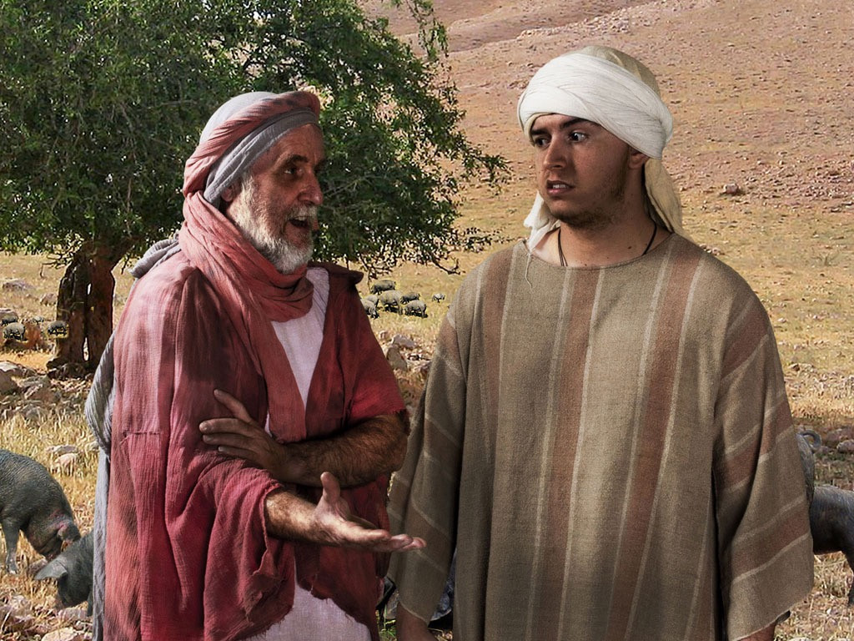
Notes:
Luke 15 v 15 The only job he can get is looking after pigs.

Slide 18
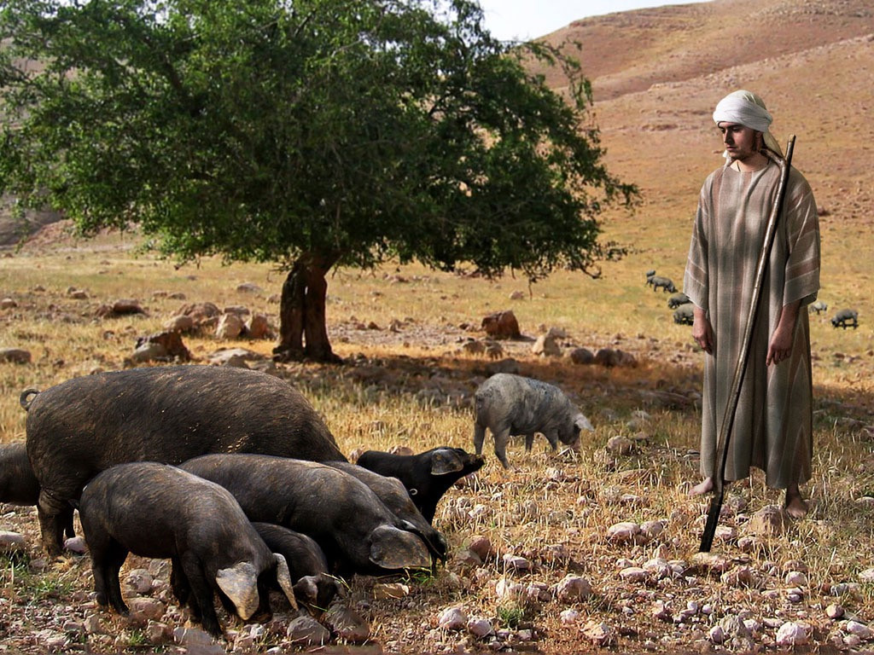
Notes:
It is one of the most unclean jobs a Jewish boy could imagine doing.

Slide 19
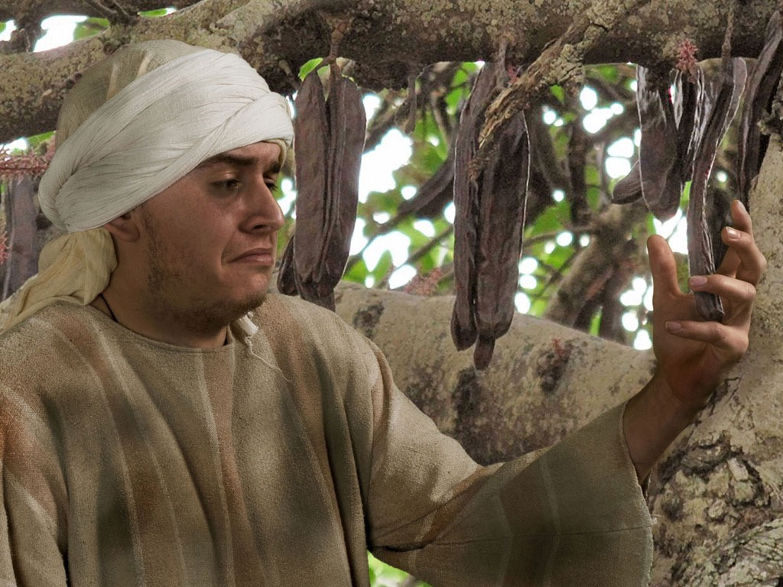
Notes:
He is so hungry he even longs to eat the pods the pigs are fed.

Slide 20
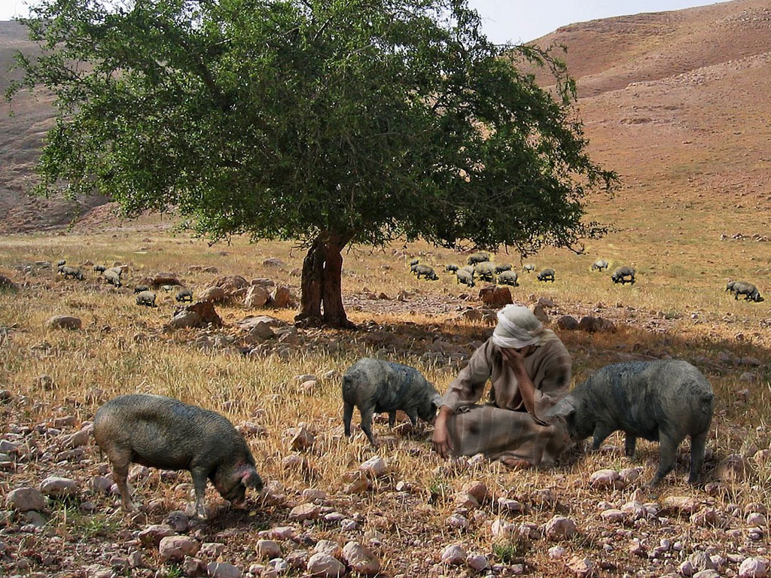
Notes:
Luke 15 v 19 He thinks of the food that the servants have at his fathers home

Slide 21
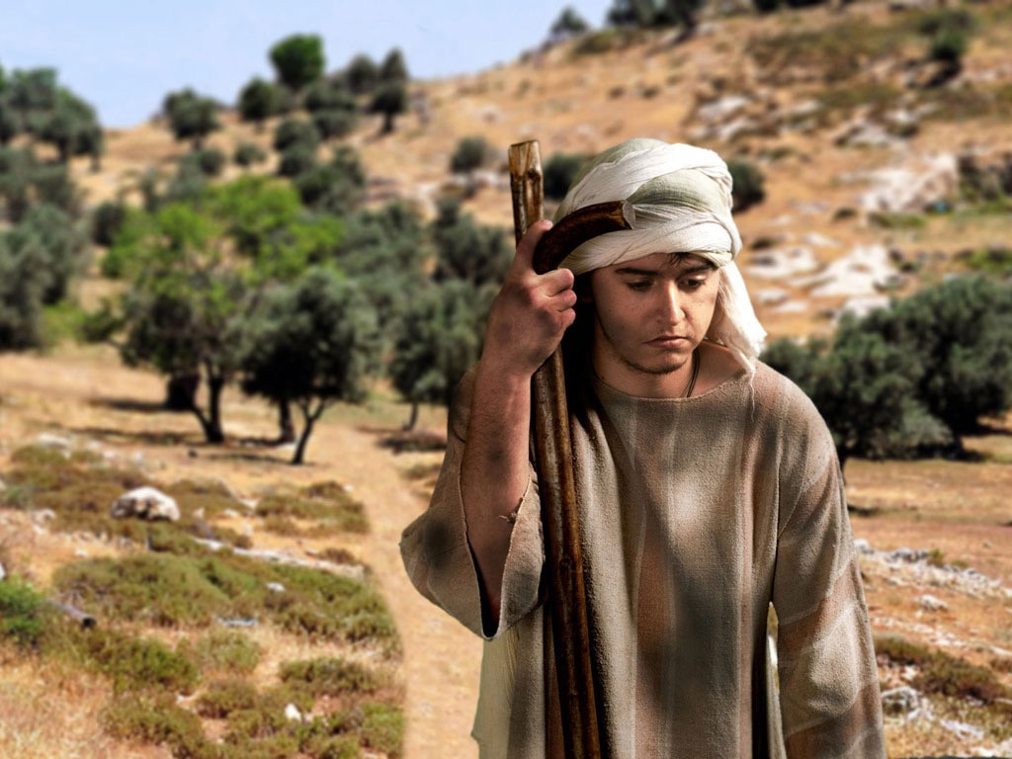
Notes:
Luke 15 v 19 He heads back home to beg his father to accept him as one of his servants.

Slide 22
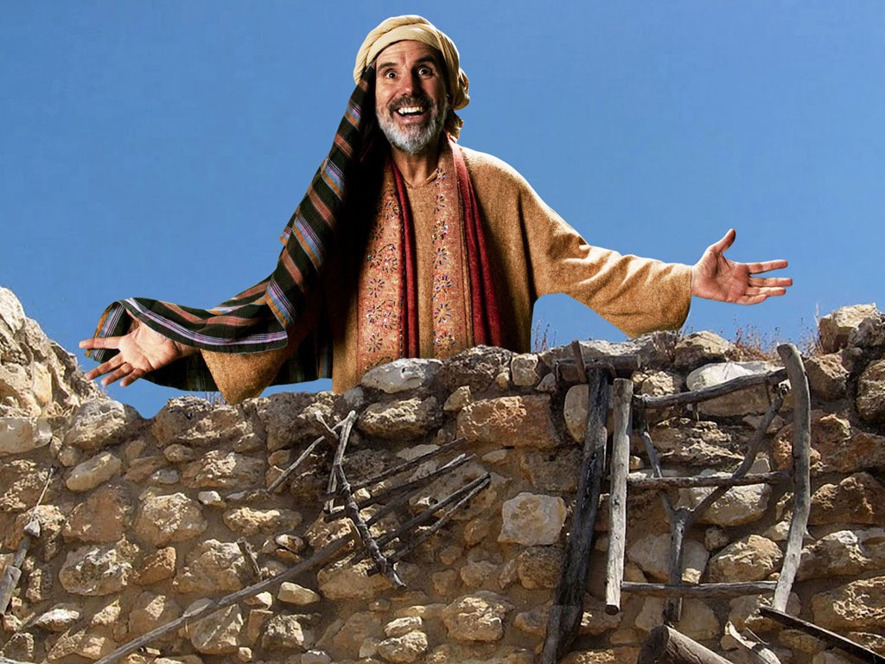
Notes:
Luke 15 v 20 His father sees him coming and is full of love for his disobedient son.

Slide 23
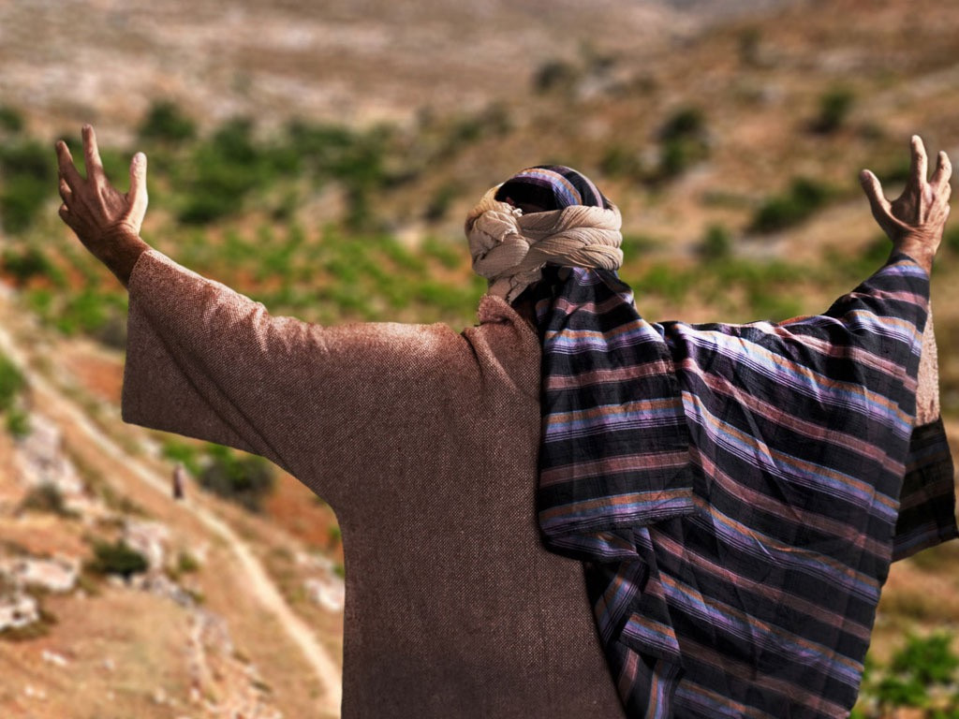
Notes:
He runs to greet his son...

Slide 24
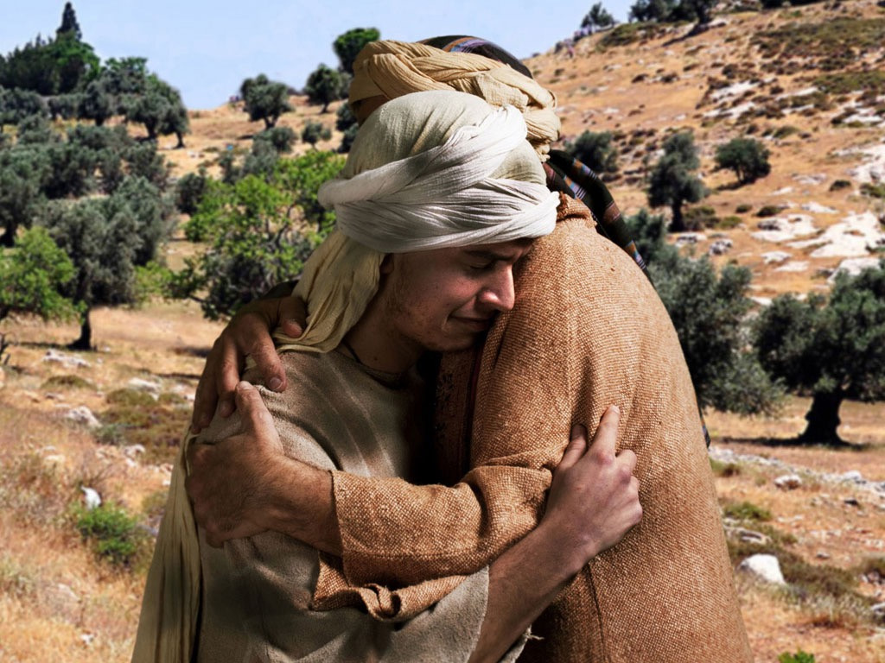
Notes:
... and throws his arms around him and kisses him.

Slide 25
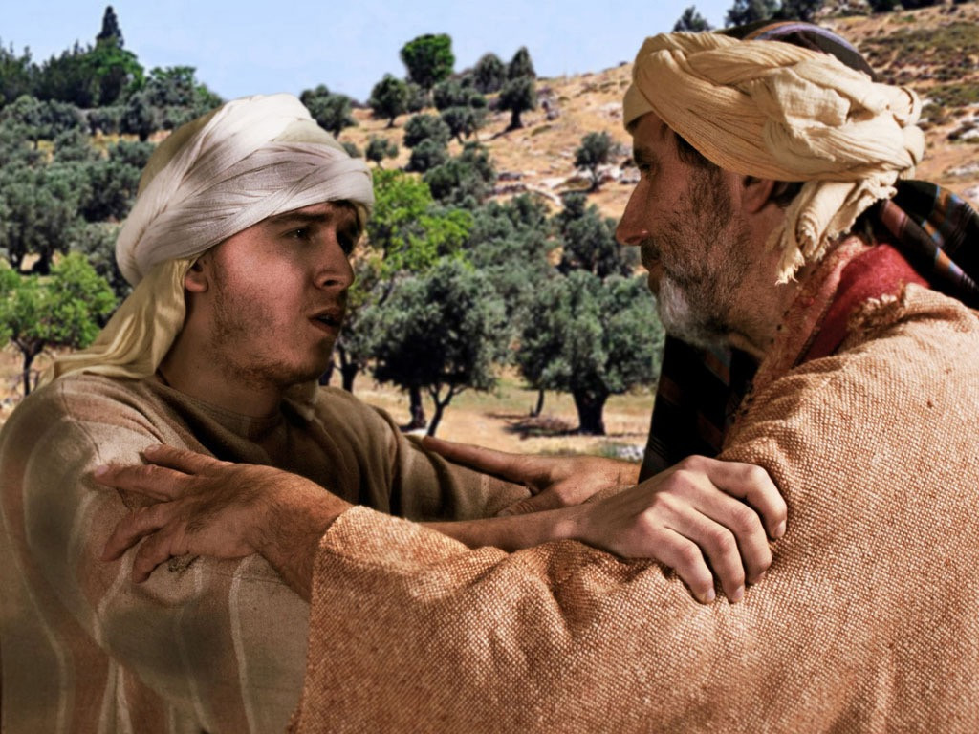
Notes:
Luke 15 v 21 The son confesses he has sinned against God and his father. He is no longer worthy to be called his son.

Slide 26
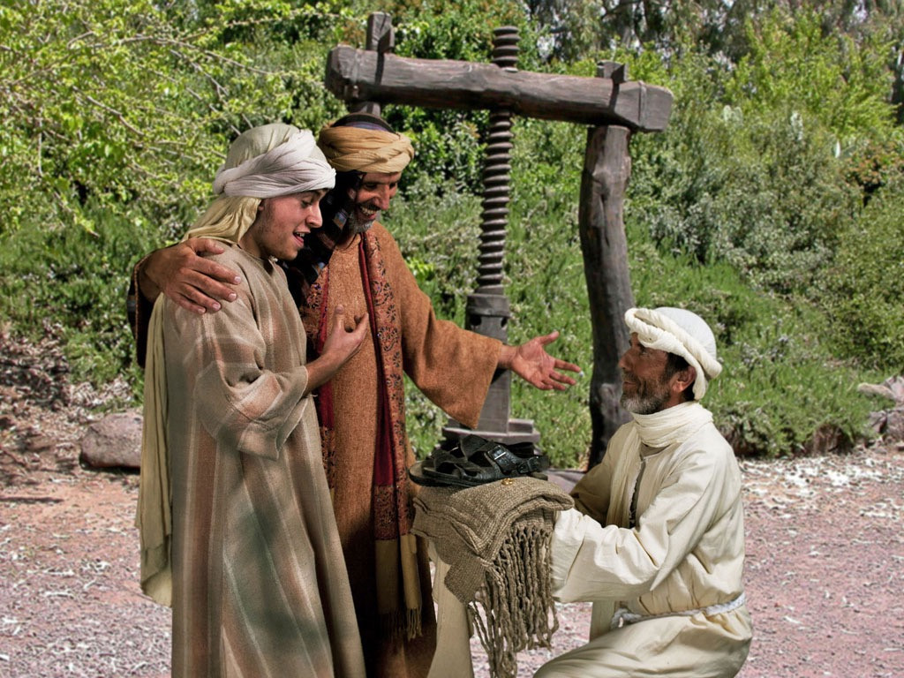
Notes:
Luke 15 v 22 His father tells the servants to bring his son the best robe, sandals and a ring for his finger.

Slide 27
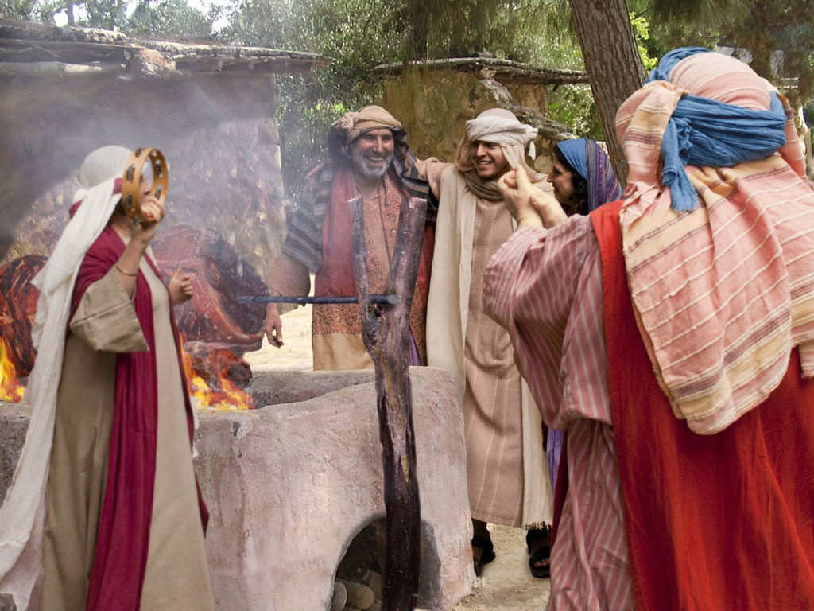
Notes:
Luke 15 v 23 The fatted calf is killed and a celebration feast begins.

Slide 28
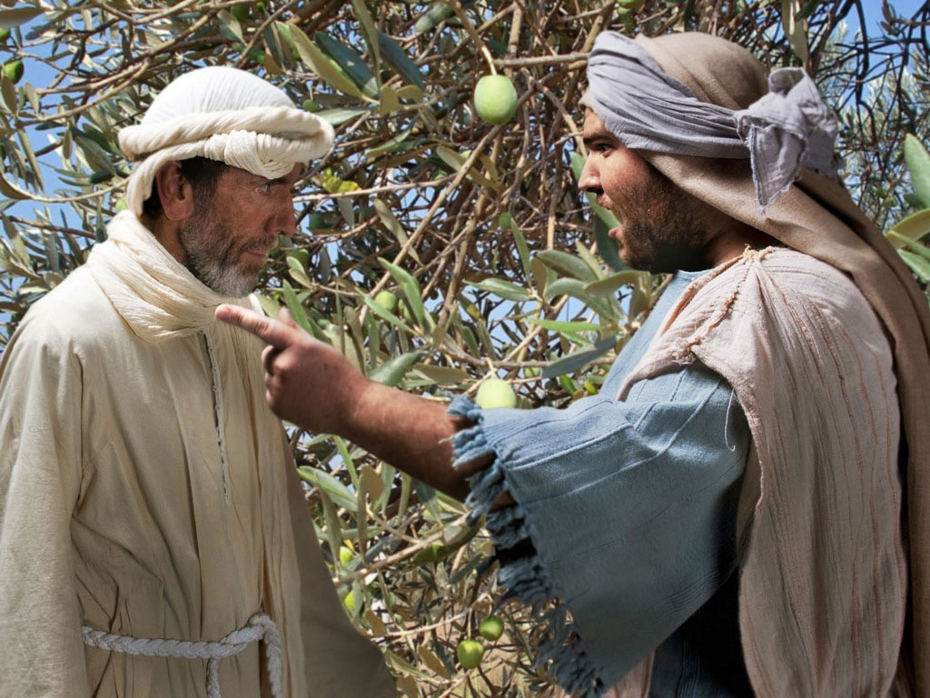
Notes:
Luke 15 v 25 Meanwhile the older son returns from working in a field and asks one of the servants what the music and dancing is all about. On hearing his younger brother has returned he is angry.

Slide 29
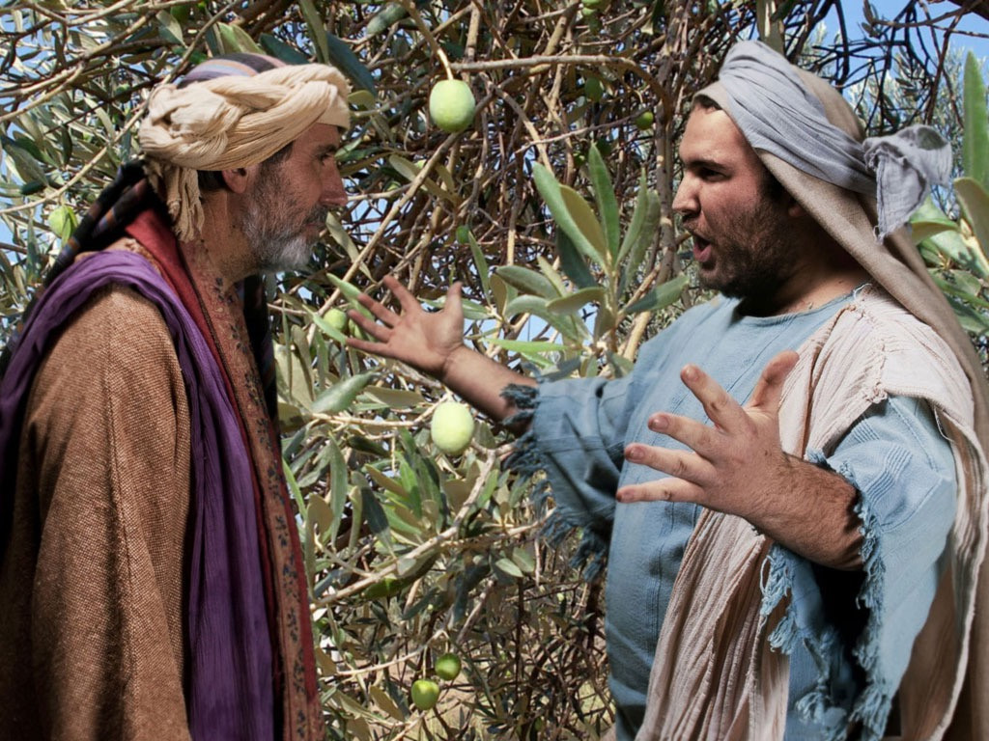
Notes:
His father goes out to plead with him to join the celebrations. The son complains how unfair it is that he has been working hard without any celebrations but his brother who has been squandering money is treated to a feast.

Slide 30
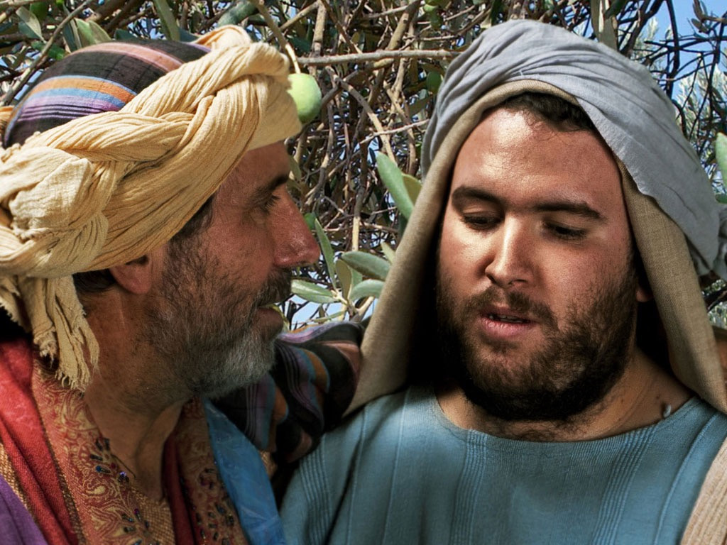
Notes:
Luke 15 v 32 His father explains that everything he has belongs to the older son but they must celebrate his lost son being found.

Slide 31
Notes:
The forgiving father celebrates his lost son being found, leaving the older son deciding how he is going to react.

