Slide 1
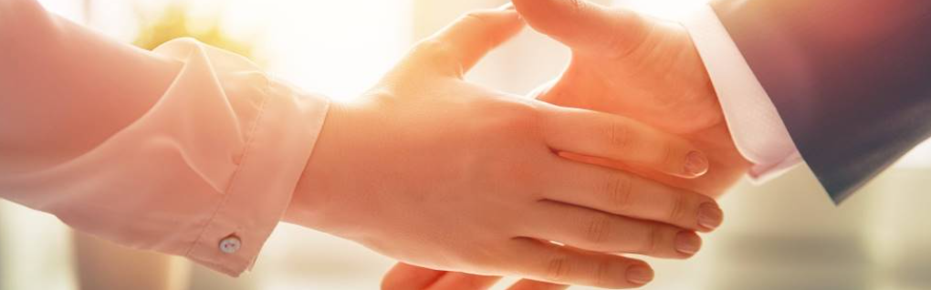
Welcome to our services
New Lebanon Church of Christ
We are Simply Christians.
Our Emphasis is Spiritual, Not Material or Social.
We are striving to be The Same Church as Described in The New Testament.
Please Come Back Again

Slide 2
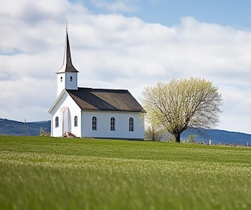
1Peter 3:15 But sanctify the Lord God in your hearts, and always be ready to give a defense to everyone who asks you a reason for the hope that is in you, with meekness and fear;

Slide 3
Questions?
Want to learn more about the Bible?
We will be glad to study the Bible with you.
New Lebanon
New Lebanon
Church of Christ
Church of Christ
New Lebanon, OH
newlebanoncoc.com
newlebanoncoc@gmail.com

Slide 4
Why I Am A Member Of
The Church Of Christ

Slide 5
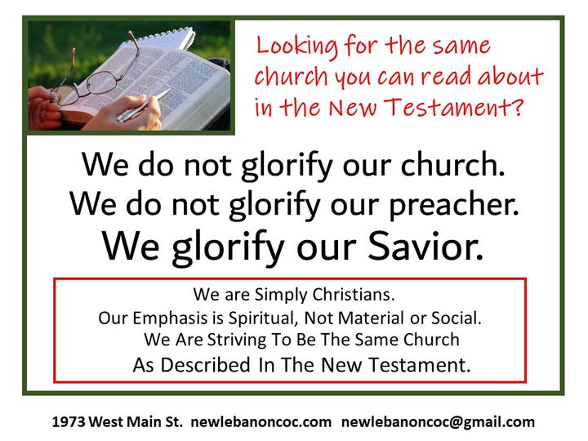

Slide 6
Why are you a member of the church you belong to?
It is a popular church?
It is a friendly church?
My mother was a member of the same church.
That’s where I was baptized as a baby.
They have the finest building in town.

Slide 7
Why I Am A Member Of The Church Of Christ
1. Because it was founded by the scriptural builder – Christ
2. Because it was founded on the scriptural foundation.
3. Because it was founded at the scriptural place- Jerusalem.

Slide 8
Why I Am A Member Of The Church Of Christ
4. Because It Was Founded at The Scriptural Time- The First Pentecost Following the Resurrection of Christ.
5. Because Christ is the founder of only one church- His church.
6. Because it is scriptural in name.

Slide 9
Why I Am A Member Of The Church Of Christ
7. Because it is scriptural in organization.
8. Because it has the Bible as its only creed, no confession of faith or church manual.
9. Because it believes all the Bible to be the inspired word of God.

Slide 10
Why I Am A Member Of The Church Of Christ
10. Because it believes the Bible is a book to be rightly divided.
11. Because it is undenominational.
12. Because it is scriptural in doing missionary work.

Slide 11
Why I Am A Member Of The Church Of Christ
13. Because it teaches the kingdom has been established and Christ is now reigning........
14. Because it gives scriptural answers to the question-what must I do to be saved?

Slide 12
Why I Am A Member Of The Church Of Christ
15. Because it teaches that man is saved by faith, but not by faith only.
16. Because it teaches that man is saved by the blood of Christ.
17. Because it teaches that a change of heart is indispensable to man's salvation.

Slide 13
Why I Am A Member Of The Church Of Christ
18. Because of its teaching and practice concerning prayer.
19. Because it teaches and administers scriptural baptism.
20. Because it teaches that a child of God can so sin as to be eternally lost.

Slide 14
Why I Am A Member Of The Church Of Christ
21. Because it teaches that infants are born pure and innocent rather than depraved.
22. Because it teaches that the miraculous manifestations of the spirit have ceased.
23. Because of its scriptural teaching and observance of the Lord's supper.

Slide 15
Why I Am A Member Of The Church Of Christ
24. Because it has scriptural music in the worship.
25. Because salvation is in Christ’s church.

Slide 16
The One Body
There Is One Body
Ephesians 2:14-16
Ephesians 4:4
1 Corinthians 12:12-13
Romans 12:4-5
The Body Is The Church
Colossians 1:18
Ephesians 1:23
Ephesians 5:23-25
1 Corinthians 12:12-13, 18
Salvation In
The Body
Ephesians 2:14-16
Ephesians 5:23
1 John 5:11
How Do We Enter
The Body?
Acts 2:47
1 Corinthians 12:13
Romans 6:3-4

