Slide 1
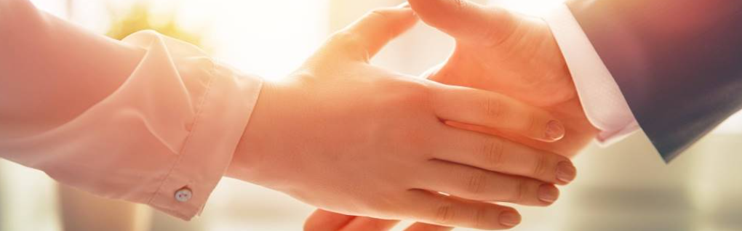
Welcome to our services
New Lebanon Church of Christ
We are Simply Christians.
Our Emphasis is Spiritual, Not Material or Social.
We are striving to be The Same Church as Described in The New Testament.
Please Come Back Again

Slide 2
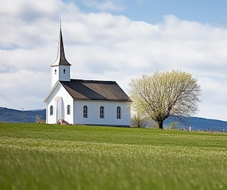
2Timothy 2:15 Be diligent to present yourself approved to God, a worker who does not need to be ashamed, rightly dividing the word of truth.

Slide 3
Questions?
Want to learn more about the Bible?
We will be glad to study the Bible with you.
New Lebanon
New Lebanon
Church of Christ
Church of Christ
New Lebanon, OH
newlebanoncoc.com
newlebanoncoc@gmail.com

Slide 4
Why I Am A Member Of
The Church Of Christ
Lesson Two

Slide 5


Slide 6
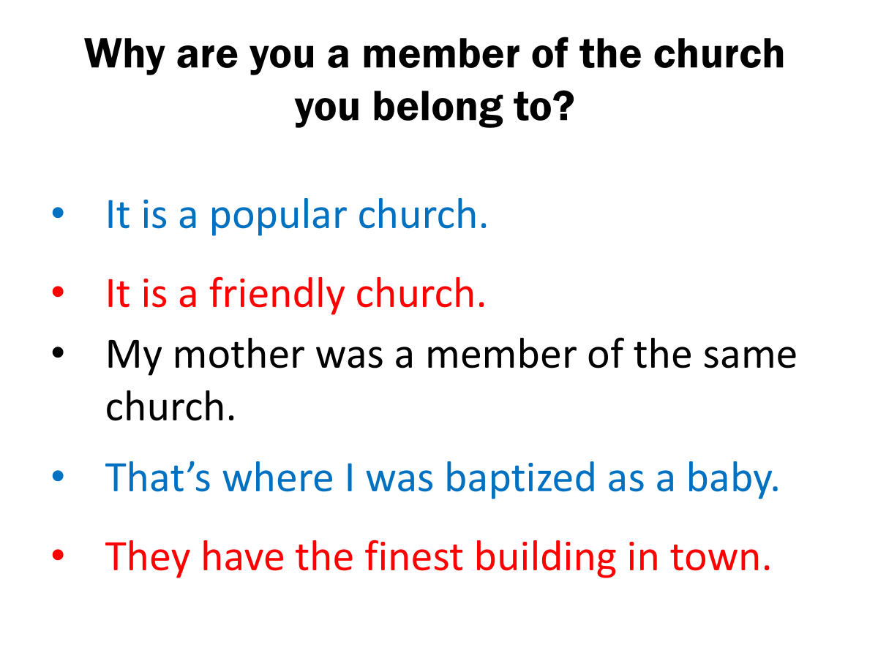

Slide 7
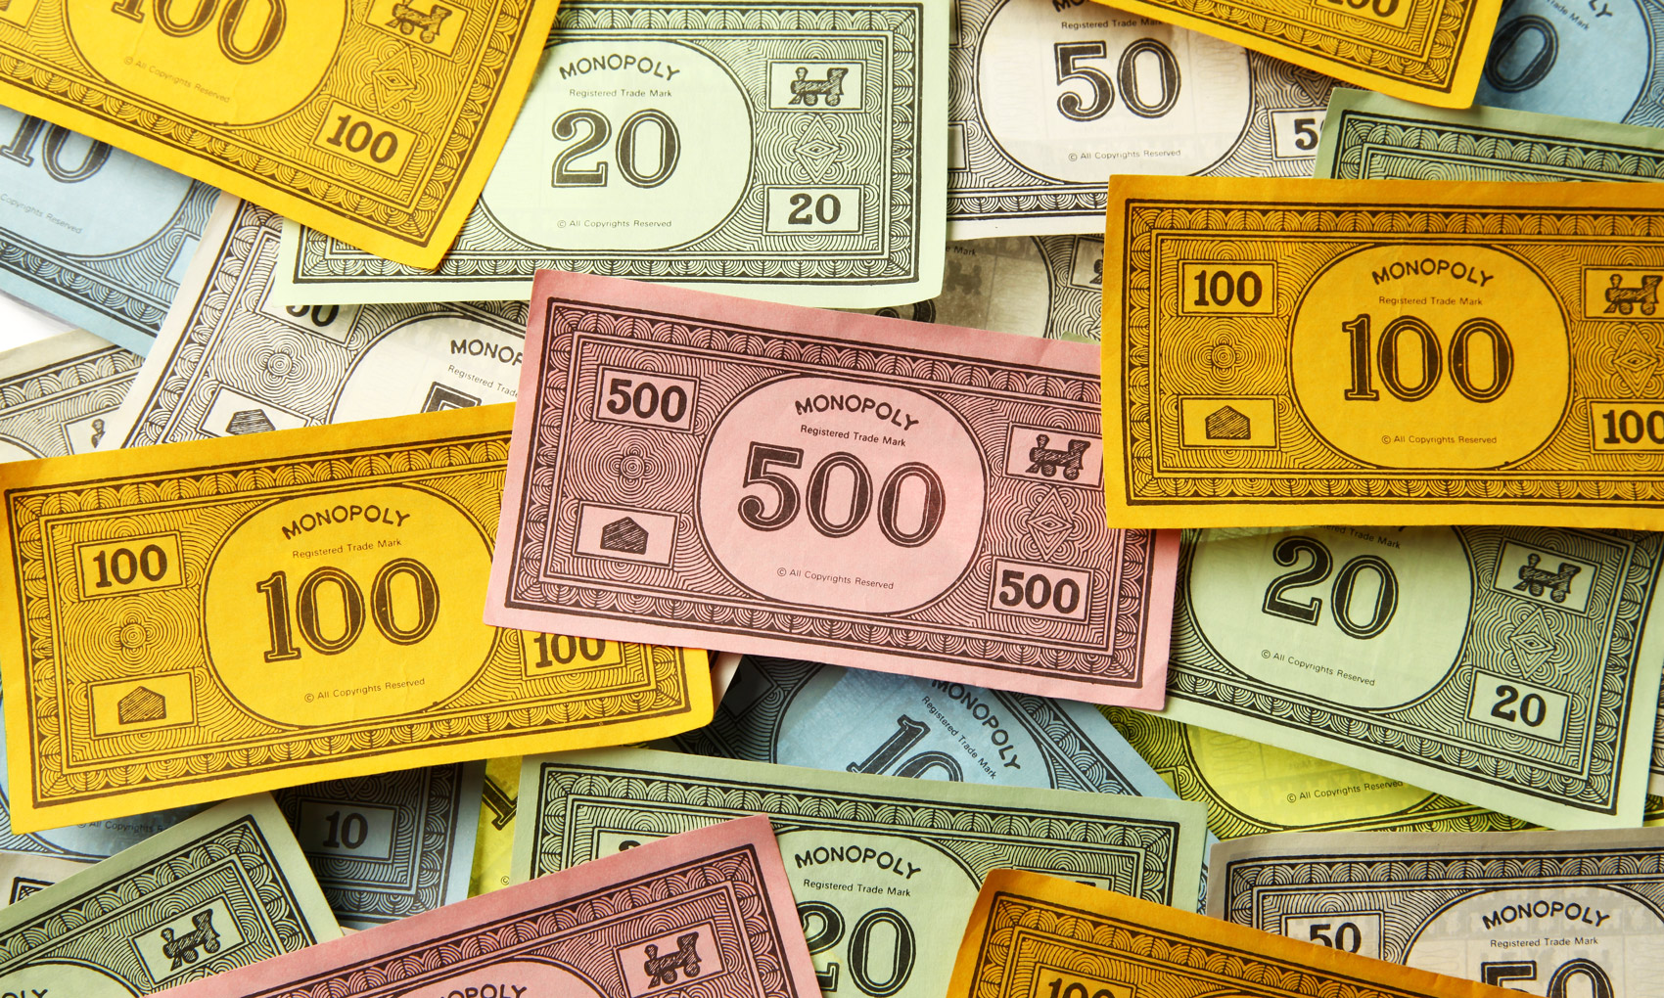
Is It Legitimate or are you playing with funny money?
Monopoly money - hellrts
hellrts.weebly.com

Slide 8
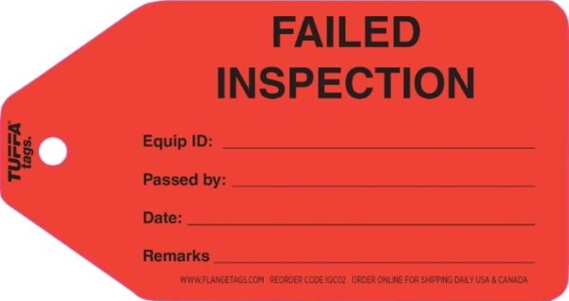
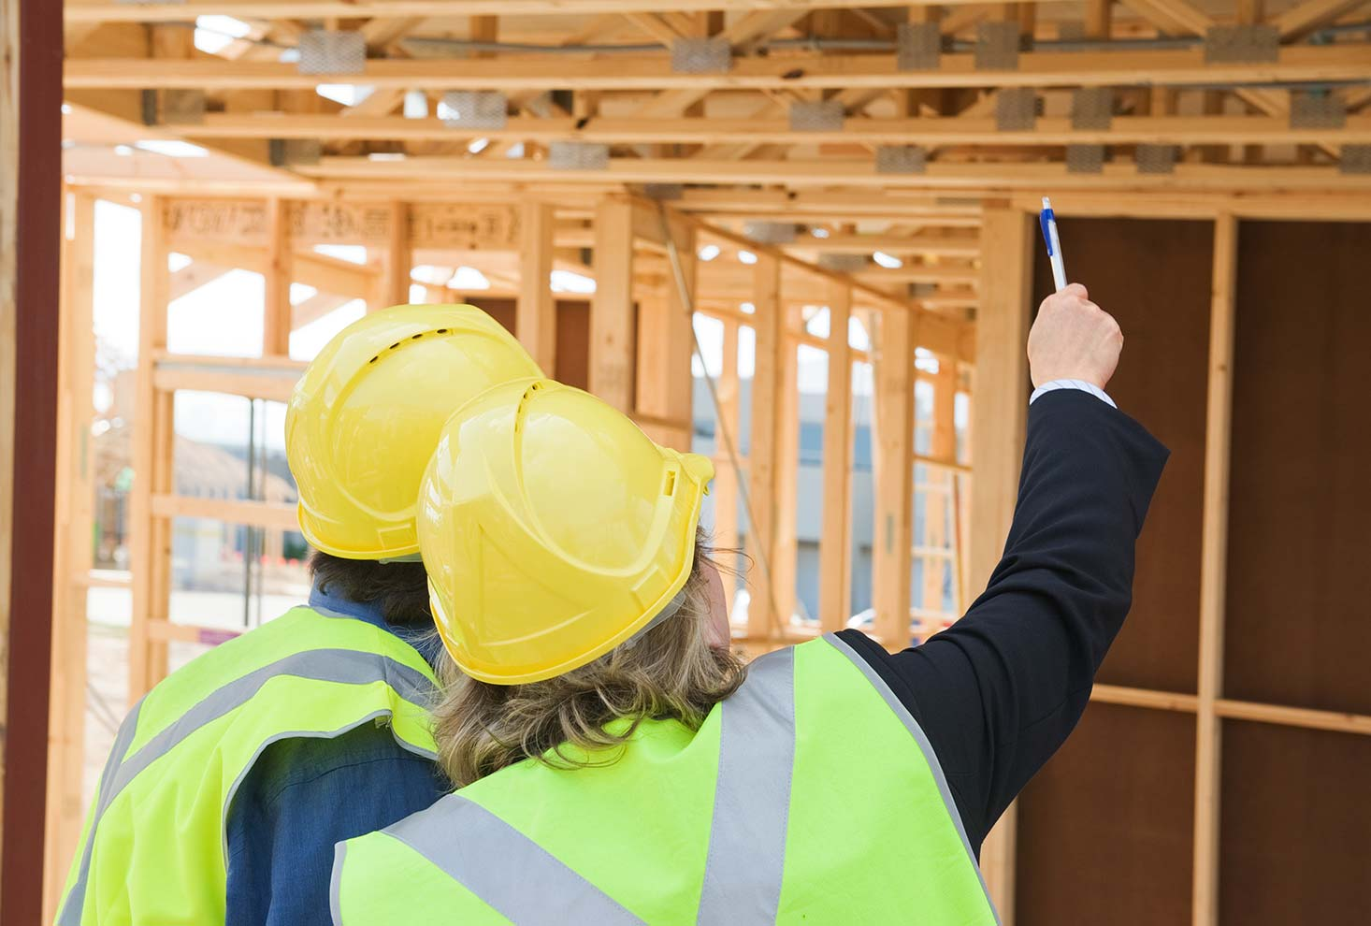
detailbuildinginspections.com.au

Slide 9
Why I Am A Member Of The Church Of Christ
1. Because it was founded by the scriptural builder – Christ
2. Because it was founded on the scriptural foundation.
3. Because it was founded at the scriptural place- Jerusalem.

Slide 10
Why I Am A Member Of The Church Of Christ
4. Because It Was Founded at The Scriptural Time- The First Pentecost Following the Resurrection of Christ.
5. Because Christ is the founder of only one church- His church.
6. Because it is scriptural in name.

Slide 11
Why I Am A Member Of The Church Of Christ
7. Because it is scriptural in organization.
8. Because it has the Bible as its only creed, no confession of faith or church manual.
9. Because it believes all the Bible to be the inspired word of God.

Slide 12
Why I Am A Member Of The Church Of Christ
10. Because it believes the Bible is a book to be rightly divided.

Slide 13
What does it mean to rightly divide??
Start with a dividing the testaments.
A proper classification of the books makes Bible study easier. The Old Testament is composed of 39 books and the New contains 27 books.
In the Old Testament we find books of law, history, poetry and prophecy. The first 5 books of the Bible have been called law, because they contain the law of Moses. The next 12 books are classed as history. And there are 6 poetical books: Job, Psalms, Proverbs, Ecclesiastes, Song of Solomon and Lamentations. The other 16 books of the Old Testament are classed as prophecy.
We must understand that the OT law was for the JEWS.

Slide 14
We need to rightly divide individual books and letters also.
Let’s use 1st Corinthians as an example. Why it was written?
1Cor. 7:1 Now concerning the things of which you wrote to me:

Slide 15
1) 1Cor. 7:1 Now concerning the things of which you wrote to me: It is good for a man not to touch a woman.
2) 1Cor. 7:25 Now concerning virgins
3) 1Cor. 8:1 Now concerning things offered to idols:
4) 1Cor. 8:4 Therefore concerning the eating of things offered to idols, we know that an idol is nothing in the world, and that there is no other God but one.
1 Cor. 11:17 begins addressing behavior in the ASSEMBLY
When you come together
When you come together as a church
When you come together in one place
Draw a line in your Bible at 1Cor.11:17

Slide 16
Paul talks about customs and practices which are not part of the church of Christ.
1Cor. 11:16 But if anyone seems to be contentious, we have no such custom, nor do the churches of God. NKJV
1Cor. 11:16 But if any man seem to be contentious, we have no such custom, neither the churches of God. KJV
* Remember Paul doesn’t start talking about assembly until v.17

Slide 17
You can’t put anything previous to chapter 11 v17 in the assembly because Paul doesn’t start talking about the assembly until 11:17
11:17 Now in giving these instructions I do not praise you, since you come together not for the better but for the worse.
11:18 For first of all, when you come together as a church,
11:20 Therefore when you come together in one place
14:23 Therefore if the whole church comes together in one place,

Slide 18
1Cor. 12 Now concerning spiritual gifts, brethren, I do not want you to be ignorant:
Paul lists 9 spiritual gifs
1Cor.13 But when that which is perfect has come, then that which is in part will be done away.
Paul gives duration of spiritual gifts
1 Cor.14 Therefore if the whole church comes together in one place, (14:23)
Paul REGULATES spiritual gifts in the ASSEMBLY and confirms he it is still in context of the assembly he introduced back in chapter 11:17.
Assembly is discussed from 11:17- through chapter 14

Slide 19
I Am A Member Of The Church Of Christ because we
RIGHTLY DIVIDE God’s word
we look at the context, the setting, and all the verses on a subject
Not just one verse,
like our believe only and faith only friends.

Slide 20
Why I Am A Member Of The Church Of Christ
10. Because it believes the Bible is a book to be rightly divided.
11. Because it is undenominational.
12. Because it is scriptural in doing missionary work.

Slide 21
Why I Am A Member Of The Church Of Christ
13. Because it teaches the kingdom has been established and Christ is now reigning........

Slide 22

The KINGDOM would come with POWER. The POWER would come when the HOLY SPIRIT came. Therefore, the KINGDOM came when the HOLY SPIRIT came.
HOW WE KNOW WHEN
THE KINGDOM CAME
Mark 9:1
“And he said unto them, Verily I say unto you, That there be some of them that stand here, which shall not taste of death, till they have seen the kingdom of God come with power. “
Mark 9:1
“And he said unto them, Verily I say unto you, That there be some of them that stand here, which shall not taste of death, till they have seen the kingdom of God come with power. “
Acts 1:8
“But ye shall receive power, after that the Holy Ghost is come upon you: and ye shall be witnesses unto me both in Jerusalem, and in all Judaea, and in Samaria, and unto the uttermost part of the earth.”
Acts 2:1-4
“¹And when the day of Pentecost was fully come, they were all with one accord in one place. ² And suddenly there came a sound from heaven as of a rushing mighty wind, and it filled all the house where they were sitting. ³ And there appeared unto them cloven tongues like as of fire, and it sat upon each of them. ⁴And they were all filled with the Holy Ghost, and began to speak with other tongues, as the Spirit gave them utterance.”

Slide 23
The KINGDOM would come with POWER. The POWER would come when the HOLY SPIRIT came. Therefore, the KINGDOM came when the HOLY SPIRIT came.
HOW WE KNOW WHEN
THE KINGDOM CAME
Acts 1:8
“But ye shall receive power, after that the Holy Ghost is come upon you: and ye shall be witnesses unto me both in Jerusalem, and in all Judaea, and in Samaria, and unto the uttermost part of the earth.”
Mark 9:1
“And he said unto them, Verily I say unto you, That there be some of them that stand here, which shall not taste of death, till they have seen the kingdom of God come with power. “
Acts 1:8
“But ye shall receive power, after that the Holy Ghost is come upon you: and ye shall be witnesses unto me both in Jerusalem, and in all Judaea, and in Samaria, and unto the uttermost part of the earth.”
Acts 2:1-4
“¹And when the day of Pentecost was fully come, they were all with one accord in one place. ² And suddenly there came a sound from heaven as of a rushing mighty wind, and it filled all the house where they were sitting. ³ And there appeared unto them cloven tongues like as of fire, and it sat upon each of them. ⁴And they were all filled with the Holy Ghost, and began to speak with other tongues, as the Spirit gave them utterance.”

Slide 24
The KINGDOM would come with POWER. The POWER would come when the HOLY SPIRIT came. Therefore, the KINGDOM came when the HOLY SPIRIT came.
Acts 2:1-4
“¹And when the day of Pentecost was fully come, they were all with one accord in one place. ²And suddenly there came a sound from heaven as of a rushing mighty wind, and it filled all the house where they were sitting. ³And there appeared unto them cloven tongues like as of fire, and it sat upon each of them. ⁴And they were all filled with the Holy Ghost, and began to speak with other tongues, as the Spirit gave them utterance.”
HOW WE KNOW WHEN
THE KINGDOM CAME
Mark 9:1
“And he said unto them, Verily I say unto you, That there be some of them that stand here, which shall not taste of death, till they have seen the kingdom of God come with power. “
Acts 1:8
“But ye shall receive power, after that the Holy Ghost is come upon you: and ye shall be witnesses unto me both in Jerusalem, and in all Judaea, and in Samaria, and unto the uttermost part of the earth.”
Acts 2:1-4
“¹And when the day of Pentecost was fully come, they were all with one accord in one place. ² And suddenly there came a sound from heaven as of a rushing mighty wind, and it filled all the house where they were sitting. ³ And there appeared unto them cloven tongues like as of fire, and it sat upon each of them. ⁴And they were all filled with the Holy Ghost, and began to speak with other tongues, as the Spirit gave them utterance.”

Slide 25
Why I Am A Member Of The Church Of Christ
13. Because it teaches the kingdom has been established and Christ is now reigning........
14. Because it gives scriptural answers to the question-what must I do to be saved?

Slide 26
CASE STUDIES OF CONVERSION
Acts | Preaching | Believed | Repented | Confessed | Baptized | Saved
2:22-41 | Pentecost |  | vv. 37-38 |  | vv. 38-41 | Remission Of Sins
8:12 | Samaritans | v. 12 |  |  | v. 12 | Believed
8:13 | Simon | v. 13 |  |  | v. 13
8:35-39 | Eunuch | vv. 36-37 |  | v. 37 | v. 38 | Rejoiced
9:17-18 | Saul |  |  |  | v. 18 | Sins Washed Away
10:34-48 | Cornelius | v. 43 |  |  | v. 48 | Remission Of Sins
16:13 | Lydia | v. 14 |  |  | v. 15
16:31-34 | The Jailer | v. 31 |  |  | v. 33 | Rejoiced
18:8 | Corinthians | v. 8 |  |  | v. 8
19:5 | Ephesians |  |  |  | v. 5
Baptized

Slide 27
Why I Am A Member Of The Church Of Christ
15. Because it teaches that man is saved by faith, but not by faith only.
16. Because it teaches that man is saved by the blood of Christ.
17. Because it teaches that a change of heart is indispensable to man's salvation.

Slide 28
Why I Am A Member Of The Church Of Christ
18. Because of its teaching and practice concerning prayer.
19. Because it teaches and administers scriptural baptism.
20. Because it teaches that a child of God can so sin as to be eternally lost.

Slide 29
Why I Am A Member Of The Church Of Christ
21. Because it teaches that infants are born pure and innocent rather than depraved.
22. Because it teaches that the miraculous manifestations of the spirit have ceased.
23. Because of its scriptural teaching and observance of the Lord's supper.

Slide 30
Why I Am A Member Of The Church Of Christ
24. Because it has scriptural music in the worship.
25. Because salvation is in Christ’s church.

Slide 31
The One Body
There Is One Body
Ephesians 2:14-16
Ephesians 4:4
1 Corinthians 12:12-13
Romans 12:4-5
The Body Is The Church
Colossians 1:18
Ephesians 1:23
Ephesians 5:23-25
1 Corinthians 12:12-13, 18
Salvation In
The Body
Ephesians 2:14-16
Ephesians 5:23
1 John 5:11
How Do We Enter
The Body?
Acts 2:47
1 Corinthians 12:13
Romans 6:3-4

