Slide 1
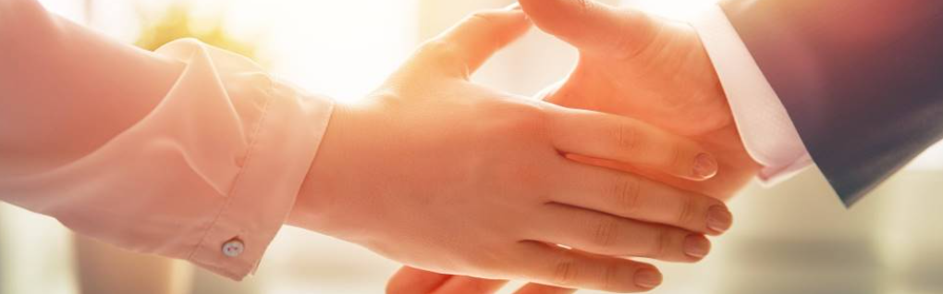
Welcome to our services
New Lebanon Church of Christ
We are Simply Christians.
Our Emphasis is Spiritual, Not Material or Social.
We are striving to be The Same Church as Described in The New Testament.
Please Come Back Again

Slide 2
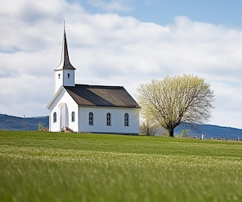
Matthew 16:18 "And I also say to you that you are Peter, and on this rock I will build My church, and the gates of Hades shall not prevail against it.

Slide 3
Questions?
Want to learn more about the Bible?
We will be glad to study the Bible with you.
New Lebanon
New Lebanon
Church of Christ
Church of Christ
New Lebanon, OH
newlebanoncoc.com
newlebanoncoc@gmail.com

Slide 4
Why I Am A Member Of
The Church Of Christ
Lesson Three

Slide 5


Slide 6
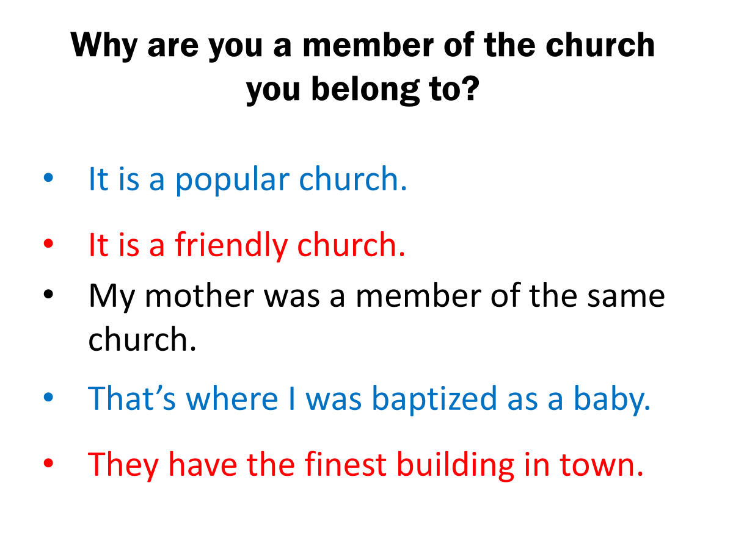

Slide 7

Is It Legitimate or are you playing with funny money?
Monopoly money - hellrts
hellrts.weebly.com

Slide 8
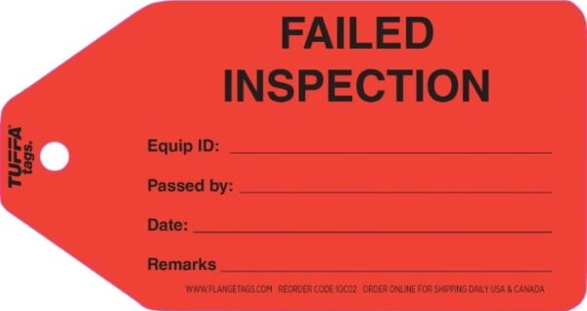
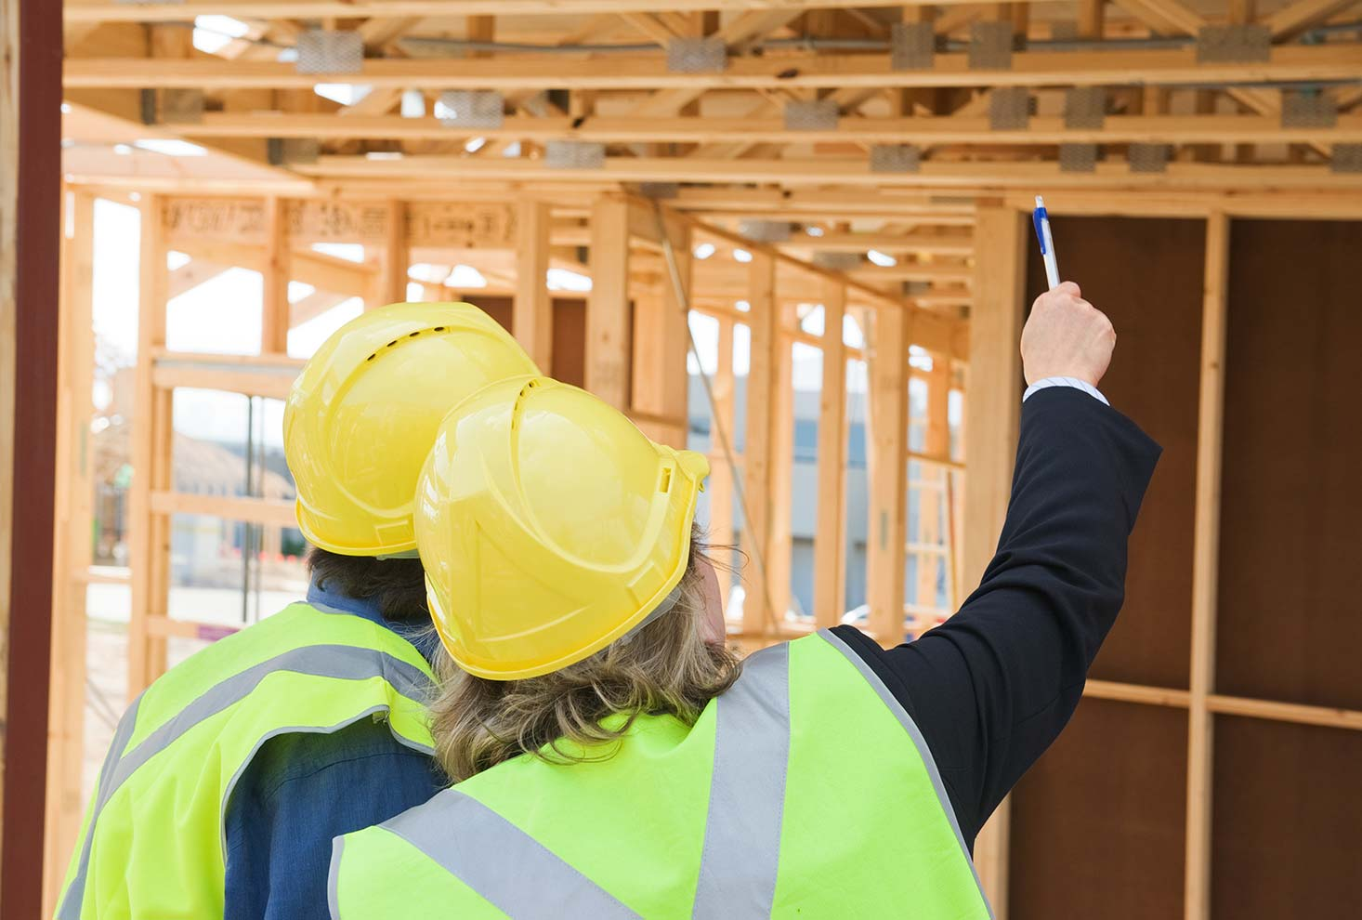
detailbuildinginspections.com.au

Slide 9
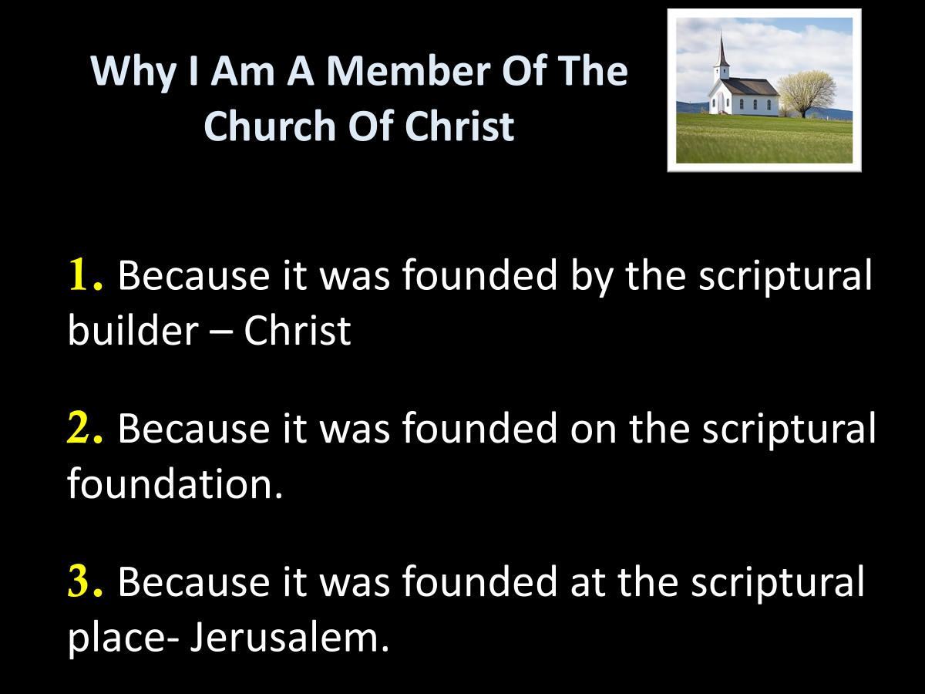

Slide 10
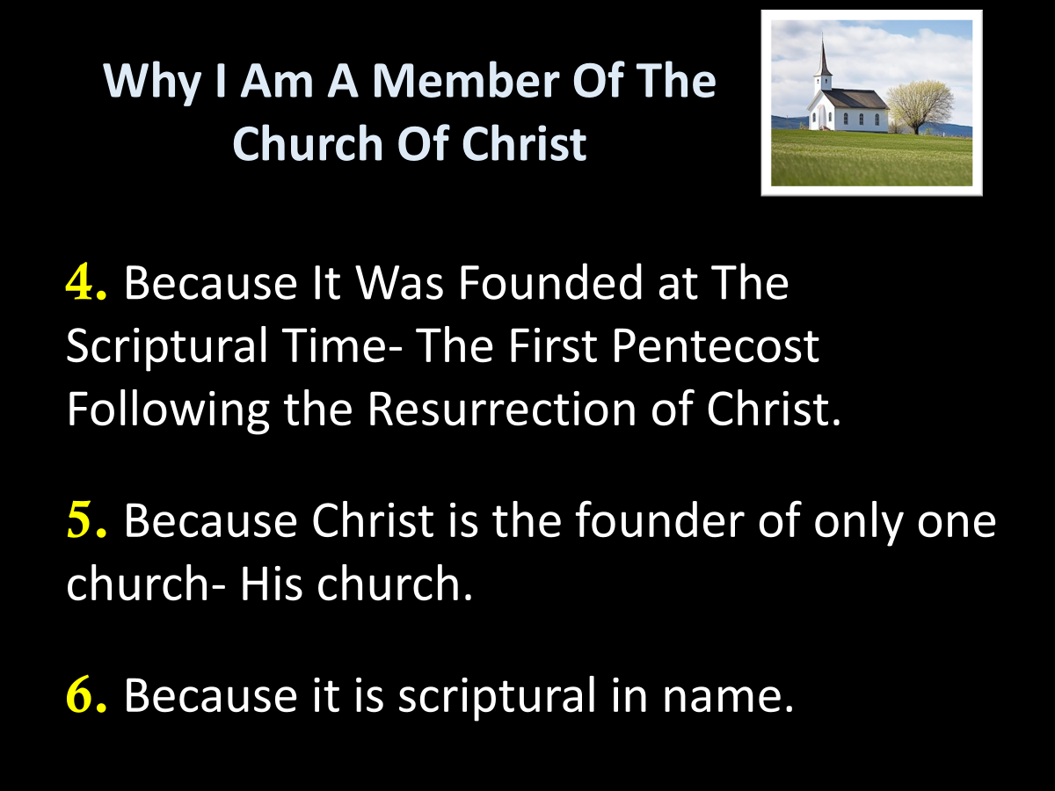

Slide 11
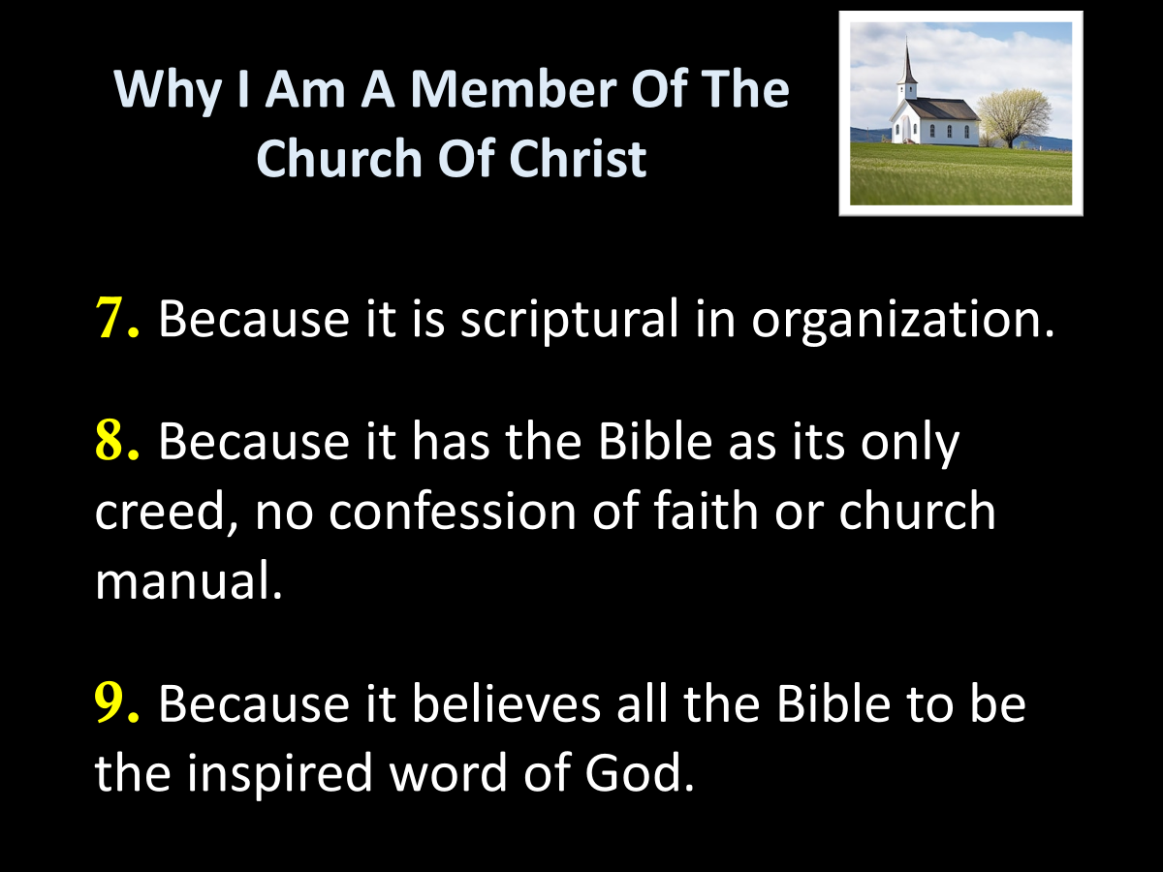

Slide 12
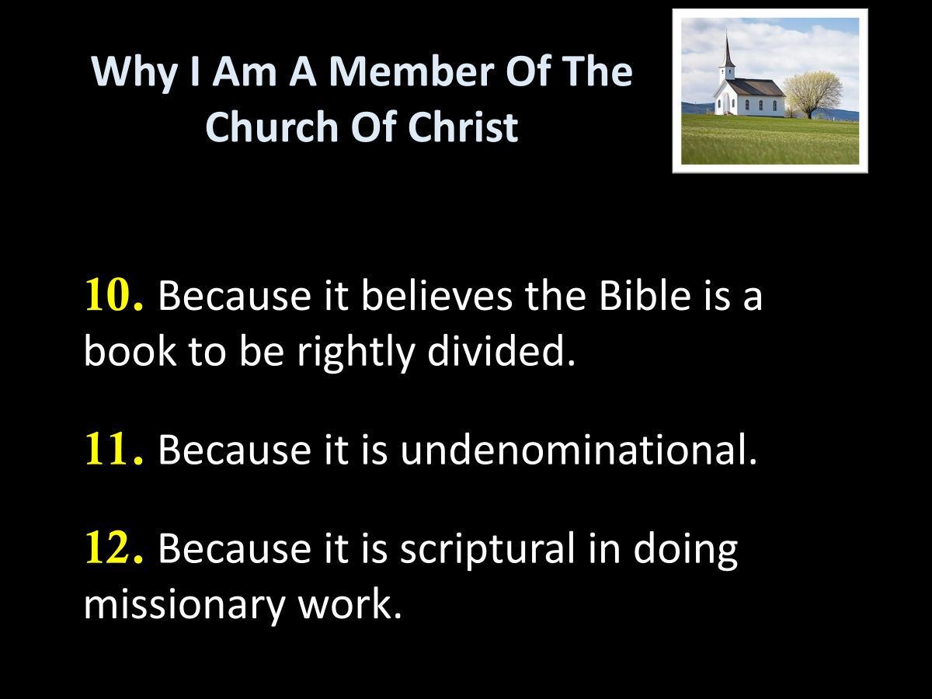

Slide 13
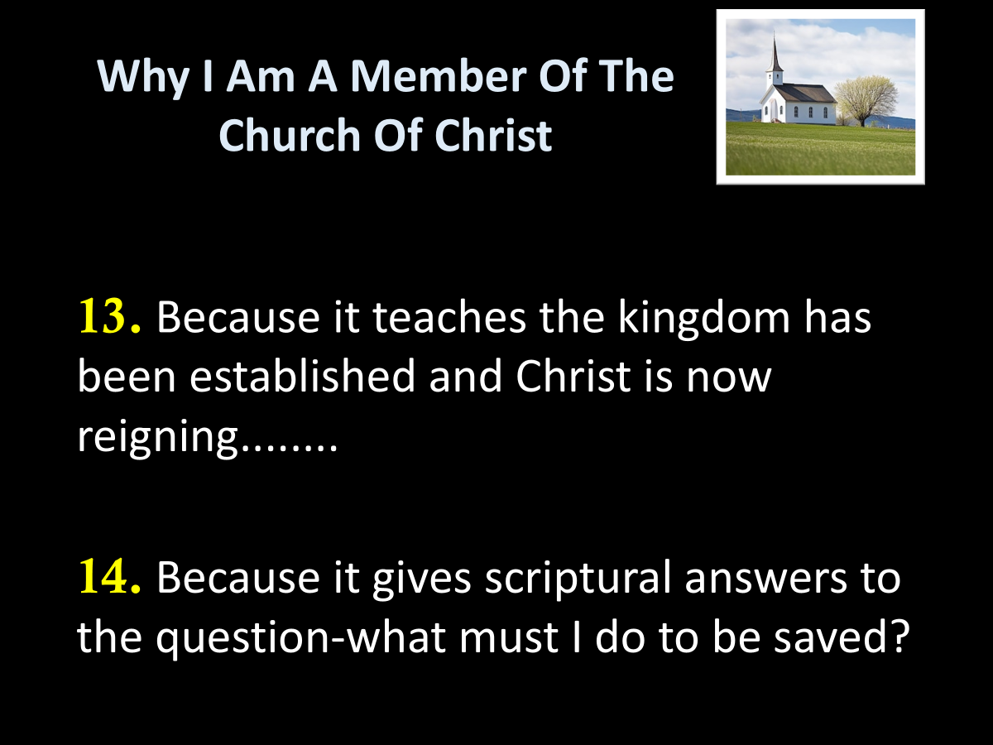

Slide 14
CASE STUDIES OF CONVERSION
Acts | Preaching | Believed | Repented | Confessed | Baptized | Saved
2:22-41 | Pentecost |  | vv. 37-38 |  | vv. 38-41 | Remission Of Sins
8:12 | Samaritans | v. 12 |  |  | v. 12 | Believed
8:13 | Simon | v. 13 |  |  | v. 13
8:35-39 | Eunuch | vv. 36-37 |  | v. 37 | v. 38 | Rejoiced
9:17-18 | Saul |  |  |  | v. 18 | Sins Washed Away
10:34-48 | Cornelius | v. 43 |  |  | v. 48 | Remission Of Sins
16:13 | Lydia | v. 14 |  |  | v. 15
16:31-34 | The Jailer | v. 31 |  |  | v. 33 | Rejoiced
18:8 | Corinthians | v. 8 |  |  | v. 8
19:5 | Ephesians |  |  |  | v. 5
Baptized

Slide 15
Why I Am A Member Of The Church Of Christ
15. Because it teaches that man is saved by faith, but not by faith only.
16. Because it teaches that man is saved by the blood of Christ.
17. Because it teaches that a change of heart is indispensable to man's salvation.

Slide 16
Why I Am A Member Of The Church Of Christ
18. Because of its teaching and practice concerning prayer.
19. Because it teaches and administers scriptural baptism.
20. Because it teaches that a child of God can so sin as to be eternally lost.

Slide 17
Why I Am A Member Of The Church Of Christ
21. Because it teaches that infants are born pure and innocent rather than depraved.

Slide 18

Some see sin like potatoes that can be passed from one person to another.
(Like passing from an adult to a child.)

Slide 19
It is impossible for sin to be inherited:
Sin is a violation of God's law by either commission or omission. Concerning commission: ''Whosoever committeth sin transgresseth also the law: for sin is the transgression of the law" (1John 3:4, K.J.V.).
Relative to omission: "To him therefore that knows to do good, and does it not, to him it is sin" (Jas. 4:17).
Sin is either a transgression or omission of law. This being true, it is absolutely impossible for man to inherit it because it is not an inherent quality.
The fact that God has not given a plan for saving infants is certain proof that they are not lost, that they are not sinners.

Slide 20
Acts 16:15 And when she and her household were baptized, she begged us, saying, "If you have judged me to be faithful to the Lord, come to my house and stay." So she persuaded us.
Can a baby believe? Mark 16:16
Can a baby repent ?? Acts 2:38
Can a baby be taught to observe all things??? Matt.28:20
Is a baby baptized by immersion ???? Acts 8:38-39
Does a baby have sin ????? Ezekiel 18:20
Is infant baptism in the name of Jesus????? Col.3:17

Slide 21
Why I Am A Member Of The Church Of Christ
21. Because it teaches that infants are born pure and innocent rather than depraved.
22. Because it teaches that the miraculous manifestations of the spirit have ceased.

Slide 22
1Cor. 12 Now concerning spiritual gifts, brethren, I do not want you to be ignorant:
Paul lists 9 spiritual gifs
1Cor.13 But when that which is perfect has come, then that which is in part will be done away.
Paul gives duration of spiritual gifts
1 Cor.14 Therefore if the whole church comes together in one place, (14:23)
Paul REGULATES spiritual gifts in the ASSEMBLY and confirms it is still in context of the assembly he introduced back in chapter 11:17.

Slide 23
1Cor.13 But when that (neuter, not masculine) which is perfect (complete) has come then that which is in part will be done away. (Distinguishing between part and whole)
James 1:25 But he who looks into the perfect law of liberty and continues in it, and is not a forgetful hearer (Romans 10:17 So then faith comes by hearing, and hearing by the word of God.) but a doer of the work, this one will be blessed in what he does.
Jude 1:3 Beloved, while I was very diligent to write to you concerning our common salvation, I found it necessary to write to you exhorting you to contend earnestly for the faith which was once for all (time) delivered to the saints.

Slide 24
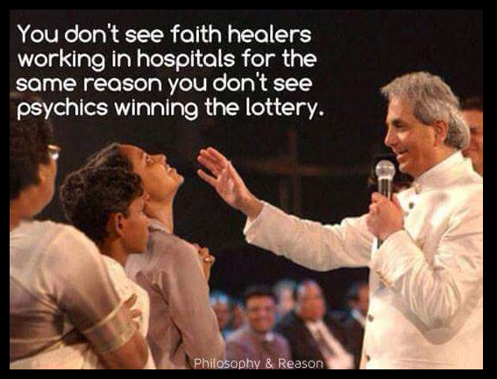

Slide 25
Why I Am A Member Of The Church Of Christ
21. Because it teaches that infants are born pure and innocent rather than depraved.
22. Because it teaches that the miraculous manifestations of the spirit have ceased.
23. Because of its scriptural teaching and observance of the Lord's supper.

Slide 26
Why I Am A Member Of The Church Of Christ
24. Because it has scriptural music in the worship.

Slide 27
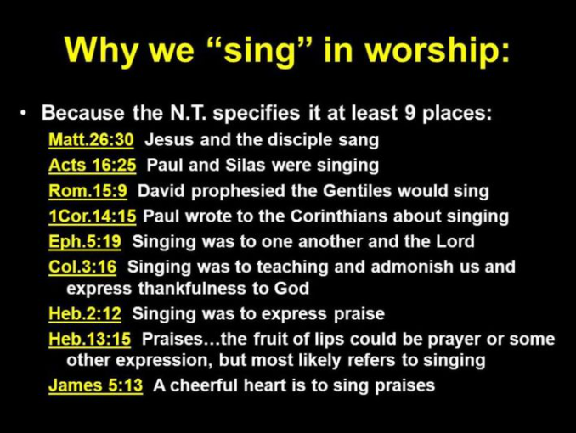

Slide 28
Why I Am A Member Of The Church Of Christ
24. Because it has scriptural music in the worship.
25. Because salvation is in Christ’s church.

Slide 29
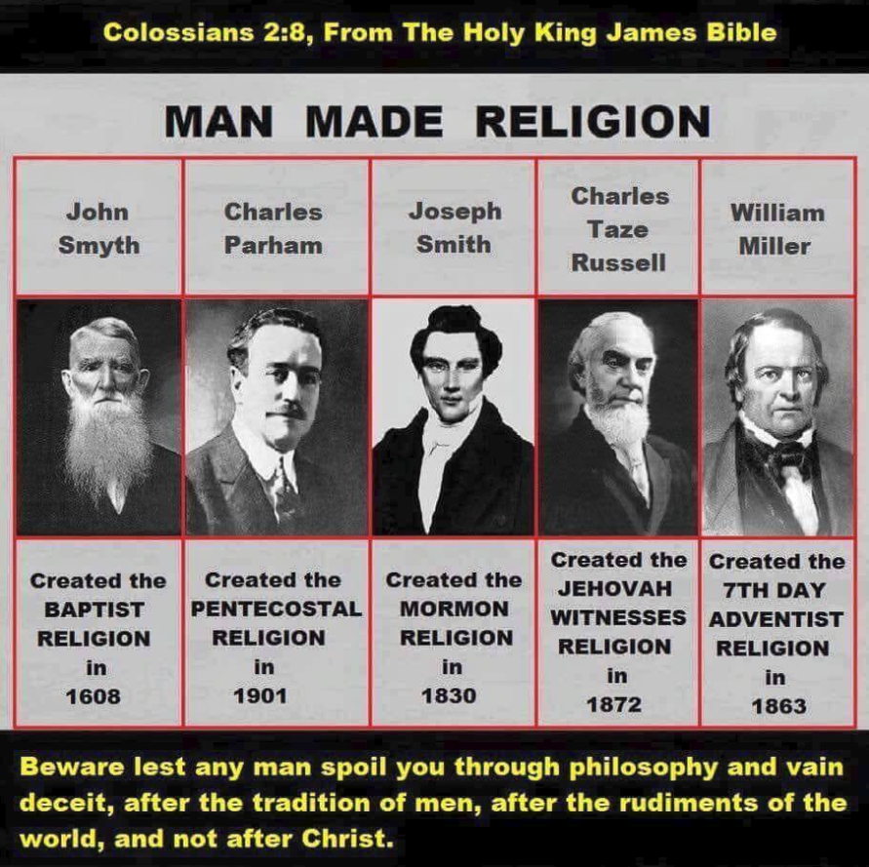

Slide 30
The One Body
There Is One Body
Ephesians 2:14-16
Ephesians 4:4
1 Corinthians 12:12-13
Romans 12:4-5
The Body Is The Church
Colossians 1:18
Ephesians 1:23
Ephesians 5:23-25
1 Corinthians 12:12-13, 18
Salvation In
The Body
Ephesians 2:14-16
Ephesians 5:23
1 John 5:11
How Do We Enter
The Body?
Acts 2:47
1 Corinthians 12:13
Romans 6:3-4

