Slide 1

Welcome to our services
New Lebanon Church of Christ
We are Simply Christians.
Our Emphasis is Spiritual, Not Material or Social.
We are striving to be The Same Church as Described in The New Testament.
Please Come Back Again

Slide 2
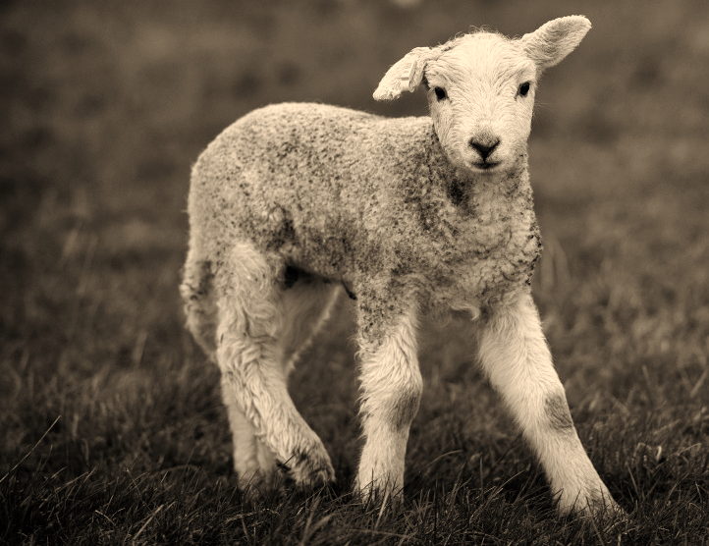
Why Are So Many Lost?
Matthew 13:15 For the hearts of this people have grown dull. Their ears are hard of hearing, And their eyes they have closed, Lest they should see with their eyes and hear with their ears, Lest they should understand with their hearts and turn, So that I should heal them..'

Slide 3
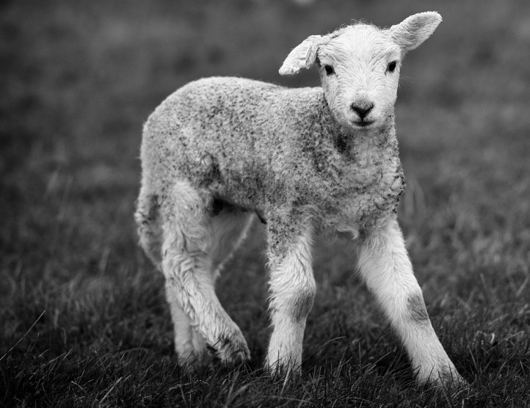
Why Are So Many Lost?
Matthew 13:15

Slide 4
Questions?
Want to learn more about the Bible?
We will be glad to study the Bible with you.
New Lebanon
New Lebanon
Church of Christ
Church of Christ
New Lebanon, OH
newlebanoncoc.com
newlebanoncoc@gmail.com

Slide 5


Slide 6
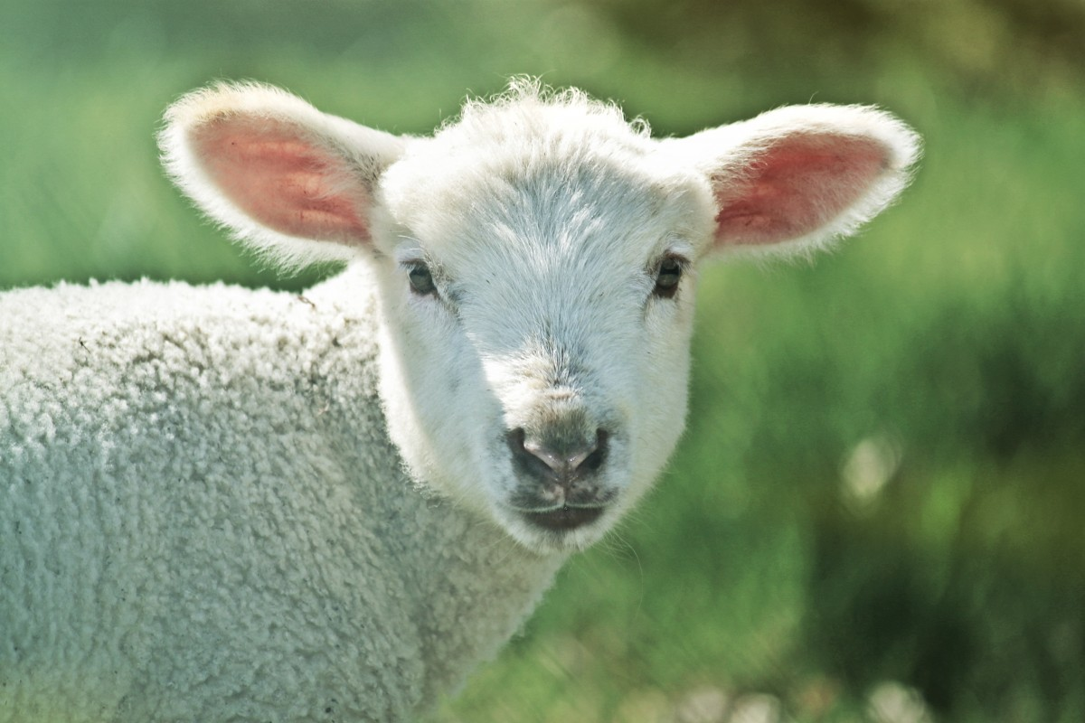
Why Are So Many Lost?
1. Because Many are not saved.
2. Many do not believe sin separates them from God.
3. Many do not think or believe that they are lost.
newlebanoncoc.com

Slide 7
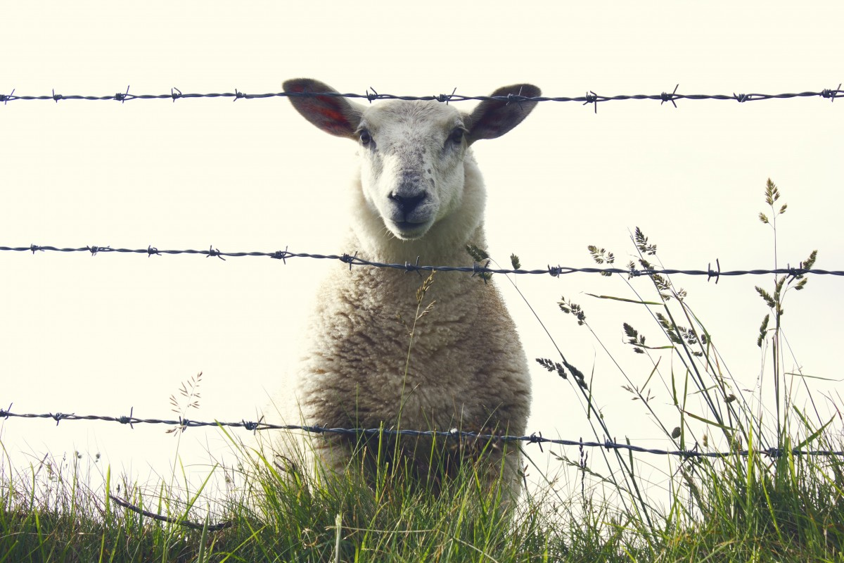
Why Are So Many Lost?
4. Many are trusting in faith only.
5. Many are trusting in feelings to assure them of salvation
5. Many are trusting in feelings to assure them of salvation.
6. Many are trusting in moral goodness.
newlebanoncoc.com

Slide 8
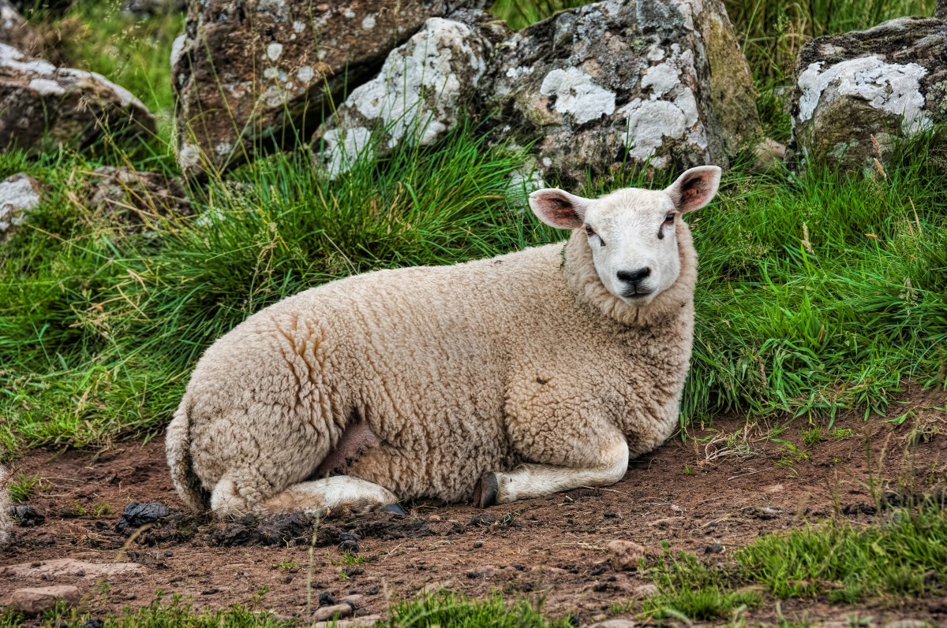
Why Are So Many Lost?
7. Many will not give up the religion of their parents.
8. Many are biased and they will not read and investigate the Bible.
9. They love sin.
10. They have become hardened.
newlebanoncoc.com

Slide 9
Why Are So Many Lost?
11. They become unfaithful.
12. They will not repent.
13. Many are LOST because we do not go and teach them.
newlebanoncoc.com

Slide 10
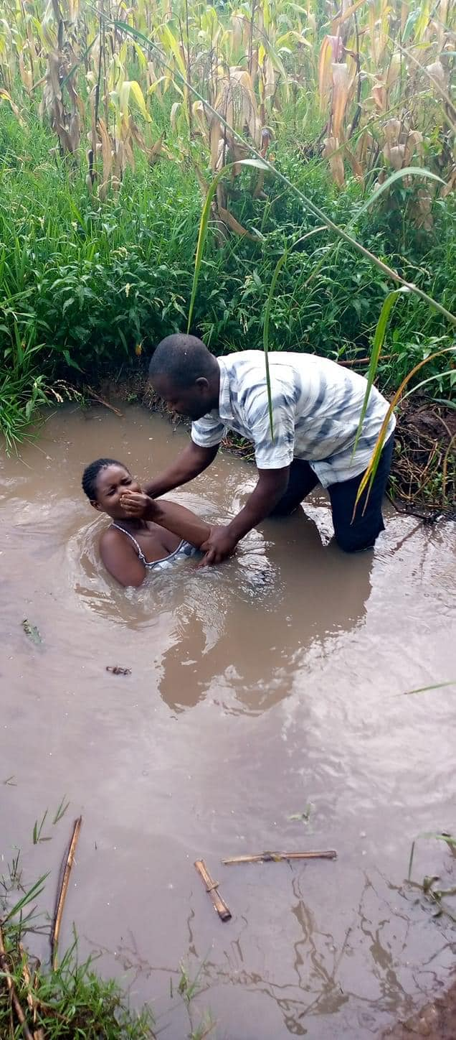

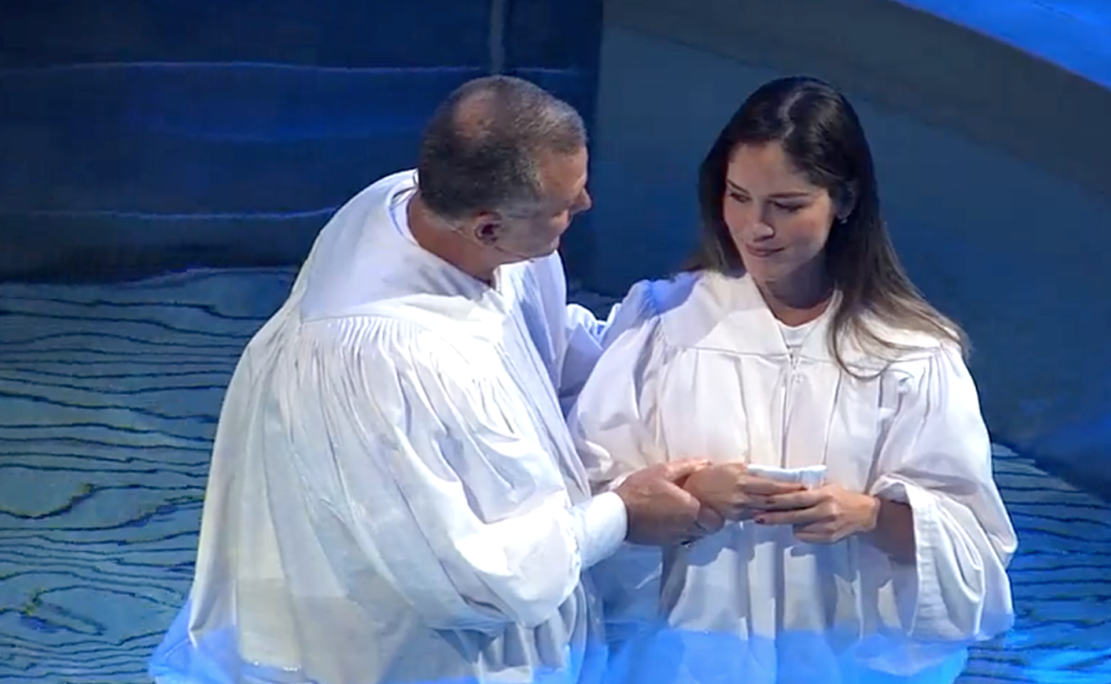
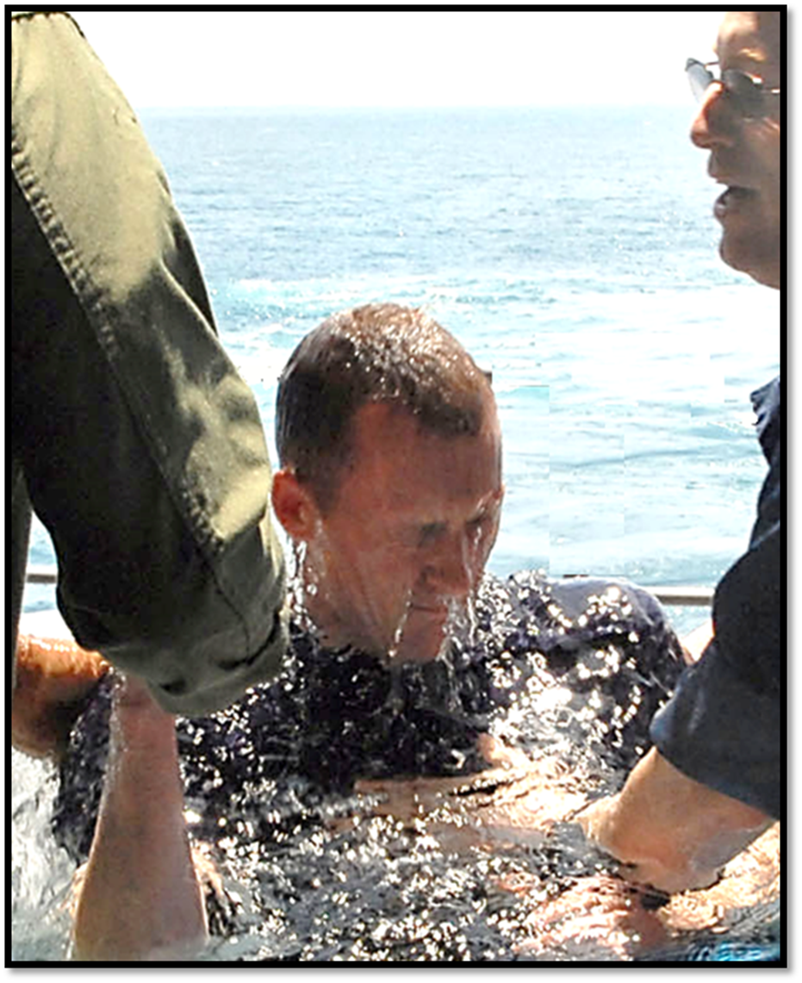
How do we get into the church? We are baptized into Christ and the Lord adds us to His church.
Acts 2:47 praising God and having favor with all the people. And the Lord added to the church daily those who were being saved.

Slide 11
The One Body
There Is One Body
Ephesians 2:14-16
Ephesians 4:4
1 Corinthians 12:12-13
Romans 12:4-5
The Body Is The Church
Colossians 1:18
Ephesians 1:23
Ephesians 5:23-25
1 Corinthians 12:12-13, 18
Salvation In
The Body
Ephesians 2:14-16
Ephesians 5:23
1 John 5:11
How Do We Enter
The Body?
Acts 2:47
1 Corinthians 12:13
Romans 6:3-4

