Slide 1
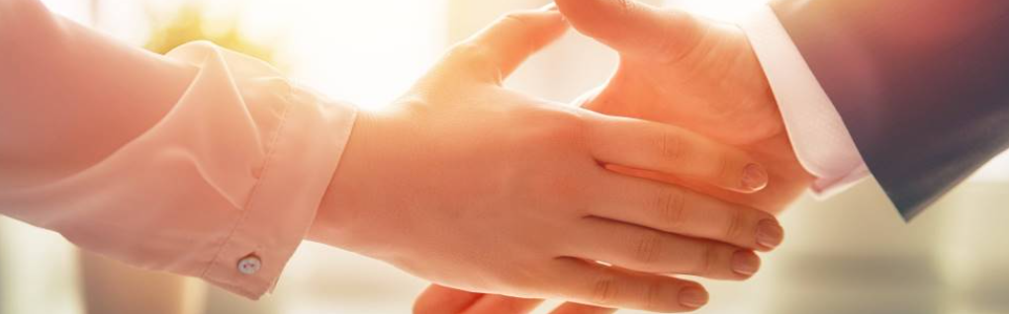
Welcome to our services
New Lebanon Church of Christ
We are Simply Christians.
Our Emphasis is Spiritual, Not Material or Social.
We are striving to be The Same Church as Described in The New Testament.
Please Come Back Again

Slide 2
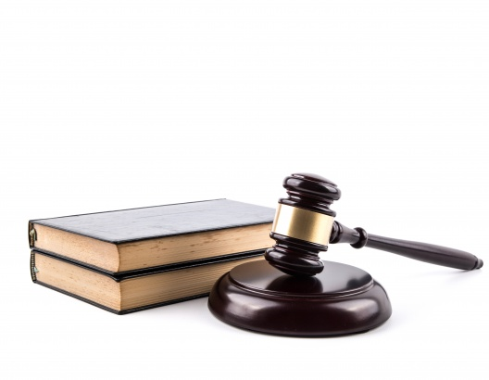
Revelation 20:12 And I saw the dead, small and great, standing before God, and books were opened. And another book was opened, which is the Book of Life. And the dead were judged according to their works, by the things which were written in the books.
newlebanoncoc.com

Slide 3
Questions?
Want to learn more about the Bible?
We will be glad to study the Bible with you.
New Lebanon
New Lebanon
Church of Christ
Church of Christ
New Lebanon, OH
newlebanoncoc.com
newlebanoncoc@gmail.com

Slide 4

Jesus is
coming.
Are you
ready?

Slide 5
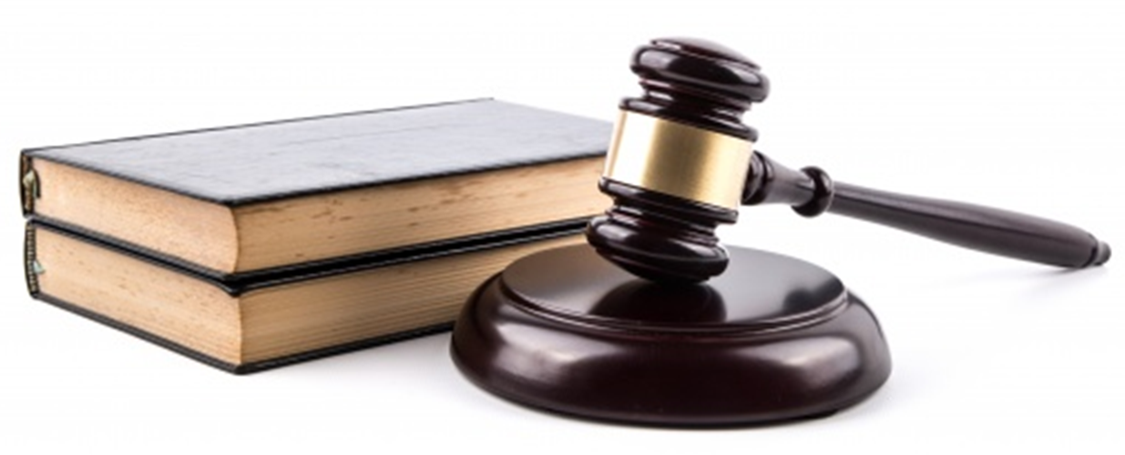
The Dead Were Judged By Things Written In The Books
Revelation 20:12 And I saw the dead, small and great, standing before God, and books were opened. And another book was opened, which is the Book of Life. And the dead were judged according to their works, by the things which were written in the books.
John 12:48 "He who rejects Me, and does not receive My words, has that which judges him--the word that I have spoken will judge him in the last day.
newlebanoncoc.com

Slide 6
The Dead Were Judged By Things Written In The Books
1. Is there any punishment at all after death?
2. When does the suffering mentioned by our Lord begin?
3. Is there such a final judgment as we have heard and been taught to believe?
4. What is to follow in the way of PUNISHMENT, if anything, after the universal judgment?
5. How long will that punishment, which comes after the judgment last?
newlebanoncoc.com

Slide 7
The Dead Were Judged By Things Written In The Books
1. Is there any punishment for the wicked after death?
ABSOLUTELY
newlebanoncoc.com

Slide 8
The Dead Were Judged By Things Written In The Books
2. When does the punishment begin?
IMMEDIATELY
newlebanoncoc.com

Slide 9
The Dead Were Judged By Things Written In The Books
3. Is there a future, final and universal judgment?
ABSOLUTELY
newlebanoncoc.com

Slide 10
The Dead Were Judged By Things Written In The Books
4. What is to follow in the way of PUNISHMENT, if anything, after the universal judgment?
THE MOST HORRIBLE, excruciating KIND POSSIBLE.
newlebanoncoc.com

Slide 11
The Dead Were Judged By Things Written In The Books
5. How long, if there is a punishment after the judgment day, how long will that punishment last?
ETERNALLY, Forever and ever without end.
newlebanoncoc.com

Slide 12
Revelation 20:12 And I saw the dead, small and great, standing before God, and books were opened. And another book was opened, which is the Book of Life. And the dead were judged according to their works, by the things which were written in the books.

