Slide 1

Welcome to our services
New Lebanon Church of Christ
We are Simply Christians.
Our Emphasis is Spiritual, Not Material or Social.
We are striving to be The Same Church as Described in The New Testament.
Please Come Back Again

Slide 2
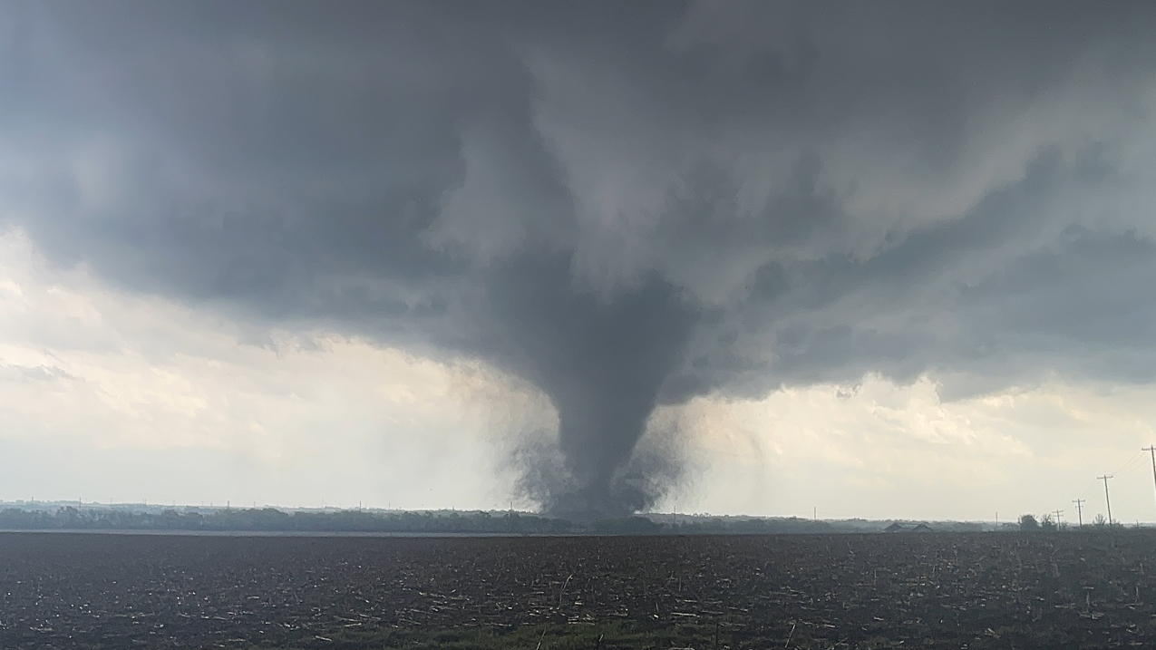
Has God Stirred Up YOUR Spirit?
Ezra 1:1 Now in the first year of Cyrus king of Persia, that the word of the LORD by the mouth of Jeremiah might be fulfilled, the LORD stirred up the spirit of Cyrus king of Persia, so that he made a proclamation throughout all his kingdom, and also put it in writing, saying,
2 Thus says Cyrus king of Persia: All the kingdoms of the earth the LORD God of heaven has given me. And He has commanded me to build Him a house at Jerusalem which is in Judah.

Slide 3
Has God Stirred Up YOUR Spirit?
Ezra 1:1-11

Slide 4
Questions?
Want to learn more about the Bible?
We will be glad to study the Bible with you.
New Lebanon
New Lebanon
Church of Christ
Church of Christ
New Lebanon, OH
newlebanoncoc.com
newlebanoncoc@gmail.com

Slide 5
Has God Stirred Up YOUR Spirit?
1. The Spirit Needs Stirring Up.
Ezra 1:1-11

Slide 6
Has God Stirred Up YOUR Spirit?
2. GOD ALONE CAN STIR UP THE SPIRIT.
Ezra 1:1-11

Slide 7
Has God Stirred Up YOUR Spirit?
3. The Means By Which The Spirit Was Stirred Up. The Word.
The Word Of God
The Providence Of God.
Ezra 1:1-11

Slide 8
Has God Stirred Up YOUR Spirit?
4. The Evidences Of A Stirred-up Spirit.
There Is Faith In The Word Of God.
There Is Confession Of The Purpose Of God.
There Are Generous Things Devised For The Honor Of God.
Ezra 1:1-11

Slide 9
Has God Stirred Up YOUR Spirit?

Slide 10
HELL
Is Not Full
of people that
God rejected.
HELL Is Full Of People
That rejected GOD!
John 14:6
newlebanoncoc.com

Slide 11

Jesus is
coming.
Are you
ready?

