Slide 1
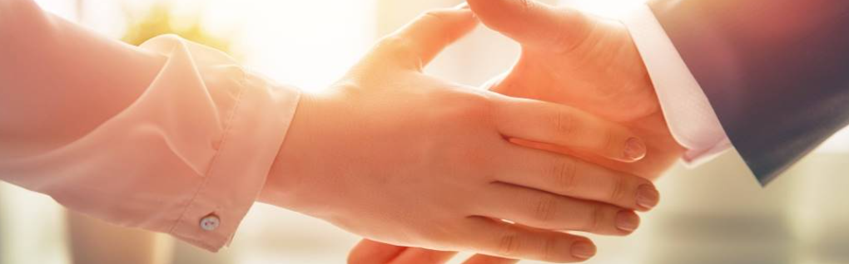
Welcome to our services
New Lebanon Church of Christ
We are Simply Christians.
Our Emphasis is Spiritual, Not Material or Social.
We are striving to be The Same Church as Described in The New Testament.
Please Come Back Again

Slide 2

John 4:23 "But the hour is coming, and now is, when the true worshipers will worship the Father in spirit and truth; for the Father is seeking such to worship Him. 24 "God is Spirit, and those who worship Him must worship in spirit and truth."

Slide 3
Questions?
Want to learn more about the Bible?
We will be glad to study the Bible with you.
New Lebanon
New Lebanon
Church of Christ
Church of Christ
New Lebanon, OH
newlebanoncoc.com
newlebanoncoc@gmail.com

Slide 4
Why Must We Worship God As He describes
In the new Testament?
In order to establish the proper relationship with Him.
If we do not do what he commands us to do…
If we do not do what he commands us to do with all our heart…then
We cannot have the proper relationship with our creator.
newlebanoncoc.com

Slide 5
Why Must We Worship God As He describes
In the new Testament?
1. Because God is worthy of all worship.
2. Because God wants us to (Teaches Us To Worship)
3. To Express The Feeling Of Our Souls
4. To Commune With God
5. To Praise God
6. To prepare us to worship him for time without end.
newlebanoncoc.com

Slide 6
The One Body
There Is One Body
Ephesians 2:14-16
Ephesians 4:4
1 Corinthians 12:12-13
Romans 12:4-5
The Body Is The Church
Colossians 1:18
Ephesians 1:23
Ephesians 5:23-25
1 Corinthians 12:12-13, 18
Salvation In
The Body
Ephesians 2:14-16
Ephesians 5:23
1 John 5:11
How Do We Enter
The Body?
Acts 2:47
1 Corinthians 12:13
Romans 6:3-4

Slide 7

Jesus is
coming.
Are you
ready?

