Slide 1
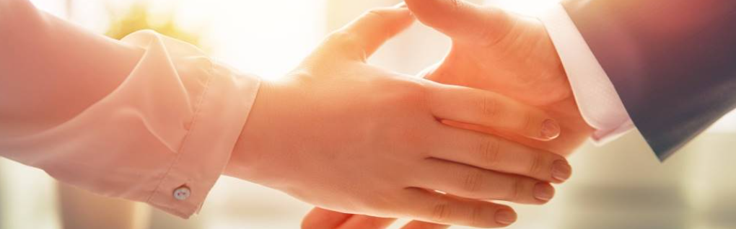
Welcome to our services
New Lebanon Church of Christ
We are Simply Christians.
Our Emphasis is Spiritual, Not Material or Social.
We are striving to be The Same Church as Described in The New Testament.
Please Come Back Again

Slide 2
Questions?
Want to learn more about the Bible?
We will be glad to study the Bible with you.
New Lebanon
New Lebanon
Church of Christ
Church of Christ
New Lebanon, OH
newlebanoncoc.com
newlebanoncoc@gmail.com

Slide 3
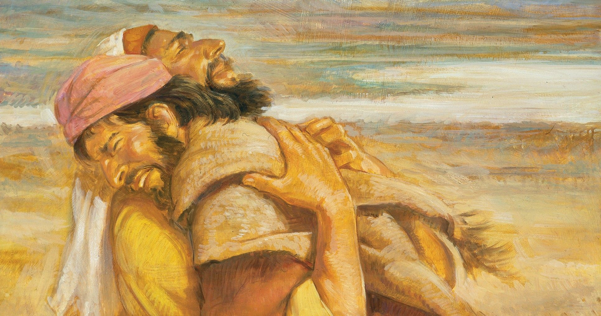
What Does Forgiveness Look Like?

Slide 4
What Does Forgiveness Look Like?
Esau forgave his brother Jacob after years of estrangement.
Genesis 25-33
Gen.27:41-46, Gen. 33
Genesis 33:4 But Esau ran to meet him, and embraced him, and fell on his neck and kissed him, and they wept.
newlebanoncoc.com

Slide 5
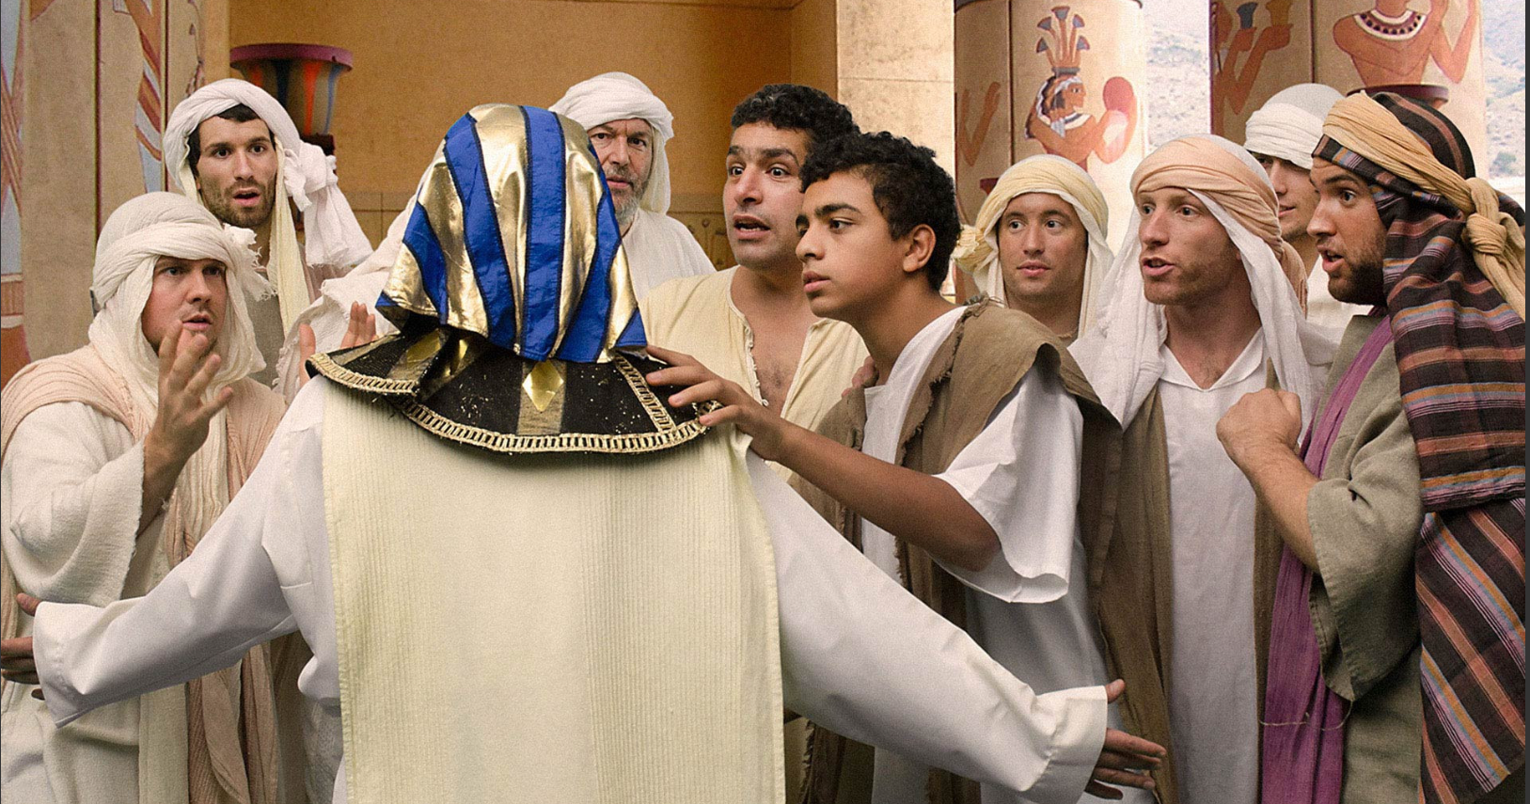
What Does Forgiveness Look Like?

Slide 6
What Does Forgiveness Look Like?
Joseph forgave his brothers who betrayed him.
Genesis 37–50
Genesis 50:15-21
Genesis 50:20 But as for you, you meant evil against me; but God meant it for good, in order to bring it about as it is this day, to save many people alive.
newlebanoncoc.com

Slide 7
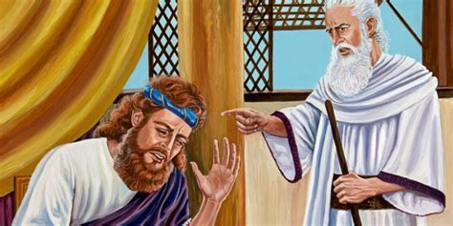
What Does Forgiveness Look Like?

Slide 8
What Does Forgiveness Look Like?
David asked for God’s forgiveness for his adultery with Bathsheba.
2 Samuel 11:1–12:25; Psalm 51
Psalm 51:2 Wash me thoroughly from my iniquity, And cleanse me from my sin. 3 For I acknowledge my transgressions, And my sin is always before me.
newlebanoncoc.com

Slide 9
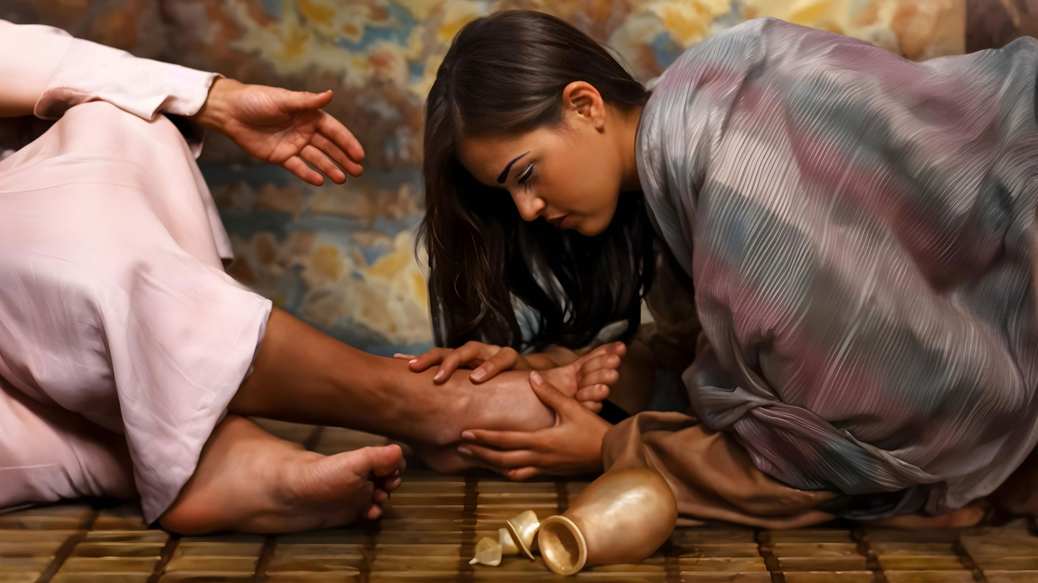
What Does Forgiveness Look Like?

Slide 10
What Does Forgiveness Look Like?
Out of love, a forgiven woman anointed
Jesus’ feet.
Luke 7:36–50
Luke 7:47 Therefore I say to you, her sins, which are many, are forgiven, for she loved much. But to whom little is forgiven, the same loves little."
newlebanoncoc.com

Slide 11
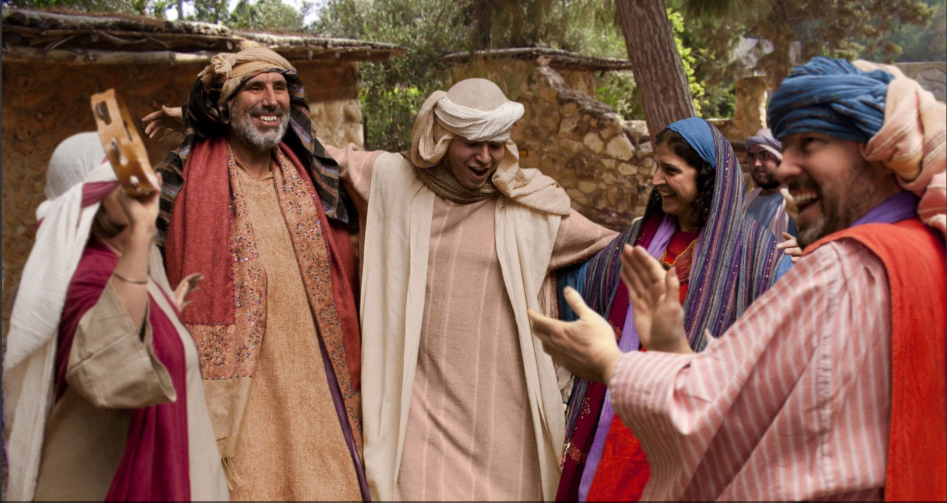
What Does Forgiveness Look Like?

Slide 12
What Does Forgiveness Look Like?
The Parable of the Prodigal Son
Luke 15:11–32
Luke 15:20 "And he arose and came to his father. But when he was still a great way off, his father saw him and had compassion, and ran and fell on his neck and kissed him.
newlebanoncoc.com

Slide 13
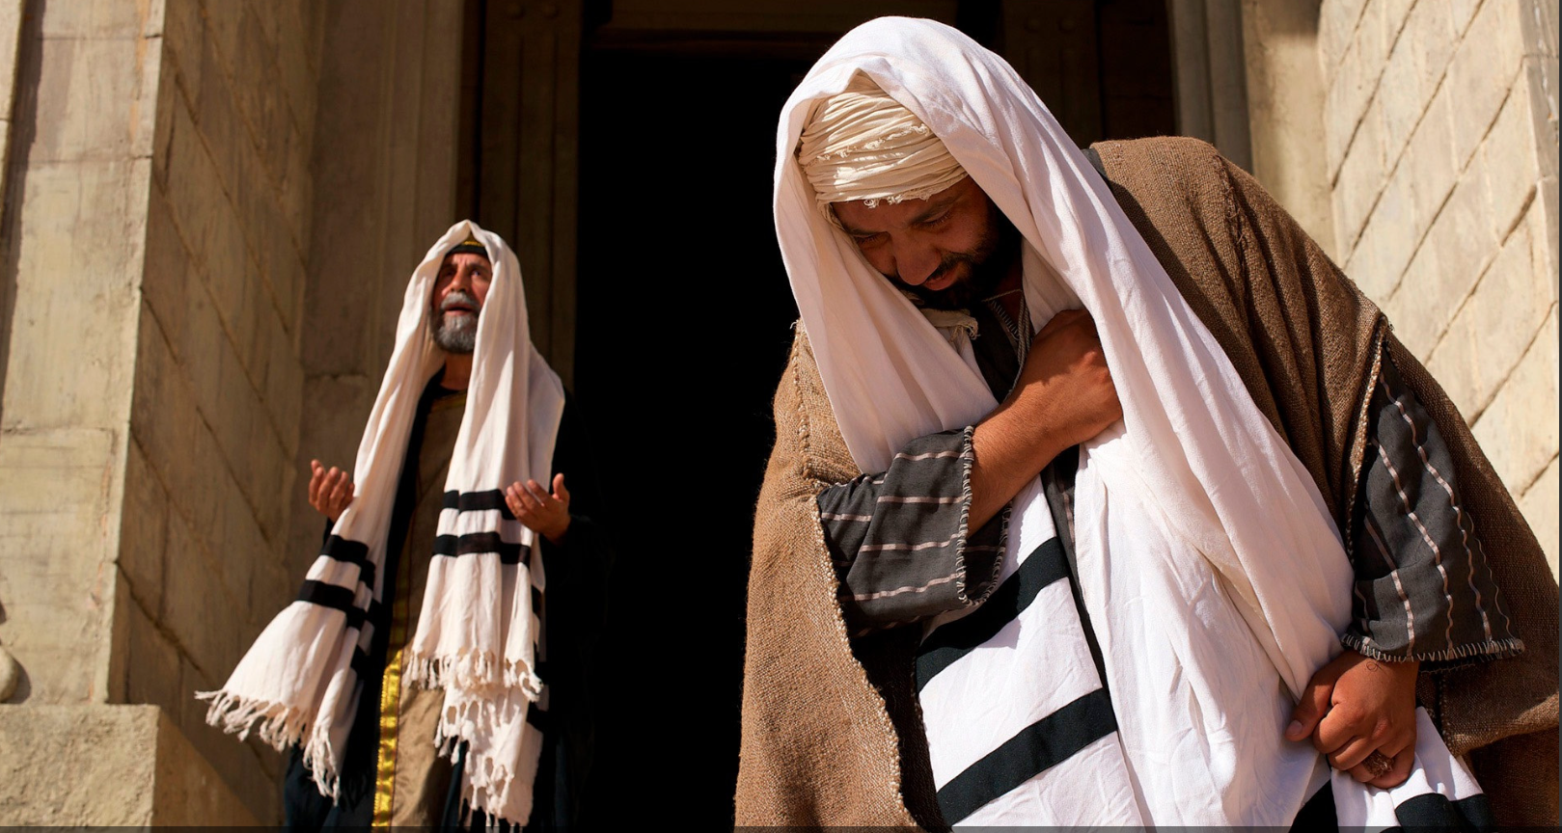
What Does Forgiveness Look Like?

Slide 14
What Does Forgiveness Look Like?
A tax collector begged for mercy while a Pharisee failed to see his own need for forgiveness.
Luke 18:9–14
Luke 18:13 "And the tax collector, standing afar off, would not so much as raise his eyes to heaven, but beat his breast, saying, 'God, be merciful to me a sinner!'
newlebanoncoc.com

Slide 15
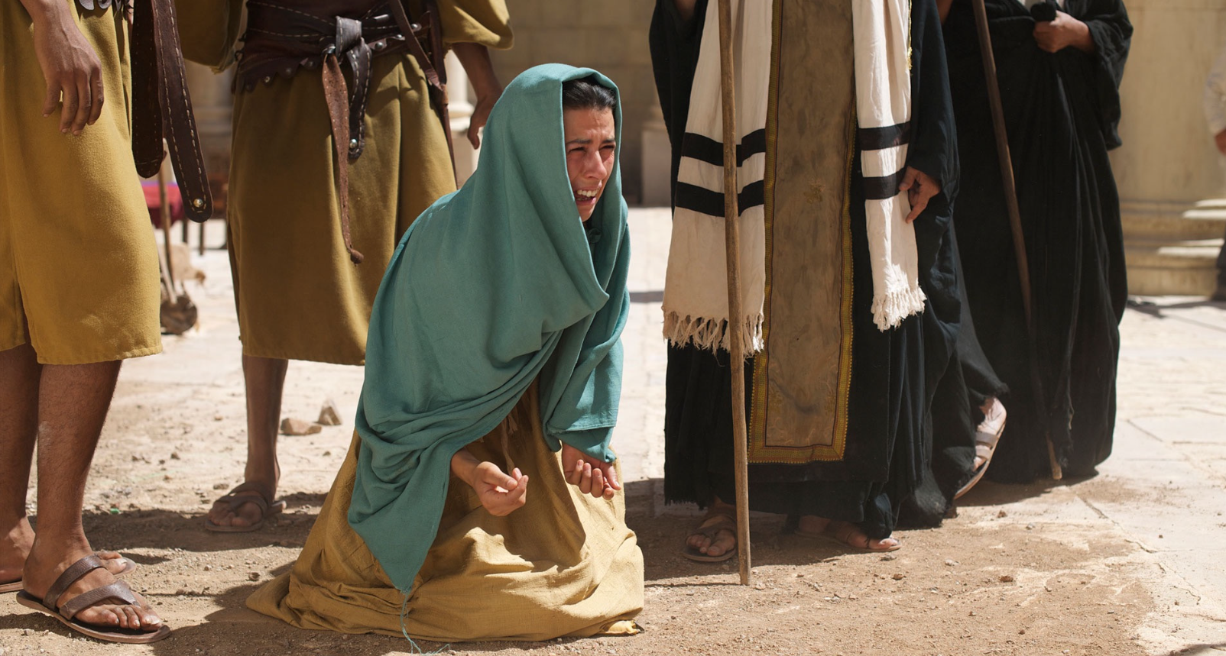
What Does Forgiveness Look Like?

Slide 16
What Does Forgiveness Look Like?
Jesus did not condemn a woman caught in adultery.
John 8:1–11
John 8:10 When Jesus had raised Himself up and saw no one but the woman, He said to her, "Woman, where are those accusers of yours? Has no one condemned you?" 11 She said, "No one, Lord." And Jesus said to her, "Neither do I condemn you; go and sin no more."
newlebanoncoc.com

Slide 17
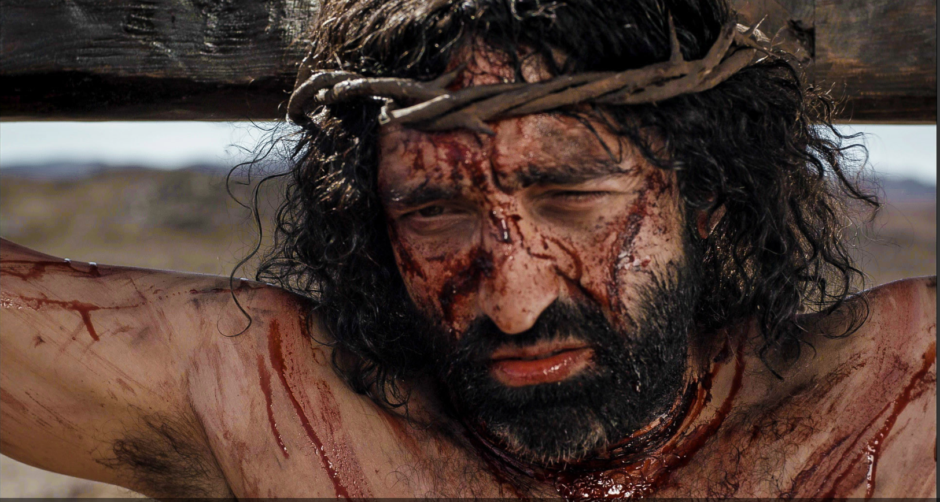
What Does Forgiveness Look Like?

Slide 18
What Does Forgiveness Look Like?
Jesus asked the Father to forgive those who crucified him.
Luke 23:32–43
Luke 23:34 Then Jesus said, "Father, forgive them, for they do not know what they do." And they divided His garments and cast lots.
newlebanoncoc.com

Slide 19
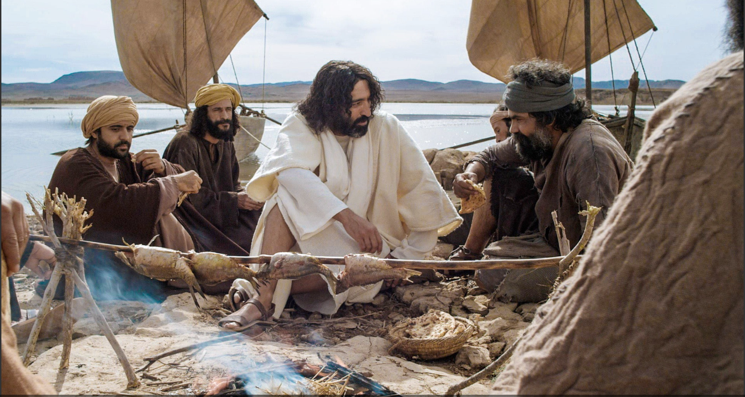
What Does Forgiveness Look Like?

Slide 20
What Does Forgiveness Look Like?
Jesus restored Peter who had denied him three times.
John 13:31–38; 18:15–27; 21:15–19
John 21:17 He said to him the third time, "Simon, son of Jonah, do you love Me?" Peter was grieved because He said to him the third time, "Do you love Me?" And he said to Him, "Lord, You know all things; You know that I love You." Jesus said to him, "Feed My sheep.
newlebanoncoc.com

Slide 21
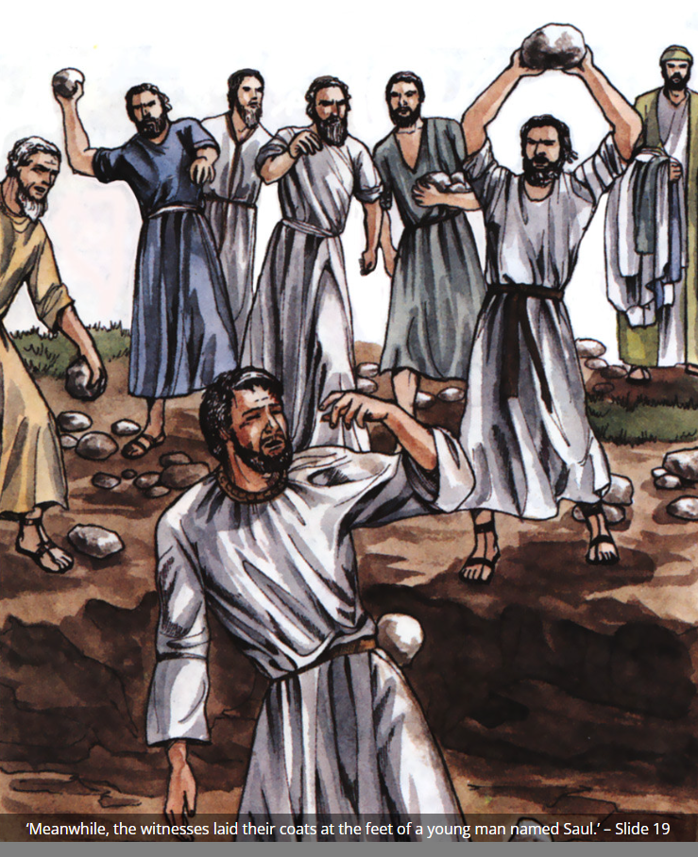
What Does Forgiveness Look Like?

Slide 22
What Does Forgiveness Look Like?
Stephen asked God to forgive those who were stoning him.
Acts 7:54–60
Acts 7:60 Then he knelt down and cried out with a loud voice, "Lord, do not charge them with this sin." And when he had said this, he fell asleep.
newlebanoncoc.com

Slide 23
What Does Forgiveness Look Like?
Matt. 6:14 "For if you forgive men their trespasses, your heavenly Father will also forgive you.
15 "But if you do not forgive men their trespasses, neither will your Father forgive your trespasses.
newlebanoncoc.com

Slide 24
The One Body
There Is One Body
Ephesians 2:14-16
Ephesians 4:4
1 Corinthians 12:12-13
Romans 12:4-5
The Body Is The Church
Colossians 1:18
Ephesians 1:23
Ephesians 5:23-25
1 Corinthians 12:12-13, 18
Salvation In
The Body
Ephesians 2:14-16
Ephesians 5:23
1 John 5:11
How Do We Enter
The Body?
Acts 2:47
1 Corinthians 12:13
Romans 6:3-4

Slide 25

Jesus is
coming.
Are you
ready?

