Slide 1
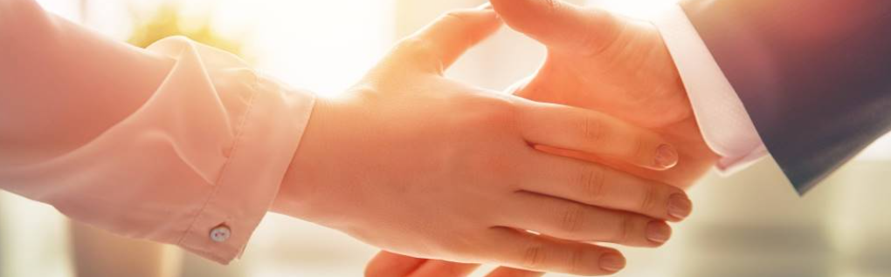
Welcome to our services
New Lebanon Church of Christ
We are Simply Christians.
Our Emphasis is Spiritual, Not Material or Social.
We are striving to be The Same Church as Described in The New Testament.
Please Come Back Again

Slide 2
Questions?
Want to learn more about the Bible?
We will be glad to study the Bible with you.
New Lebanon
New Lebanon
Church of Christ
Church of Christ
New Lebanon, OH
newlebanoncoc.com
newlebanoncoc@gmail.com

Slide 3
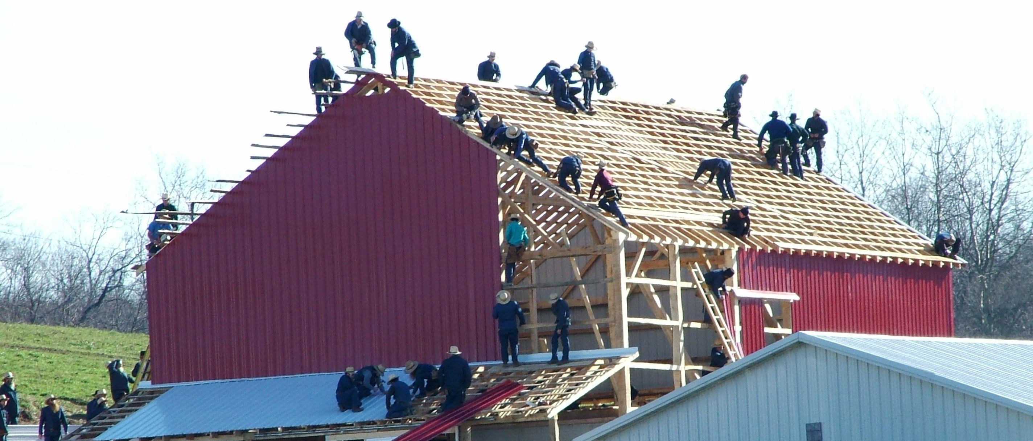
Learning To Work Together
Kidron Store Amish Country Photos - Lehman’s lehmans.com
Therefore, let us pursue the things which make for peace and the things by which one may edify another. Rom.14:19

Slide 4
Learning To Work Together
We Must Follow Rules
Concede Personal Preference
We Must Learn To Accept Criticism
We Must Learn To Esteem Others
We Must Learn To Value Leadership
We Must Learn To Be Tolerant Toward Others
Be Dependable
Communicate Effectively
newlebanoncoc.com

Slide 5

BUSYBODY
periergazomai (περιεργάζομαι, 4020), lit., “to be working round about, instead of at one’s own business” (peri, “around,” ergon, “work”), signifies to take more pains than enough about a thing, to waste one’s labor, to be meddling with, or bustling about, other people’s matters. This is found in 2 Thess. 3:11, where, following the verb ergazomai, “to work,” it forms a paronomasi. This may be produced in a free rendering: “some who are not busied in their own business, but are overbusied in that of others.”¶
W. E. Vine, Merrill F. Unger, and William White Jr., Vine’s Complete Expository Dictionary of Old and New Testament Words (Nashville, TN: T. Nelson, 1996), 85.
haphazardstuff.com

Slide 6
Learning To Work Together
Examples of working together with differences.
A woman wearing pants.
Having a Christmas tree in your home.
Second serving of Lord’s Supper.
1Cor. 11:15 But if a woman has long hair, it is a glory to her; for her hair is given to her for a covering. 16 But if anyone seems to be contentious, we have no such custom, nor do the churches of God.
Therefore, let us pursue the things which make for peace and the things by which one may edify another. Rom.14:19
newlebanoncoc.com

Slide 7

Taking My Marbles & Going Home - by Norman Rockwell

Slide 8


What Kind Of Worker Am I ?
Kidron Store Amish Country Photos - Lehman’s lehmans.com
Therefore, let us pursue the things which make for peace and the things by which one may edify another. Rom.14:19

