Slide 1
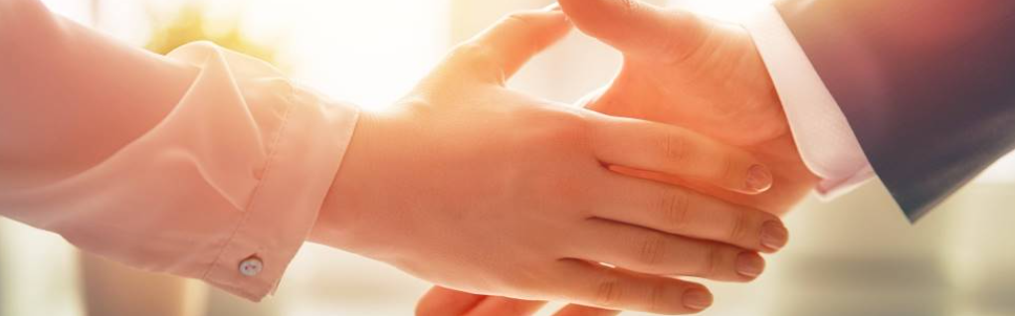
Welcome to our services
New Lebanon Church of Christ
We are Simply Christians.
Our Emphasis is Spiritual, Not Material or Social.
We are striving to be The Same Church as Described in The New Testament.
Please Come Back Again

Slide 2
Christ and the church He built.
Matt. 16:16 Simon Peter answered and said, "You are the Christ, the Son of the living God."
17 Jesus answered and said to him, "Blessed are you, Simon Bar-Jonah, for flesh and blood has not revealed this to you, but My Father who is in heaven.
18 "And I also say to you that you are Peter, and on this rock I will build My church, and the gates of Hades shall not prevail against it.

Slide 3
Questions?
Want to learn more about the Bible?
We will be glad to study the Bible with you.
New Lebanon
New Lebanon
Church of Christ
Church of Christ
New Lebanon, OH
newlebanoncoc.com
newlebanoncoc@gmail.com

Slide 4
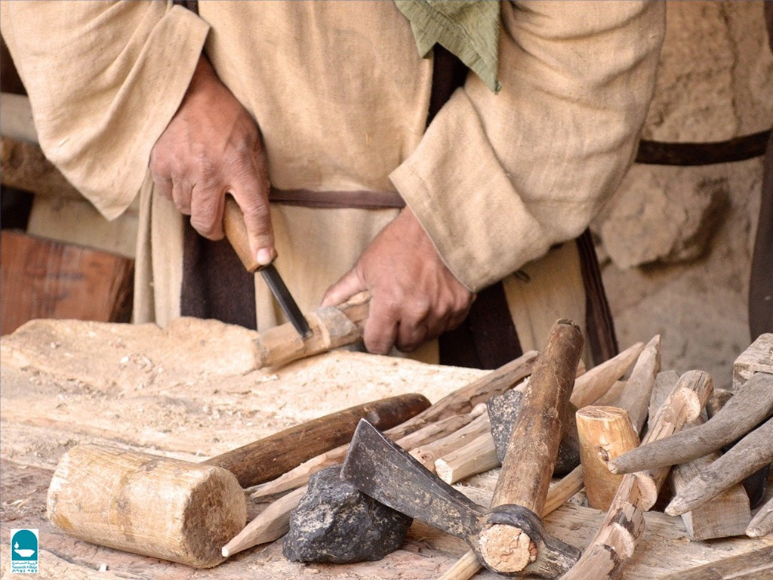

Christ and the Church He Built
Matt.16:16-18

Slide 5
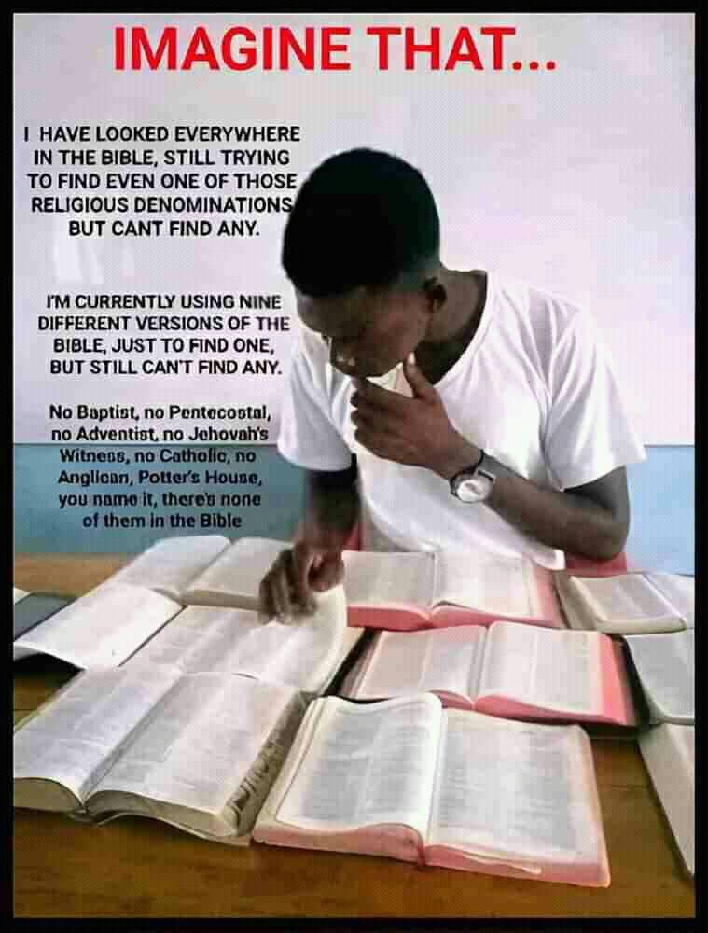

Slide 6
Christ and the church He built.
Who Is Jesus the Christ?
Matt. 16:16 Simon Peter answered and said, "You are the Christ, the Son of the living God."
17 Jesus answered and said to him, "Blessed are you, Simon Bar-Jonah, for flesh and blood has not revealed this to you, but My Father who is in heaven. (prophecies of O.T.)
18 "And I also say to you that you are Peter, and on this rock (confession) I will build My church, and the gates of Hades shall not prevail against it. (church and it singular, not plural)

Slide 7
Christ and the church He built.
Church = Kingdom
Matt. 16:16 Simon Peter answered and said, "You are the Christ, the Son of the living God.“ 17 Jesus answered and said to him, "Blessed are you, Simon Bar-Jonah, for flesh and blood has not revealed this to you, but My Father who is in heaven. (prophecies of O.T.) 18 "And I also say to you that you are Peter, and on this rock I will build My church, and the gates of Hades shall not prevail against it.
Matt. 16:19 And I will give unto thee the keys of the kingdom of heaven: and whatsoever thou shalt bind on earth shall be bound in heaven: and whatsoever thou shalt loose on earth shall be loosed in heaven. 20 Then charged he his disciples that they should tell no man that he was Jesus the Christ. 21 From that time forth began Jesus to show unto his disciples, how that he must go unto Jerusalem, and suffer many things of the elders and chief priests and scribes, and be killed, and be raised again the third day. (4x+)

Slide 8
Christ and the church He built.
Who Is Jesus the Christ?
Jesus – Matt. 1:21 And she shall bring forth a son, and thou shalt call his name JESUS: for he shall save his people from their sins. (JESUS: that is, Savior, Hebrew – Joshua)
Luke 19:10 "for the Son of Man has come to seek and to save that which was lost."
Christ – The anointed one. The Messiah.

Slide 9
Title
Christ and the church He built.
Gospels
Matthew -J
Mark -R
Luke -G
John -U
Paul’s Letters
Romans
1st Cor
2nd Cor
Gal.
Eph.
Phil.
Col
1Thess
2Thess
1Tim
2Tim
Titus
Phil.
General letters
Hebrews
James
1Peter
2Peter
1 John
2 John
3 John
Jude
The life of Christ
History
Acts
History of the church.
How to be a Christ-ian
These 21 letters tell us how to LIVE the Christian life.
Revelation –
Tells us how to DIE in Christ.
Be faithful unto death.

Slide 10
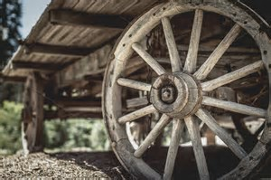
O.T. prophecies point to the establishment of the church / kingdom on the day the Holy Spirit would come
Daniel 2:31-35
Psalm 2:1-12
Acts 2. Hub of the Bible
Isaiah 2:1-4
In kingdom
today
Joel 2:28-32
Col. 1:13

Slide 11
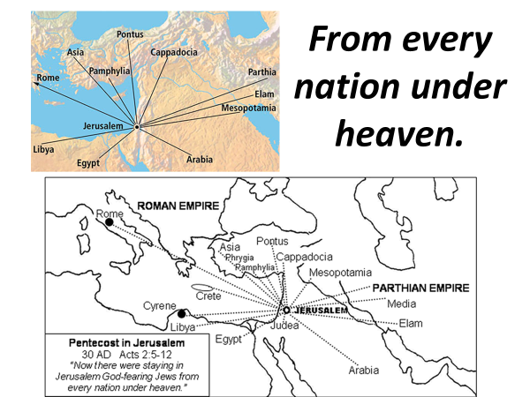
Captivity
Migration
Expulsion

Slide 12

The KINGDOM would come with POWER.
The POWER would come when the HOLY SPIRIT came.
Therefore, the KINGDOM came when the HOLY SPIRIT came.
HOW WE KNOW WHEN
THE KINGDOM CAME
Mark 9:1
“And he said unto them, Verily I say unto you, That there be some of them that stand here, which shall not taste of death, till they have seen the kingdom of God come with power. “
Mark 9:1
“And he said unto them, Verily I say unto you, That there be some of them that stand here, which shall not taste of death, till they have seen the kingdom of God come with power. “
Acts 1:8
“But ye shall receive power, after that the Holy Ghost is come upon you: and ye shall be witnesses unto me both in Jerusalem, and in all Judaea, and in Samaria, and unto the uttermost part of the earth.”
Acts 2:1-4
“¹And when the day of Pentecost was fully come, they were all with one accord in one place. ² And suddenly there came a sound from heaven as of a rushing mighty wind, and it filled all the house where they were sitting. ³ And there appeared unto them cloven tongues like as of fire, and it sat upon each of them. ⁴And they were all filled with the Holy Ghost, and began to speak with other tongues, as the Spirit gave them utterance.”

Slide 13
The KINGDOM would come with POWER.
The POWER would come when the HOLY SPIRIT came.
Therefore, the KINGDOM came when the HOLY SPIRIT came.
HOW WE KNOW WHEN
THE KINGDOM CAME
Acts 1:8
“But ye shall receive power, after that the Holy Ghost is come upon you: and ye shall be witnesses unto me both in Jerusalem, and in all Judaea, and in Samaria, and unto the uttermost part of the earth.”
Mark 9:1
“And he said unto them, Verily I say unto you, That there be some of them that stand here, which shall not taste of death, till they have seen the kingdom of God come with power. “
Acts 1:8
“But ye shall receive power, after that the Holy Ghost is come upon you: and ye shall be witnesses unto me both in Jerusalem, and in all Judaea, and in Samaria, and unto the uttermost part of the earth.”
Acts 2:1-4
“¹And when the day of Pentecost was fully come, they were all with one accord in one place. ² And suddenly there came a sound from heaven as of a rushing mighty wind, and it filled all the house where they were sitting. ³ And there appeared unto them cloven tongues like as of fire, and it sat upon each of them. ⁴And they were all filled with the Holy Ghost, and began to speak with other tongues, as the Spirit gave them utterance.”

Slide 14
The KINGDOM would come with POWER.
The POWER would come when the HOLY SPIRIT came.
Therefore, the KINGDOM came when the HOLY SPIRIT came.
Acts 2:1-4
“¹And when the day of Pentecost was fully come, they were all with one accord in one place. ²And suddenly there came a sound from heaven as of a rushing mighty wind, and it filled all the house where they were sitting. ³And there appeared unto them cloven tongues like as of fire, and it sat upon each of them. ⁴And they were all filled with the Holy Ghost, and began to speak with other tongues, as the Spirit gave them utterance.”
HOW WE KNOW WHEN
THE KINGDOM CAME
Mark 9:1
“And he said unto them, Verily I say unto you, That there be some of them that stand here, which shall not taste of death, till they have seen the kingdom of God come with power. “
Acts 1:8
“But ye shall receive power, after that the Holy Ghost is come upon you: and ye shall be witnesses unto me both in Jerusalem, and in all Judaea, and in Samaria, and unto the uttermost part of the earth.”
Acts 2:1-4
“¹And when the day of Pentecost was fully come, they were all with one accord in one place. ² And suddenly there came a sound from heaven as of a rushing mighty wind, and it filled all the house where they were sitting. ³ And there appeared unto them cloven tongues like as of fire, and it sat upon each of them. ⁴And they were all filled with the Holy Ghost, and began to speak with other tongues, as the Spirit gave them utterance.”

Slide 15
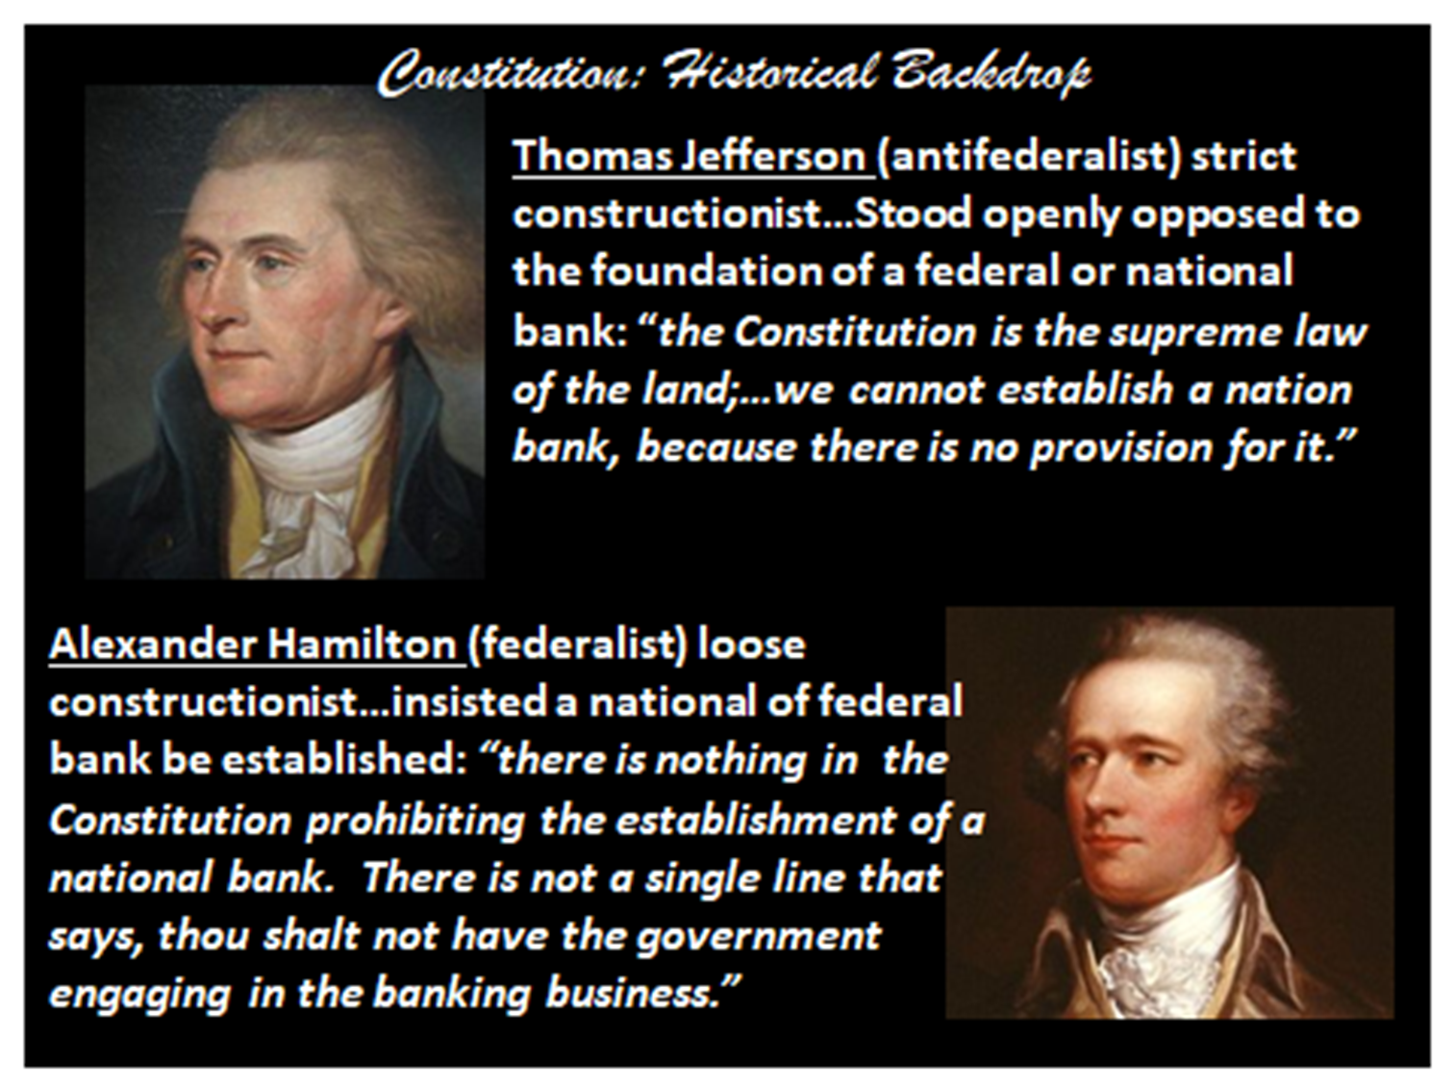
I went to school with Nadab and Abihu.

Slide 16
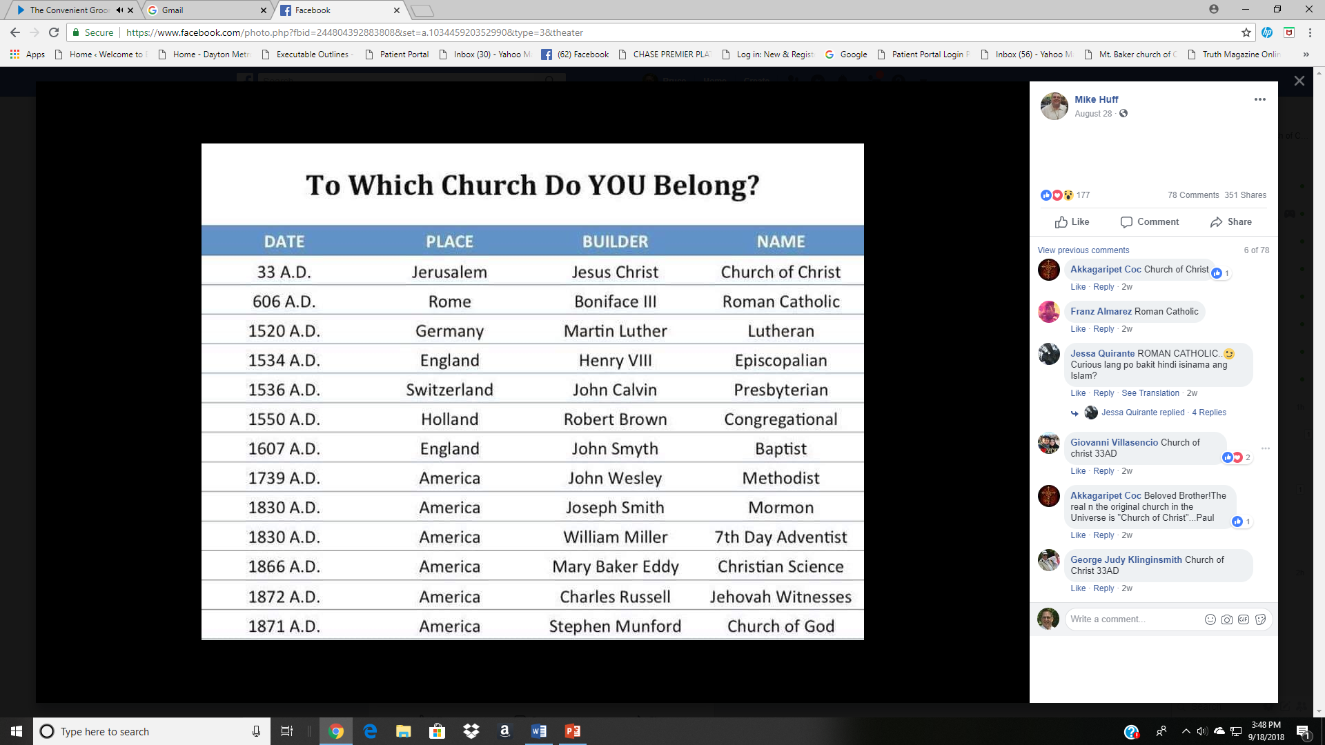
Christ and the church He built.
Acts 2:47 praising God and having favor with all the people. And the Lord added to the church daily those who were being saved.
These churches are too late to be the Lord’s church.
These churches are not the Bride of Christ (Eph.5) Christ has ONE Bride.
Which church were those in Acts 2:47 added to?

Slide 17
Christ and the church He built.
God’s Law of Reproduction
Plant Kingdom
A SOWER plants a SEED in the FIELD (soil). Seed reproduces after its own kind.
Animal Kingdom
A sower (MAN) plants a SEED in the FIELD (Womb of woman.) Seed reproduces after its own kind.
Spiritual Kingdom
A SOWER plants a SEED (Gospel) in the FIELD (hearts of men and women). Seed reproduces after its own kind.
God’s Laws Can Not Be Broken
b hastings newlebanoncoc.com

Slide 18

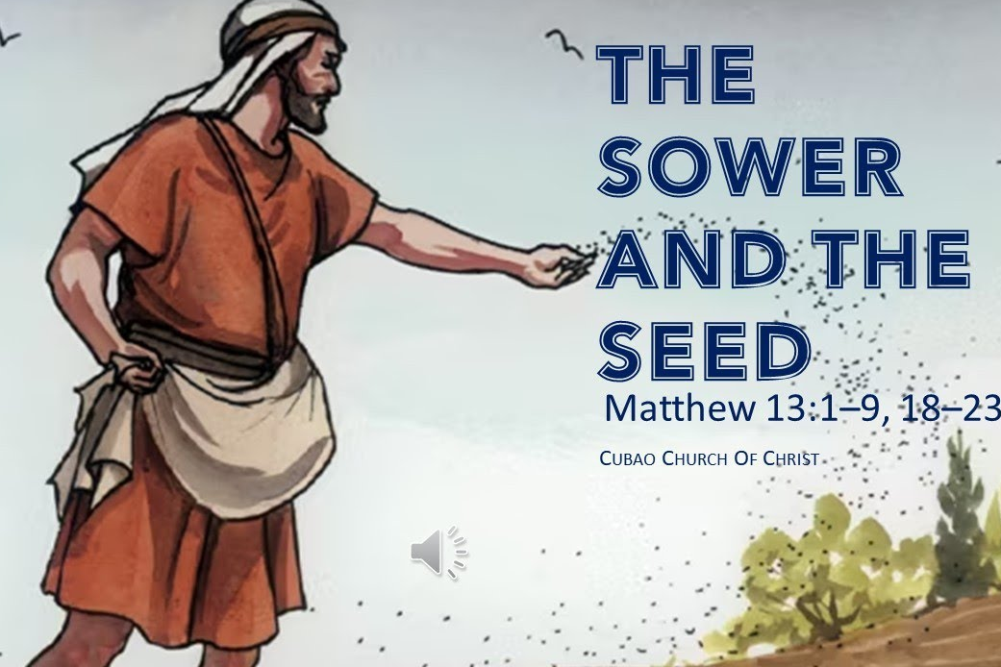
Christ and the church He built.

Slide 19
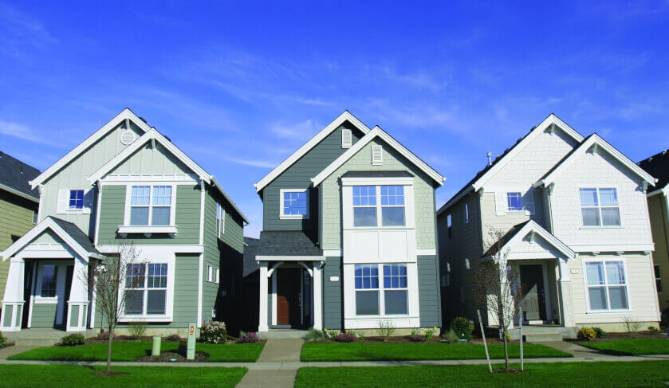
Two of these are not what you can read about in the Bible
Church of Bruce
Church of Christ
Church of Bruce
b hastings newlebanoncoc.com

Slide 20
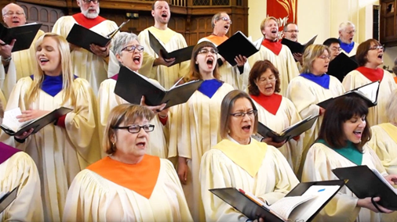
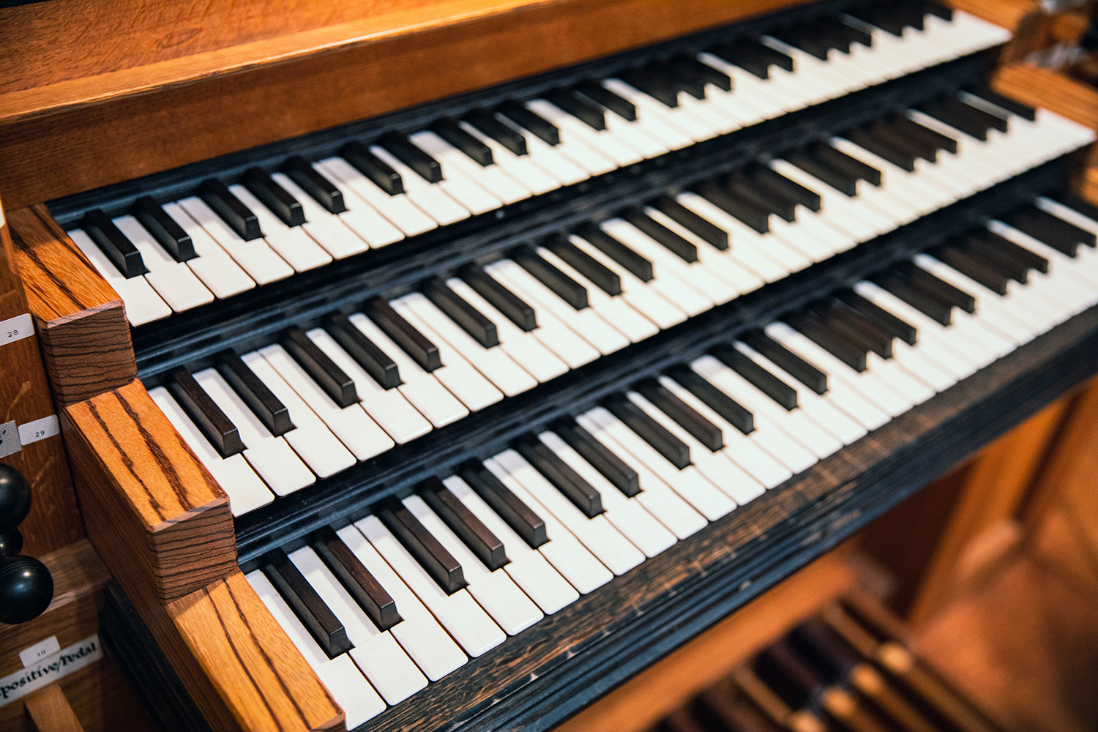
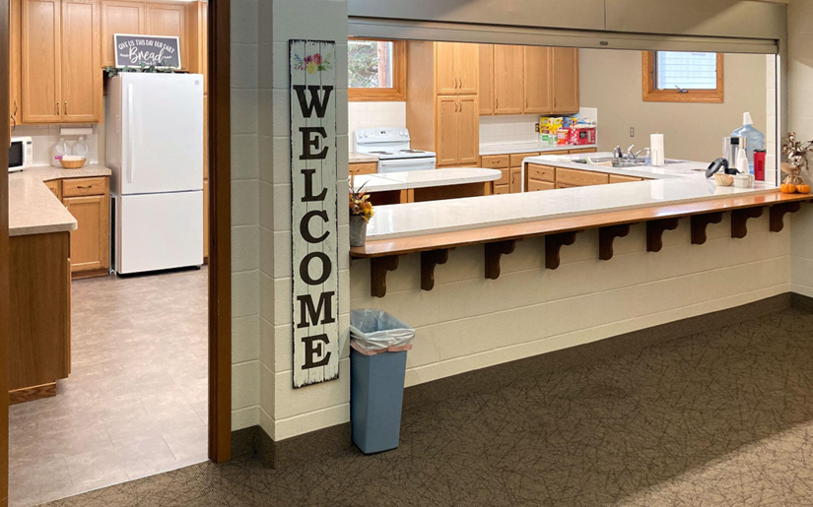
Christ and the church He built.
Where is your…
b hastings newlebanoncoc.com

Slide 21
Christ and the church He built.
These are not in the church that Christ built.
b hastings newlebanoncoc.com

Slide 22
Christ and the church He built.
The church that Christ built bears His name. Not some man’s name.
Too Late
Wrong Place
Wrong name
b hastings newlebanoncoc.com

Slide 23
Christ and the church He built.
How do we get into the church?
“Jesus answered and said to him, "Most assuredly, I say to you, unless one is born again, he cannot see the kingdom of God. Nicodemus said to Him, How can a man be born when he is old? Can he enter a second time into his mother's womb and be born? Jesus answered, "Most assuredly, I say to you, unless one is born of water and the Spirit, he cannot enter the kingdom of God.” (John 3:3-5)
b hastings newlebanoncoc.com

Slide 24
CASE STUDIES OF CONVERSION
Acts | Preaching | Believed | Repented | Confessed | Baptized | Saved
2:22-41 | Pentecost |  | vv. 37-38 |  | vv. 38-41 | Remission Of Sins
8:12 | Samaritans | v. 12 |  |  | v. 12 | Believed
8:13 | Simon | v. 13 |  |  | v. 13
8:35-39 | Eunuch | vv. 36-37 |  | v. 37 | v. 38 | Rejoiced
9:17-18 | Saul |  |  |  | v. 18 | Sins Washed Away
10:34-48 | Cornelius | v. 43 |  |  | v. 48 | Remission Of Sins
16:13 | Lydia | v. 14 |  |  | v. 15
16:31-34 | The Jailer | v. 31 |  |  | v. 33 | Rejoiced
18:8 | Corinthians | v. 8 |  |  | v. 8
19:5 | Ephesians |  |  |  | v. 5
Preached
Repented
Baptized

Slide 25
Christ and the church He built.
Lev. 17:11 'For the life of the flesh is in the blood, and I have given it to you upon the altar to make atonement for your souls; for it is the blood that makes atonement for the soul.'
Heb. 10:4 For it is not possible that the blood of bulls and goats could take away sins.
1Peter 1:18 knowing that you were not redeemed with corruptible things, like silver or gold, from your aimless conduct received by tradition from your fathers, 19 but with the precious blood of Christ, as of a lamb without blemish and without spot.

Slide 26
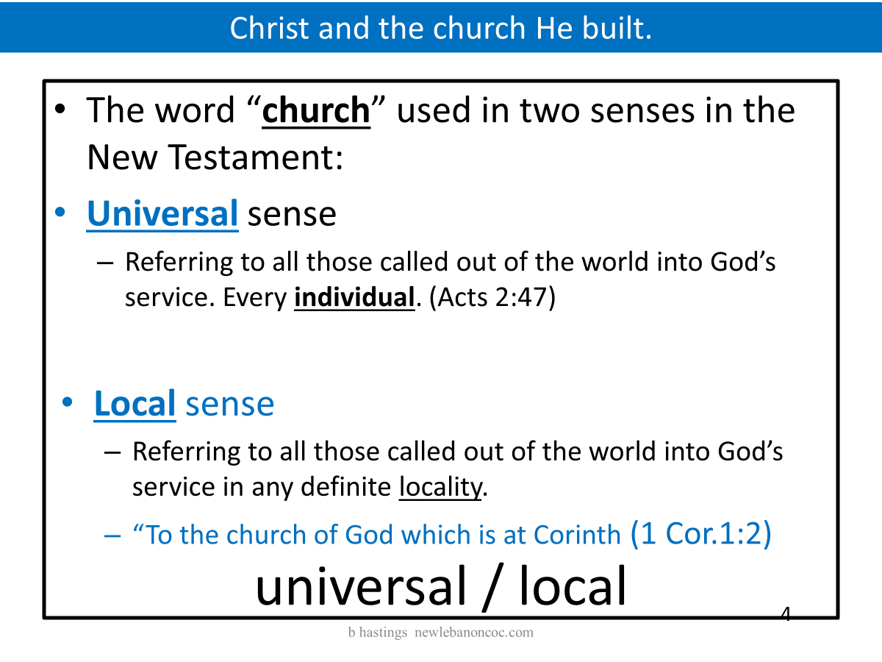
Christ and the church He built.

Slide 27
Christ and the church He built.
The work and worship that our savior and king reveals to us is carried out in the LOCAL church. Not the universal church.
The Called Out Body
The Body Of Christ
The Household Of God
The Temple Of God
The Kingdom Of God
The Bride of Christ
The Vineyard Of The Lord
The 21 letters in the Bible that tell us how to live the Christian life
universal / local

Slide 28
Christ and the church He built.
NT:1577 (Strong’s number) Thayer’s definition
ekkleesia, (from ekkleetos called out or forth, and this from ekkaleoo); properly, a gathering of citizens called out from their homes into some public place; an assembly; so used:
Heb. 10:24 And let us consider one another in order to stir up love and good works,
25 not forsaking the assembling of ourselves together, as is the manner of some, but exhorting one another, and so much the more as you see the Day approaching.
26 For if we sin willfully after we have received the knowledge of the truth, there no longer remains a sacrifice for sins,

Slide 29
Christ and the church He built.
Eph. 4:15 but, speaking the truth in love, may grow up in all things into Him who is the head--Christ—
16 from whom
the whole body,
joined and knit together
by what every joint supplies, according to the effective working
by which every part does its share, causes growth of the body for the edifying of itself in love.

Slide 30
Christ and the church He built.
Where Does God Want To Be Worshipped ?
Altar? Tabernacle? Temple? Assembly?
Gen.22:5 (Abraham) Acts 8:27(Et. Treasurer)
Acts 20:16 (Paul) Acts 20:1-7
1st Cor. 11:17-20
Come together
Come together as the church
Come together in one place
Not The Riverside church of Christ
Not The Hunting Lodge church Of Christ
Not The Airport church of Christ
Not The Troas Cruise Ship church of Christ
Notes:
This is nothing new. You can trace it back to Jeroboam setting altars up at Dan and Bethel.

Slide 31
Christ and the church He built.
Commitment
Luke 9:57 Now it happened as they journeyed on the road, that someone said to Him, "Lord, I will follow You wherever You go." 58 And Jesus said to him, "Foxes have holes and birds of the air have nests, but the Son of Man has nowhere to lay His head."
59 Then He said to another, "Follow Me." But he said, "Lord, let me first go and bury my father."
60 Jesus said to him, "Let the dead bury their own dead, but you go and preach the kingdom of God."
61 And another also said, "Lord, I will follow You, but let me first go and bid them farewell who are at my house."
62 But Jesus said to him, "No one, having put his hand to the plow, and looking back, is fit for the kingdom of God."

Slide 32
Christ and the church He built.
1st Coming A mission of Mercy
2nd Coming A mission of Vengeance
God will remove sin by one of two ways
1) wrath
2) forgiveness
He leaves the choice up to us.

Slide 33
Christ and the church He built.
Christ is coming back for His wife His church, the church of Christ, Eph.5:23-27, Matt.16:18, Rom. 16,16.
He will not be coming back for other men’s wives (denominations).
Are you ready for His return?

