Slide 1
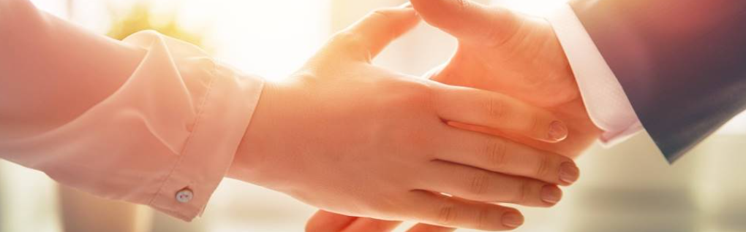
Welcome to our services
New Lebanon Church of Christ
We are Simply Christians.
Our Emphasis is Spiritual, Not Material or Social.
We are striving to be The Same Church as Described in The New Testament.
Please Come Back Again

Slide 2

Romans 8:28 And we know that all things work together for good to them that
love God, to them
who are the called
according to his purpose.

Slide 3
Questions?
Want to learn more about the Bible?
We will be glad to study the Bible with you.
New Lebanon
New Lebanon
Church of Christ
Church of Christ
New Lebanon, OH
newlebanoncoc.com
newlebanoncoc@gmail.com

Slide 4


Slide 5
Are You A New Testament Christian?
Hear the Gospel (Rom.10:14).
Believe the Gospel (Heb. 11:6).
Repent of Sins (Acts 3:19).
Confess Christ (Rom.10:9).
Be Baptized Into Christ (1 Cor.12:13).
1 Timothy 4:16
“Take heed unto thyself, and unto the doctrine; continue in them: for in doing this thou shalt both save thyself, and them that hear thee.”

Slide 6

Jesus is
coming.
Are you
ready?

