Slide 1

Welcome to our services
New Lebanon Church of Christ
We are Simply Christians.
Our Emphasis is Spiritual, Not Material or Social.
We are striving to be The Same Church as Described in The New Testament.
Please Come Back Again

Slide 2
Why Do I Want To Sin ?
Col. 3:5 Therefore put to death your members which are on the earth: fornication, uncleanness, passion, evil desire, and covetousness, which is idolatry.
newlebanoncoc.com

Slide 3
Why Do I Want To
SIN?

Slide 4
Questions?
Want to learn more about the Bible?
We will be glad to study the Bible with you.
New Lebanon
New Lebanon
Church of Christ
Church of Christ
New Lebanon, OH
newlebanoncoc.com
newlebanoncoc@gmail.com

Slide 5
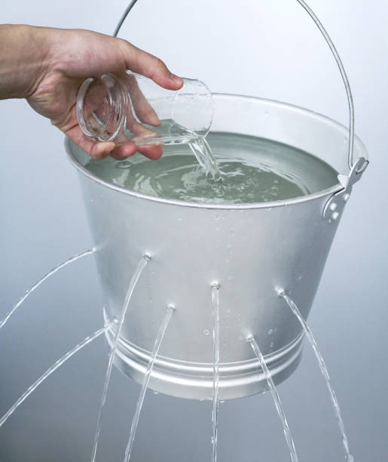

Slide 6

Why do I want to sin?
Because I want to do what I want to do instead of what my Father told me to do.

Slide 7
Why Do I Want To Sin ?
Col.3:5 – Therefore put to death your members which are on the earth: fornication, uncleanness, passion, evil desire, and covetousness, which is idolatry. (NKJV)
Col 3:5 Mortify therefore your members which are upon the earth; fornication, uncleanness, inordinate affection, evil concupiscence, and covetousness, which is idolatry: (KJV)
newlebanoncoc.com

Slide 8
Why Do I Want To Sin ?
Notice the sequence. It starts with evil action, immorality; and it ends with idolatry. So it flows from the action back to the motive. That’s the path of sin you’re going to see. It flows from the action back to the motive. In fact, you go back from immorality > to impurity, > to passion, > to evil desire, > and to greed, > and to idolatry.
newlebanoncoc.com

Slide 9
Why Do I Want To Sin ?
The word “immorality” basically refers to any unlawful sexual act.
And to be clear, there’s only one lawful sexual act, and that is a sexual relationship between a man and a woman who are married; that’s it.
So anything other than that is unlawful and falls into the category of immorality.
newlebanoncoc.com

Slide 10
Why Do I Want To Sin ?
Jesus said, “That which proceeds out of the man, that is what defiles the man.” So when you see the defiling behavior, it’s coming from something inside the man.
Verse 21, “For from within, out of the heart of men, proceed the evil thoughts, fornications, thefts, murders, adulteries, deeds of coveting and wickedness, as well as deceit, sensuality, envy, slander, pride and foolishness.
newlebanoncoc.com

Slide 11
Why Do I Want To Sin ?
Ex. 20:1 And God spoke all these words, saying: 2 "I am the LORD your God, who brought you out of the land of Egypt, out of the house of bondage. 3 "You shall have no other gods before Me.
Ex. 20:17 "You shall not covet your neighbor's house; you shall not covet your neighbor's wife, nor his male servant, nor his female servant, nor his ox, nor his donkey, nor anything that is your neighbor's."
Col.3:5 – Therefore put to death your members which are on the earth: fornication, uncleanness, passion, evil desire, and covetousness, which is idolatry
newlebanoncoc.com

Slide 12
Why Do I Want To Sin ?
Idolatry
Matt. 6:24 "No one can serve two masters; for either he will hate the one and love the other, or else he will be loyal to the one and despise the other. You cannot serve God and mammon.
Luke 16:13 "No servant can serve two masters; for either he will hate the one and love the other, or else he will be loyal to the one and despise the other. You cannot serve God and mammon.
Col. 3:5 Therefore put to death your members which are on the earth: fornication, uncleanness, passion, evil desire, and covetousness, which is idolatry.
Eph. 5:5 For this you know, that no fornicator, unclean person, nor covetous man, who is an idolater, has any inheritance in the kingdom of Christ and God.

Slide 13
Why Do I Want To Sin ?
Greed or covetousness is the last sin listed in the Ten Commandments, the Decalogue; but it really is the basic motive of all sin.
It is the last sin in the Decalogue, but it is what is behind all the other sins. It is the desire for what isn’t yours. It is the desire for what is forbidden. It is the desire for what is against the will of God. It’s the desire for something you have no right to, you’re not entitled to have – the desire to have more than you have.
newlebanoncoc.com

Slide 14

Why Do I Want To Sin ?
It is the absence of contentment,
It is the opposite of contentment.
It is the desire to have more; and
it is the desire to have more of something you’re not entitled to.
Jesus considered the covetous heart to be the very source from which all evil rose.
newlebanoncoc.com

Slide 15
Why Do I Want To Sin ?
The Greeks defined it as the
insatiable desire that can never be satisfied.
To want what you don’t have. And the Greeks actually said to satisfy that in the human heart is like trying to fill a bowl with no bottom.
And this, of course, is self-seeking pride.
newlebanoncoc.com

Slide 16
Why Do I Want To Sin ?
When it directed toward money, it ends up with stealing.
When it is directed toward fame, it ends up in boasting.
When it is directed toward worldly success, it ends up in selfish ambition.
When it is directed toward power, it ends up in exploitation, intimidation, and tyranny.
And when directed toward a physical relationship with someone, it ends up in sexual sin.
It is the desire to have what you don’t have. It is a lack of contentment. It is covetousness.
newlebanoncoc.com

Slide 17
Why Do I Want To Sin ?
Every sin comes from this. The reason you do any sin is because you have decided that you will do what you have no right to do.
You will take what you have no right to take; that’s what sin is.
And Jesus said even in the longing there is sin, Matthew 5, “If a man looks on a woman to lust after her he’s committed adultery in his heart.”
newlebanoncoc.com

Slide 18
Why Do I Want To Sin ?
So are we at the bottom with greed and covetousness? No.
The end of verse 5, “which amounts to idolatry.”
What is idolatry? Worshiping someone other than God, right? What’s at the top of Ten Commandments? The first one: “You shall have no other Gods.”
newlebanoncoc.com

Slide 19
Why Do I Want To Sin ?
So idolatry is the root of all sin. Now we’re at the bottom of this this path of sin works and Idolatry is at the bottom of every sin.
It’s when you stop worshiping God and you decide you’re going to worship yourself. It’s like saying, “I will not submit to you as my Sovereign. I want what I want. I will be sovereign. You’re not going to tell me what I can and cannot have, I will determine what I can or cannot have.”
newlebanoncoc.com

Slide 20
Why Do I Want To Sin ?
Though covetousness is the last of the Ten Commandments, by definition it is a violation of the first of the Ten Commandments to have no other gods, especially not you.
It is self-worship. It isn’t even so much sex worship or money worship or power worship or fame worship. It is self-worship. It is the opposite of this. “Seek first the kingdom of God and His righteousness, and all these things will be added.”
newlebanoncoc.com

Slide 21
Why Do I Want To Sin ?
Anything that you have no right to that you want, is a test of who you worship.
If you worship God, you say no at that point. If you worship yourself, you say yes at that point; and that’s what James says lust wants, because then lust conceives and brings forth sin. And ultimately, sin brings forth death.
newlebanoncoc.com

Slide 22
Why Do I Want To Sin ?
The ability to live the Christian life is not related to somebody giving you a pep talk, it is directly related to what you think about God and what you think about yourself.
newlebanoncoc.com

Slide 23
Why do we sin?
We want to satisfy our lusts but sin satisfaction is an illusion. Satisfaction can never be found in sin because its pleasure is only temporary.

Slide 24
Why do I want to sin?
Because I want to do what I want to do instead of what my Father told me to do.

Slide 25
The One Body
There Is One Body
Ephesians 2:14-16
Ephesians 4:4
1 Corinthians 12:12-13
Romans 12:4-5
The Body Is The Church
Colossians 1:18
Ephesians 1:23
Ephesians 5:23-25
1 Corinthians 12:12-13, 18
Salvation In
The Body
Ephesians 2:14-16
Ephesians 5:23
1 John 5:11
How Do We Enter
The Body?
Acts 2:47
1 Corinthians 12:13
Romans 6:3-4

Slide 26

Jesus is
coming.
Are you
ready?

