Slide 1
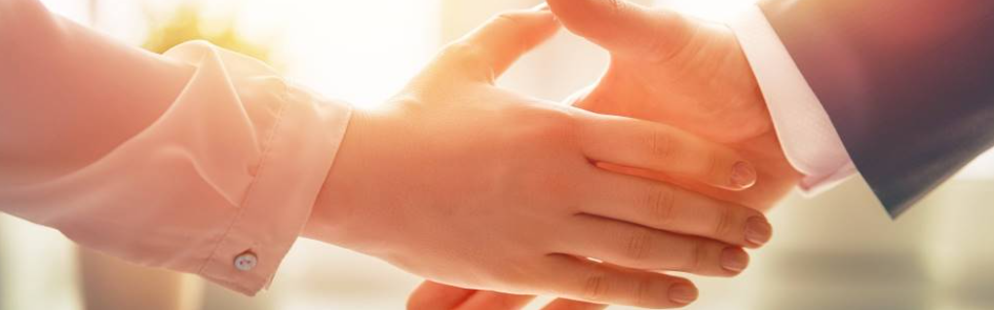
Welcome to our services
New Lebanon Church of Christ
We are Simply Christians.
Our Emphasis is Spiritual, Not Material or Social.
We are striving to be The Same Church as Described in The New Testament.
Please Come Back Again

Slide 2

Matters of Faith,
Indifference,
and Expediency
1Cor. 10:23 All things are lawful for me, but all things are not expedient: all things are lawful for me, but all things edify not.

Slide 3
Faith,
Rom. 10:17 So then faith cometh by hearing, and hearing by the word of God.
Rom. 14:23 But he who doubts is condemned if he eats, because he does not eat from faith; for whatever is not from faith is sin. (whatever is not from the word of God)
Lawlessness, iniquity = acting without authority, without law, without the word of God

Slide 4
EXPEDIENT
Expedient Strong’s Greek #1561
sumphero (συμφέρω, 4851) signifies (a), “to bring together,” (sun, “with,” phero, “to bring”), Acts 19:19; (b) “to be an advantage, profitable, expedient” (not merely ‘convenient’);
it is used mostly impersonally, “it is (it was) expedient”; so in Matt. 19:10, rv (negatively), kjv, “it is (not) good”; John 11:50; 16:7; 18:14; 1 Cor. 6:12; 10:23; 2 Cor. 8:10; 12:1; “it is profitable,” Matt. 5:29–30; 18:6, “was profitable,” Acts 20:20; “to profit withal,” 1 Cor. 12:7;
W. E. Vine, Merrill F. Unger, and William White Jr., (Nashville, TN: T. Nelson, 1996), 218.

Slide 5
John 11:50 Nor consider that it is expedient for us, that one man should die for the people, and that the whole nation perish not.
John 16:7 Nevertheless I tell you the truth; It is expedient for you that I go away: for if I go not away, the Comforter will not come unto you; but if I depart, I will send him unto you.
John 18:14 Now Caiaphas was he, which gave counsel to the Jews, that it was expedient that one man should die for the people.
1Cor. 5:12 For what have I to do to judge them also that are without? do not ye judge them that are within? {expedient: or, profitable}
1Cor. 6:12 All things are lawful unto me, but all things are not expedient: all things are lawful for me, but I will not be brought under the power of any.
1Cor. 10:23 All things are lawful for me, but all things are not expedient: all things are lawful for me, but all things edify not.
2Cor. 8:10 And herein I give my advice: for this is expedient for you, who have begun before, not only to do, but also to be forward a year ago. {forward: Gr. willing}
2Cor. 12:1 It is not expedient for me doubtless to glory. I will come to visions and revelations of the Lord. {I will come: Gr. For I will come}

Slide 6
Matters of Faith, Indifference, and Expediency
What is expediency? An expediency is but that way, means or method of doing that required by law and within the law.
It facilitates or expedites the accomplishment of a given task or the performance of a divine commandment.
Example - a baptistry may be an expedient because it facilitates the obedience to the law or command to be baptized. If there was not first the command to be baptized, there could be no authority in regarding a baptistry as an expedient.

Slide 7
Matters of Faith, Indifference, and Expediency
For a thing to be expedient, it first must be lawful.
Therefore, to talk of a given thing being expedient, it first must be established that it is lawful.
(of Faith, of the word of God)
With many, they think that if a thing is found to be expedient, it is by virtue thereof, lawful;
that is, its lawfulness is established by its expediency rather than its expediency being first found to be lawful. They have it backwards.
Sing –
Songbook

Slide 8
Matters of Faith, Indifference, and Expediency
This is reasoning on the principle that the end justifies the means, which is by far and large the principle of reasoning that governs the religious world.
This way of thinking reflects a basic disregard for the authority of Christ as revealed by the apostles in the New Testament. It gives to one's faith and practice such looseness that permits all sorts of innovation to intrude.
But Paul also said: "If a man strives for mastery yet is he not crowned except he strive lawfully."

Slide 9
Matters of Faith, Indifference, and Expediency
Likewise, if there was not first the law to observe the Lord's Supper, there could be no expediency attaching to the individual communion tray and cups.
There can be no expedient way to do an unlawful thing.
There may be inexpedient ways of doing lawful things, but such would not render the performance unlawful or unscriptural. (All coming forward to take Lord’s supper)
The very statement of Paul which introduces this subject implies that the inexpedient, as distinguished from the expedient, is also lawful.

Slide 10
Matters of Faith, Indifference, and Expediency
(1) Conditions of forgiveness.
(2) Items of worship.
(3) Christian duties, such as preaching the gospel, helping poor, etc.
The result is unity.
Faith
Things that are necessary about which God has not spoken.
Expedients were and are necessary.
Expedience
(Rom. 14) (1 Cor. 8:8),
the number of songs, how to take the collection, assembly times, etc.
Indifference

Slide 11
Matters of Faith, Indifference, and Expediency
(1) Conditions of forgiveness.
(2) Items of worship.
(3) Christian duties, such as preaching the gospel, helping poor, etc.
The result is unity.
Faith
unity
Things that are necessary about which God has not spoken.
Expedients were and are necessary.
Expedience
liberty
(Rom. 14) (1 Cor. 8:8),
the number of songs, how to take the collection, assembly times, etc.
Indifference
love

Slide 12
Matters of Faith, Indifference, and Expediency
How do we establish authority?
Command, Example, Necessary Inference / Unavoidable Conclusion
Acts 15
John 13:34 "A new commandment I give to you, that you love one another; as I have loved you, that you also love one another.
35 "By this all will know that you are My disciples, if you have love for one another."

Slide 13
Matters of Faith, Indifference, and Expediency
Warning -God’s silence limits what we can do.
Deut. 4:2 "You shall not add to the word which I command you, nor take from it, that you may keep the commandments of the LORD your God which I command you.
Proverbs 30:6 Do not add to His words, Lest He rebuke you, and you be found a liar.
Rev. 22:18 For I testify to everyone who hears the words of the prophecy of this book: If anyone adds to these things, God will add to him the plagues that are written in this book;

Slide 14
Matters of Faith, Indifference, and Expediency
Back in the middle 1800's men began to argue that authority was not necessary for action-that if they believed a thing was good and would "aid" or "assist," then it would be right to do it.
As the attitude took hold of the minds of brethren, it resulted in the formation of an organization, separate and apart from the church, to do some of the work the Lord gave the church to do. They formed what was known as the American Christian Missionary Society. Then in about ten years the instrument of music was introduced into the worship. And so the wedge was driven even more.

Slide 15
Matters of Faith, Indifference, and Expediency
Where does it stop?
Baptism?
Lord’s Supper?
Worship?

Slide 16
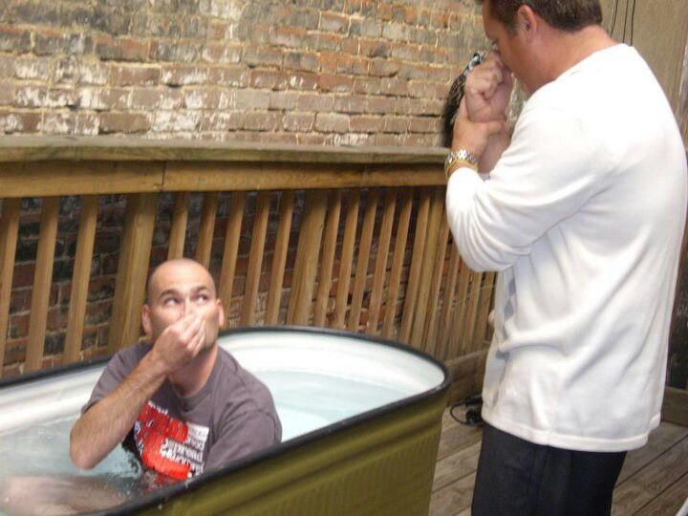
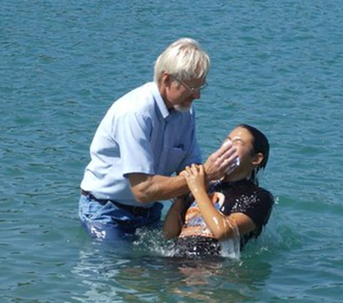
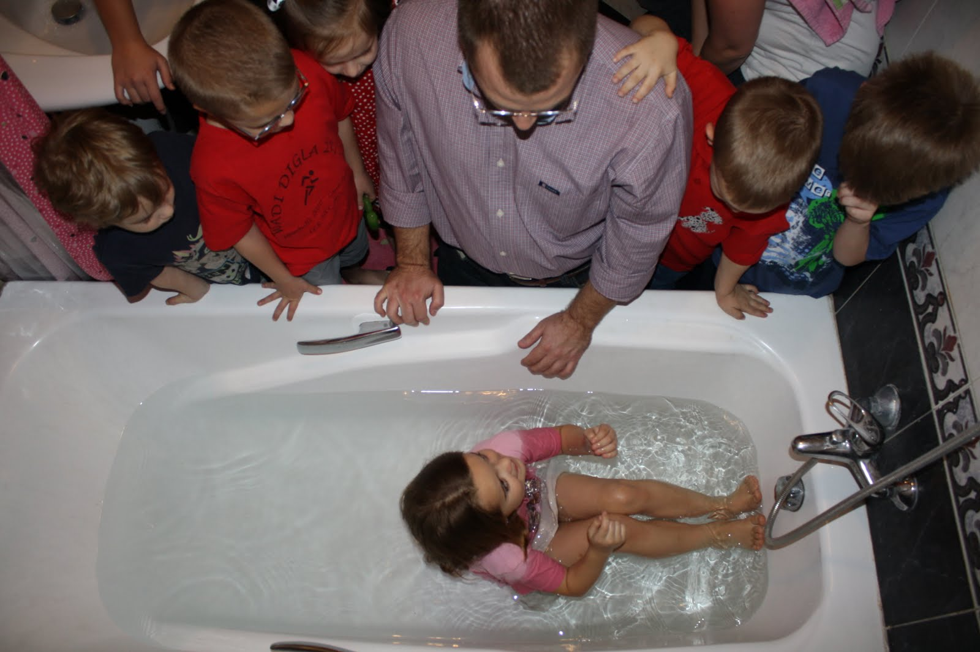

Rom. 6:4 Therefore we are buried with him by baptism into death:
Acts 8:38 And he commanded the chariot to stand still: and they went down both into the water, both Philip and the eunuch; and he baptized him. 39 And when they were come up out of the water…
John 3:23 And John also was baptizing in Aenon near to Salim, because there was much water there: and they came, and were baptized.
McD

Slide 17
Rom. 6:4 Therefore we are buried with him by baptism into death:
Not by Faith
Acts 8:38 And he commanded the chariot to stand still: and they went down both into the water, both Philip and the eunuch; and he baptized him. 39 And when they were come up out of the water…
John 3:23 And John also was baptizing in Aenon near to Salim, because there was much water there: and they came, and were baptized.

Slide 18


Matters of Faith, Indifference, and Expediency
Lord’s supper to go…???
“authority was not necessary for action-that if they believed a thing was good and would "aid" or "assist," then it would be right to do it.”
Faith? – NO
Expedient? – NO
Indifference? - NO
Substitutions???

Slide 19
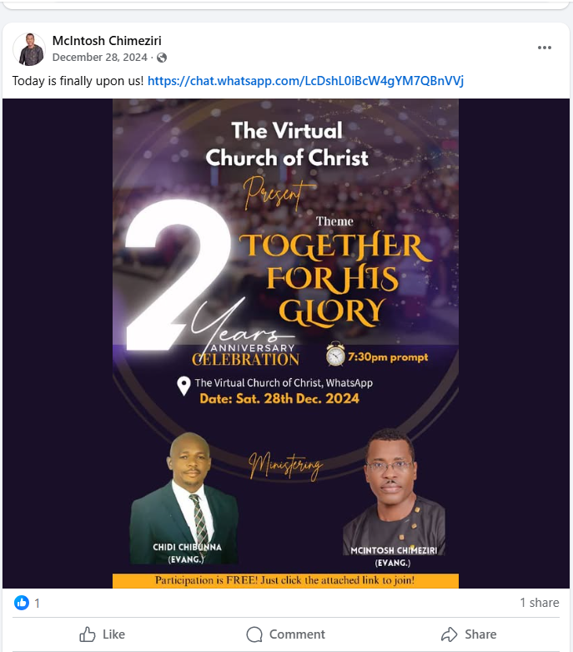
???
Faith
Expedient
Indifference

Slide 20
Matters of Faith, Indifference, and Expediency
1Cor. 11:17 Now in giving these instructions I do not praise you, since you come together
not for the better but for the worse. 18 For first of all,
when you come together as a church, I hear that there are divisions among you, and in part I believe it. 19 For there must also be factions among you, that those who are approved may be recognized among you. 20 Therefore when you come together in one place, it is not to eat the Lord's Supper.
Worship takes place in the assembly, not out of the assembly.
Heb. 10:25 not forsaking the assembling of ourselves together, as is the manner of some, but exhorting one another, and so much the more as you see the Day approaching.

Slide 21
Matters of Faith, Indifference, and Expediency
Where does it stop?
Baptism?
Lord’s Supper?
Worship?
Benevolence
Evangelism
Pattern of finance

Slide 22
Matters of Faith, Indifference, and Expediency
(1) Conditions of forgiveness.
(2) Items of worship.
(3) Christian duties, such as preaching the gospel, helping poor, etc.
The result is unity.
Faith
unity
Things that are necessary about which God has not spoken.
Expedients were and are necessary.
Expedience
liberty
(Rom. 14) (1 Cor. 8:8),
the number of songs, how to take the collection, assembly times, etc.
Indifference
love

Slide 23
Matters of Faith, Indifference, and Expediency
Benevolence
Evangelism
Pattern of finance
Individual or congregation
Widows, orphans, “unwed mothers”
Is the work of the church physical or spiritual?
Where is the pattern? By Faith?
Missionary societies
Preaching
Church run businesses

Slide 24
Matters of Faith, Indifference, and Expediency
The Bible was written so that any people, any culture, any place, any where in time…could obey God’s word!
We honor God by honoring His word.
Malachi 1:6 "A son honors his father, And a servant his master. If then I am the Father, Where is My honor? And if I am a Master, Where is My reverence? Says the LORD of hosts To you priests who despise My name. Yet you say, 'In what way have we despised Your name?'
7 "You offer defiled food on My altar. But say, 'In what way have we defiled You?' By saying, 'The table of the LORD is contemptible.'
8 And when you offer the blind as a sacrifice, Is it not evil? And when you offer the lame and sick, Is it not evil? Offer it then to your governor! Would he be pleased with you? Would he accept you favorably?" Says the LORD of hosts.

