Slide 1
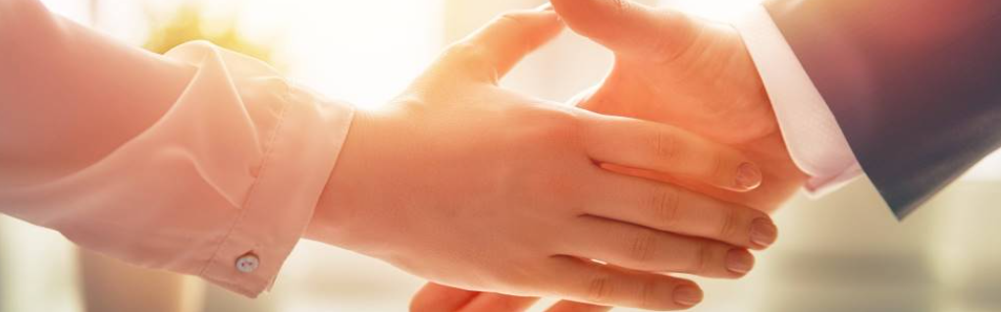
Welcome to our services
New Lebanon Church of Christ
We are Simply Christians.
Our Emphasis is Spiritual, Not Material or Social.
We are striving to be The Same Church as Described in The New Testament.
Please Come Back Again

Slide 2

Jeremiah
Jeremiah 1:10 See, I have this day set thee over the nations and over the kingdoms, to root out, and to pull down, and to destroy, and to throw down, to build, and to plant.

Slide 3
Questions?
Want to learn more about the Bible?
We will be glad to study the Bible with you.
New Lebanon
New Lebanon
Church of Christ
Church of Christ
New Lebanon, OH
newlebanoncoc.com
newlebanoncoc@gmail.com

Slide 4
Lessons From The Weeping Prophet Jeremiah
Jeremiah had a harsh message of judgment.
Delivered with tears
Never won a convert.
His message was not only unwelcome to the nation whose 70 years’ captivity he predicted, but was totally rejected.
But his great accomplishment appears in his character.
Fearless, faithful, and passionate for souls.
He was misrepresented, persecuted, but never stopped proclaiming God’s word.

Slide 5
Lessons From The Weeping Prophet Jeremiah
Jeremiah was one of the great prophets of Israel.
Name means Jehovah is High, or Exalted of God.
Born a priest, called by God to be a prophet, Jer. 1:1, 4-5.
Active as a prophet in Jerusalem (627-586 BC), then Egypt several years (total of about 50 yrs).

Slide 6
Lessons From The Weeping Prophet Jeremiah
Jeremiah teaches us tremendous lessons in the face of trials, Jeremiah was a Man of Faith.
He was forbidden to marry or to be present in homes of mourning or feasting.
Standing alone, he soon found himself opposed by princes, the people, false prophets and priests.
Wherever he appeared he was hated, despised, feared and threatened.

Slide 7
Lessons From The Weeping Prophet Jeremiah
When Jerusalem was besieged he bought a field, demonstrating his faith that God would again bless the land, Jer.32:6-7, 9,

Slide 8
Lessons From The Weeping Prophet Jeremiah
He saw beyond the tragedy of exile to restoration to land, 31:23-28; and,
Jer. 31:31 "Behold, the days are coming, says the LORD, when I will make a new covenant with the house of Israel and with the house of Judah-

Slide 9
Lessons From The Weeping Prophet Jeremiah
Jeremiah was a Courageous Man,
Courageous because God was with him,
Jer. 1:19 They will fight against you, But they shall not prevail against you. For I am with you," says the LORD, "to deliver you."
We need courage in the face of temptations, false allegations and enemies of the cross.

Slide 10
Lessons From The Weeping Prophet Jeremiah
His Message, Jer 1:10.
Denounced sin and announced God’s judgment (God’s wrath), 1:16; 16:10-13.
Assured a future restoration (God’s mercy), 46:27-28; 29:10.

Slide 11
Lessons From The Weeping Prophet Jeremiah
His Manner, Jer 1:17-19.
1. Urgent (he had to preach), 20:9 (2 Tim 4:2).
2. Decisive (he preached what needed to be heard), 37:16-17 (Acts 24:25).

Slide 12
Lessons From The Weeping Prophet Jeremiah
Consistent: His message and his life agreed, 1 Tim. 4:16.
1Tim. 4:16 Take heed to yourself and to the doctrine. Continue in them, for in doing this you will save both yourself and those who hear you.
God’s servant today, (2 Tim. 2:24-26) 3:16-17.

Slide 13
Lessons From The Weeping Prophet Jeremiah
Jeremiah And Jesus.
Jeremiah Jesus
Prophet & Priest (1:1, 5) The Prophet & High Priest (Ac 3:22; Heb. 3:1)
Personal Sorrow (15:18) Man of Sorrows (Isa 53:3)
Wept over Sins (9:1) Wept over Jerusalem (Lk 19:41)
Despised & Rejected (20:10) Despised & Rejected (Isa 53:3)
Sacrifice (16:1-9) Sacrifice (Heb. 10:12)
Intercession (18:20) Intercession (Heb. 7:25)
Spoke Truth w/o Reservation (20:7-9) Spoke Truth w/o Reservation (John 12:49)

Slide 14
Lessons From The Weeping Prophet Jeremiah
Let us learn from Jeremiah:
Never stop speaking God’s word
Always speak God’s word with compassion.
Always remember, we are not responsible for the results, we are responsible for sharing the gospel.
We don’t wait till the time is right. The time may never come.
We must be busy, in season, and out of season.

Slide 15
Lessons From The Weeping Prophet Jeremiah
LESSONS:
God chooses whom He will to do His purposes here on earth.
You do your part and God will do His.
God always holds out a ray of hope.
Live like animals, therefore die like animals.
Prayers of the ungodly are not heard.
Our sins testify against us.
All of God’s promises are conditional.
Cursed is he who does the work of the Lord negligently.

Slide 16
Lessons From The Weeping Prophet Jeremiah
Jeremiah 1:17 "Therefore prepare yourself and arise, And speak to them all that I command you. Do not be dismayed before their faces, Lest I dismay you before them.
18 For behold, I have made you this day A fortified city and an iron pillar, And bronze walls against the whole land-Against the kings of Judah, Against its princes, Against its priests, And against the people of the land.
19 They will fight against you, But they shall not prevail against you. For I am with you," says the LORD, "to deliver you."
Jeremiah - “As a man he melts in tears and pines away in sympathy; as the bearer of God’s word he is firm and hard like pillar and wall, on which the storm of a nation’s wrath breaks in vain” (von Orelli, 1889).

Slide 17
The One Body
There Is One Body
Ephesians 2:14-16
Ephesians 4:4
1 Corinthians 12:12-13
Romans 12:4-5
The Body Is The Church
Colossians 1:18
Ephesians 1:23
Ephesians 5:23-25
1 Corinthians 12:12-13, 18
Salvation In
The Body
Ephesians 2:14-16
Ephesians 5:23
1 John 5:11
How Do We Enter
The Body?
Acts 2:47
1 Corinthians 12:13
Romans 6:3-4

Slide 18
Jesus is
coming.
Are you
ready?

