Slide 1
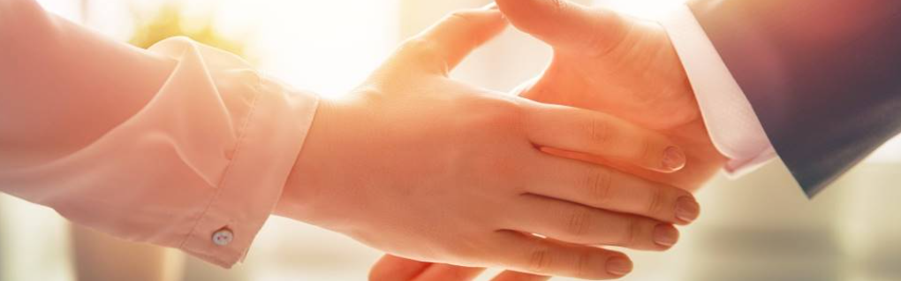
Welcome to our services
New Lebanon Church of Christ
We are Simply Christians.
Our Emphasis is Spiritual, Not Material or Social.
We are striving to be The Same Church as Described in The New Testament.
Please Come Back Again

Slide 2
Numbers 20:17 Please let us pass through your country. We will not pass through fields or vineyards, nor will we drink water from wells; we will go along the King's Highway; we will not turn aside to the right hand or to the left until we have passed through your territory.
18 Then Edom said to him, "You shall not pass through my land, lest I come out against you with the sword."

Slide 3
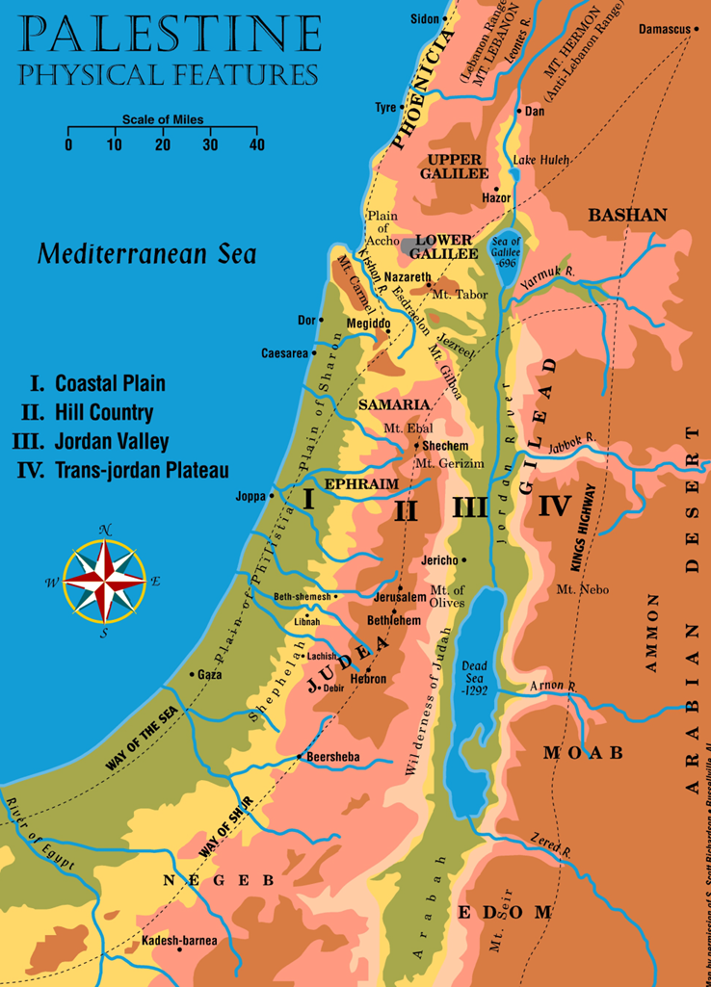


Slide 4
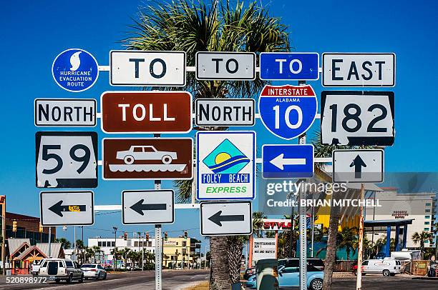

Slide 5
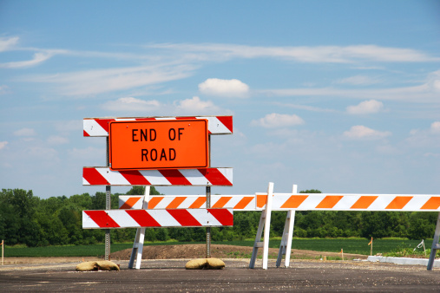

Slide 6


Slide 7

Road Signs On The King’s Highway
2John 1:8 Look to yourselves, that we do not lose those things we worked for, but that we may receive a full reward.
Look

Slide 8

Road Signs On The King’s Highway
Eph 5:6 Let no one deceive you with empty words, for because of these things the wrath of God comes upon the sons of disobedience.
Be
Not
Deceived
1Cor. 15:33 Do not be deceived: "Evil company corrupts good habits.“
Gal. 6:7 Do not be deceived, God is not mocked; for whatever a man sows, that he will also reap.

Slide 9

Road Signs On The King’s Highway
James 4:7 Therefore submit to God. Resist the devil and he will flee from you.
1Peter 5:8 Be sober, be vigilant; because your adversary the devil walks about like a roaring lion, seeking whom he may devour.
9 Resist him, steadfast in the faith, knowing that the same sufferings are experienced by your brotherhood in the world.
Resist

Slide 10

Road Signs On The King’s Highway
1Peter 1:13 Therefore gird up the loins of your mind, be sober, and rest your hope fully upon the grace that is to be brought to you at the revelation of Jesus Christ;
1Thess. 5:6 Therefore let us not sleep, as others do, but let us watch and be sober.
7 For those who sleep, sleep at night, and those who get drunk are drunk at night.
8 But let us who are of the day be sober, putting on the breastplate of faith and love, and as a helmet the hope of salvation.
Be Sober

Slide 11
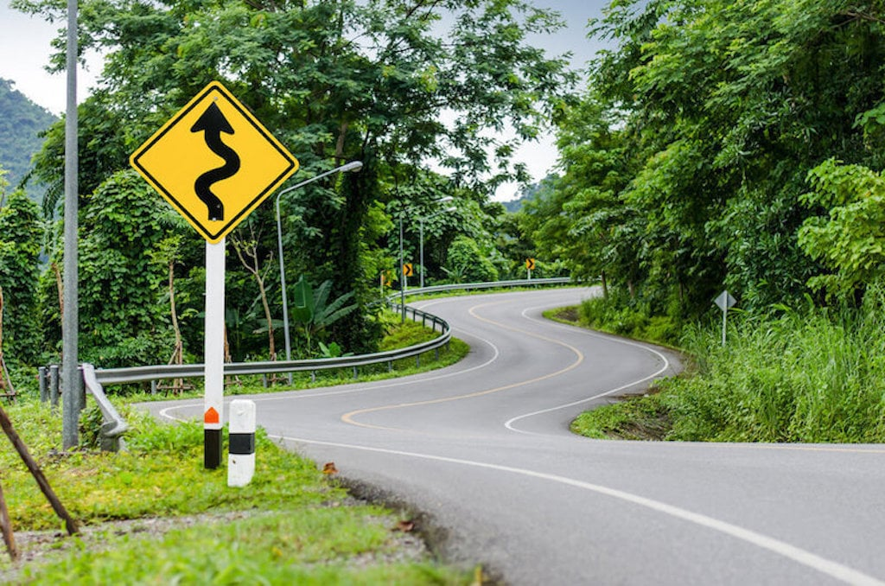

Slide 12

Road Signs On The King’s Highway
Beware
Matt. 7:15 "Beware of false prophets, who come to you in sheep's clothing, but inwardly they are ravenous wolves.
Luke 12:15 And He said to them, "Take heed and beware of covetousness, for one's life does not consist in the abundance of the things he possesses."

Slide 13
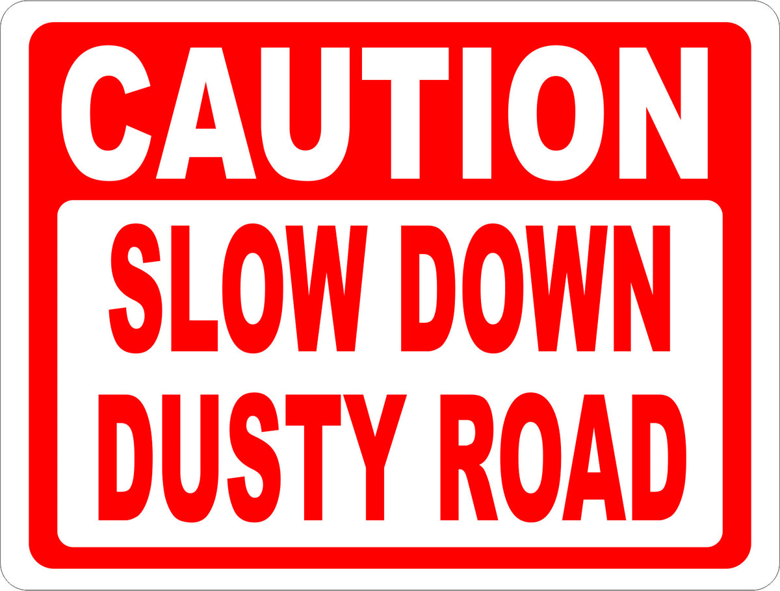

Slide 14

Road Signs On The King’s Highway
1Peter 2:11 Beloved, I beg you as sojourners and pilgrims, abstain from fleshly lusts which war against the soul,
12 having your conduct honorable among the Gentiles, that when they speak against you as evildoers, they may, by your good works which they observe, glorify God in the day of visitation.
Abstain

Slide 15
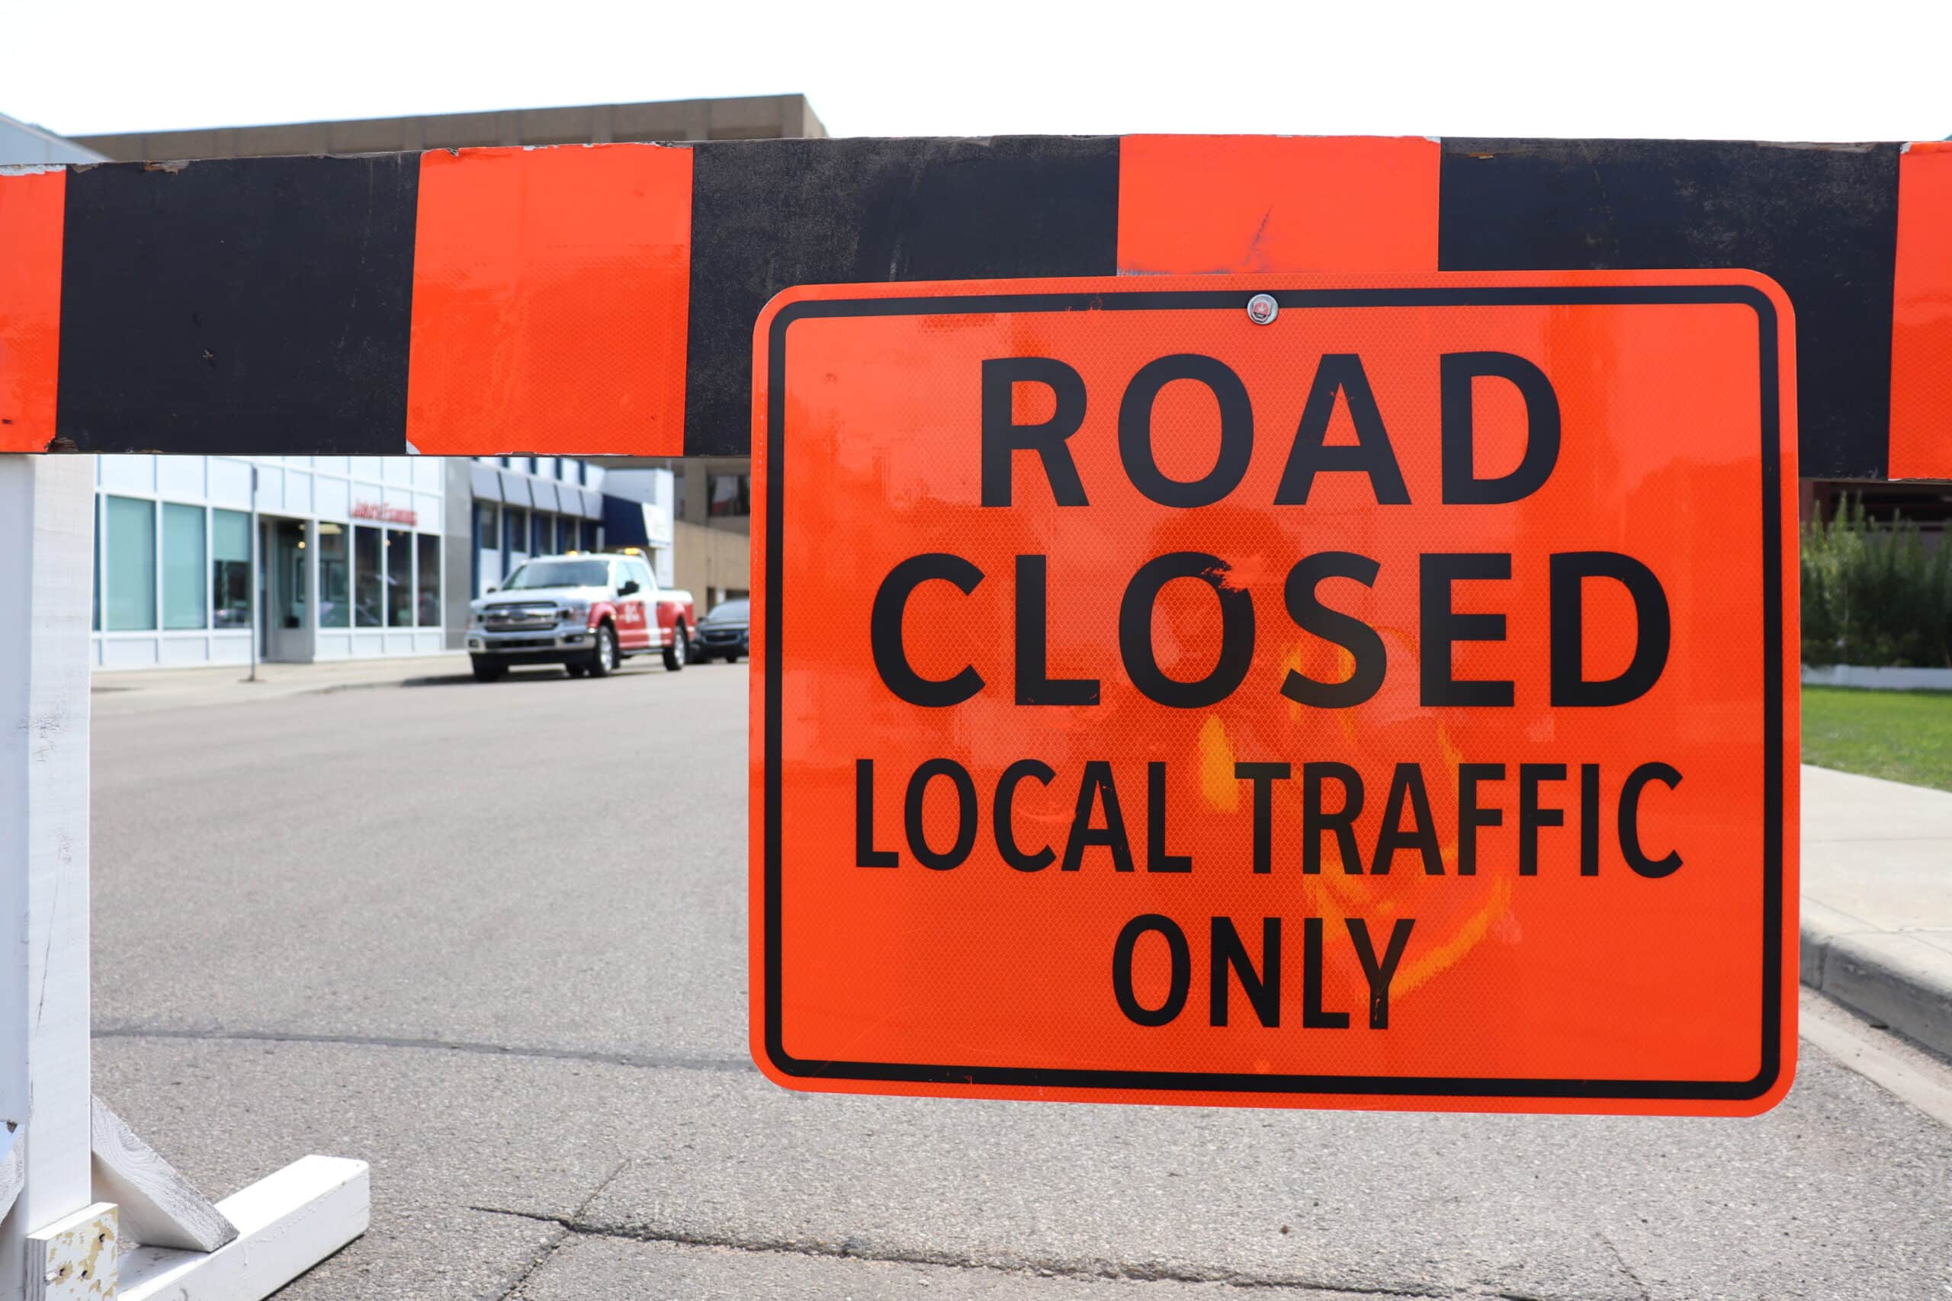

Slide 16
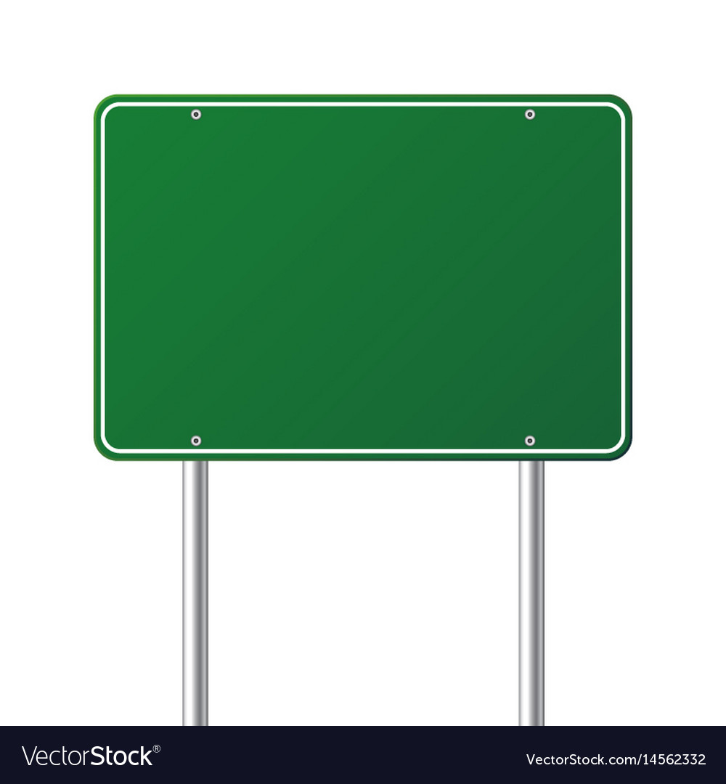
Road Signs On The King’s Highway
1Peter 5:8 Be sober, be vigilant; because your adversary the devil walks about like a roaring lion, seeking whom he may devour.
9 Resist him, steadfast in the faith, knowing that the same sufferings are experienced by your brotherhood in the world.
Be
Vigilant

Slide 17
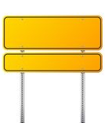
Acts 20:31 "Therefore watch, and remember that for three years I did not cease to warn everyone night and day with tears.
Col 1:28 Him we preach, warning every man and teaching every man in all wisdom, that we may present every man perfect in Christ Jesus.29 To this end I also labor, striving according to His working which works in me mightily. 2:1 For I want you to know what a great conflict I have for you and those in Laodicea, and for as many as have not seen my face in the flesh,
Warning

Slide 18
Road Signs On The King’s Highway
Matt 17:5 While he was still speaking, behold, a bright cloud overshadowed them; and suddenly a voice came out of the cloud, saying, "This is My beloved Son, in whom I am well pleased. Hear Him!"
Hear
Acts 3:22 "For Moses truly said to the fathers, 'The LORD your God will raise up for you a Prophet like me from your brethren. Him you shall hear in all things, whatever He says to you.23 'And it shall be that every soul who will not hear that Prophet shall be utterly destroyed from among the people.'

Slide 19
Road Signs On The King’s Highway
Be Careful
Titus 3:8 This is a faithful saying, and these things I want you to affirm constantly, that those who have believed in God should be careful to maintain good works. These things are good and profitable to men.

Slide 20
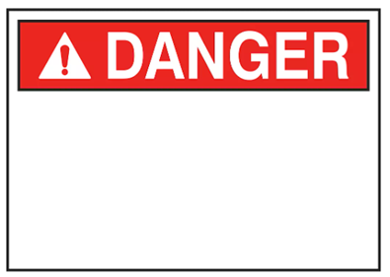
Road Signs On The King’s Highway
Matt. 5:21 "You have heard that it was said to those of old, 'You shall not murder, and whoever murders will be in danger of the judgment.'
22 "But I say to you that whoever is angry with his brother without a cause shall be in danger of the judgment. And whoever says to his brother, 'Raca!' shall be in danger of the council. But whoever says, 'You fool!' shall be in danger of hell fire.
Mark 3:29 "but he who blasphemes against the Holy Spirit never has forgiveness, but is subject to eternal condemnation"

Slide 21
Road Signs On The King’s Highway
Matt. 25:13 "Watch therefore, for you know neither the day nor the hour in which the Son of Man is coming.
Watch
1Cor. 16:13 Watch, stand fast in the faith, be brave, be strong.

Slide 22
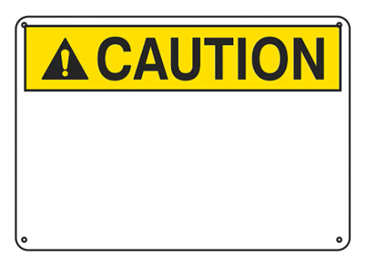
Road Signs On The King’s Highway
Luke 17:3 "Take heed to yourselves. If your brother sins against you, rebuke him; and if he repents, forgive him.
1Cor. 10:12 Therefore let him who thinks he stands take heed lest he fall.
Heed
Heb 3:12 Beware, brethren, lest there be in any of you an evil heart of unbelief in departing from the living God;

Slide 23
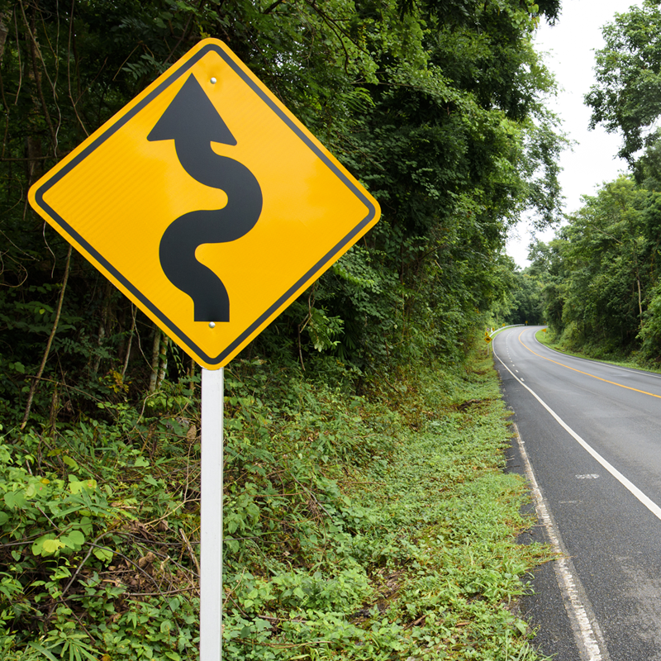

Slide 24
Road Signs On The King’s Highway
Rom. 6:13 And do not present your members as instruments of unrighteousness to sin, but present yourselves to God as being alive from the dead, and your members as instruments of righteousness to God.
14 For sin shall not have dominion over you, for you are not under law but under grace.
15 What then? Shall we sin because we are not under law but under grace? Certainly not!
16 Do you not know that to whom you present yourselves slaves to obey, you are that one's slaves whom you obey, whether of sin leading to death, or of obedience leading to righteousness?
Yield
Not

Slide 25
Road Signs On The King’s Highway
Rom. 12:2 And do not be conformed to this world, but be transformed by the renewing of your mind, that you may prove what is that good and acceptable and perfect will of God.
1Cor. 15:33 Do not be deceived: "Evil company corrupts good habits."
Be Not
1Tim. 6:17 Command those who are rich in this present age not to be haughty, nor to trust in uncertain riches but in the living God, who gives us richly all things to enjoy.
18 Let them do good, that they be rich in good works, ready to give, willing to share,

