Slide 1
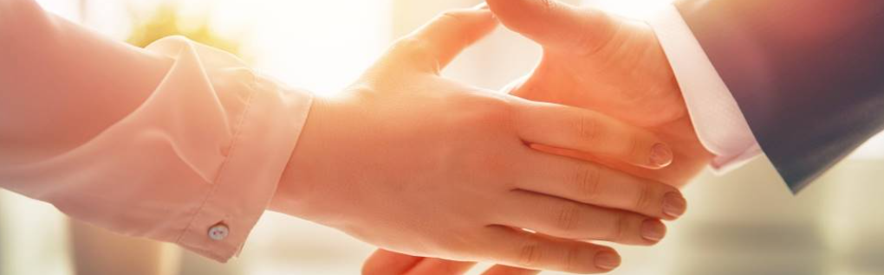
Welcome to our services
New Lebanon Church of Christ
We are Simply Christians.
Our Emphasis is Spiritual, Not Material or Social.
We are striving to be The Same Church as Described in The New Testament.
Please Come Back Again

Slide 2

Christ's Constraining Love
2 Cor. 5:14-15. For the love of Christ compels us, because we judge thus: that if One died for all, then all died; 15 and He died for all, that those who live should live no longer for themselves, but for Him who died for them and rose again.

Slide 3


Slide 4
The love of Christ constrains us to obey him
Christ’s Constraining Love
The love of Christ constrains us to obey him
Christ's love constrains us to abide in him
Christ's love constrains us to remember him
Christ's love constrains us to preach him
Christ's love constrains us to sacrifice for him
Christ's love constrains us to love one another

Slide 5
Hebrews 13:1 Let brotherly love continue.

Slide 6
God expects Christians to “let brotherly love continue”
Let brotherly love continue during times of joy.
Let brotherly love continue during times of sorrow.
Let brotherly love continue during struggles with sin.
Let brotherly love continue during moments of disagreement.

