Slide 1
Welcome to our services
New Lebanon Church of Christ
We are Simply Christians.
Our Emphasis is Spiritual, Not Material or Social.
We are striving to be The Same Church as Described in The New Testament.
Please Come Back Again

Slide 4
When You Feel Like Giving Up
1. When you feel like giving up because of the trials you are suffering, remember righteous Job.

Slide 5
When You Feel Like Giving Up
James 5:10 My brethren, take the prophets, who spoke in the name of the Lord, as an example of suffering and patience.
11 Indeed we count them blessed who endure. You have heard of the perseverance of Job and seen the end intended by the Lord--that the Lord is very compassionate and merciful.

Slide 6
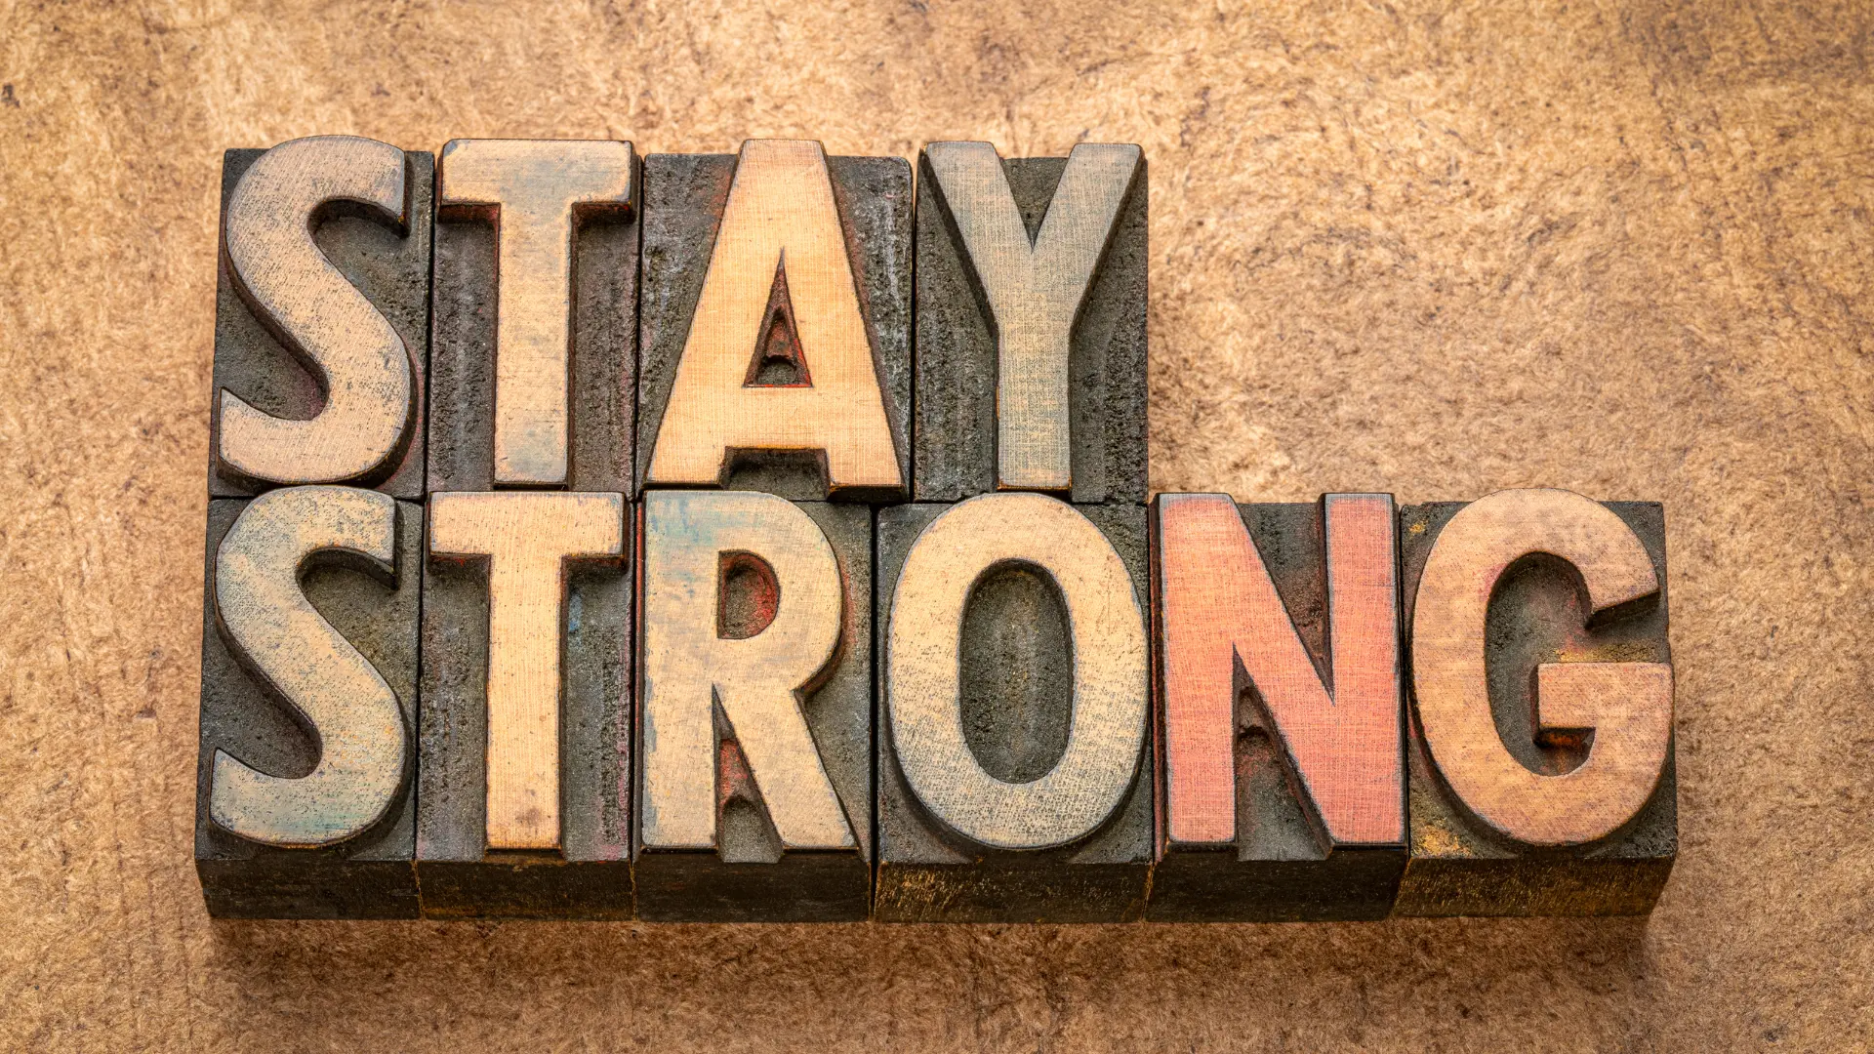

Slide 9
When You Feel Like Giving Up
2. When you feel like giving up because it seems like your righteous efforts are to no avail, remember Elijah.

Slide 10
When You Feel Like Giving Up
1Kings 19:1 And Ahab told Jezebel all that Elijah had done, also how he had executed all the prophets with the sword. 2 Then Jezebel sent a messenger to Elijah, saying, "So let the gods do to me, and more also, if I do not make your life as the life of one of them by tomorrow about this time."
3 And when he saw that, he arose and ran for his life, and went to Beersheba, which belongs to Judah, and left his servant there. 4 But he himself went a day's journey into the wilderness, and came and sat down under a broom tree. And he prayed that he might die

Slide 11
When You Feel Like Giving Up
1Kings 19:10 So he said, "I have been very zealous for the LORD God of hosts; for the children of Israel have forsaken Your covenant, torn down Your altars, and killed Your prophets with the sword. I alone am left; and they seek to take my life."

Slide 12
When You Feel Like Giving Up
2. When you feel like giving up because you’re weary and discouraged in your soul, remember Jesus.

Slide 13
When You Feel Like Giving Up
Genesis 50:20 But as for you, you meant evil against me; but God meant it for good, in order to bring it about as it is this day, to save many people alive.
Joshua 1:9 Have I not commanded you? Be strong and of good courage; do not be afraid, nor be dismayed, for the LORD your God is with you wherever you go.

Slide 14
When You Feel Like Giving Up
2Chronicles 15:7 But you, be strong and do not let your hands be weak, for your work shall be rewarded!
Isaiah 41:10 Fear not, for I am with you; Be not dismayed, for I am your God. I will strengthen you, Yes, I will help you, I will uphold you with My righteous right hand.

Slide 15
When You Feel Like Giving Up
Jeremiah 29:11 For I know the thoughts that I think toward you, says the LORD, thoughts of peace and not of evil, to give you a future and a hope.
Matthew 19:26 But Jesus looked at them and said to them, "With men this is impossible, but with God all things are possible."

Slide 16
When You Feel Like Giving Up
Luke 1:37 For with God nothing will be impossible."
John 8:12 Then Jesus spoke to them again, saying, "I am the light of the world. He who follows Me shall not walk in darkness, but have the light of life."

Slide 17
When You Feel Like Giving Up
Romans 8:28 And we know that all things work together for good to those who love God, to those who are the called according to His purpose.
1Corinthians 9:24 Do you not know that those who run in a race all run, but one receives the prize? Run in such a way that you may obtain it. 25 And everyone who competes for the prize is temperate in all things. Now they do it to obtain a perishable crown, but we for an imperishable crown.

Slide 18
When You Feel Like Giving Up
Galatians 6:9 And let us not grow weary while doing good, for in due season we shall reap if we do not lose heart.
Hebrews 11:6 But without faith it is impossible to please Him, for he who comes to God must believe that He is, and that He is a rewarder of those who diligently seek Him.

Slide 20
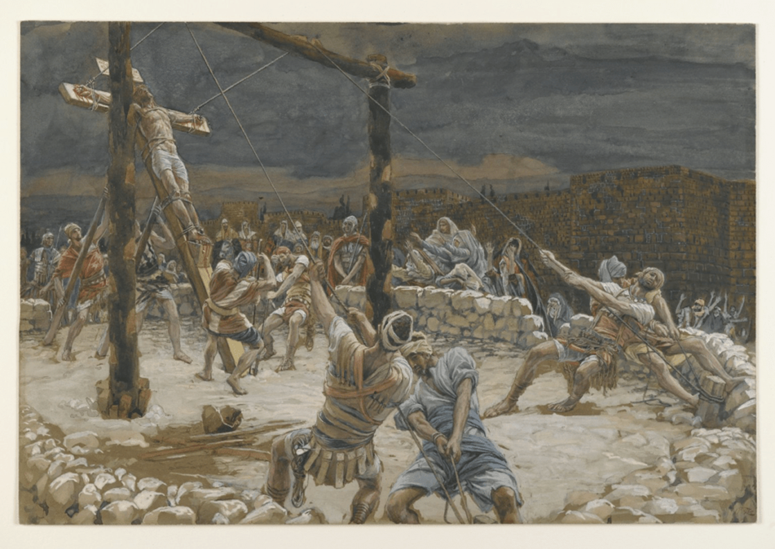
Don’t give up on Christ!
What if Christ gave up on you?

