Slide 1
Welcome to our services
New Lebanon Church of Christ
We are Simply Christians.
Our Emphasis is Spiritual, Not Material or Social.
We are striving to be The Same Church as Described in The New Testament.
Please Come Back Again

Slide 2
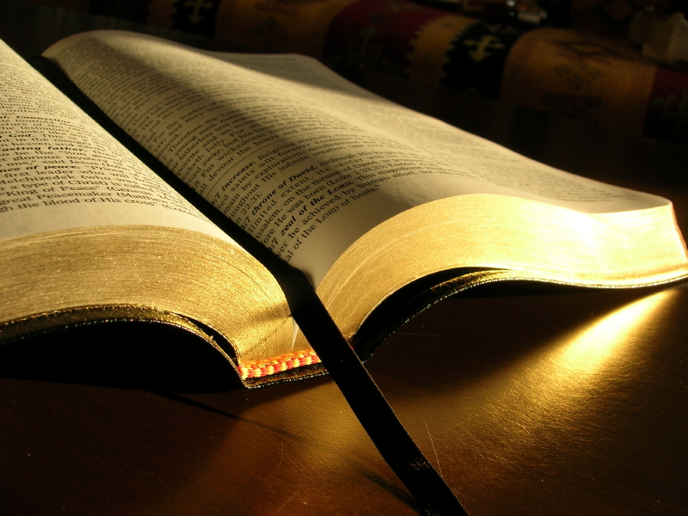
Revelation and Inspiration
2Timothy 3:16 All Scripture is given by inspiration of God, and is profitable for doctrine, for reproof, for correction, for instruction in righteousness,17 that the man of God may be complete, thoroughly equipped for every good work.

Slide 3
Revelation and Inspiration.
Reasons (excuses) people do not Believe.
Bias Against God
Parents and Upbringing
Education
Pride
Immorality
Intellectual Intimidation
Evil, Pain, and Suffering
Hypocrisy or Misconduct of Believers
Unjust Acts Committed by Believers in the Name of God

Slide 4
The Case for The Existence Of God.
Psalm 19
Cause and Effect—
The Cosmological Argument
Throughout history, one of the most effective arguments for the existence
of God has been the cosmological argument, which addresses the fact that the Universe (Cosmos) is here and therefore must be explained in some fashion.

Slide 5
the Law of Cause and Effect

Slide 6
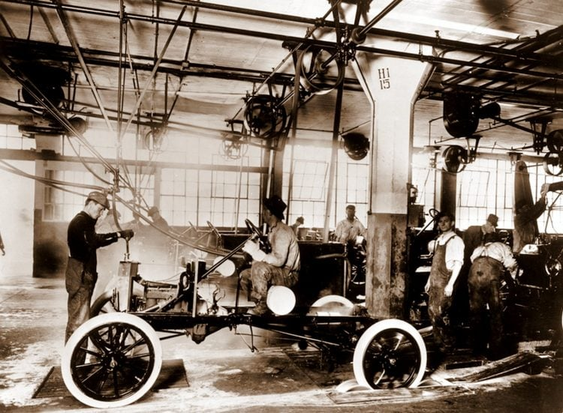

Slide 7
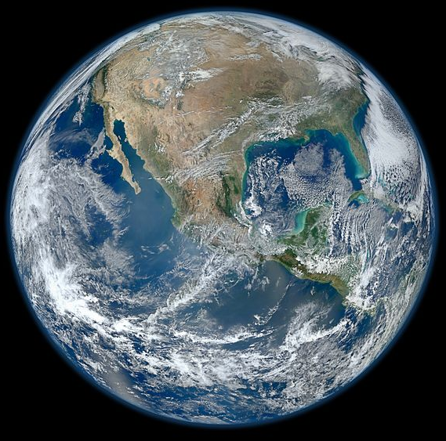
FIVE
Fundamental facts Of Science
Time -In the beginning
Force - God
Action - Created
Space - The Heavens And
Matter - The earth
1

Slide 8
God
Sending
message
Man
Receiving

Slide 9
Revelation and Inspiration
So what is the truth of the matter?
Where did we come from?
Why are we here?
What is our purpose?
Can we really KNOW?
We need a truthful, accurate record of life

Slide 11
Revelation and Inspiration
Truth, represents a fundamental reality that transcends Everything. Most people want to obtain a certain amount of knowledge that they then can put to good use in their everyday lives. We want to be educated –whether formally or informally…we want to know the truth of the matter.
We understand Most people prefer not be deceived, but instead prefer to be dealt with honestly and truthfully. One of the Ten Commandments, in fact, was based upon just such a concept: “Thou shalt not bear false witness against thy neighbor” (Exodus 20:16).

Slide 12
Revelation and Inspiration
Truth always has been the basis for the moral, legal, and ethical codes of nations. And, an abiding respect for truth has the foundation for the legitimacy of those codes.
“Buy the truth, and sell it not,” Proverbs 23:23.
John 8:32 And you shall know the truth and the truth shall make you free.

Slide 13
Revelation and Inspiration
God’s written revelation makes it clear that in the past He provided that revelation in a variety of ways.
1. In the works of His creative genius (Psa.19:1; Rom.1:20-21).
2. In a direct, word-of-mouth fashion (Gen. 3:9-16; Num. 12:8).
3. Through visions and dreams (Gen. 20:3; Num.12:6; Isaiah 29:10-11; Ezk.1:3-4; Dan.2:19; Amos 1:1).
4. Through angels (Gen.16:10-12; 18:13-14; Acts 7:38).

Slide 14
Revelation and Inspiration
5. “a still, small voice” (1 Kings 19:12),
6. the mouth of a donkey (Num. 22:28),
7 a bright cloud (Matthew 17:5).
8.God’s greatest revelation of Himself, however, was in the person of
His Son, Jesus Christ (John 3:16; 14: 9; Col. 2:9).

Slide 15
Revelation and Inspiration
A written form
could be duplicated and distributed as needed,
thus benefiting
the whole of mankind
across the ages.

Slide 16
Revelation and Inspiration
What Does The Bible Contain?
It contains two things:
(1) known facts; and
(2) revelation.
What is the difference between them?

Slide 17
Revelation and Inspiration
“Known facts,” means it contains information known to the people of that time and place.
Example, if the Bible mentions people known as Hittites (Exodus 23:28), then historical records could verify their existence.
If the Bible mentions that the Roman Emperor, Caesar Augustus, commanded that a census be taken at a certain time (Luke 2:1), then we could set about verifying the truthfulness of such a statement.

Slide 18
Revelation and Inspiration
The Bible also contains revelation.
By definition, revelation is the unveiling of facts and truths to man by God—
facts and truths that man, on his own, otherwise could not have known.
Revelation has reference to the communication of information.

Slide 19
Revelation and Inspiration
Compare and contrast - When Moses wrote in Numbers about Israel’s wilderness wanderings after the Exodus from Egypt, he did not need revelation from God to do so. He was their leader during that period and simply wrote what he had observed as an eyewitness.
When Luke penned in his Gospel, he did not need revelation from God to do so. He acknowledged as much when he said: “It seemed good to me also, having traced the course of all things accurately from the first, to write unto thee in order, most excellent Theophilus” (Luke 1:3). Luke had been on certain of the missionary journeys, and thus was able to write from firsthand experience.

Slide 20
Revelation and Inspiration
On the other hand, notice Moses’ statement in Deut. 29:29: “The secret things belong unto Jehovah our God; but the things that are revealed belong unto us and to our children forever, that we may do all the words of this law.”
As an illustration - Moses would have had absolutely no way to know either generic or specific details of the activities of the creation week (Gen. 1:1.) unless God Himself had revealed those details to Moses.

Slide 21
Revelation and Inspiration
John could not have described heaven (as he did within the book of Revelation), unless God first described to John the splendors of heaven.
On occasion, the various Bible writers could, and did, place into print what they had seen or what they had been told by credible witnesses. When they penned such matters, they had no need of revelation from God since they wrote from firsthand experience.
At other times, they wrote about things they neither had experienced themselves nor had been told by others. When they did so, it was God’s revelation that provided the information they needed (Amos 3:7; Daniel 2:28; Eph.3:3-5).

Slide 22
Revelation and Inspiration
There are 2 different types of revelation.
General (or natural) revelation designates the revelation that God has provided of Himself in nature (Rom.1:20-21, Acts 14:17, Psalm 19:1).
Special (or supernatural) revelation is the name that designates the revelation that God has provided within the Bible.

Slide 23
Revelation and Inspiration
General revelation comes to man through nature.
The first 6 verses of Psalm 19 declare that God has given a revelation of Himself in nature that constantly testifies of the Creator.
In Rom.1:20, Paul stated that “the invisible things of him since the creation of the world are clearly seen, being perceived through the things that are made, even his everlasting power and divinity; that they may be without excuse.”

Slide 24
Revelation and Inspiration
The Scriptures teach that general revelation is universal. At no time in history has God left Himself without a witness of Himself (Acts 14:17).
General revelation is universal in both scope and territory. God’s glory can be seen whenever and wherever a heavenly body is observed.

Slide 25
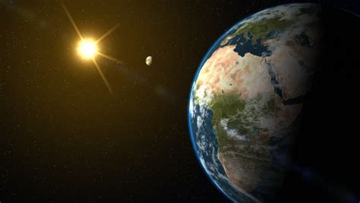
Revelation and Inspiration
PICTURE

Slide 26
Revelation and Inspiration
General revelation simply is not enough. It never was intended to be. It does not provide man the reliable knowledge of God (or other important spiritual matters) that he needs for salvation. By itself, therefore, it is inadequate as the sole foundation of a person’s faith.
From nature alone, man never would be able to infer the need for a personal Savior. Therefore, God has seen fit to give man a second type of revelation.
Special Revelation

Slide 27
Revelation and Inspiration
God has revealed Himself in the 66 books of the Bible in a specific fashion. Speaking in general terms, there has been only one permanent revelation, i.e., the supernatural revelation found within the Scriptures. However, throughout history, God has disclosed Himself and His will in at least 3 different ways:
theophanies,
direct communications,
and miracles.

Slide 28
Revelation and Inspiration
Theophanies are appearances of God Himself.
He is spoken of as dwelling between the cherubim (Psalm 80:1; 99:1).
He appeared in fire and clouds and smoke (cf. Gen.15:17, Ex.3:2, 19:9,16., 33:9, Psalms 78:14, 99:7).
He appeared in stormy winds (Job 38:1; 40:6; Psalm 18:10-16).
Theophany reached its highest point in the incarnation, in which Jesus Christ became flesh and dwelt among men (Col.1:19; 2:9).

Slide 29
Revelation and Inspiration
God disclosed Himself in a second way through direct communications. In doing so, He made His thoughts and will known to men.
Sometimes it was through an audible voice (Gen. 2:16; 3:8-19; Ex.19:9; Deut. 5:4-5;
He worked through dreams (Num.12:6; Deut.13:1-6; 1 Sam. 28:6;
He communicated through visions (Isaiah 6; 21:6.; Ezk. 1-3; 8-11; Daniel 1:17; 2:19; 7-10).
And lastly, God has communicated His thoughts and will to men via the Holy Spirit (Mark 13:11; Luke 12:12; John 14:17; 15:26; 16:13; Acts 6:10; 2 Peter 1:20-21).

Slide 30
Revelation and Inspiration
God also chose to reveal Himself through miracles that not only showcased His power and presence but emphasized great truths as well. They confirmed the words of prophecy and stood as evidence of God’s omnipotence among the people that He had created.
The greatest of these miracles was the incarnation.

Slide 31
Revelation and Inspiration
Revelation is of word and fact;
as such, it is historical in nature.
Its purposes are many, but among those purposes are
justification, sanctification, and redemption.

Slide 32
Revelation and Inspiration
God’s revelation was progressive and unfolding in character—dim at first, then gradually increasing in light until its fullness finally arrived.
As Harold Lindsell observed: This revelation of God of which I have been speaking has become “inscripturated.” It has come down to us in written form.
Thus, there are two Words:
the Word of God incarnate, Jesus Christ,
and the Word of God written, the Bible.

Slide 33
Revelation and Inspiration
It is the
written word
of God
that reveals God
to man.

Slide 34
Jesus is coming.
Are you ready?

