Slide 1
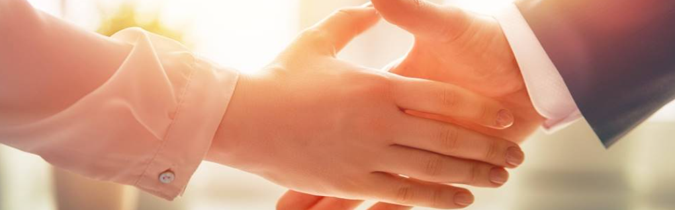
Welcome to our services
New Lebanon Church of Christ
We are Simply Christians.
Our Emphasis is Spiritual, Not Material or Social.
We are striving to be The Same Church as Described in The New Testament.
Please Come Back Again

Slide 2
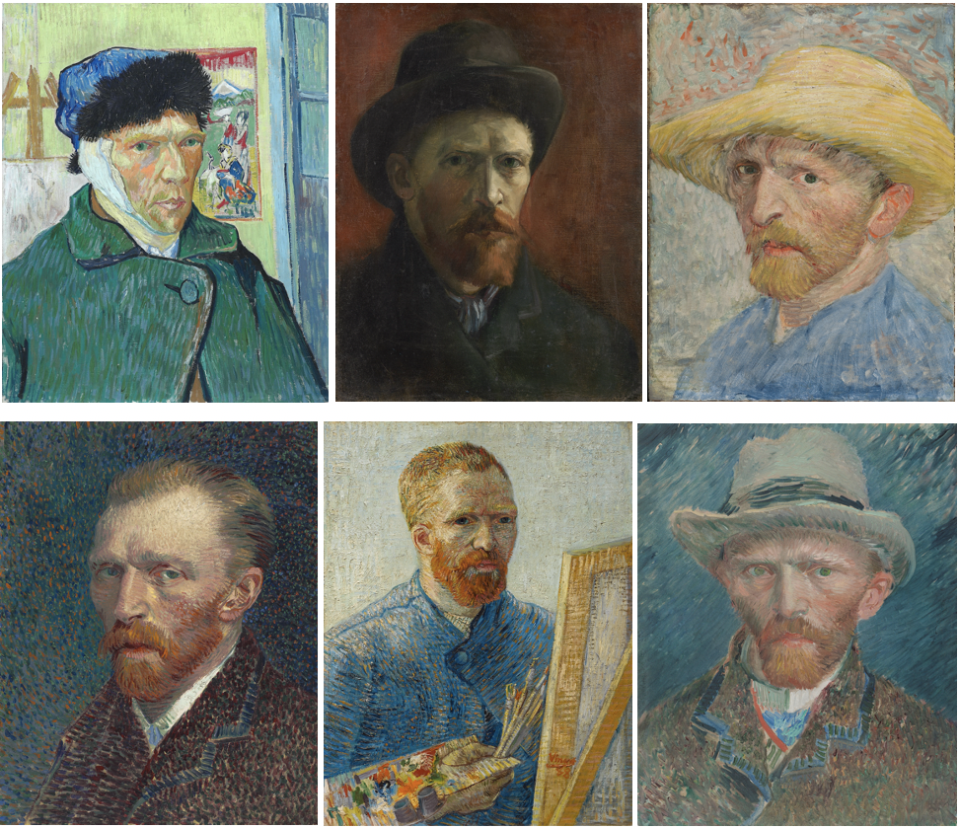
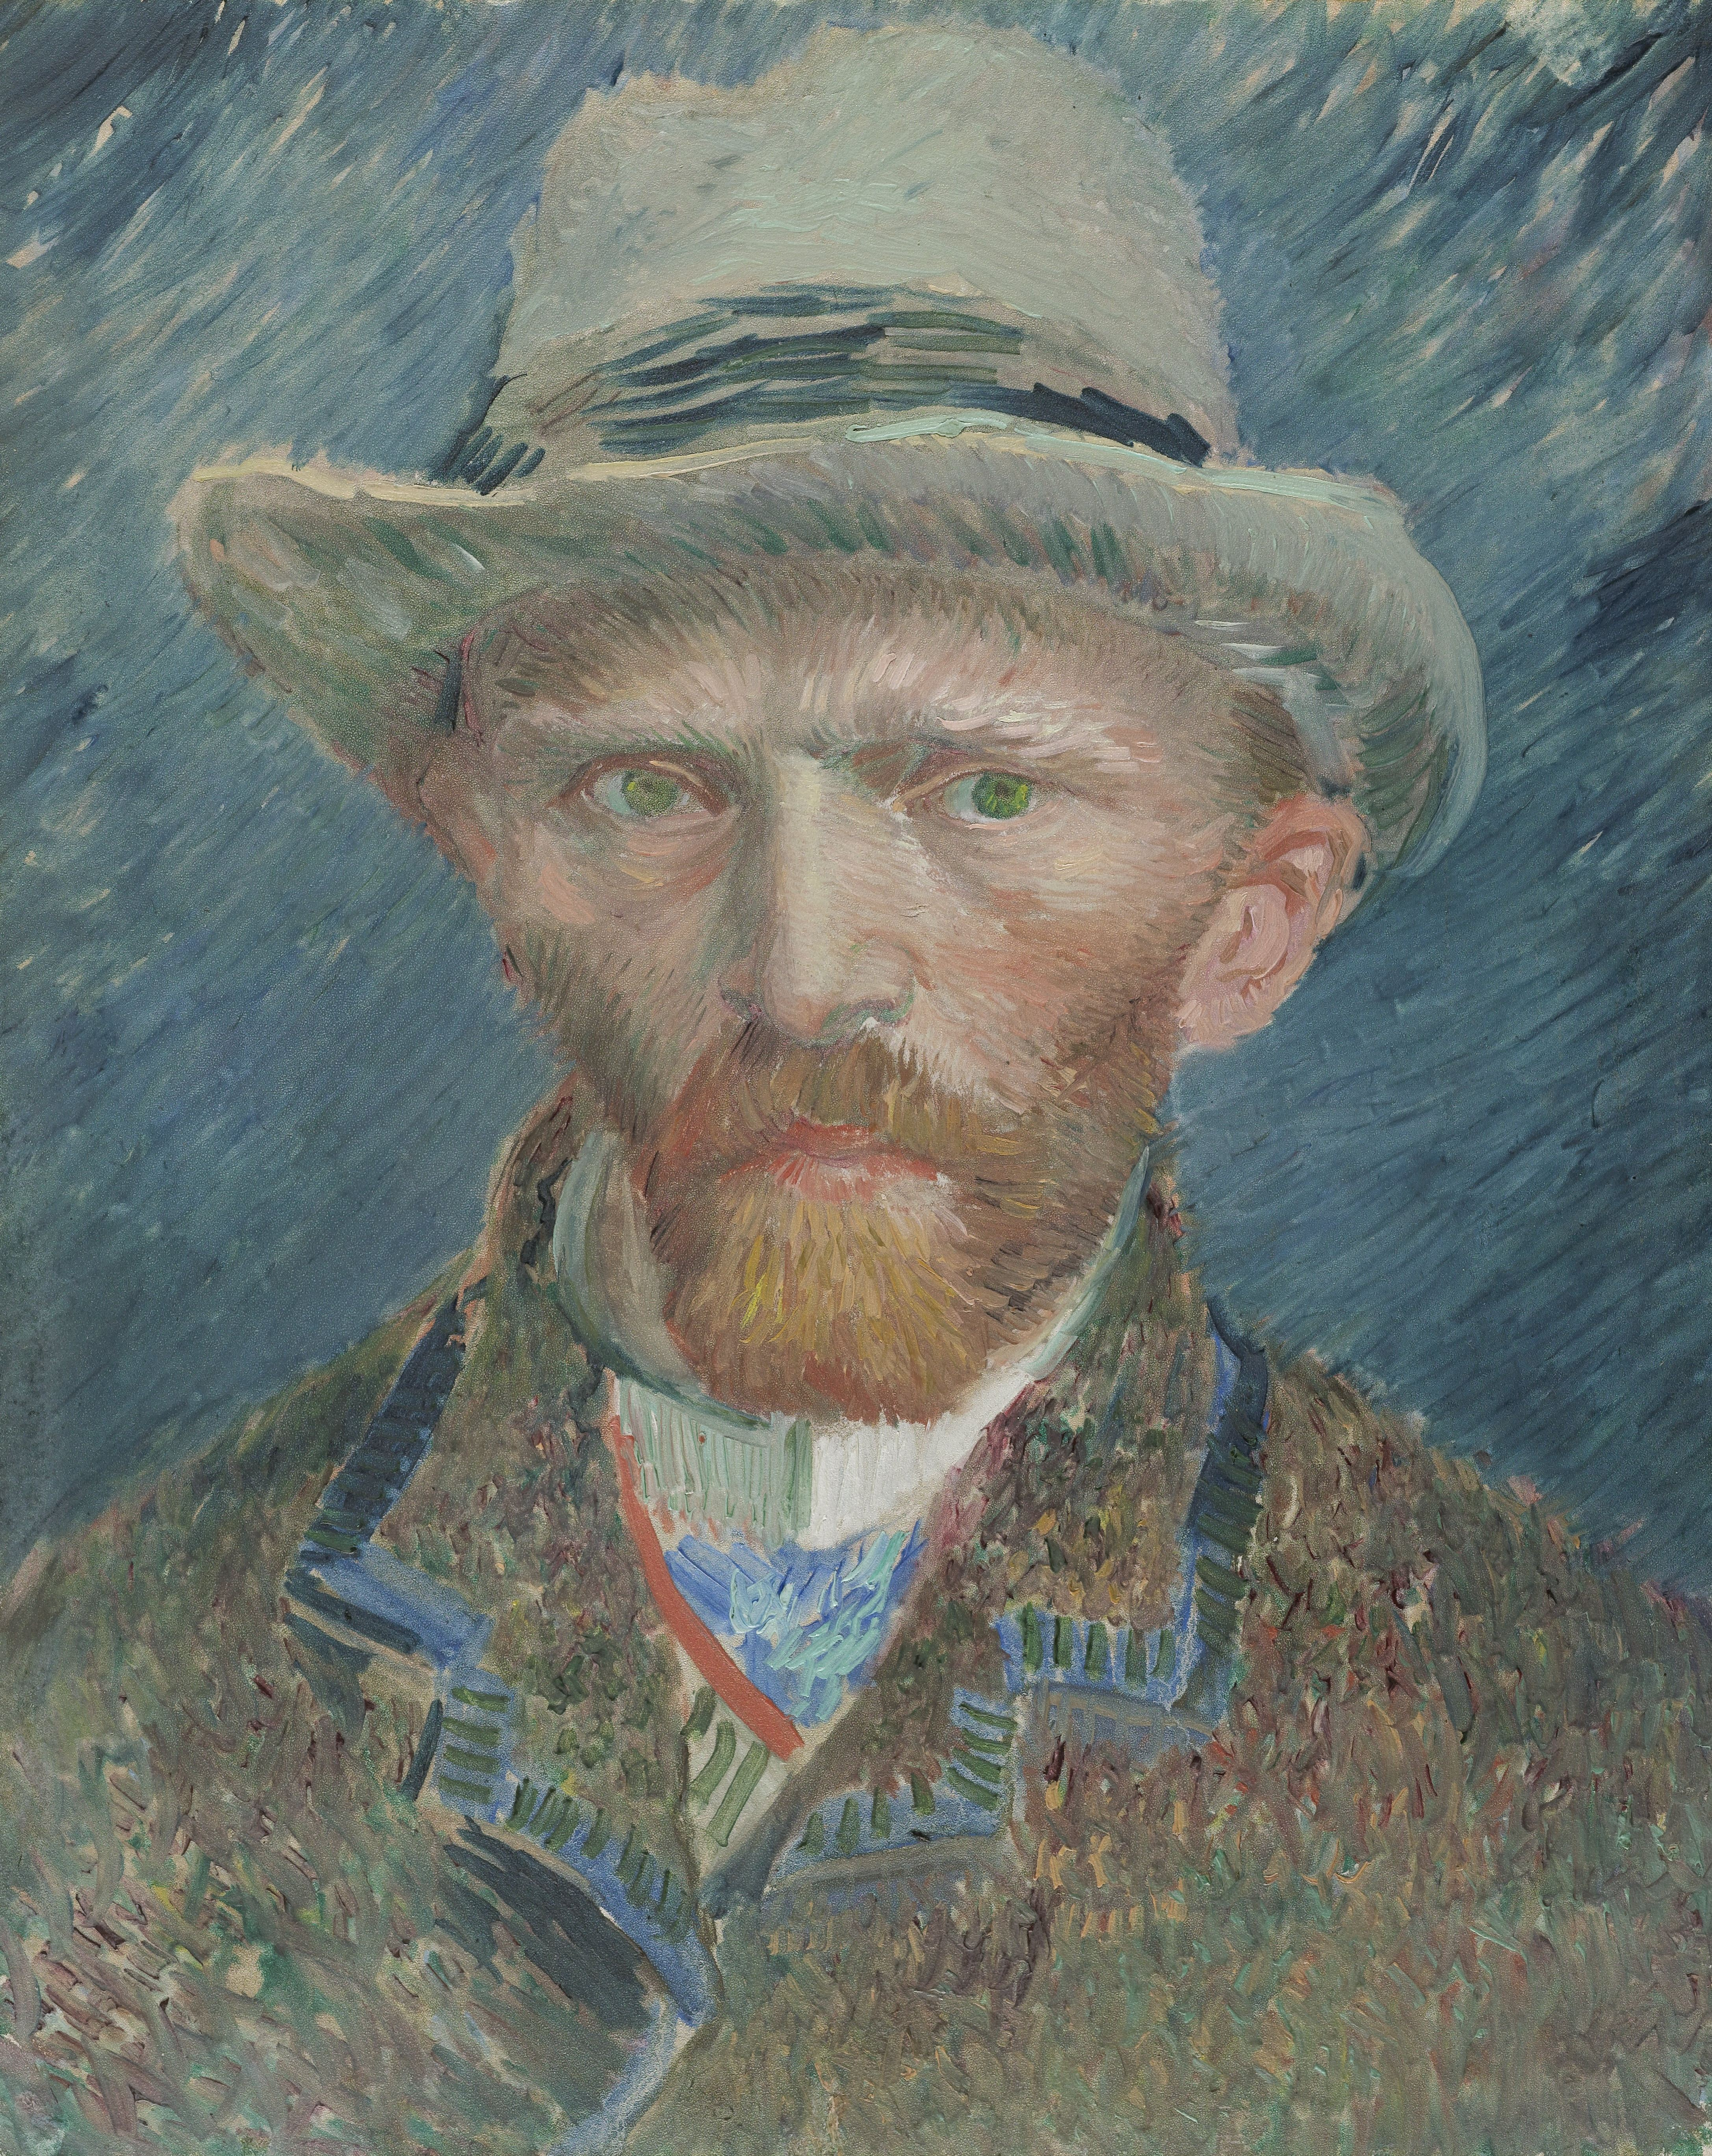

Slide 3

The museum collection of Christ

Slide 4
Portraits of
Christ

Slide 5
Portraits of Christ
Jesus Our Sacrificial Lamb
Isaiah 53:1-8

Slide 6
Portraits of Christ
The Transfigured Christ
Matt.17:1-9

Slide 7
Portraits of Christ
The Risen Christ
Acts 9:1-5

Slide 8
Portraits of Christ
The Reigning Christ
Rev.1:5-8

Slide 9
Portraits of Christ
The Christ worthy of worship.
Rev.1:10-18

Slide 10
Portraits of Christ
Christ the Lamb with all power.
Rev.5:1-10

Slide 11
Portraits of Christ
Christ the victorious on a white horse.
Rev.19:11-16

Slide 12
The museum collection of Christ

Slide 13
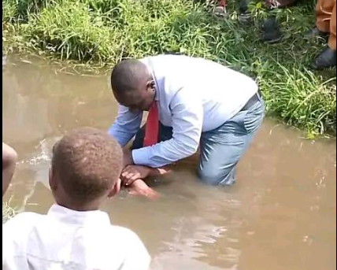
Are you a New Testament Christian??
Hear the Gospel (Rom.10:14)
Believe the Gospel (Heb. 11:6)
Repent of Sins (Acts 3:19)
Confess Christ (Rom.10:9)
Be Baptized Into Christ (1 Cor.12:13)
Serve our Lord the rest of our lives (Rev.2:10)
You Must Be Born Again. John 3:1-7

