Slide 1
Welcome to our services
New Lebanon Church of Christ
We are Simply Christians.
Our Emphasis is Spiritual, Not Material or Social.
We are striving to be The Same Church as Described in The New Testament.
Please Come Back Again

Slide 2
Romans 6:13 And do not present your members as instruments of unrighteousness to sin, but present yourselves to God as being alive from the dead, and your members as instruments of righteousness to God. 14 For sin shall not have dominion over you, for you are not under law but under grace. 15 What then? Shall we sin because we are not under law but under grace? Certainly not!
16 Do you not know that to whom you present yourselves slaves to obey, you are that one's slaves whom you obey, whether of sin leading to death, or of obedience leading to righteousness?
17 But God be thanked that though you were slaves of sin, yet you obeyed from the heart that form of doctrine to which you were delivered. 18 And having been set free from sin, you became slaves of righteousness.

Slide 3
Matt. 4:10 Then Jesus said to him, "Away with you, Satan! For it is written, 'You shall worship the LORD your God, and Him only you shall serve.’”
Matt. 6:24 "No one can serve two masters; for either he will hate the one and love the other, or else he will be loyal to the one and despise the other. You cannot serve God and mammon.

Slide 5
Being a slave to sin – Digital Addiction.
Screen time
Excessive / addictive screen time
Explicit – addictive screen time
Emotional fantasizing
Family / Social / Christ-like Relationships

Slide 6
The obsession to a screen (coping mechanism) prevents you from focusing. How could I be a Christian without focus on Christ?
1Peter 5:8 Be sober, be vigilant; because your adversary the devil walks about like a roaring lion, seeking whom he may devour.

Slide 7
Slides with medical information from Dr. Trish Leigh.

Slide 8
Digital Addiction

Slide 9
Digital Addiction

Slide 10
Digital addiction bypasses emotional depth of real life connections

Slide 11
Digital Addiction

Slide 12
Digital Addiction

Slide 13
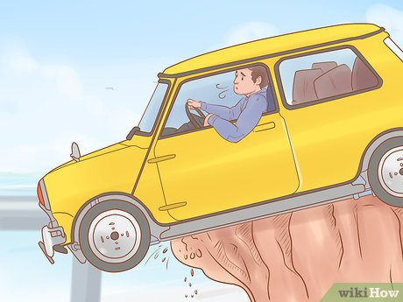
Digital Addiction
Like pushing on the brake pedal in your car to slow down but the brakes are not working and your car keeps going.

Slide 15
Digital Addiction
(The bypass principle)

Slide 16
Digital Addiction

Slide 17
Digital Addiction

Slide 18
Digital Addiction

Slide 21
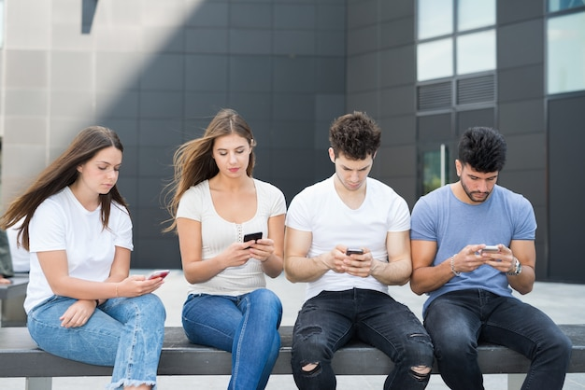

Slide 22
Digital Addiction

Slide 23
Digital Addiction
Explicit images are addictive
• To your brain, they have the same effect as drugs.
• They hijack the reward pathway in the brain.
• Just like drugs, you build up a tolerance, so you need more images for the same effects.
• Withdrawal symptoms can occur when you try and walk away.

Slide 24
Problem for Men and Women.
? Men – visual addiction
? Women – emotional addiction
Emo stories
Soap operas
Romance novels

Slide 26
Emotional Fantasizing - coping - addiction

Slide 27
Digital Addiction
Matt. 5:28 "But I say to you that whoever looks at a woman to lust for her has already committed adultery with her in his heart.
Look
Lust
Adultery
Whoever – whosoever (universal, all men, all women)

Slide 28
Digital Addiction
But we need to tread carefully: When sinful conduct is defined as an addiction it tends to remove accountability for guilt and shame of the sin. Addicts are not viewed as sinners, but as "victims." (that removes free will)
At some point, one's addictive behavior was chosen: Alcohol, drugs, lust, sex, pornography, gambling, lying, etc. Sin becomes addicting (habit-forming) as one lives in sin, walking in its darkness:
Rom. 6:15-17: "What then? Shall we sin because we are not under law but under grace? Certainly not! 16 Do you not know that to whom you present yourselves slaves to obey, you are that one's slaves whom you obey, whether of sin leading to death, or of obedience leading to righteousness?"

Slide 29
Digital Addiction
We must realize that when sin is repeated over and over it:
Sears the conscience (1 Tim. 4:1-2),
Hardens the heart (Heb. 3:12-13),
Can make repentance "impossible" (Heb. 6:4-6).
We must be diligent to develop the "fruit of the Spirit" in our lives; especially: Self-control (Gal. 5:22-25), Discipline (1 Cor. 9:24-27).

Slide 30
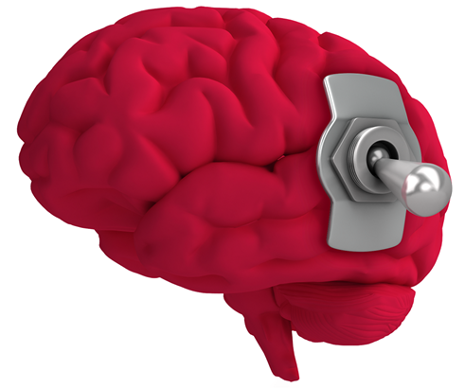
Digital Addiction

Slide 31
Digital Addiction

Slide 32
Digital Addiction

Slide 33
Digital Addiction

Slide 34
Digital Addiction

Slide 35
Digital Addiction

Slide 36
Digital Addiction
James 4:4
Adulterers and adulteresses! Do you not know that friendship with the world is enmity with God? Whoever therefore wants to be a friend of the world makes himself an enemy of God.

Slide 37
Digital Addiction
1Thess. 4:3
For this is the will of God, your sanctification: that you should abstain from sexual immorality;
4 that each of you should know how to possess his own vessel in sanctification and honor,
5 not in passion of lust, like the Gentiles who do not know God;

Slide 38
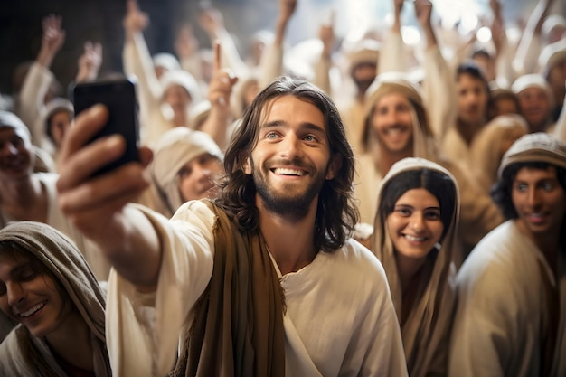
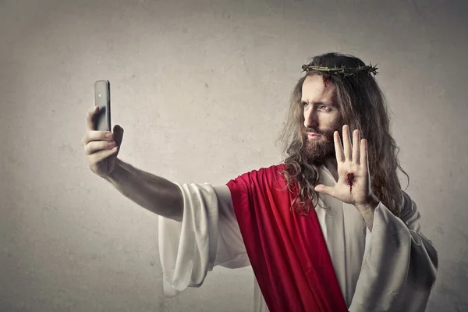
Romans 6:16 Do you not know that to whom you present yourselves slaves to obey, you are that one's slaves whom you obey, whether of sin leading to death, or of obedience leading to righteousness?
Stop the sin. Take back control of your life!

