Slide 1
Welcome to our services
New Lebanon Church of Christ
We are Simply Christians.
Our Emphasis is Spiritual, Not Material or Social.
We are striving to be The Same Church as Described in The New Testament.
Please Come Back Again

Slide 2
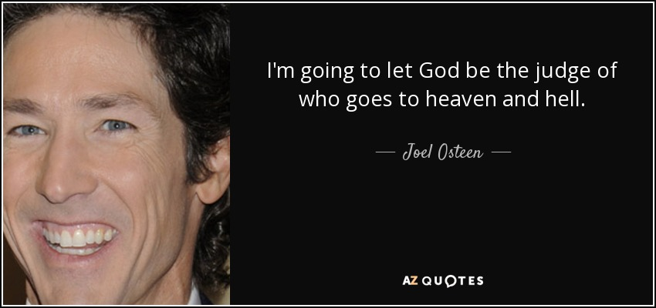
“I Will Just Let God be The Judge?”

Slide 3
“I Will Just Let God be The Judge?”
If I will just let God be the judge, then -
1Timothy 6:3 If anyone teaches otherwise and does not consent to wholesome words, even the words of our Lord Jesus Christ, and to the doctrine which accords with godliness,
4 he is proud, knowing nothing, but is obsessed with disputes and arguments over words, from which come envy, strife, reviling, evil suspicions,
5 useless wranglings of men of corrupt minds and destitute of the truth, who suppose that godliness is a means of gain (Joel Olsteen). From such withdraw yourself.

Slide 5
I believe… I believe… I believe… I believe… I believe…

Slide 6
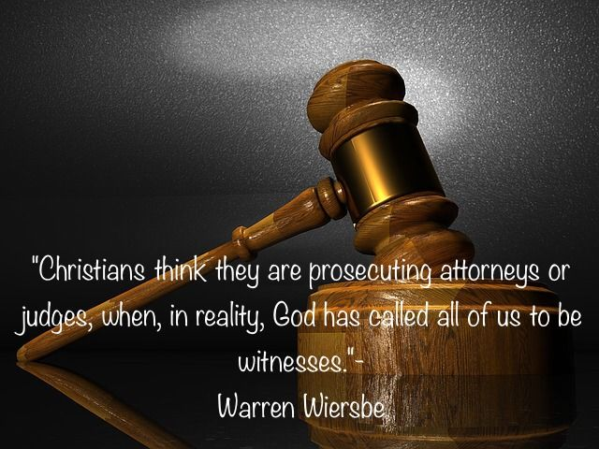

Slide 7
“I Will Just Let God be The Judge?”
“Scripture shapes our understanding of the Father. Yet, we often fall into the habit of crafting our own version of God in our minds. Someone once said, “You can safely assume that you’ve created God in your own image when it turns out that God hates all the same people as you do.” We tend to justify our shortcomings or find excuses to dismiss our poor choices. This inclination is all too natural.”
We make God what we want Him to be in our mind instead of what he actually is in His recorded word.

Slide 8
“I Will Just Let God be The Judge?”
We judge people and things everyday.
(job interviews, buying products, buying food)
Some people do not want to judge on the basis of religion – the most important thing.

Slide 9
“I Will Just Let God be The Judge?”
If I will just let God be the judge, then -
I will not need to speak against sin
I will not need to train or discipline my children
I will not need to expect discipline in the church
Then I will not need to care for the lost and persuade them to repent

Slide 10
“I Will Just Let God be The Judge?”
If I will just let God be the judge, then -
I will not need to Preach!!!
All the Christian martyrs that stood for the truth died in vain
Then the elders will not need to watch over the flock
Then we don’t need to practice the command to withdraw from Christians in sin

Slide 11
“I Will Just Let God be The Judge?”
If I will just let God be the judge, then -
I need to stop preaching against false doctrine.
Gal. 1:6 I marvel that you are turning away so soon from Him who called you in the grace of Christ, to a different gospel,
7 which is not another; but there are some who trouble you and want to pervert the gospel of Christ.
8 But even if we, or an angel from heaven, preach any other gospel to you than what we have preached to you, let him be accursed.
9 As we have said before, so now I say again, if anyone preaches any other gospel to you than what you have received, let him be accursed.

Slide 12
“I Will Just Let God be The Judge?”
If I will just let God be the judge, then -
Acts 20:28 "Therefore take heed to yourselves and to all the flock, among which the Holy Spirit has made you overseers, to shepherd the church of God which He purchased with His own blood.
29 "For I know this, that after my departure savage wolves will come in among you, not sparing the flock.
30 "Also from among yourselves men will rise up, speaking perverse things, to draw away the disciples after themselves.
31 "Therefore watch, and remember that for three years I did not cease to warn everyone night and day with tears.

Slide 13
“I Will Just Let God be The Judge?”
If I will just let God be the judge, then -
1Timothy 6:3 If anyone teaches otherwise and does not consent to wholesome words, even the words of our Lord Jesus Christ, and to the doctrine which accords with godliness,
4 he is proud, knowing nothing, but is obsessed with disputes and arguments over words, from which come envy, strife, reviling, evil suspicions,
5 useless wranglings of men of corrupt minds and destitute of the truth, who suppose that godliness is a means of gain (Joel Olsteen). From such withdraw yourself.

Slide 14
“I Will Just Let God be The Judge?”
2Tim. 3:1 But know this, that in the last days perilous times will come:
2 For men will be lovers of themselves, lovers of money, boasters, proud, blasphemers, disobedient to parents, unthankful, unholy,
3 unloving, unforgiving, slanderers, without self-control, brutal, despisers of good, 4 traitors, headstrong, haughty, lovers of pleasure rather than lovers of God, 5 having a form of godliness but denying its power. And from such people turn away!
6 For of this sort are those who creep into households and make captives of gullible women loaded down with sins, led away by various lusts, 7 always learning and never able to come to the knowledge of the truth. 8 Now as Jannes and Jambres resisted Moses, so do these also resist the truth: men of corrupt minds, disapproved concerning the faith;
9 but they will progress no further, for their folly will be manifest to all, as theirs also was.

Slide 16
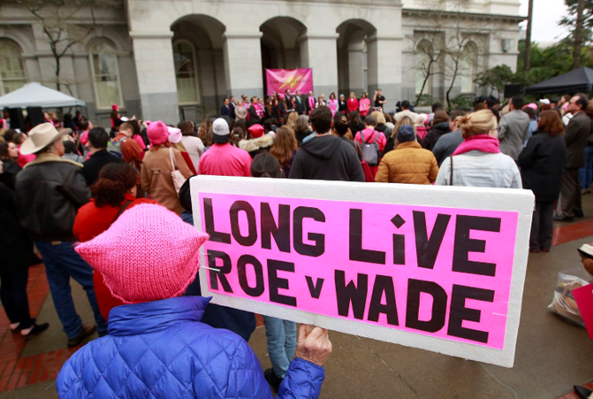

Slide 17
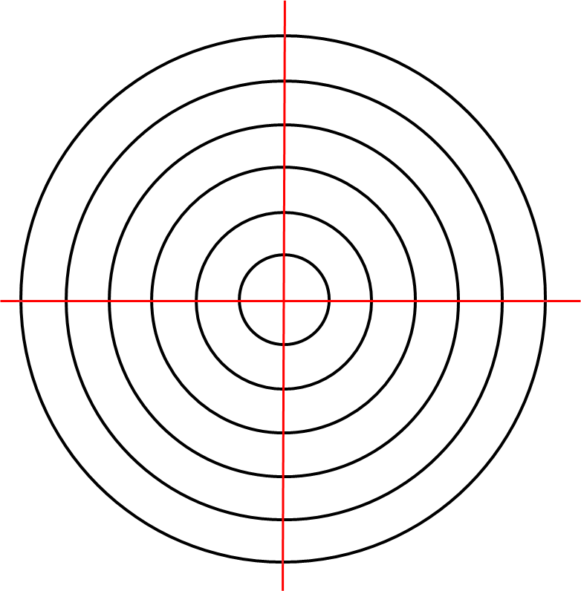
“I Will Just Let God be The Judge?”
Many people don’t understand that sin is missing the mark.
We sin by falling short or going too far.

Slide 18
“I Will Just Let God be The Judge?”
Has God made His law so hard to understand that we can not tell when we hit the mark or miss the mark???
Matt. 7:21 "Not everyone who says to Me, 'Lord, Lord,' shall enter the kingdom of heaven, but he who does the will of My Father in heaven.
22 "Many will say to Me in that day, 'Lord, Lord, have we not prophesied in Your name, cast out demons in Your name, and done many wonders in Your name?'
23 "And then I will declare to them, 'I never knew you; depart from Me, you who practice lawlessness!'

Slide 19
“I Will Just Let God be The Judge?”
Principle and Fact
Ezekiel 3:16 Now it came to pass at the end of seven days that the word of the LORD came to me, saying,
17 "Son of man, I have made you a watchman for the house of Israel; therefore hear a word from My mouth, and give them warning from Me:
18 "When I say to the wicked, 'You shall surely die,' and you give him no warning, nor speak to warn the wicked from his wicked way, to save his life, that same wicked man shall die in his iniquity; but his blood I will require at your hand.
19 "Yet, if you warn the wicked, and he does not turn from his wickedness, nor from his wicked way, he shall die in his iniquity; but you have delivered your soul. >>>

Slide 20
“I Will Just Let God be The Judge?”
20 "Again, when a righteous man turns from his righteousness and commits iniquity, and I lay a stumbling block before him, he shall die; because you did not give him warning, he shall die in his sin, and his righteousness which he has done shall not be remembered; but his blood I will require at your hand.
21 "Nevertheless if you warn the righteous man that the righteous should not sin, and he does not sin, he shall surely live because he took warning; also you will have delivered your soul."

Slide 21
“I Will Just Let God be The Judge?”
Acts 20:20 "how I kept back nothing that was helpful, but proclaimed it to you, and taught you publicly and from house to house, 21 "testifying to Jews, and also to Greeks, repentance toward God and faith toward our Lord Jesus Christ. 22 "And see, now I go bound in the spirit to Jerusalem, not knowing the things that will happen to me there,
23 "except that the Holy Spirit testifies in every city, saying that chains and tribulations await me. 24 "But none of these things move me; nor do I count my life dear to myself, so that I may finish my race with joy, and the ministry which I received from the Lord Jesus, to testify to the gospel of the grace of God.
25 "And indeed, now I know that you all, among whom I have gone preaching the kingdom of God, will see my face no more.
26 "Therefore I testify to you this day that I am innocent of the blood of all men. 27 "For I have not shunned to declare to you the whole counsel of God.

Slide 22
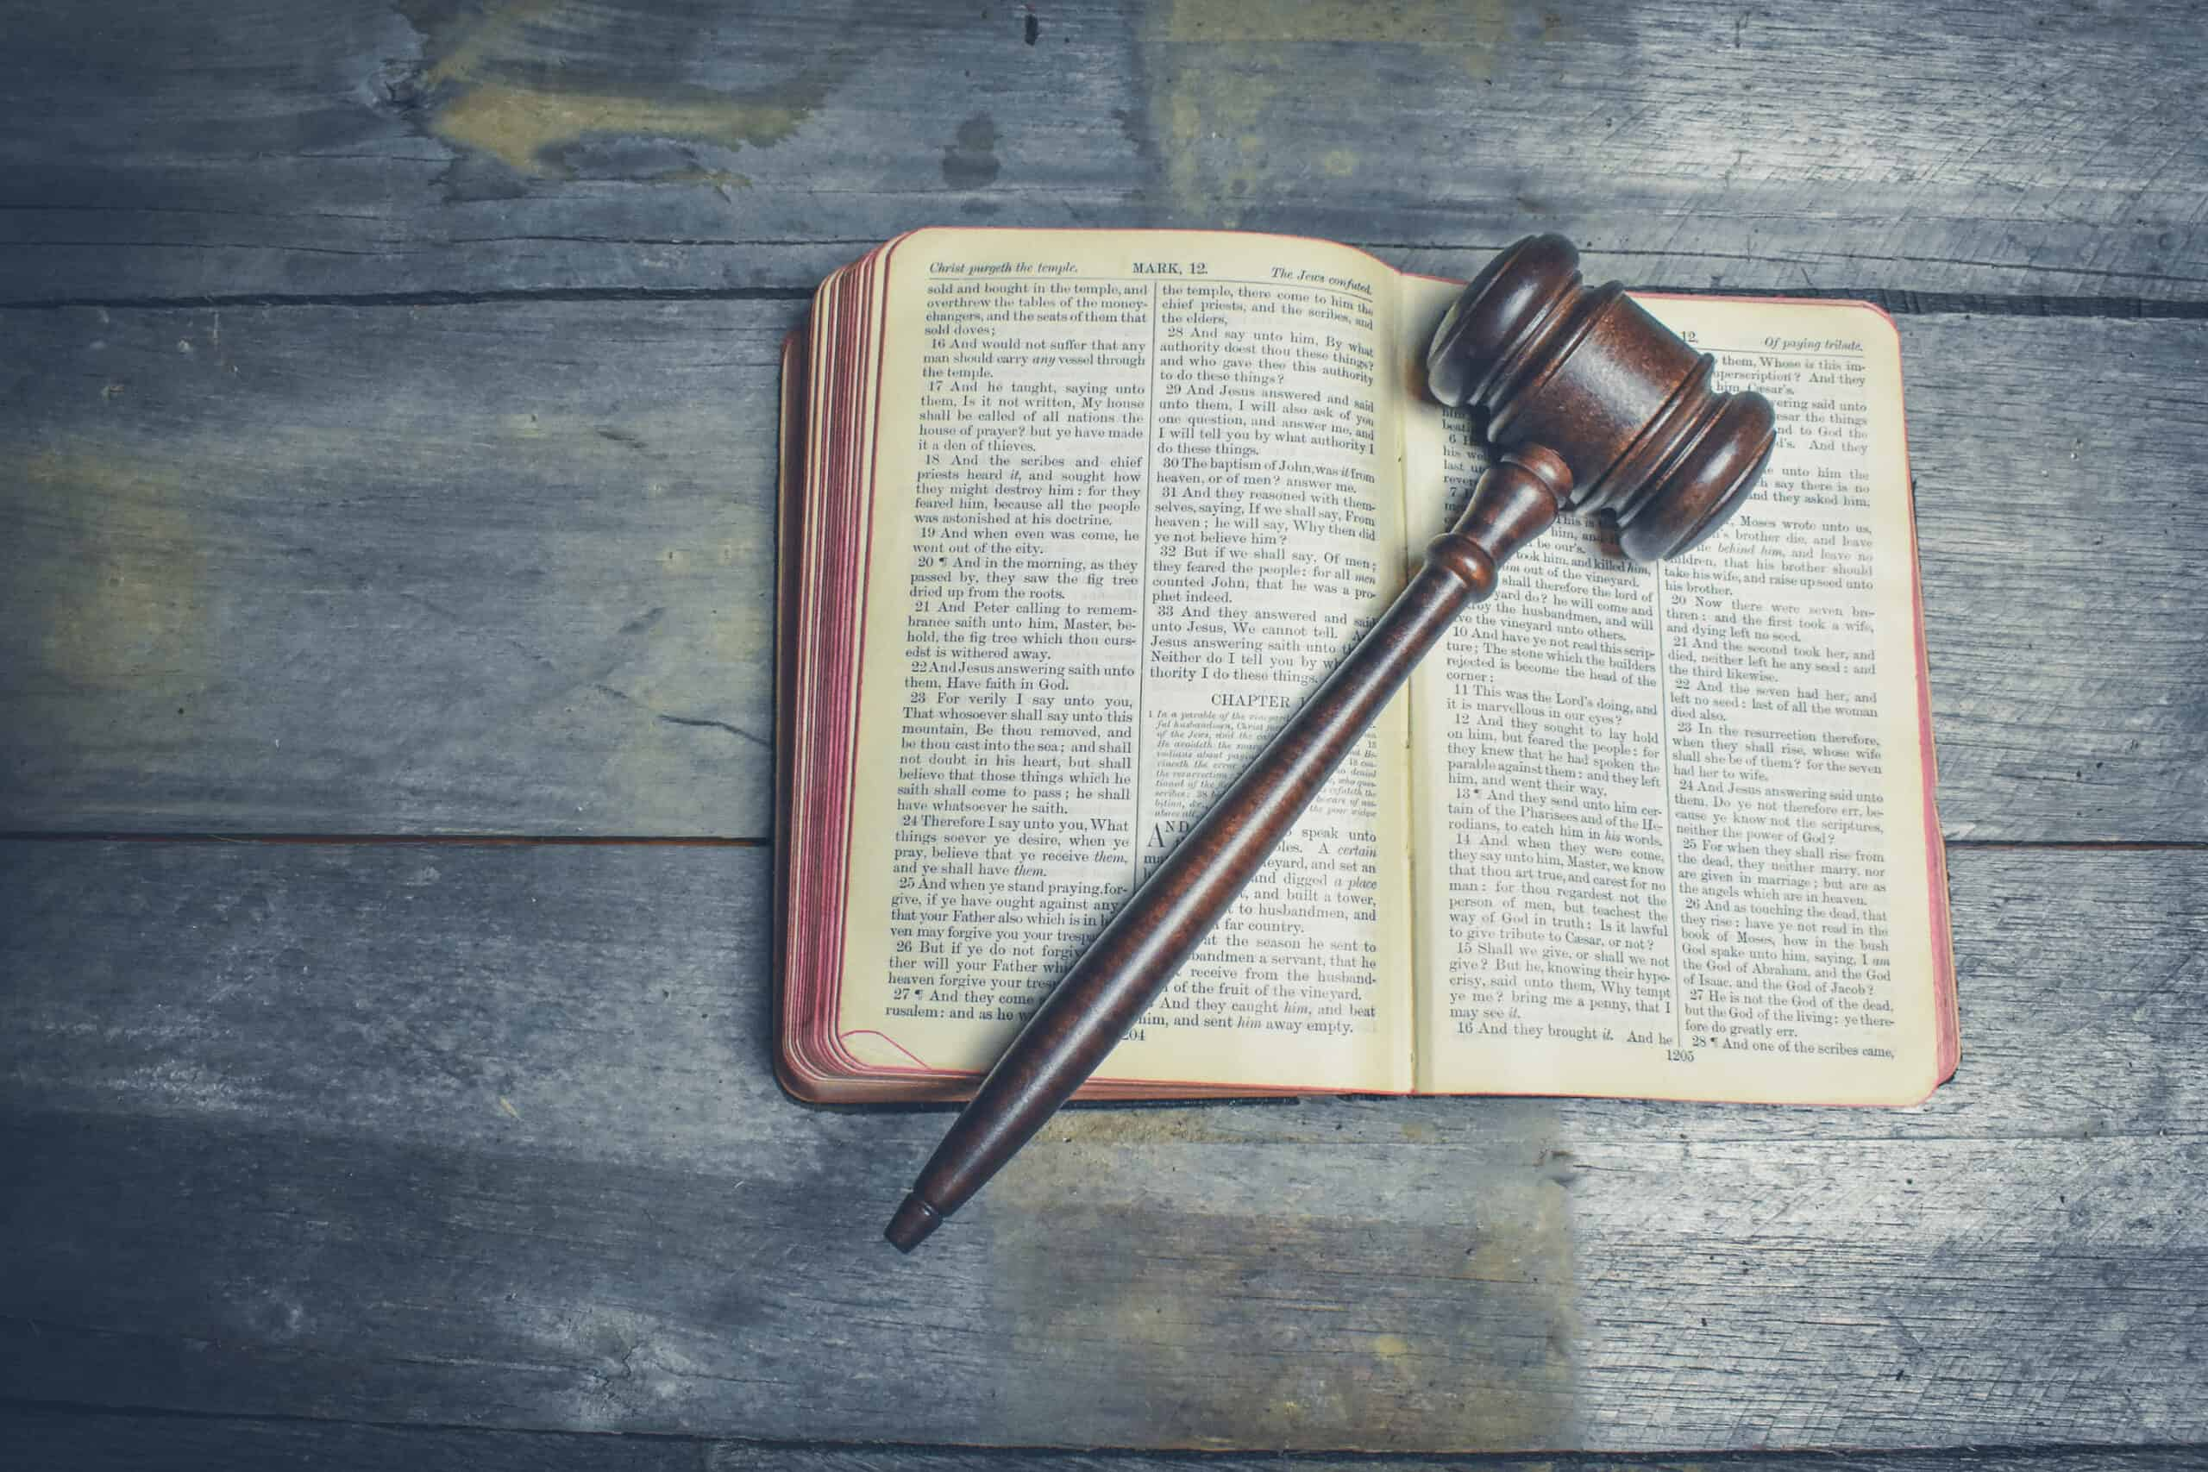
“I Will Just Let God be The Judge?”
John 12:48 "He who rejects Me, and does not receive My words, has that which judges him--the word that I have spoken will judge him in the last day.

