Slide 1
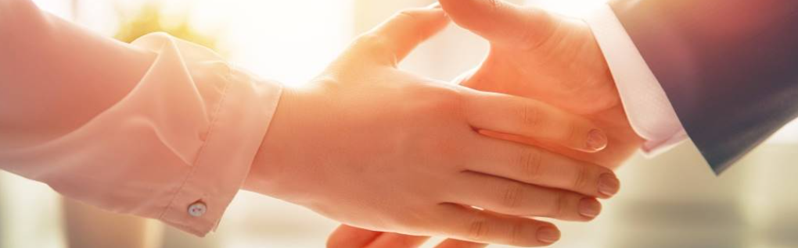
Welcome to our services
New Lebanon Church of Christ
We are Simply Christians.
Our Emphasis is Spiritual, Not Material or Social.
We are striving to be The Same Church as Described in The New Testament.
Please Come Back Again

Slide 2
The House Church Movement
Acts 2:46 So continuing daily with one accord in the temple, and breaking bread from house to house, they ate their food with gladness and simplicity of heart,
Acts 20:20 "how I kept back nothing that was helpful, but proclaimed it to you, and taught you publicly and from house to house,

Slide 3
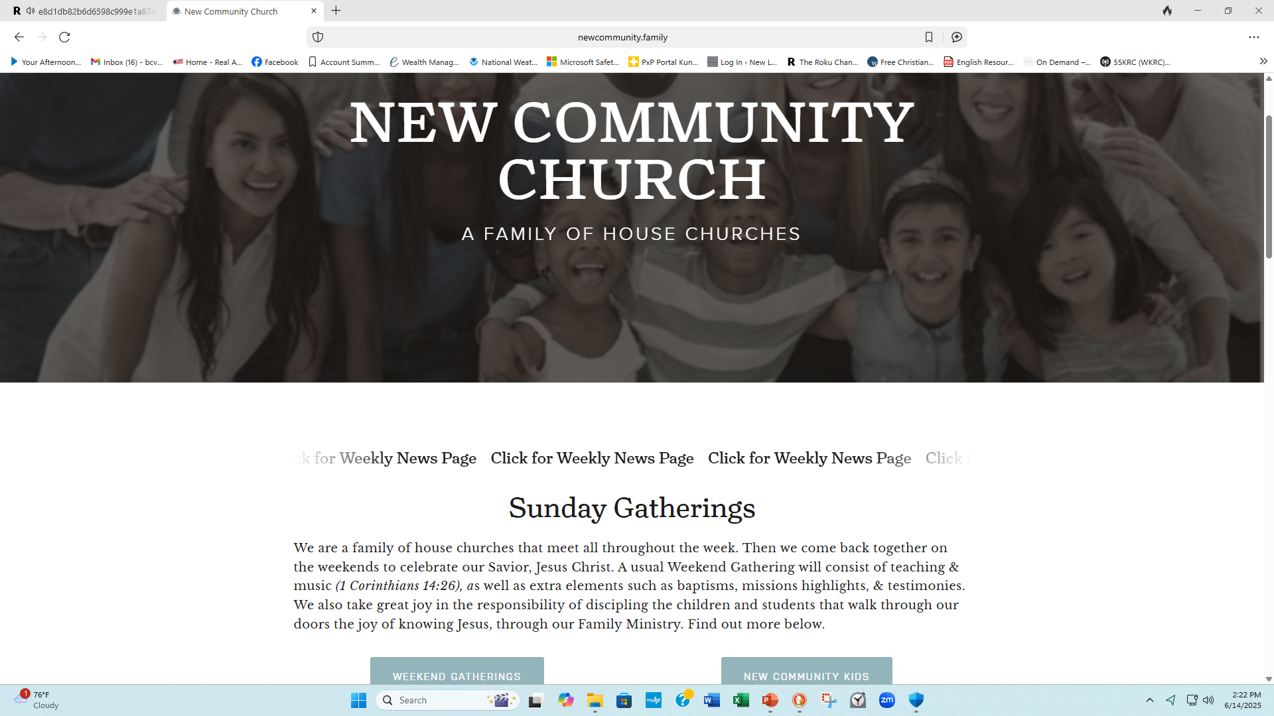

Slide 5
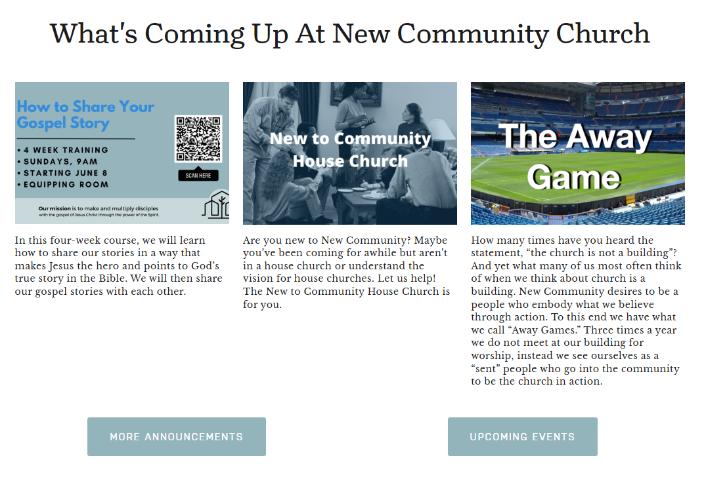

Slide 6
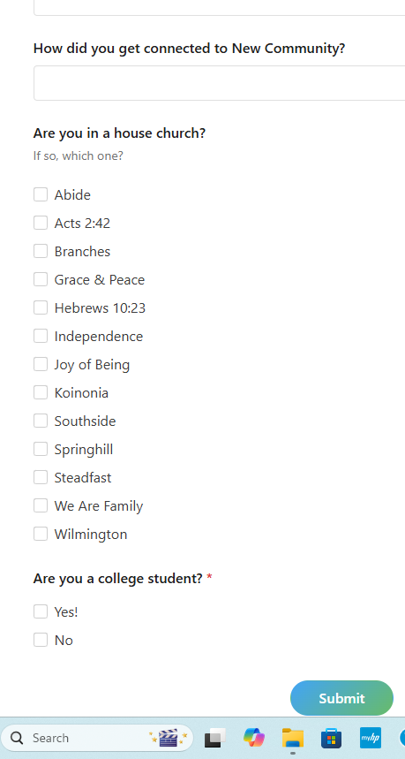

Slide 7
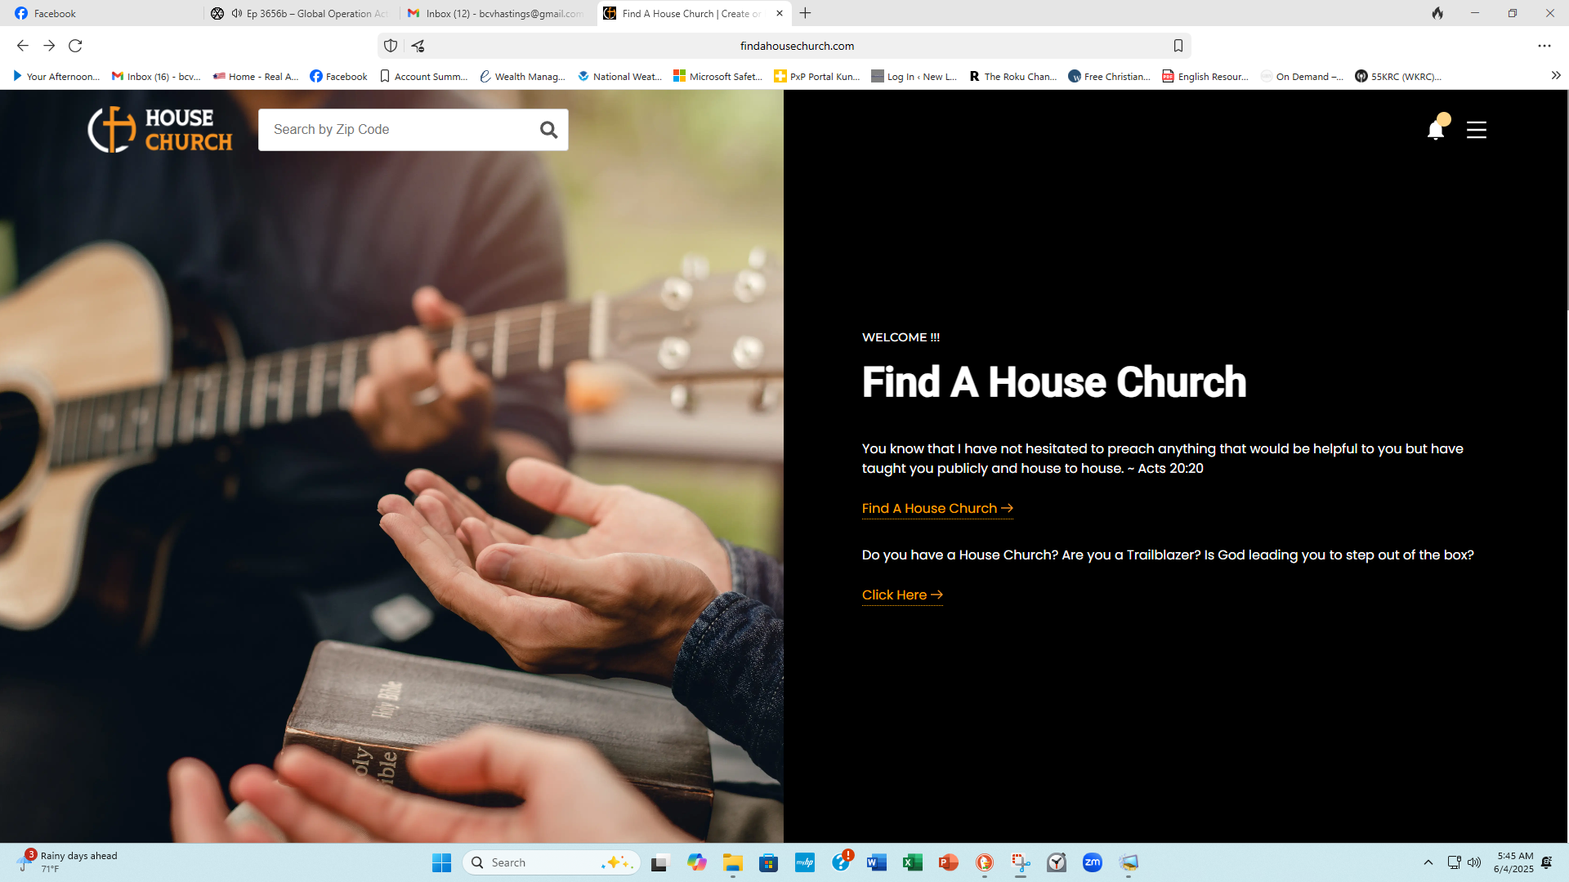

Slide 8
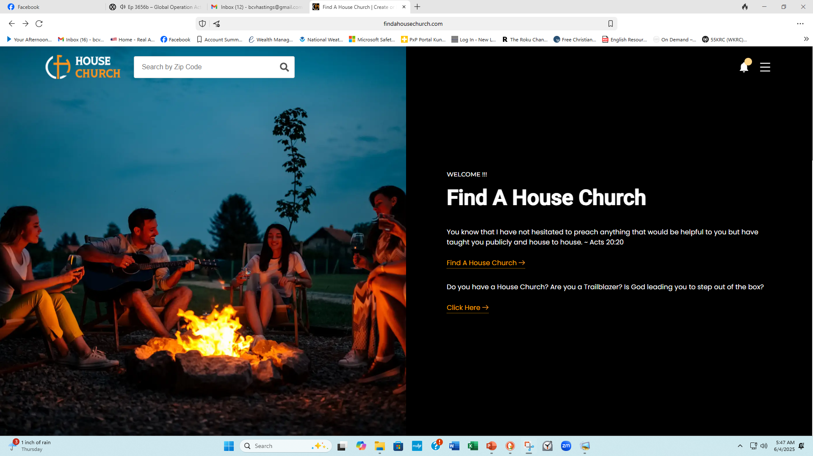

Slide 9
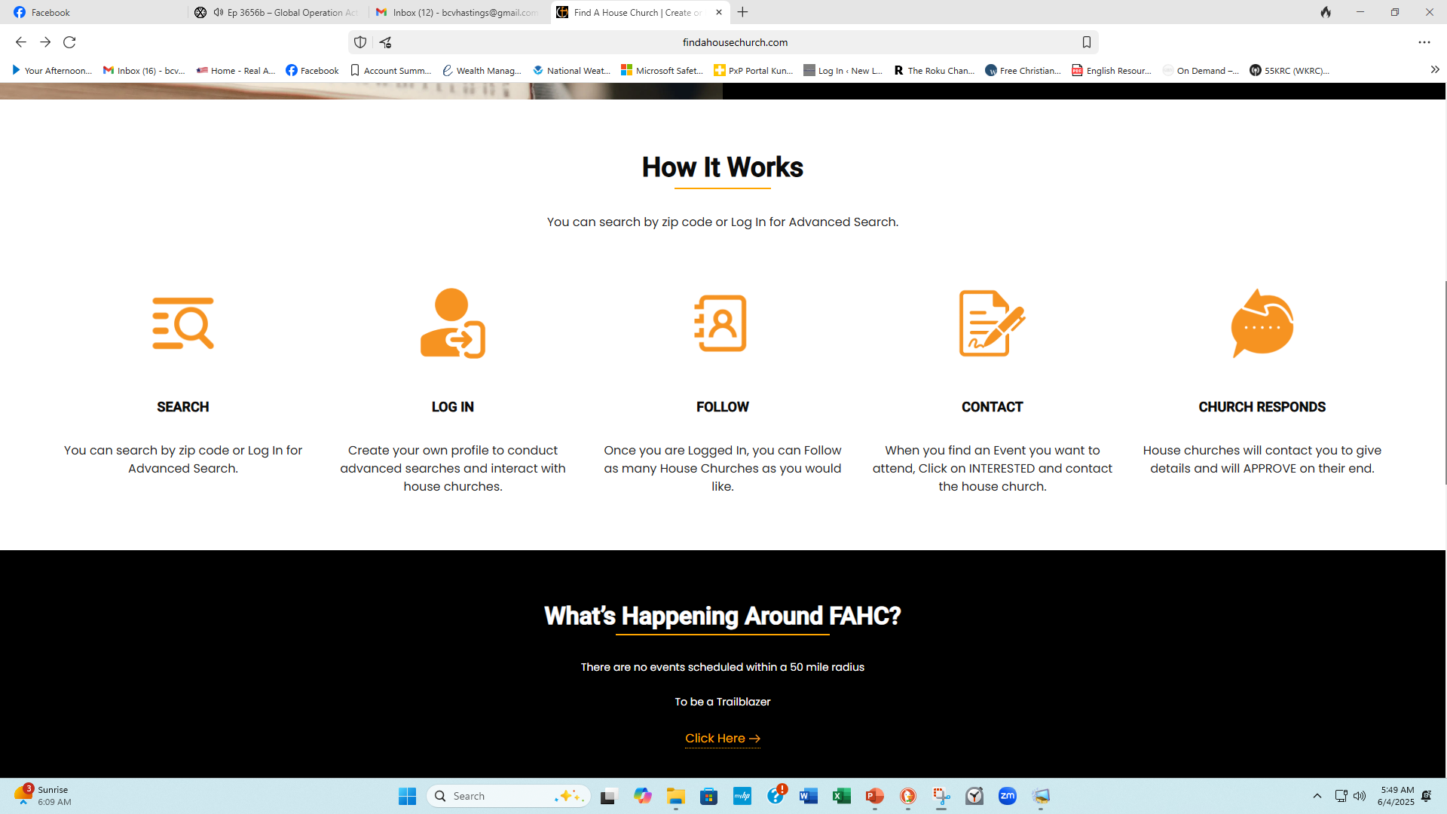

Slide 10
With the Find A House Church website, it is easy to start something right where you are! The website is free and does not solicit funds, so promoting it is a ministry in itself. With very little to nothing, you can start spreading the word in your area and potentially start a movement. All of this is dependent on God bringing favor and quickening the spirit of those finding the website. His hand will be on it! Here in the Dallas / Fort Worth area, I use a percentage of my company’s radio advertising budget to run ads for Find A House Church. That is a more expensive way to do it and gets broader results. However, when I started my own house church, I went to the local Sign Shop and had a few yard signs made.
Within 3 weeks we had over 20 people that we didn’t know contact us. We met with them for coffee or dinner and invited them to our home. This led to salvations and a bond that goes beyond gathering together. These signs also alerted other house churches in the area to list their house church! So, whether you have your own house church or are looking for house churches, this simple and fairly inexpensive sign could spark something amazing. Once there are several listed, then someone may feel led to reach out to all the leaders and bring them together. This is an apostolic work that multiplies and spreads. Do you feel the leading of the Holy Spirit to do something? This simple act of purchasing and putting out signs could lead to the salvation of many souls. It could bring about a great move of God in your area! You can also simply share the website on social media or come up with your own creative ways to get the movement started in your area. If you are part a traditional church, then you can share the website with your pastor, and he can help equip the saints to do the work of ministry in their own neighborhoods.
The church’s small groups can become evangelistic by simply listing them! For traditional churches and organizations, we even give the ability to have their own free landing page to send their people to and keep track of their house churches. CLICK HERE to create your free landing page. If enough people get onboard with promoting the website, there is no telling how that could affect the neighborhoods in your city and the growth of the local church.

Slide 11
The House Church Movement
What Is Not Under Review?
• Christians meeting in a home is not under review.
The practice of Christians meeting in a home is as old as the NT and often expedient today.
• Christians desiring to be more spiritually minded in their service to God, more active in their participation, and closer in fellowship with one another is not under review.
The NT teaches that we all must be spiritually-minded (Rom. 12:1-2, etc.), active in our participation (Heb. 12:28; 13:15; etc.), and close in fellowship (1 John 1:3; etc.).

Slide 12

The House Church Movement
What Is Under Review?
• What is under review is the practice of some Christians today who make meeting in a home “essential” to true and proper Christianity. These Christians “attempt to get away from institutional church” by meeting in homes. They believe that this is the way to “really worship” God today.
• What is under review is the mind-set of some Christians who believe that small, informal, and casual meetings in a home produce more spirituality and fellowship, than meetings in a church building

Slide 13
The House Church Movement
House Church Formations
• First arose among the denominations in the 1980’s in opposition to organized, institutional religion and traditional churches
• There was a desire for change in organizational structure more than doctrinal changes
• The religious pendulum swung away from the “mega-church” structure (thousands of members) to the “house church” structure (12 members or less)

Slide 14
The House Church Movement
House Church Formations
• In January 2011, Barna Research, found that about 11.5 million American adults, say they attend a house church or simple church, which is not associated in any way with a local, congregational type of church, at least weekly or monthly.
That number is up from 8.8 million adults in 2006

Slide 15
The House Church Movement
House Church Advocates
• Advocates among the brethren include…
• Alvin Jennings (How Christianity Grows in the City, 1985)
• F. LaGard Smith (Radical Restoration, 2001)
• Other advocates include members of non-institutional churches.

Slide 16
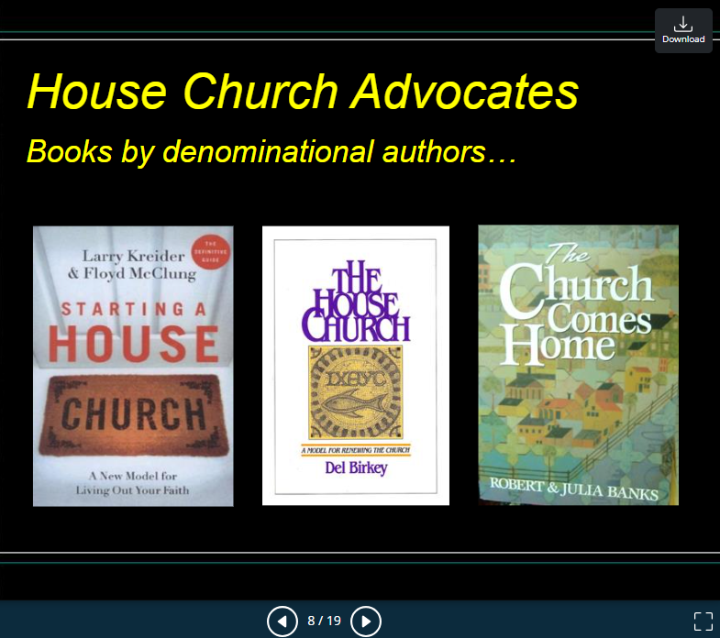

Slide 17
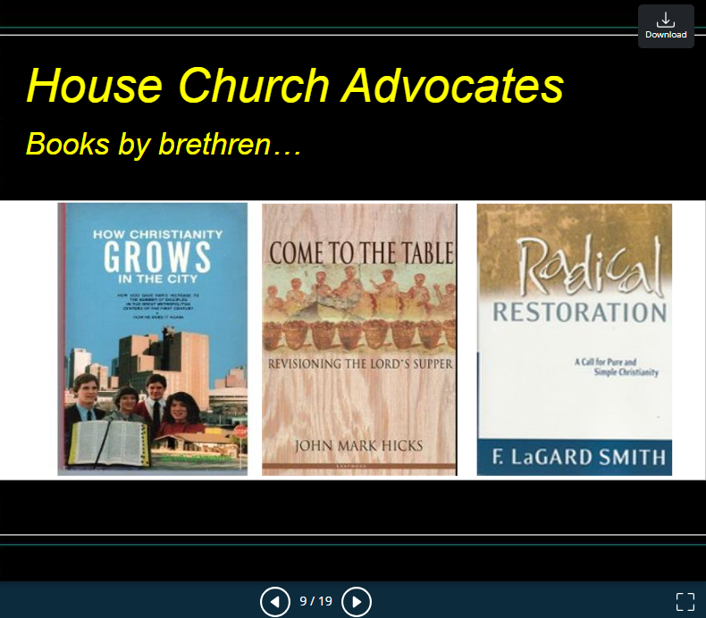

Slide 18
The House Church Movement
House Church Assumptions
• Assumption: “House church” means a local church that meets in a house.
Fact: The phrase can mean the church itself, or the church meeting place ( “the church that is in their house” - Rom. 16:5; 1 Cor. 16:19; Col. 4:15; Philemon 2).
• Assumption: Meeting in a house was normal
in the NT.
Fact: Local churches in the NT met in different locations, including public meeting places (Acts 5:12; 20:7; etc.)

Slide 19
The House Church Movement
House Church Assumptions
• Assumption: Small, informal, and casual groups are more spiritual and closer in fellowship.
Fact: Spirituality is not determined by outward size, structure, or dress of the group, but rather by the inward, mental attitude and heart of the individual Christian in relationship to God’s word (Rom. 12:1; 1 Cor. 2:13; Col. 1:9)

Slide 20
The House Church Movement
House Church Characteristics
• Remove “church of Christ” (or other identifying names) from the sign (Rom. 16:16)
• Small (Acts 2:41-42; 4:4; 5:14; 6:1; note the large assembly of saints in Jerusalem flourished)
• Informal, casual, sit in a circle (? Jas. 2:1-4 ?)
• Emphasis on social or relational practices, not doctrinal preaching and teaching (Acts 2:42; 20:7; 1 Cor. 14:26)

Slide 21
The House Church Movement
House Church Characteristics
• Favor mutual ministry over a located preacher (Acts 18:11; 20:31; Eph. 4:11; 1 Tim. 1:3)
• No standing treasury (1 Cor. 16:1-2)
• Offering a “fellowship meal” (common meal) in connection with the Lord’s supper or sometime during the assembly (Lk. 22:20; Acts 2:42,46; 1 Cor. 11:20-34; note that the assembly of saints at Corinth was not in a home)

Slide 22
The House Church Movement
1 Corinthians 11:20-22
1Cor. 11:20 Therefore when you come together in one place, it is not to eat the Lord's Supper.
21 For in eating, each one takes his own supper ahead of others; and one is hungry and another is drunk.
22 What! Do you not have houses to eat and drink in? Or do you despise the church of God and shame those who have nothing? What shall I say to you? Shall I praise you in this? I do not praise you.

Slide 23
The House Church Movement
NT:1577 (Strong’s number) Thayer’s definition
ekkleesia, (from ekkleetos called out or forth, and this from ekkaleoo); properly, a gathering of citizens called out from their homes into some public place; an assembly; so used:
Heb. 10:24 And let us consider one another in order to stir up love and good works,
25 not forsaking the assembling of ourselves together, as is the manner of some, but exhorting one another, and so much the more as you see the Day approaching.
26 For if we sin willfully after we have received the knowledge of the truth, there no longer remains a sacrifice for sins,

Slide 24

The House Church Movement
House Church Characteristics
• One set of elders in a city over many house churches (Acts 14:23; Acts 20:28; Phil. 1:1; Tit. 1:5; 1 Pet. 5:2)
• Informal, spontaneous worship and mutual participation (including the expanded role of women), not structure (1 Cor. 14:26, 27, 29, 30, 34, 40)
• Hand clapping, lifting up and swaying hands, drama and role-playing, etc. (Col. 3:17)

Slide 25
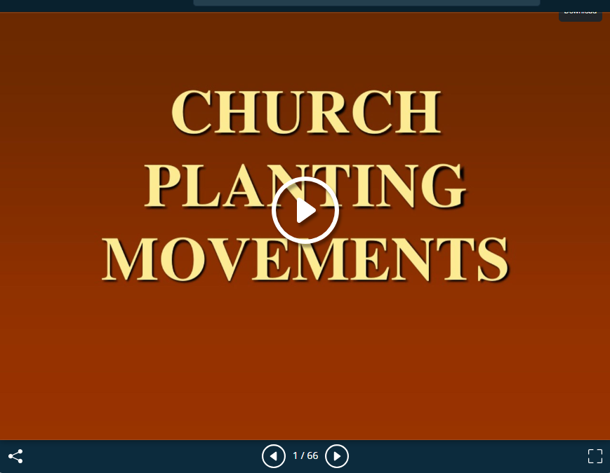
The House Church Movement

Slide 26
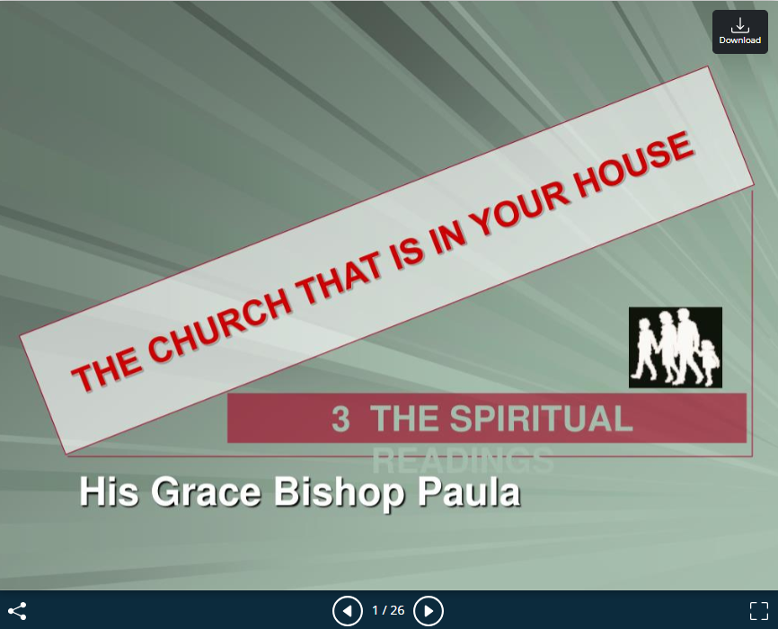
The House Church Movement

Slide 27
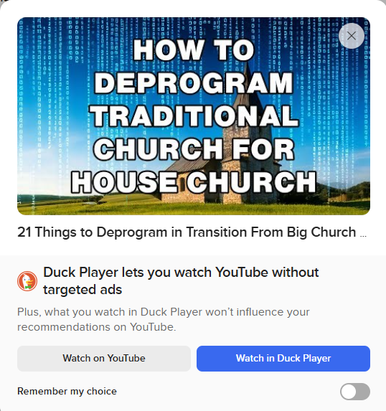
The House Church Movement

Slide 28
The House Church Movement
1Cor. 11:17 Now in giving these instructions I do not praise you, since you come together not for the better but for the worse.
18 For first of all, when you come together as a church, I hear that there are divisions among you, and in part I believe it.
19 For there must also be factions among you, that those who are approved may be recognized among you.
20 Therefore when you come together in one place, it is not to eat the Lord's Supper.
(NKJV)

Slide 29
The House Church Movement
Differences Between The Universal & Local Church.
Universal: Worldwide in scope, composed of saints -- not congregations or churches - Heb. 12:22-23; 1 Cor. 12:27.
In universal sense, the church is (only) viewed as a spiritual relationship, not a collective, a functioning organization.
Body - Christ its head - Signifies relation to Christ (rule, authority)-Col.1:18.
House - Family - God the Father, provisions, etc. - Eph. 2:19.
Temple - Habitation of God w/ His people - Eph. 2:20-22 (2 Cor. 6:16-18).
No functional organization of universal church in the NT:
No governing organization - Hierarchy, ecclesiastical framework.
No worship & work organization - To control worldwide activity.
No disciplinary organization –

Slide 30
The House Church Movement
Organization of the universal church into collective action is unauthorized! (Col. 3:17).
Local: Composed of saints who form an organic body -- an organization.
It too describes a spiritual relationship - 1 Cor. 3:16-17.
In addition to that, it is a functional organization, a group or collective which functions together - Acts 11:22; 15:22.

Slide 31
The House Church Movement
All Of The Collective Work Of The Church Is Enacted & Accomplished By Means Of The Local Church.
Organization (local in scope) - Acts 14:23; 20:17, 28.
Worship & Work (local in scope) - Acts 20:7; 1 Cor. 11:18-20.
Membership/Fellowship (locally controlled) - Acts 9:19, 26-28.
Discipline (locally applied) - 1 Cor. 5:4, 13; 2 Ths. 3:6.
Every collective work given the church is achieved by & through the local church (Edification, Evangelism, Benevolence.)
Each church is directly responsible to the Lord for its faithfulness in the areas of divinely-given, collective work (Rev. 2-3).

Slide 32
The House Church Movement
Organization of the universal church into collective action is unauthorized! (Col. 3:17).
Local: Composed of saints who form an organic body -- an organization.
It too describes a spiritual relationship - 1 Cor. 3:16-17.
In addition to that, it is a functional organization, a group or collective which functions together - Acts 11:22; 15:22.

Slide 33
The House Church Movement
The Christian's Responsibility To The Local Church.
To Identify With A Local Church - cf. Acts 9:26.
Worship, edification, work.
Be active in its worship & work - 1 Thess. 5:12-15.
Help maintain its unity & purity - 1 Cor. 1:10; 3:3, 16-17.

