Slide 1
Forgetting The Past. Phil.3:13
Philippians 3:13 Brethren, I do not count myself to have apprehended; but one thing I do, forgetting those things which are behind and reaching forward to those things which are ahead, 14 I press toward the goal for the prize of the upward call of God in Christ Jesus.

Slide 2
Forgetting the Past. Philippians 3:13
Acts 7:53
Acts 8:1
Acts 9:1
Acts 9:19
Acts 14:18

Slide 3
Forgetting the Past. Philippians 3:13
Some examples of past events that can be difficult to let go of include:
intimate relationships
perceived successes or failures
mistakes or regrets
events that were upsetting or disturbing
Emotional
events

Slide 4
Forgetting the Past. Philippians 3:13
forgetting those things … behind—Looking back is sure to end in going back
Luke 9:62 But Jesus said to him, "No one, having put his hand to the plow, and looking back, is fit for the kingdom of God.“
Luke 17:32. "Remember Lot's wife.

Slide 5
Forgetting the Past. Philippians 3:13
If we stop rowing in a boat when the current is against us, we are carried back.
God’s word to us is as it was to Israel,
Ex 14:15. And the LORD said to Moses, "Why do you cry to Me? Tell the children of Israel to go forward.
The Bible is our landmark to show us we are going forward or backward.

Slide 6
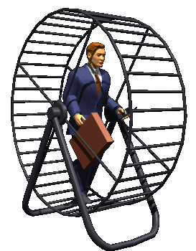
Forgetting the Past. Philippians 3:13
Reliving sad memories makes us feel like a hamster in the wheel.
No matter how hard we try, we can't move forward.
You can't change how your brain works. But you can train yourself to get off of the hamster wheel. That requires cutting the emotional attachment we have with the past, especially negative experiences.

Slide 7
Phil. 4:5 Let your gentleness be known to all men. The Lord is at hand. 6 Be anxious for nothing, but in everything by prayer and supplication, with thanksgiving, let your requests be made known to God;
7 and the peace of God, which surpasses all understanding, will guard your hearts and minds through Christ Jesus.
8 Finally, brethren, whatever things are true, whatever things are noble, whatever things are just, whatever things are pure, whatever things are lovely, whatever things are of good report, if there is any virtue and if there is anything praiseworthy--meditate on these things.
9 The things which you learned and received and heard and saw in me, these do, and the God of peace will be with you.

Slide 8
Forgetting the Past. Philippians 3:13
Choose to let go of the past.
Look forward to your future.
Be fully present in this moment.
Realize you can't change what's happened, but you can change how you move through it.
Move on.
You are grateful for who you are today.
You are more than what has happened to you.

Slide 9
3:13Brethren, I do not count myself to have apprehended; but one thing I do, forgetting those things which are behind and reaching forward to those things which are ahead, 14 I press toward the goal for the prize of the upward call of God in Christ Jesus.
Forget the past.
Get off the wheel.
Move forward!

