Slide 1
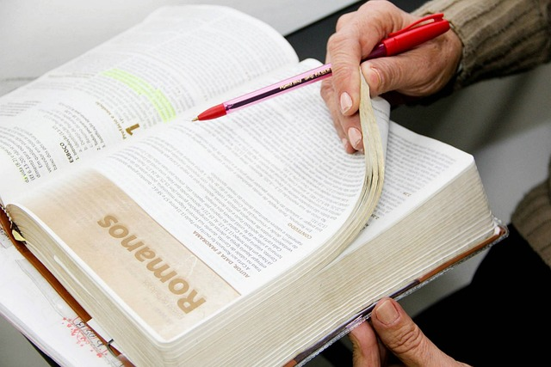
Does everyone have a right to their own belief?
Judges 17:6
Judges 17:6 In those days there was no king in Israel; everyone did what was right in his own eyes.

Slide 2


Slide 3
It is often asserted that every person has a right to his own belief.
If the Bible teaches this, everyone ought to teach it; if the Bible does not teach it, no one should teach it.
This, being a religious question, must be answered by the Bible.
Let us now examine this question in light of the Bible.

Slide 4
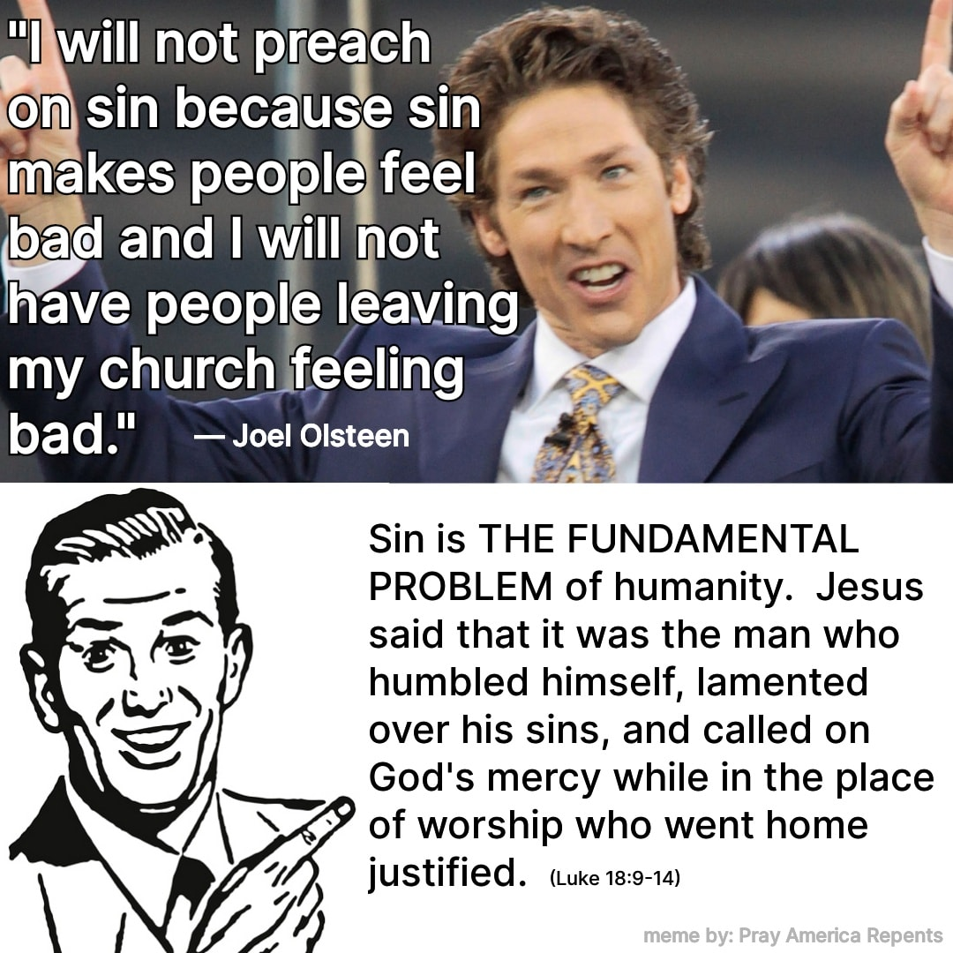

Slide 5
Paul never said
We should respect other
Religious Beliefs
He said if anyone preach
A different Gospel
Let them be accursed.
(Galatians 1:8)

Slide 6
Does everyone have a right…?
Cain did not have a right to his own belief.
Naaman did not have a right….
Paul did not have a right to his own belief.
Paul did not teach everyone has a right.
If so, God’s will would be ruled out.
If so, it would make God a respecter of persons.
God never gave us the right to our own belief.

Slide 7
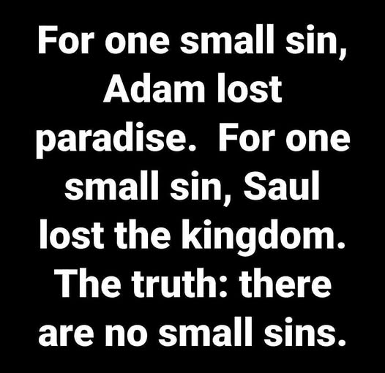

Slide 8
Can you imagine the twelve apostles of Jesus Christ to belong to different denominations:
Peter … a Roman Catholic
Paul … a Methodist
John … a Mormon
Matthew … a Faith Tabernacle
James … a Presbyterian
Judas … a Pentecostal Holiness
Andrew … a Jehovah's Witness
Thomas... held to the Jewish faith
Philip … a Baptist
James … a Seventh Day Adventist
Simon … a Christ Apostolic Church
Bartholomew … a Lutheran
Judas ... thought one church was as good as another
Matthias … to say there is no church in heaven!

Slide 9
Does everyone have a right to their own belief?
Judges 17:6
Judges 17:6 In those days there was no king in Israel; everyone did what was right in his own eyes.

