Slide 1
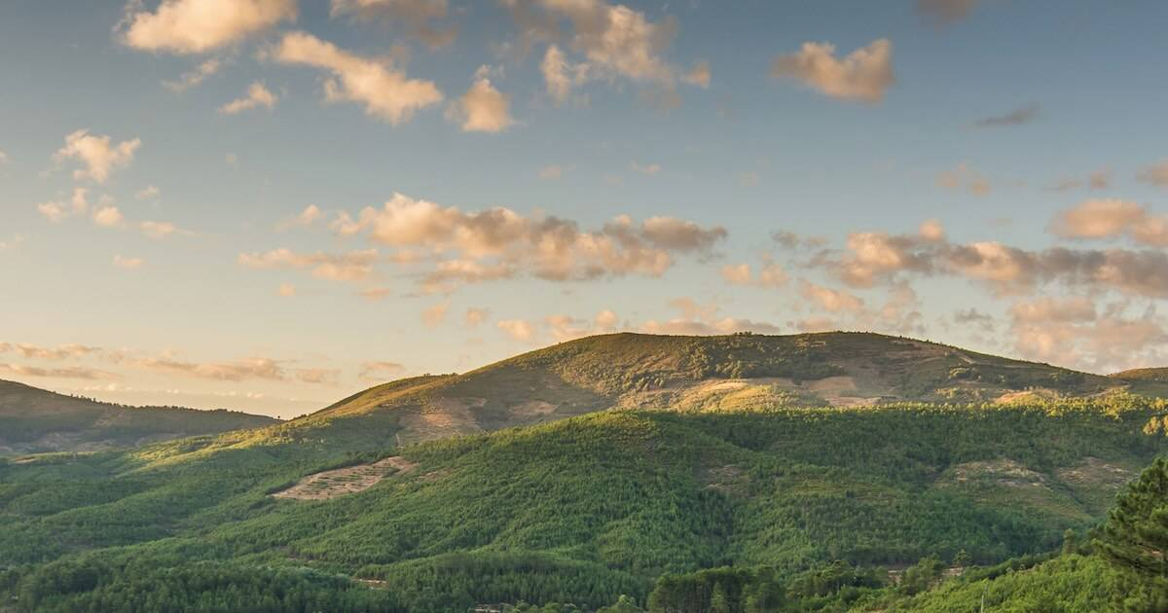
Come To The Mountain To Learn God’s Will
Hebrews 12:22 But you have come to Mount Zion and to the city of the living God, the heavenly Jerusalem, to an innumerable company of angels,
23 to the general assembly and church of the firstborn who are registered in heaven, to God the Judge of all, to the spirits of just men made perfect.

Slide 2
Come To The Mountain To Learn God’s Will
Come To The Mountain To Learn God’s Will For Your Life.

Slide 3
Come To The Mountain To Learn God’s Will
1.) We must look to the church Heb. 12:23

Slide 4
Come To The Mountain To Learn God’s Will
Interesting comparison between the literal Mt Zion of the OT. and this figurative Mt.Zion of the NT.
Mt. Zion was in the best part of the world. - The land of milk and honey.
It was in the best part of that land-The territory of Judah.
It was in the best part of that territory- In Jerusalem. It was in the best part of Jerusalem. Where David built that fortress .
So when we look at Mt. Zion it is the best of the best. The choicest place. Where God chose to locate his name. Where the one (David) who was after God’s own heart, chose to locate his home. And the Hebrews writer makes that synonymous with the church.

Slide 5
Come To The Mountain To Learn God’s Will
Mt 16:18 "And I also say to you that you are Peter, and on this rock I will build My church, and the gates of Hades shall not prevail against it.

Slide 6
Come To The Mountain To Learn God’s Will
Today God meets with the redeemed, Christians, in the church of His son. Look at Ephesians, which shows us what we have in Christ.
In Christ, we have:
all spiritual blessings. Eph1:3.
In Christ we are chosen Eph.1:4.
In Christ we have redemption Eph.1:7 thru his blood , the forgiveness of sins, .
In Christ we have an inheritance, Eph.1:10-11.
We have a seal Eph1:13,
we have a seat in heaven, Eph.2:6.
We have the kindness of God Eph.2:7.
We have good works to do Eph.2:10 .
We have nearness to God Eph.2:13.
We have a promise, Eph.3:6.
We have boldness and access Eph. 3:12.
And we have forgiveness Eph. 4:32.

Slide 7
Come To The Mountain To Learn God’s Will
2.) So we must look to the Christ. Heb.12:24

Slide 8
Come To The Mountain To Learn God’s Will
Hebrews tells us that Christ gives us
A better hope Heb.7:19.
A better covenant Heb.8:6.
A better possession, Heb.10:34.
A better country, Heb.11:16.
And a better resurrection, Heb.11:35.

Slide 9
Come To The Mountain To Learn God’s Will
Christ gives us a NEW Covenant.
The Hebrews writer calls it a better covenant ch7:22.
It is an eternal covenant, Heb.13:20?
It is a NEW covenant and in 9:15.
It is a different kind of covenant . One that is written on our hearts, Heb.8:10.
It was a covenant requiring the blood and death of Jesus Heb.9:17-20.

Slide 10
Come To The Mountain To Learn God’s Will
And Jesus said, “for this is the blood of the covenant which is poured out for many for the remission of sins.” Matt.26:28.
This gift implies sacrifice. He died in the course of offering the blood.
This gift implies love. That’s what motivated the gift. There is no greater love than this John 15:13,
This gift implies purpose. It was in the mind of God. The eternal plan of salvation .
This gift implies reconciliation. What does the blood do? It brings us back to God. The Hebrew writer says its better blood than Abel’s . Because his blood cried out for vengeance. But Christ blood cries out for forgiveness. It cleanses the guilty conscience. It paves the way to heaven while Abel’s could not.

Slide 11
Come To The Mountain To Learn God’s Will
3.) We must look to the Word. Heb. 12:25-27.

Slide 12
Come To The Mountain To Learn God’s Will
3.) We must look to the Word. Heb.12:25-27.
How can I know God’s will for my life without reading his revelation?
(Rom. 10:17)……So then faith comes by hearing, and hearing by the word of God.

Slide 13
Come To The Mountain To Learn God’s Will
4.) We must look to our own hearts. Heb. 12:28

Slide 14
Come To The Mountain To Learn God’s Will
4.) We must look to our own hearts. Heb. 12:28
Heb 12:28 Therefore, since we are receiving a kingdom which cannot be shaken, let us have grace, by which we may serve God acceptably with reverence and godly fear.
We ought to be reverent, filled with awe, eager to learn his will, eager to obey, . We need the fear of God.

Slide 15
Come To The Mountain To Learn God’s Will
Hebrews 12:22 But you have come to Mount Zion and to the city of the living God, the heavenly Jerusalem, to an innumerable company of angels,
23 to the general assembly and church of the firstborn who are registered in heaven, to God the Judge of all, to the spirits of just men made perfect.

