Slide 1
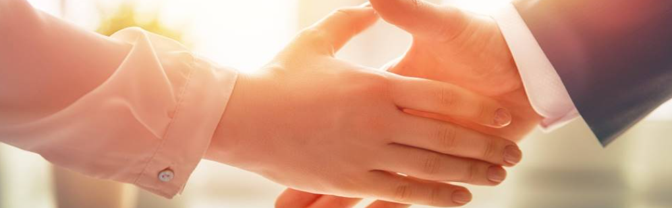
Welcome to our services
New Lebanon Church of Christ
We are Simply Christians.
Our Emphasis is Spiritual, Not Material or Social.
We are striving to be The Same Church as Described in The New Testament.
Please Come Back Again

Slide 2
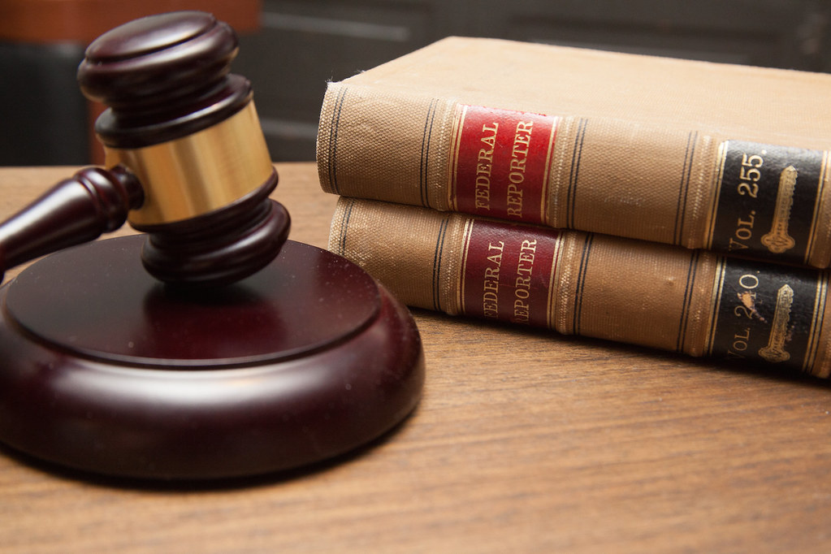
Principles of Judgment

Slide 3
Principles of Judgment
1. People are self-condemned when they practice what they condemn in others.
Rom. 2:1 Therefore you are inexcusable, O man, whoever you are who judge, for in whatever you judge another you condemn yourself; for you who judge practice the same things.

Slide 4
Principles of Judgment
2. God’s judgment will be according to the truth of the word of God, that is, his revealed word in the Bible.
Rom. 2:2 But we know that the judgment of God is according to truth against those who practice such things.

Slide 5
Principles of Judgment
3.God’s goodness to sinful people does not indicate approval of their sins but longsuffering in hope of their repentance.
Rom. 2:4 Or do you despise the riches of His goodness, forbearance, and longsuffering, not knowing that the goodness of God leads you to repentance?

Slide 6
Principles of Judgment
4.God’s judgment of man will be according to their works (Rom. 2:6).
Rom. 2:6 who "will render to each one according to his deeds"

Slide 7
Principles of Judgment
5.God requires obedience of man and will punish disobedience (Rom. 2:8).
Rom. 2:8 but to those who are self-seeking and do not obey the truth, but obey unrighteousness--indignation and wrath,

Slide 8
Principles of Judgment
6. Greater privilege only entails greater responsibility (Rom. 2:9–10).
Rom. 2:9 tribulation and anguish, on every soul of man who does evil, of the Jew first and also of the Greek; 10 but glory, honor, and peace to everyone who works what is good, to the Jew first and also to the Greek.

Slide 9
Principles of Judgment
7. God is no respecter of persons.
Rom.2:11 For there is no partiality with God.

Slide 10
Principles of Judgment
8. Judgment will be according to the light people have (Rom. 2:14–15).
Rom. 2:14 for when Gentiles, who do not have the law, by nature do the things in the law, these, although not having the law, are a law to themselves, 15 who show the work of the law written in their hearts, their conscience also bearing witness, and between themselves their thoughts accusing or else excusing them)

Slide 11
Principles of Judgment
9. Judgment will be according to the New Testament (Rom. 2:16).
Rom. 2:16 in the day when God will judge the secrets of men by Jesus Christ, according to my gospel.

Slide 12
Principles of Judgment
10. It will be through Jesus Christ, now constituted judge of all, and according to his word (Rom. 2:16).
Rom. 2:16 in the day when God will judge the secrets of men by Jesus Christ, according to my gospel.

