Slide 1
Welcome to our services
New Lebanon Church of Christ
We are Simply Christians.
Our Emphasis is Spiritual, Not Material or Social.
We are striving to be The Same Church as Described in The New Testament.
Please Come Back Again

Slide 2
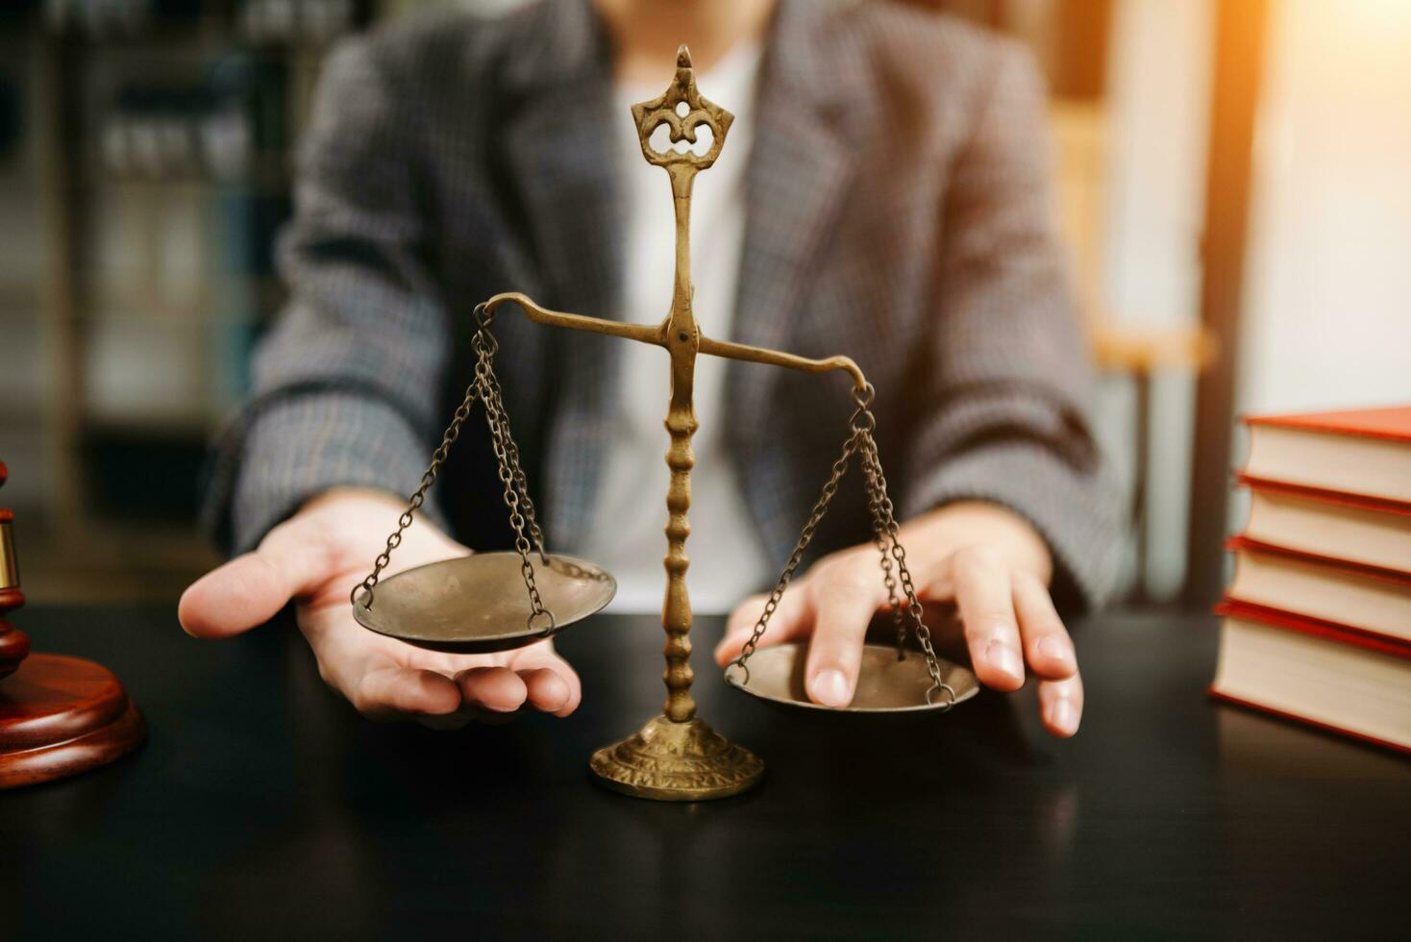
God Is No Respecter Of Persons
Acts 10:34 - Then Peter opened his mouth, and said, Of a truth I perceive that God is no respecter of persons: 35 But in every nation he that fears him, and works righteousness, is accepted with him.

Slide 3
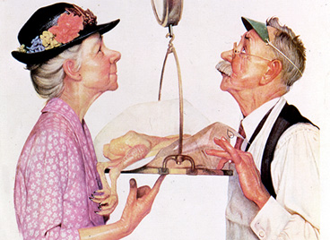

Slide 4
1. God Has Declared All Under Sin.

Slide 5
2. Because sin is common to all, a common Redeemer is Provided for all.

Slide 6
3. Since God is no respecter of persons, God requires the same conditions of pardon for all.

Slide 7
4. Since God is no respecter, He did not build different churches. He adds all to the same church.

Slide 8
5. Since God is no respecter of persons, He is consistent In His manner of judging.

Slide 9
6. Since God is no respecter of persons, the same invitation is extended to all.

Slide 10
God’s justice can not let unforgiven transgressions of His law to go unpunished. He has prepared a day to judge, and a place to send those found guilty.
God is no respecter of persons.

