Slide 1
Welcome to our services
New Lebanon Church of Christ
We are Simply Christians.
Our Emphasis is Spiritual, Not Material or Social.
We are striving to be The Same Church as Described in The New Testament.
Please Come Back Again

Slide 2
And let us consider one another to provoke unto love and to good works: Hebrews 10:24

Slide 3
Consider -
to think about carefully:
to take into account
to regard or treat in an attentive or kindly way
to gaze on steadily or reflectively

Slide 4
Matt 6:28 Consider the lilies of the field,
Luke 12:24 Consider the ravens:
Luke 12:27 Consider the lilies how they grow:
Acts 15:6 …came together for to consider of this matter.
2Tim 2:7 Consider what I say;
Heb 3:1 consider the Apostle and High Priest of our profession, Christ Jesus;
Heb 7:4 Now consider how great this man was,
Heb 10:24 And let us consider one another
Heb 12:3 For consider him

Slide 5
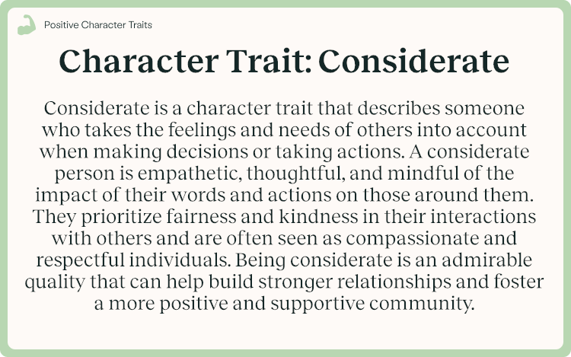

Slide 7
Let us consider one another
1. Consider one another through the week.

Slide 8
Let us consider one another
2. Consider one another in the assembly.

Slide 9
Cell phone addiction

Slide 10
Let us consider one another
3. Consider one another in the home.

Slide 11
Let us consider one another
3. Consider one another in the home.
1. Failure to communicate

Slide 12
Let us consider one another
3. Consider one another in the home.
2. Finances

Slide 13
Let us consider one another
3. Consider one another in the home.
3. Lack of Romance

Slide 14
Let us consider one another
3. Consider one another in the home.
4. In-laws, family, and friends

Slide 15
Let us consider one another
3. Consider one another in the home.
5. Spiritual immaturity, little faith.

Slide 16
Let us consider one another

