Slide 1
Welcome to our services
New Lebanon Church of Christ
We are Simply Christians.
Our Emphasis is Spiritual, Not Material or Social.
We are striving to be The Same Church as Described in The New Testament.
Please Come Back Again

Slide 2
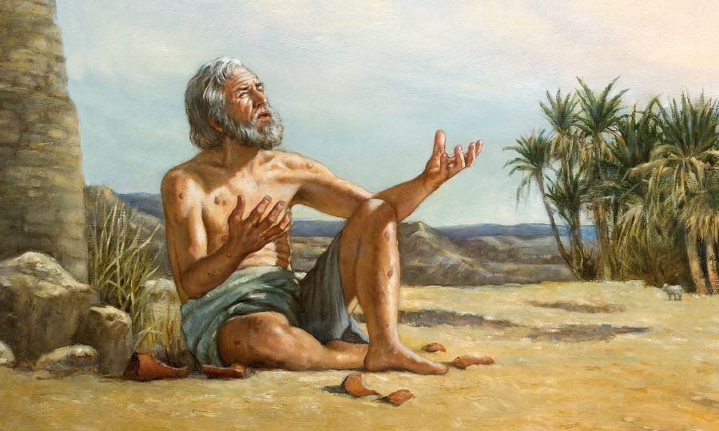
Though He slay me, yet will I trust Him. Job 13:15
I Know that my Redeemer lives. Job 19:25.

Slide 3
Adam
Noah
Abraham
Isaac
Jacob & Esau
Job
Joseph
Moses
Joshua, Judges, Ruth
Samuel
Saul, David, Solomon
Divided Kingdom
Elijah & Elisha
Jonah
Northern Kingdom/Israel taken into Assyrian Captivity
Southern Kingdom/Judah taken into Babylonian Captivity
Daniel & Ezekiel in Babylon
Persia takes Babylon – becomes world power
Return to Canaan begins – rebuilding of the temple / Ezra
Esther Persian Queen
More Jews return – rebuilding of the wall / Nehemiah
Malachi
TIMELINE OF THE OLD TESTAMENT
Patriarchal
Age
The book of Job in our Bibles is listed with the books of poetry and falls right before Psalms, but chronologically it should be placed here in the Patriarchal Age and among the accounts in Genesis.
It is always important to consider the context of Bible accounts and their placement in history as you read and study.
Mosaical
Age

Slide 4
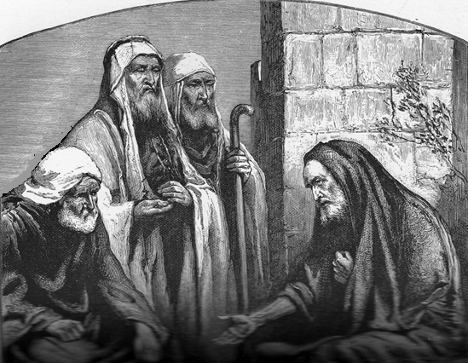
Friends Of Job
Help Date The Book—
Eliphaz - Bildad - Zophar
Eliphaz
was a descendant of Esau and an Edomite.
Bildad
was a descendant of Abraham.
Zophar
was of unknown origin.

Slide 5
The Book Of Job
Is Wisdom Literature,
A Book Of Poetry.
Job
Psalms
Hebrew poetry did not have meter or rhyme like English poetry. It was made up of thought rhythm, the sentiment of one line echoed in the next. Sometimes a single thought is carried through as many as eight lines.
The books of poetry are grouped together in our copies of the scripture.
Proverbs
Ecclesiastes
Song Of Solomon

Slide 6
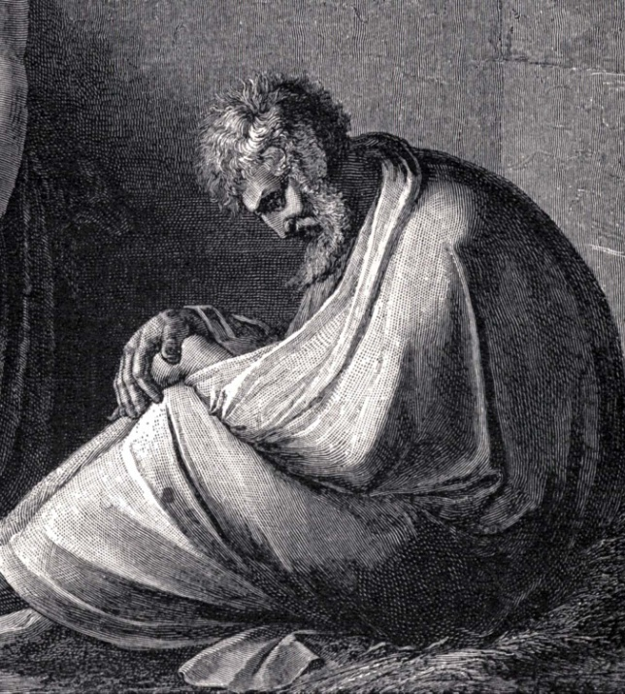
Job
The book of Job is a historical poem based on an event that actually occurred.
The events that happened to Job were known far and wide. For many months people talked about it (7:3), men wrote about it (13:26), and Job’s friends came to him with advice. Finally, God gave Job an answer.

Slide 7
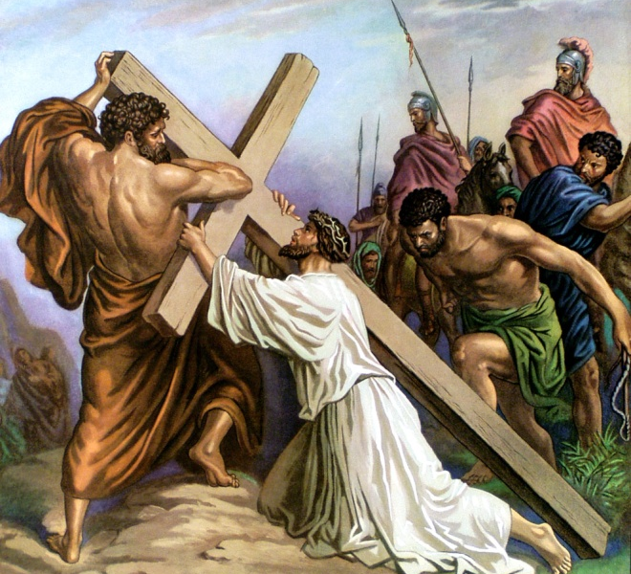
The Message Of Job:
Human Suffering
Perhaps from the dawn of human history men have wondered how a good God could make a world where men suffer. Many times this suffering is endured by those who least deserve it.
The Lord Jesus Christ became a partaker with us of the suffering of mankind.
While this may not increase our understanding of suffering it does help us to be reconciled to it and to know that “all things work together for good to them that love the Lord.”

Slide 8
The Book Of Job

Slide 9
Lam. 4:21
“Rejoice and be glad, O daughter of Edom, that dwellest in the land of Uz; the cup also shall pass through unto thee: thou shalt be drunken, and shalt make thyself naked.”
BABYLON
Mediterranean Sea
Job lived in the land of Uz.
The land of Uz is thought to have been somewhere on the caravan route from Babylon to Egypt on the east side of the Sea of Galilee and the Dead Sea possibly as far south as Edom.
CANAAN
Hebron
(Mamre)
Dead Sea
Sodom
Gomorrah
EDOM
EGYPT

Slide 10
Job
Job was the greatest and most widely known man in his part of the world.
He was a wealthy patriarch with vast herds, camels, oxen, many servants, and a family of 10 children.

Slide 11
Job
Outline
Chapters 1, 2, 3
Job
Is Confronted By Satan

Slide 12
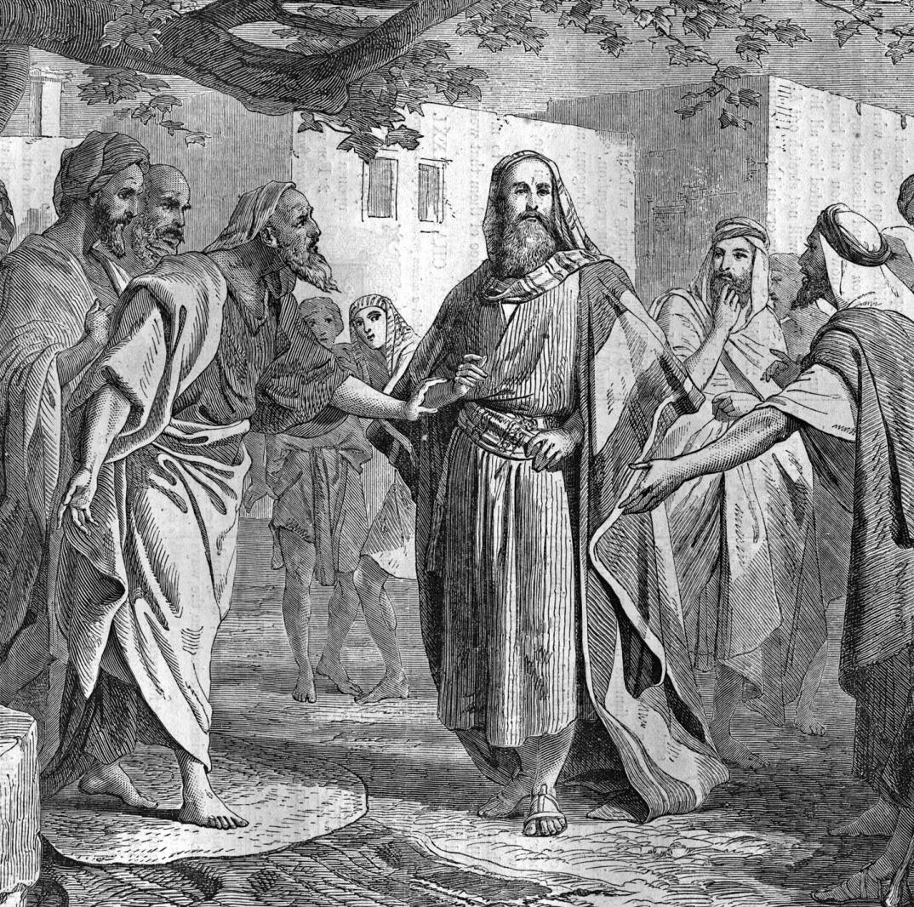
Job was not only wealthy but he was influential and known for his faithfulness to God.
Satan accused Job of serving God only for physical gain. God permitted Satan to test this accusation. Job stood the test.

Slide 13
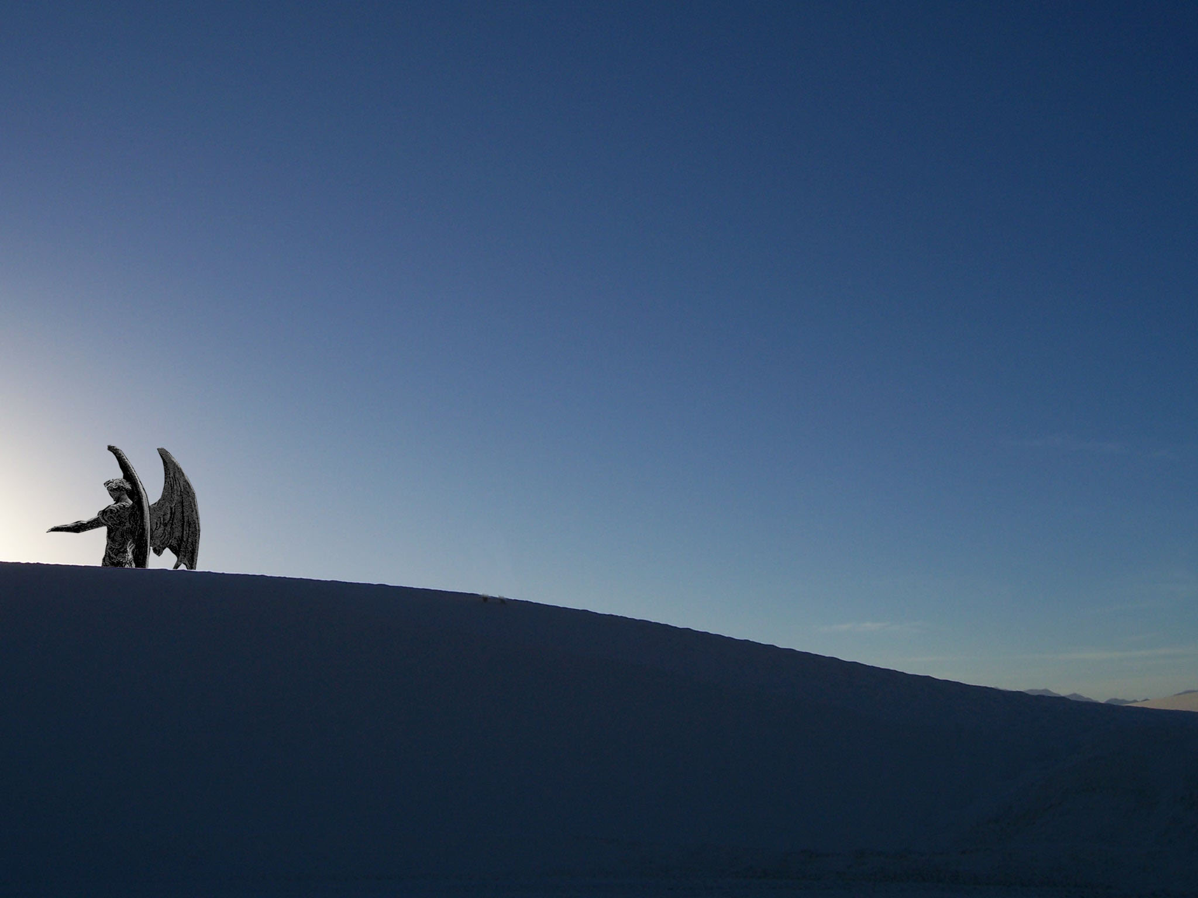
Job 1:7
“And the LORD said unto Satan, Whence comest thou? Then Satan answered the LORD, and said, From going to and fro in the earth, and from walking up and down in it.”
I Peter 5:8
“Be sober, be vigilant; because your adversary the devil, as a roaring lion, walketh about, seeking whom he may devour.”

Slide 14
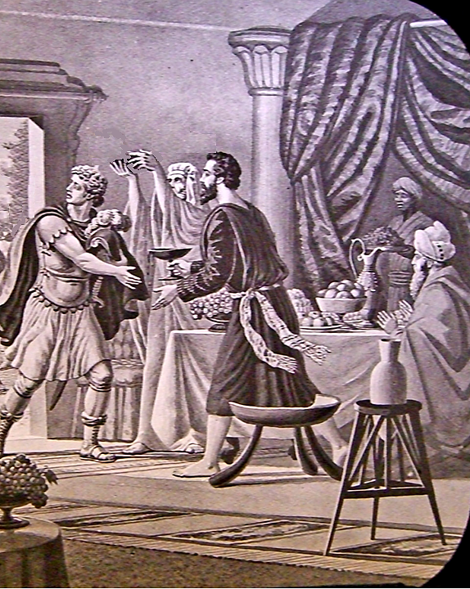
Job 1
“¹³And there was a day when his sons and his daughters were eating and drinking wine in their eldest brother’s house:
¹⁴And there came a messenger unto Job, and said, The oxen were plowing, and the asses feeding beside them:
¹⁵And the Sabeans fell upon them, and took them away; yea, they have slain the servants with the edge of the sword; and I only am escaped alone to tell thee.”
Job 1
“¹¹[Satan said to God] put forth thine hand now, and touch all that he hath, and he will curse thee to thy face.
¹²And the LORD said unto Satan, Behold, all that he hath is in thy power; only upon himself put not forth thine hand. So Satan went forth from the presence of the LORD.”

Slide 15
Job 1
“¹⁶While he was yet speaking, there came also another, and said, The fire of God is fallen from heaven, and hath burned up the sheep, and the servants, and consumed them; and I only am escaped alone to tell thee.
¹⁷While he was yet speaking, there came also another, and said, The Chaldeans made out three bands, and fell upon the camels, and have carried them away, yea, and slain the servants with the edge of the sword; and I only am escaped alone to tell thee.”
Job 1
“¹⁸While he was yet speaking, there came also another, and said, Thy sons and thy daughters were eating and drinking wine in their eldest brother’s house:
¹⁹And, behold, there came a great wind from the wilderness, and smote the four corners of the house, and it fell upon the young men, and they are dead; and I only am escaped alone to tell thee.”

Slide 16
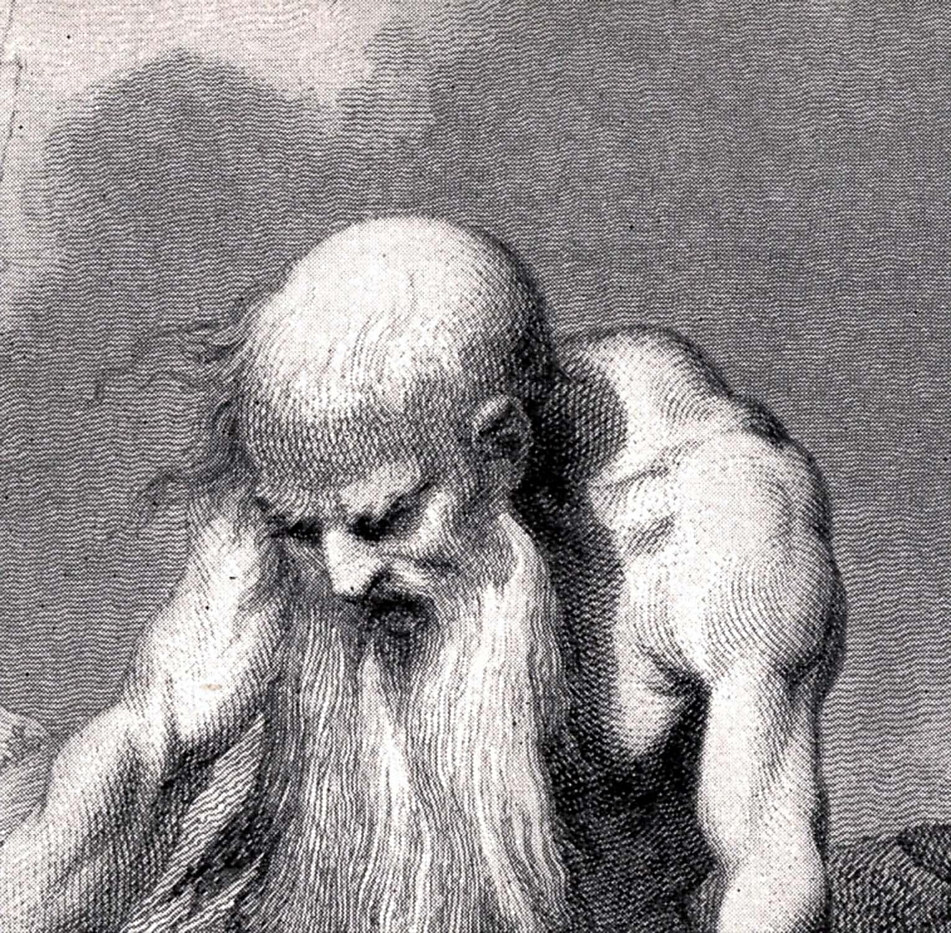
Job 1
“²⁰Then Job arose, and rent his mantle, and shaved his head, and fell down upon the ground, and worshipped,
²¹And said, Naked came I out of my mother’s womb, and naked shall I return thither: the LORD gave, and the LORD hath taken away; blessed be the name of the LORD.
²²In all this Job sinned not, nor charged God foolishly.”

Slide 17
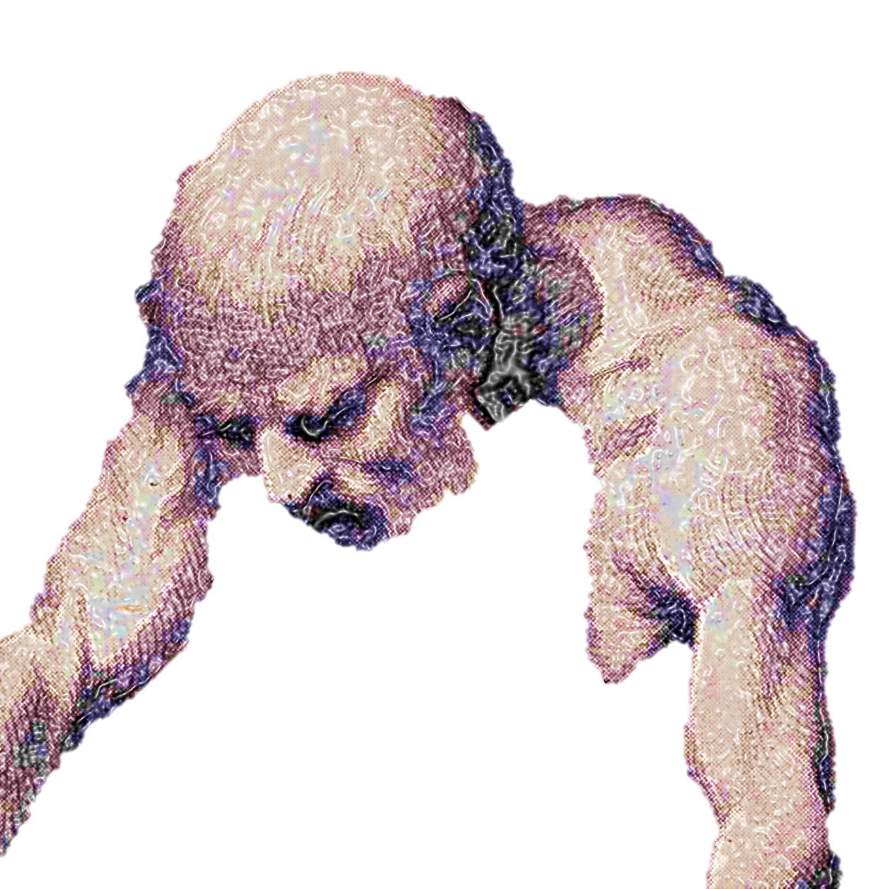
Job 2
“⁷So went Satan forth from the presence of the LORD, and smote Job with sore boils from the sole of his foot unto his crown.
⁸And he took him a potsherd to scrape himself withal; and he sat down among the ashes.
⁹Then said his wife unto him, Dost thou still retain thine integrity? curse God, and die.
¹⁰But he said unto her, Thou speakest as one of the foolish women speaketh. What? shall we receive good at the hand of God, and shall we not receive evil? In all this did not Job sin with his lips.”
Job was afflicted with a terrible disease. The description of it sounds like leprosy.

Slide 19
Outline
Job
Chapters 4 - 37
Job And His Friends

Slide 20
THE DEBATE—
THREE CYCLES OF SPEECHES
Bildad’s advice was simple:
“God is just. Confess your sin.”
Contention of the friends:
Suffering is the consequence of sin; Job is guilty of a great sin and should repent.
Contention of Job:
How can God’s dealings with me be consistent with His moral government of the world?
Zophar backed his argument with some old proverbs
and said,
“God is all wise. He knows man.”
Eliphaz advises Job to turn to God and suggests that if Job would repent, his troubles would disappear.
First cycle of speeches 4-14
1. Eliphaz, 4, 5—Job’s reply, 6, 7
2. Bildad, 8—Job’s reply, 9, 10
3. Zophar, 11—Job’s reply, 12-14
Second cycle of speeches 15-21
1. Eliphaz, 15—Job’s reply, 16, 17
2. Bildad, 18—Job’s reply, 19
3. Zophar, 20—Job’s reply, 21
Third cycle of speeches, 22-31
1. Eliphaz, 22—Job’s reply, 23, 24
2. Bildad, 25—Job’s reply, 26-31
3. Zophar fails to reply

Slide 21
Chapters 6 and 7
Job’s Outlook
Job longed for sympathy, not reproof.
He was disappointed in his friends.
He knew he was not a wicked man, yet he was suffering terrible affliction.
Even if he had sinned, he did not feel that he deserved such terrible punishment.
He wished he had never been born.
He prayed that he might die.

Slide 22
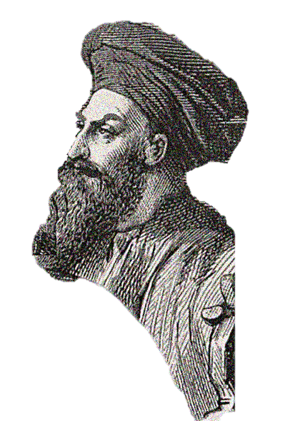
Elihu, another friend of Job’s, enters the scene . . .

Slide 23
Chapter 32 introduces Elihu, and he is angry!
He gave reasons for not speaking sooner.
He criticized Job’s three friends.
He refuted Job’s argument and virtually had the same position as the three friends but stressed God’s goodness.
He magnified the power of Jehovah.
Job 32
“¹So these three men ceased to answer Job, because he was righteous in his own eyes.
²Then was kindled the wrath of Elihu the son of Barachel the Buzite, of the kindred of Ram: against Job was his wrath kindled, because he justified himself rather than God.
³Also against his three friends was his wrath kindled, because they had found no answer, and yet had condemned Job.”

Slide 24
Job lost his friends
Their advice was wrong.
He was glad to see them and tell them his troubles, but they did not understand.
He was miserable and misunderstood.
He turned to God
Only God understands all of our problems and knows the answer to every question.

Slide 25
Outline
Job
Chapters 38 - 42
God And Job

Slide 26
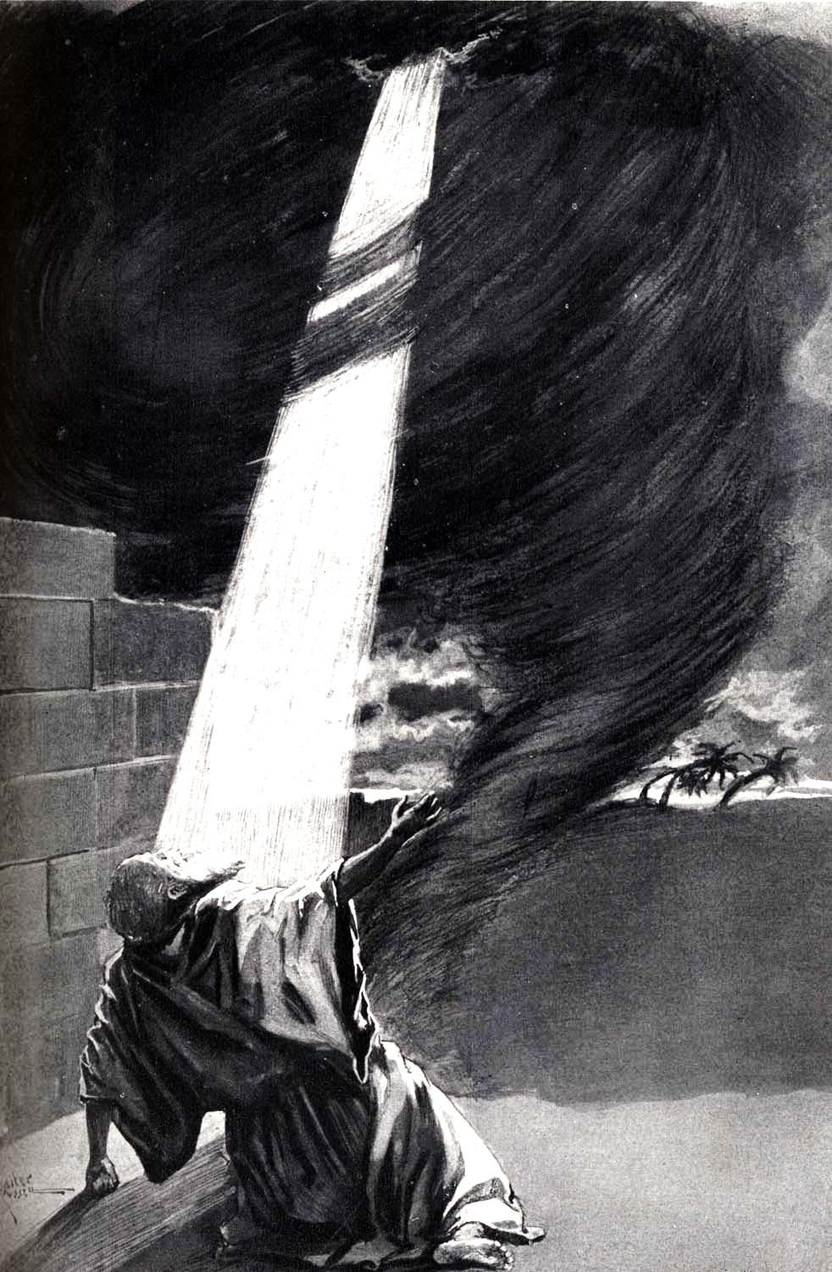
Job 38 – 41
God asked question after question. Job was awed into silence. He could not answer any of the questions. These are some of the greatest chapters in any literature.
Out of the
whirlwind,
A whirlwind prefaced Ezekiel’s vision (Ezekiel 1:4) and Elijah’s (I Kings 19:11).
God is said to “have his way in the whirlwind,” (Nahum 1:3).
Where were you when I made the earth?
Who can measure the earth?
Where are the foundations of the earth fastened?
Who made the stars?
Who made the sea?
Have you caused the sun to rise?
Do you know the depth of the ocean?
Do you know where light dwells?
Can you make it snow or hail?
Can you cause it to lightening?
Can you cause it to rain?
Can you cause a herb to grow?
Can you feed the lion or the raven?
Do you know when the animals give birth?
Did you give the peacocks their feathers?
Did you give the horse his strength?
Did you teach the hawk to fly? . . . .
Job 38
“¹Then the LORD answered Job out of the whirlwind, and said,
²Who is this that darkeneth counsel by words without knowledge?
³Gird up now thy loins like a man; for I will demand of thee, and answer thou me.”

Slide 27
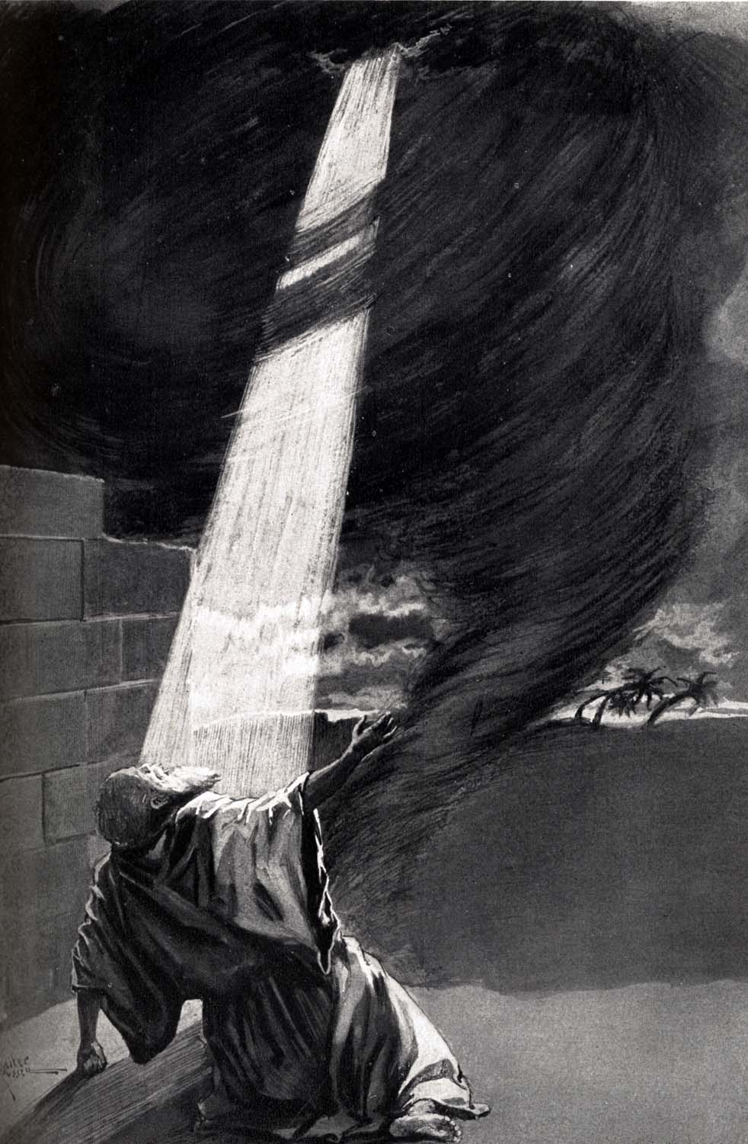
Job’s repentance and restoration is described in
Chapter 42.
Job 42
“¹Then Job answered the LORD, and said,
²I know that thou canst do every thing, and that no thought can be withholden from thee.
³Who is he that hideth counsel without knowledge? therefore have I uttered that I understood not; things too wonderful for me, which I knew not. . . .
⁶Wherefore I abhor myself, and repent in dust and ashes.”

Slide 28
CHAPTER 42
God endorsed the ideas Job had expressed rather than the ideas of others.
Job was not a wicked man. He was a righteous man brought face to face with human suffering.
He stood his trials magnificently, and God blessed his old age with great rewards.

Slide 29
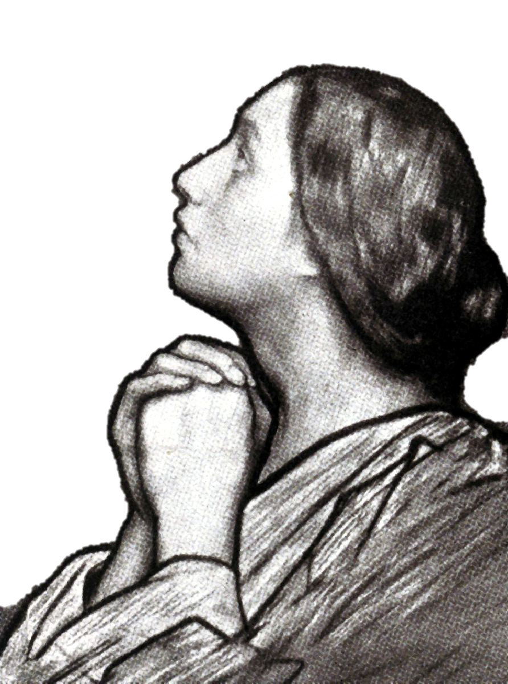
God allows his children to suffer in order to reveal character, to set forth an object lesson, and to bring to light man’s dependence on God.
The book of Job well illustrates Romans 8:28.
Romans 8:28
“And we know that all things work together for good to them that love God, to them who are the called according to his purpose.”

Slide 30
Job found God in his troubles.
Many know God as Creator and believe in His greatness, but they do not really know the help which God extends in time of trouble.
Even Job had to learn this.

Slide 31
God’s speech at the end of the book seems to indicate that God’s idea is that men with their finite minds ought not to expect to understand all the mysteries of God and his creation, but those who suffer in the end should come to see God and be abundantly rewarded with greater prosperity and blessedness than at the first.
Job 42
“¹²So the LORD blessed the latter end of Job more than his beginning: for he had fourteen thousand sheep, and six thousand camels, and a thousand yoke of oxen, and a thousand she asses.
¹³He had also seven sons and three daughters.”

Slide 36
Providence Has two edges.
One edge brings protection from painful things.
The other edge permits painful things in order to build strong people.

Slide 37
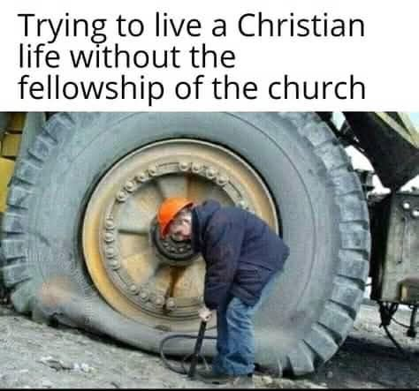

Slide 38
Though He slay me, yet will I trust Him. Job 13:15
I Know that my Redeemer lives. Job 19:25.

